Slide 1
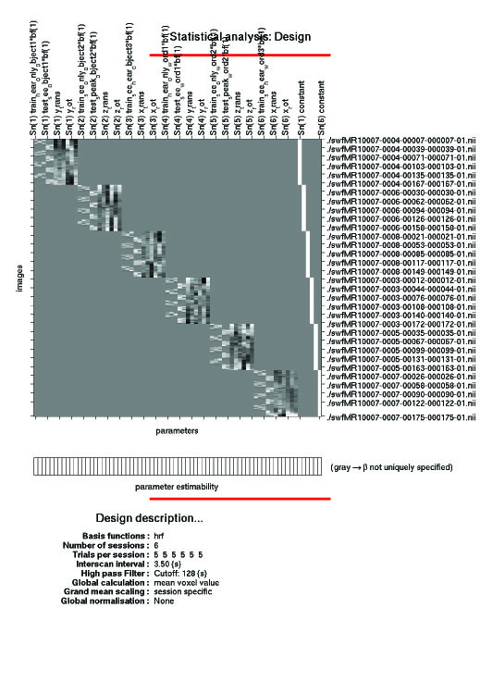
1st level analysis:
Design matrix

Slide 2
When do you construct the design matrix?
1st level analysis:
  After pre-processing
  Before group/between-subjects/2nd level analysis
Within-subject analysis
  Average across scans for an individual subject
Forms part of GLM as Apoorva explained

Slide 3
General Linear Model
β
Y
X
⁺
E
⁼
^{x}
Dependent Variable
(What you measure)
Independent Variable
(What you manipulate)
Relative Contribution
(need to be estimated)
Error
(difference between observed data and that predicted by the model)
Aim: To explain as much of the variance in Y by using X, and thus reducing E
More than 1 IV ?
Y = X₁β₁ + X₂β₂ + ....X _{n} β_{n}.... + E

Slide 4
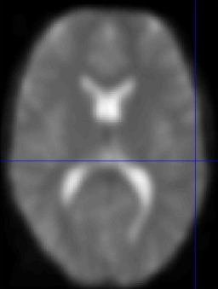
Each component of the GLM is a 2D matrix
Y = matrix of BOLD signals
EPIs
Time course for each voxel
time
i.e. scans
time
i.e. scans
height of BOLD signal
Notes:
From each scan take each voxel’s intensity at that time point.

Slide 5
What are the components of the GLM?
X = design matrix
regressors (1 column = 1 regressor)
Regressors of interest
independent variables (conditions)
and parametric modulators, e.g., RT, accuracy
Regressors of no interest or nuisance regressors
things which you didn’t manipulate but which may have en effect, e.g., the 6 movement regressors, heart rate
time
i.e. scans
Notes:
From each scan take each voxel’s intensity at that time point.

Slide 6
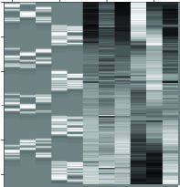
More on regressors
Dark-light colour map used to represent values of regressors
Representation of regressors depends on type of variable.....
white = 1 = highest value
black = 0 = lowest value
intermediate values

Slide 7

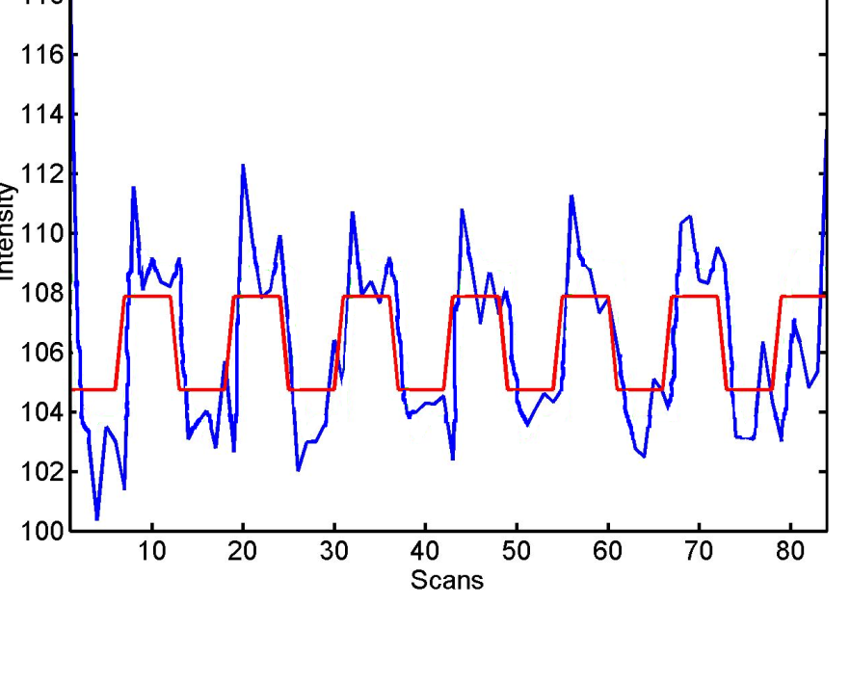
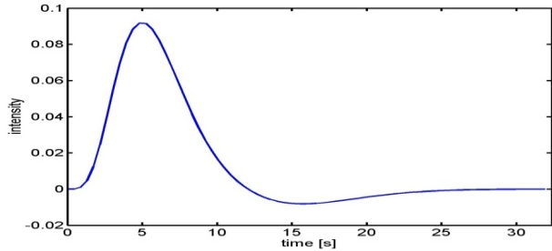
Types of variables
Indicator variables = conditions manipulated
E.g., 2 levels of a variable – on or off, 0 or 1
This on-off representation of your variable doesn’t capture the rise and fall of the BOLD response
Convolve with haemodynamic response function

Slide 8
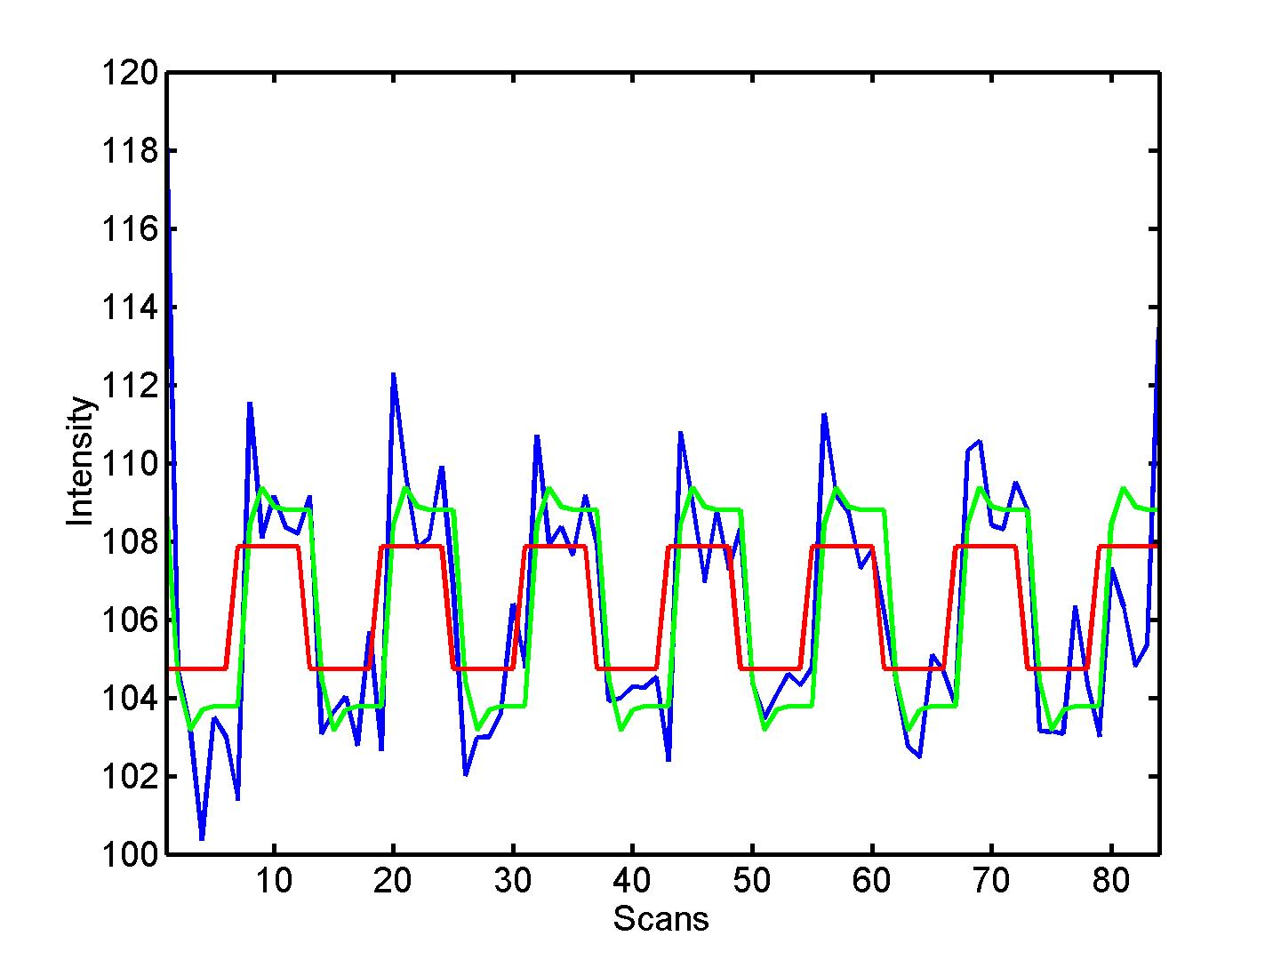

Types of variables
Indicator variables = conditions manipulated
E.g., 2 levels of a variable – on or off, 0 or 1
This on-off representation of your variable doesn’t capture the rise and fall of the BOLD response
Convolve with haemodynamic response function

Slide 9
Covariates
Parametric modulators, e.g., RT
Movement regressors (rotations and translations - X Y Z)
These can vary continuously taking any value (0 to 1)
So type of variable affects its representation in the design matrix

Slide 10
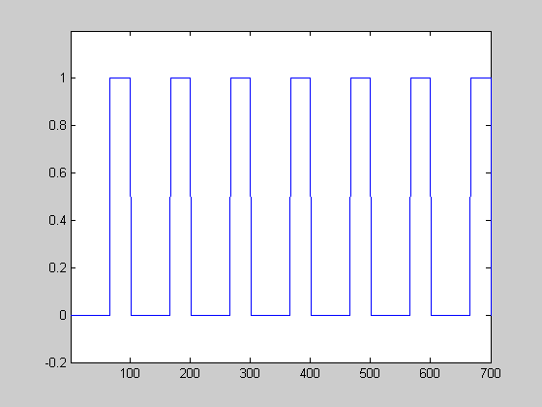
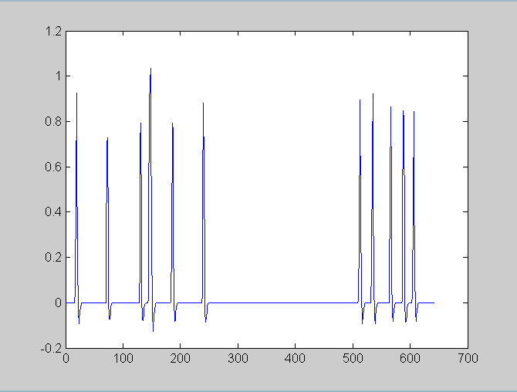
Type of design also important
Block design
Event related design
Intentionally design events of interest into blocks
Retrospectively look at when events of interest occurred
Must code onset time for each regressor

Slide 11
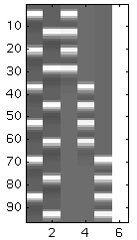
Making sure regressors not correlated
Say you had an experiment where people saw words and nonwords and had to either read them out loud or just think about how to read them....
4 conditions: word, nonword, think, speak
word
think
non
speak
Can test main effects
Words vs. nonwords
Think vs. speak
Can’t test for interactions
For e.g., is activity for words and nonwords the same during think trials but different during speak trials
Correlated regressors (white and black sections occur at same time point in different variables

Slide 12
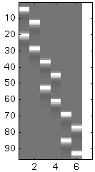
Making sure regressors not correlated
Can now test main effects and interactions
e.g., are there voxels where activity is different for W-speak vs. NW-speak but not for W-think vs. NW-think....
W
W
NW
NW
think
spk
think
spk
Can test main effects
Words vs. nonwords
Think vs. speak
Can also test for interactions
For e.g., is activity for words and nonwords the same during think trials but different during speak trials
Regressors no longer correlated (white and black sections do not occur at same time point in different variables

Slide 13
General Linear Model
β
Y
X
⁺
E
⁼
^{x}
Matrix of bold signals (what you collect)
Design Matrix
(what you put in SPM)
Matrix of parameters
(estimate of contribution of each regressor in design matrix)
Error matrix
Residual variance
at each voxel
Aim: To explain as much of the variance in Y by using X, and thus reducing E

Slide 14
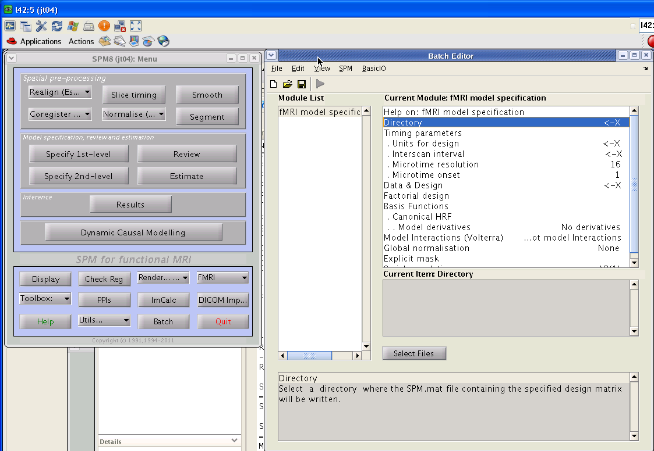
SPM walk-through

Slide 15
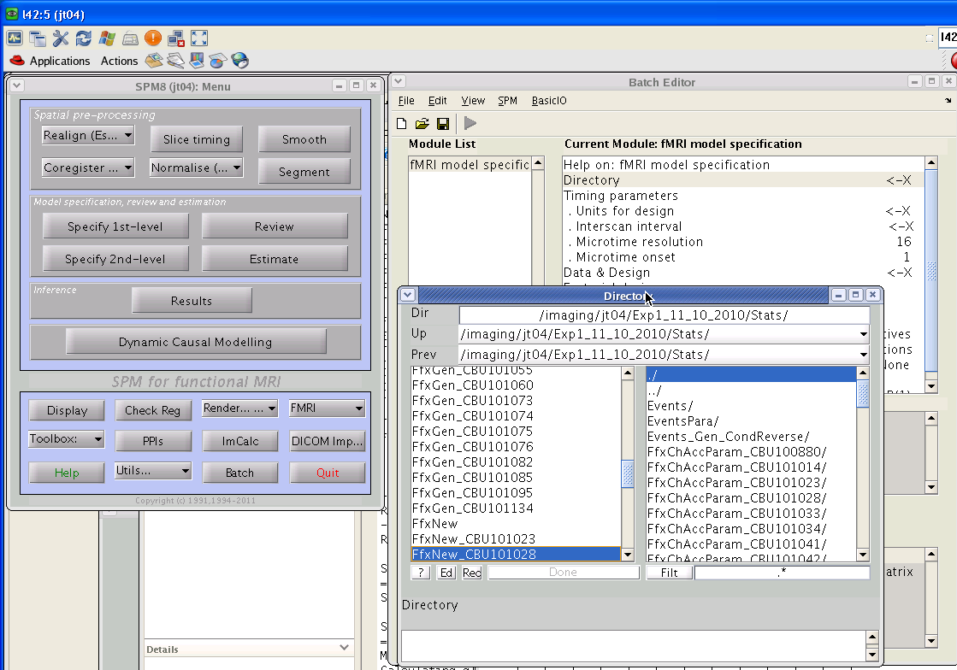
Select directory to put design matrix in

Slide 16
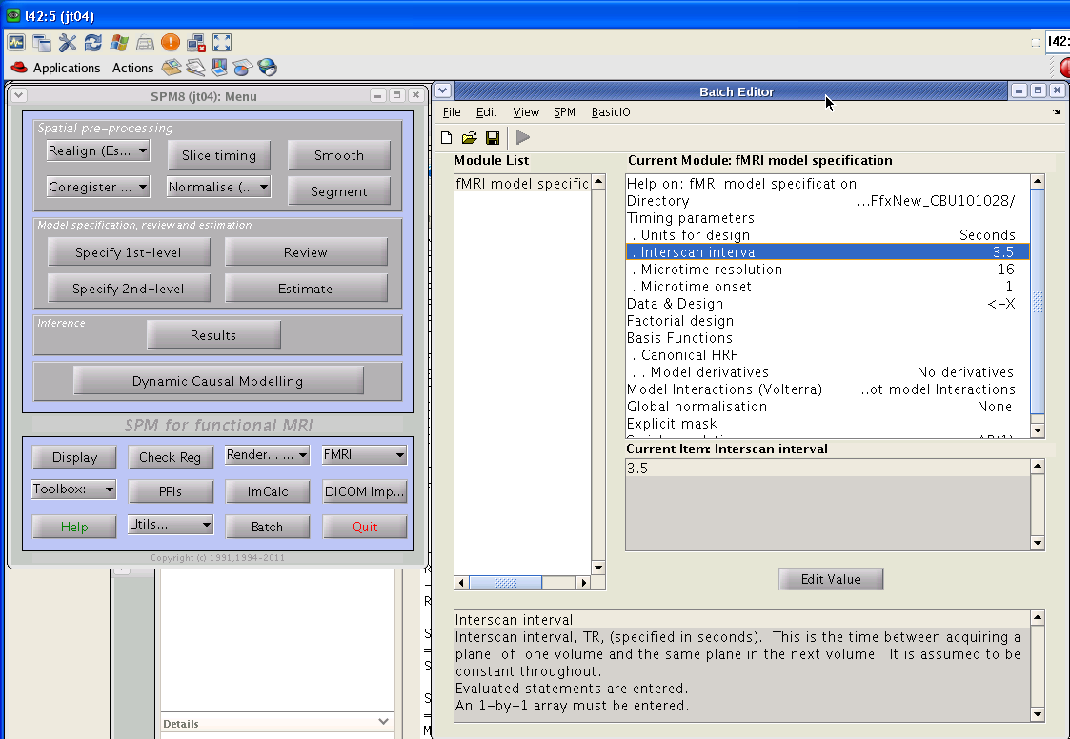
Give it timing parameters

Slide 17
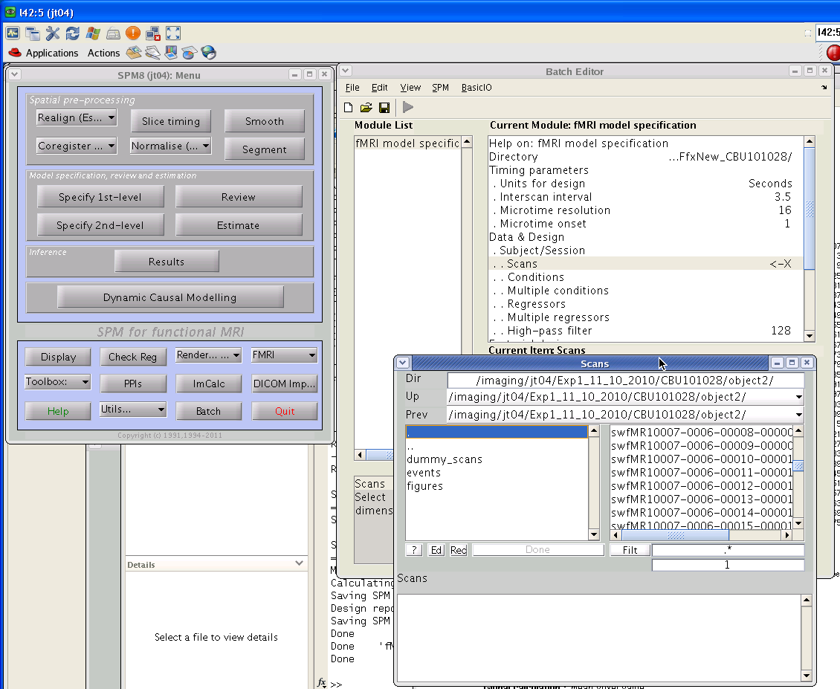
Give it scans for this subject for this session
all files with swf prefix
Check = number of scans you had in this session

Slide 18
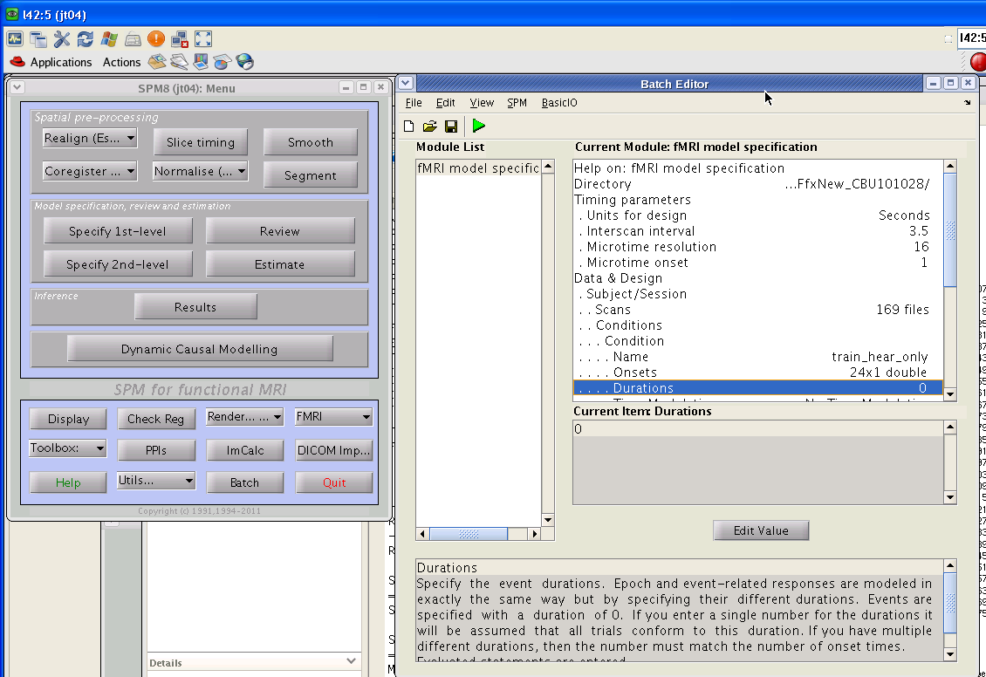
Onset times for each condition in this session
Paste from text/excel file make sure sec not ms

Slide 19
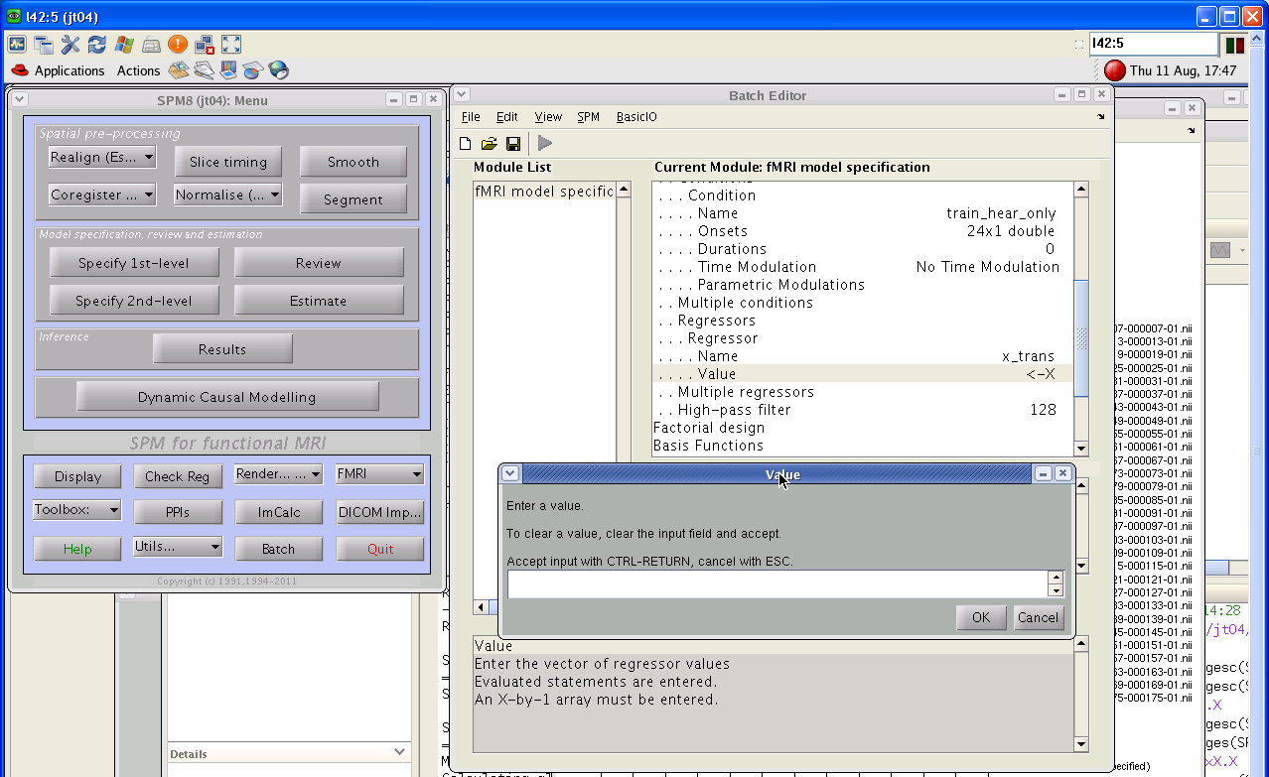
Movement regressors

Slide 20
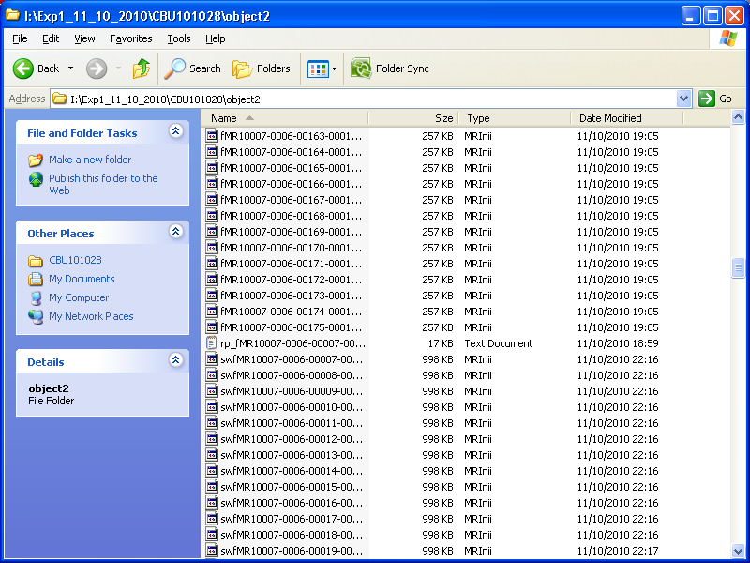
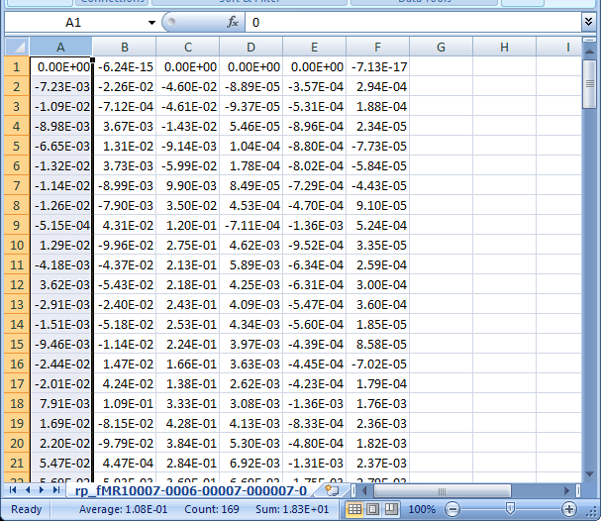
Movement regressors
x_trans y_trans z_trans x_rot y_rot z_rot

Slide 21
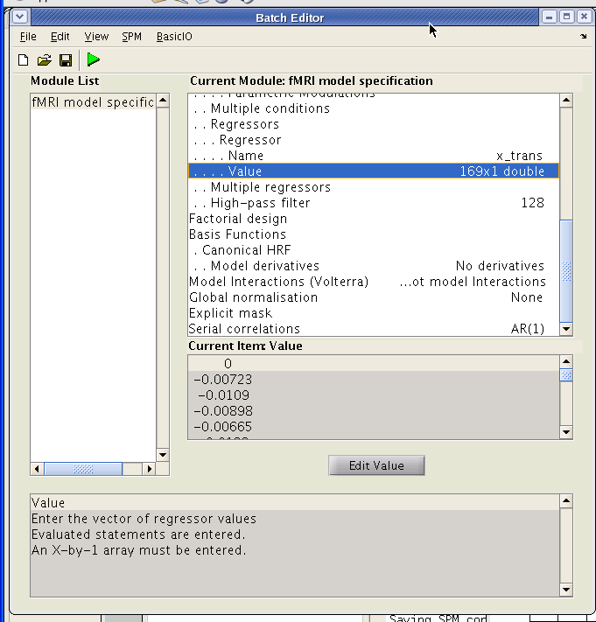
Run!

Slide 22
conditions
6 runs
time
i.e. scans

Slide 23
4 alternating blocks of training and testing, 5 different trial types
train
test
see
hear
both
think
speak
movement regressors x 6
Note:
Not black and white for condition present/absent because convolved with HRF
time
i.e. scans

Slide 24
Thanks!

