Slide 1
Bayesian Theory Interest Group
Session 1
What is Bayesian inference?
What are prior, likelihood, and posterior?
What is the evidence (or marginal likelihood)?
What is Bayesian model selection?
Alex Billig

Slide 2
Bayesian inference
Inferring something about the world by optimally combining existing beliefs with new evidence.
Bayes’ rule (or theorem) specifies how to do this, providing a mathematical relationship between two events’ probabilities, and their probabilities conditioned on each other.
Examples:
Scientific research: Improving models for some phenomenon/process, based on latest empirical data.
Human perception: Determining the physical cause of ambiguous sensory information, based on past experience.
Machine learning: Automatic character recognition.

Slide 3
The sandwich van
?
Unexpected morning meeting with supervisor …
… finishes at 10:35am.
Have I missed the sandwich van?
From experience, van has left by 10.35am on 10 out of 11 mornings …

Slide 4
The sandwich van
Probably going to go hungry today …

Slide 5
The sandwich van
?
No email from Susan this morning to say the van has arrived …
… do I still think I’ve missed the van?

Slide 6
The sandwich van
p (van been) 10/11
Van is rarely still there at 10.35am
p (van been | no email) ?
p (no email | van been) 1/10
Once a fortnight, Susan too busy
p (no email | van not been) 1
Susan doesn’t lie

Slide 7
The sandwich van
Email
p = 9/11
p = 9/10
Van been
No email
p = 10/11
p = 1/10
p = 1/11
Van not been
p = 1/11
Email
p = 0
p = 0
No email
p = 1
p = 1/11

Slide 8
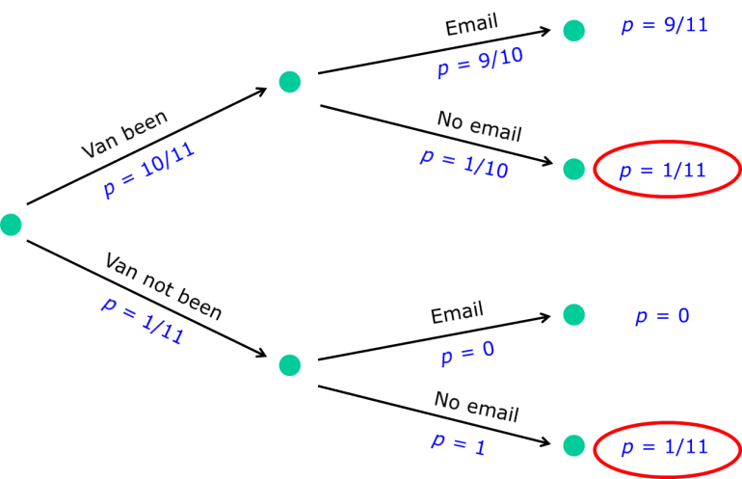
Bayes’ rule
For two events A and B, where p(B)≠0:
p(B) p(A|B) =
p(A and B) =
p(A) p(B|A)
p(A|B) = p(B|A) p(A)
p (van been|no email) = p (no email|van been) p (van been)
p(B)
p (no email)
= p (no email|van been) p (van been)
p (no email|van been) p (van been) + p (no email|van not been) p (van not been)
= 1/10 * 10/11
1/11
1
=
=
1/10 * 10/11 + 1 * 1/11
2/11
2

Slide 9
Terminology
Likelihood
Prior
Probability of the new data B, given that A occurred.
Probability of A, prior to any
new evidence being available.
p(A|B) = p(B|A) p(A)
p(B)
Posterior
Evidence
(marginal likelihood)
Probability of A, taking into
account both the new data B,
and the prior probability of A.
Normalising constant, weighted sum of likelihoods over all possible values of A.

Slide 10
Terminology
Likelihood
Prior
Probability of the new data B, given that A_{i} occurred.
Probability of A_{i}, prior to any
new evidence being available.
p(A_{i}|B) = p(B|A_{i}) p(A_{i})
p(B|A_{i}) p(A_{i})
Posterior
Evidence
(marginal likelihood)
Probability of A_{i}, taking into
account both the new data B,
and the prior probability of A_{i}.
Normalising constant, weighted sum of likelihoods over all possible values of A_{i}.

Slide 11
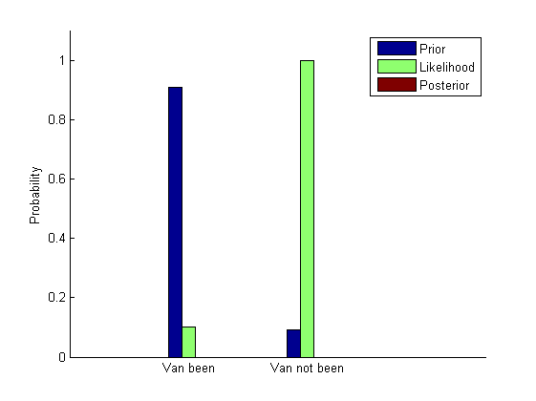
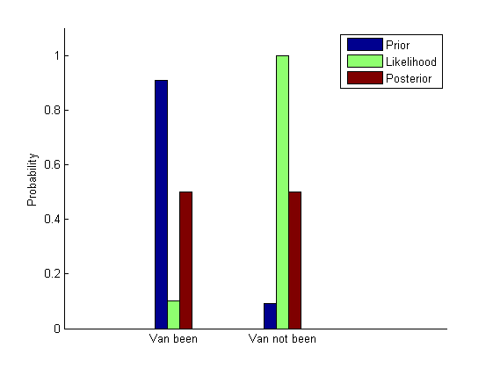
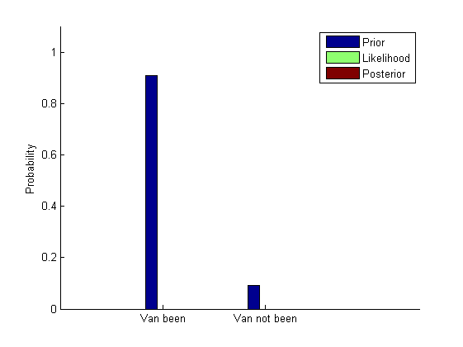
Combining prior and likelihood / normalisation
Divide by total probability of the data (i.e. no email sent). Known as marginal likelihood or evidence.
For each hypothesis, multiply prior by likelihood, then normalise for posterior
Across hypotheses, prior probabilities sum to 1, as do posterior probabilities
For comparison of two hypotheses, can use the un-normalised values

Slide 12
Types of inference
Sandwich van example:
Data: discrete binary variable – presence or absence of email
Models/hypotheses: discrete possibilities – van has or hasn’t been
Often our data are observations of a continuous variable (e.g. apparent length of an object, level of BOLD signal), and we want to test hypotheses about the underlying probability distribution behind the data:
Parameters of the distributions (e.g. mean and variance of a Gaussian)
What kind of distribution (e.g. Gaussian, mixture of two Gaussians)
We can do this by applying Bayesian inference at two levels:
For each candidate model, infer details of (continuous) parameters
Use outputs from first level to compare (discrete) models across entire range of parameters
Notes:
Note can think of parameter estimation as model selection too in some senses.

Slide 13
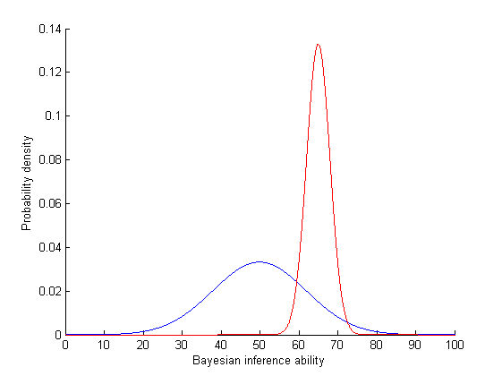
Example: parameter estimation
How good are Cambridge scientists at Bayesian inference?
Assume Bayesian inference ability is normally distributed, want to find mean (μ) and standard deviation (σ) of this distribution.
So want to compare infinitely many hypotheses about the parameters, like these:
μ=65
σ=3
μ=50
σ=12

Slide 14
Example: parameter estimation
Write down prior beliefs about the parameters (μ, σ)
Test a random sample of 40 Cambridge scientists
Apply Bayes’ rule to combine these two sources of information
But previous example dealt with just two hypotheses …
Van been
Van not been
… and two observable outcomes
Email
No email
Notes:
Need to adapt Bayes’ rule to handle cases where:
The hypothesis (parameter) space is continuous, and multi-dimensional (the two parameters, μ and σ, could each take one of infinitely many values)
The data space is continuous (test scores can vary from 0 to 100)

Slide 15
Discrete and continuous Bayes
Discrete case
A_{i} are alternative explanations
B is the one observed data point
p(A_{i}|B) = p(B|A_{i}) p(A_{i})
p(B|A_{i}) p(A_{i})
Continuous case
θ are the parameters of the model we wish to infer
y are the observed data
m is the assumed model
p(θ|y,m) = p(y|θ,m) p(θ|m)
p(θ|y) = p(y|θ) p(θ)
p(y|θ) p(θ) dθ
p(y|θ,m) p(θ|m) dθ

Slide 16
Example: parameter estimation
p(θ|y,m) = p(y|θ,m) p(θ|m)
p(y|θ,m) p(θ|m) dθ
θ are the parameters of the model we wish to infer
The mean and standard deviation of the distribution of Cambridge scientists’ Bayesian inference abilities
y are the observed data
The scores of the 40 scientists who take the written exam
m is the assumed model
The assumption that Cambridge scientists’ Bayesian inference abilities come from a single normal distribution
Notes:
Describe how sum becomes integral

Slide 17
Terminology
Likelihood
Prior
p(θ|y,m) = p(y|θ,m) p(θ|m)
θ: parameters
y: data
m: model
p(y|θ,m) p(θ|m) dθ
Posterior
Evidence
(marginal likelihood)
Notes:
Describe how sum becomes integral

Slide 18
Simplification for clarity
Rather than trying to infer both the mean and standard deviation of the distribution of Bayesian inference abilities …
… let’s assume the population standard deviation is already known to be 15
So we are now making inferences about a single parameter, μ
This simplifies the story, and the visualisation …
… but the same principles can be applied when inferring over a multi-dimensional parameter space.

Slide 19
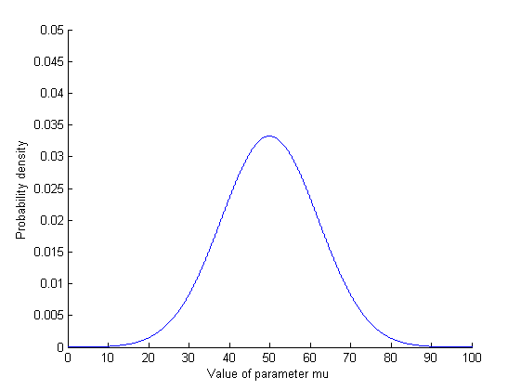
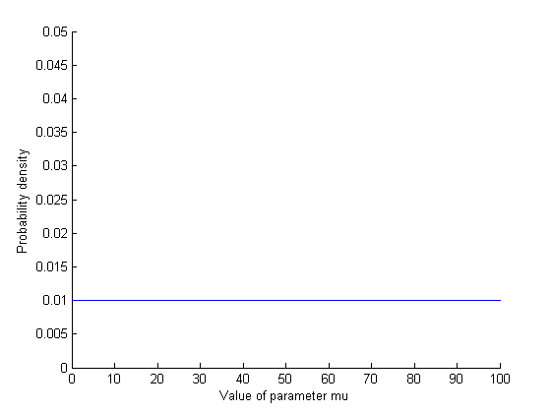
Priors
The prior probability distribution describes our beliefs about parameters, before new data is taken into account.
Priors can be “informative” – strong/specific beliefs, with a “peaky” distribution in parameter space …
… or “uninformative” – assigning equal probability to all (feasible) possibilities, with a “flat” distribution in parameter space
The more specific (“peakier”) the prior, the greater its contribution to the posterior probability distribution
Notes:
For two parameters, our prior is a surface – assigning a probability to each combination of mu and sigma

Slide 20
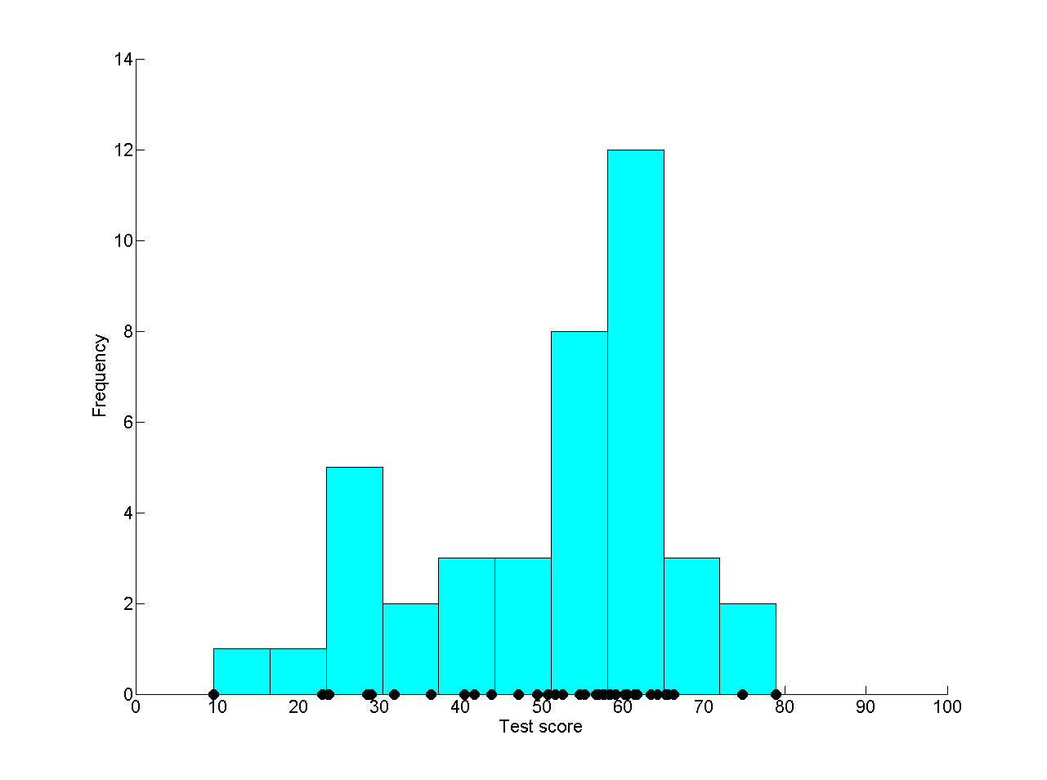
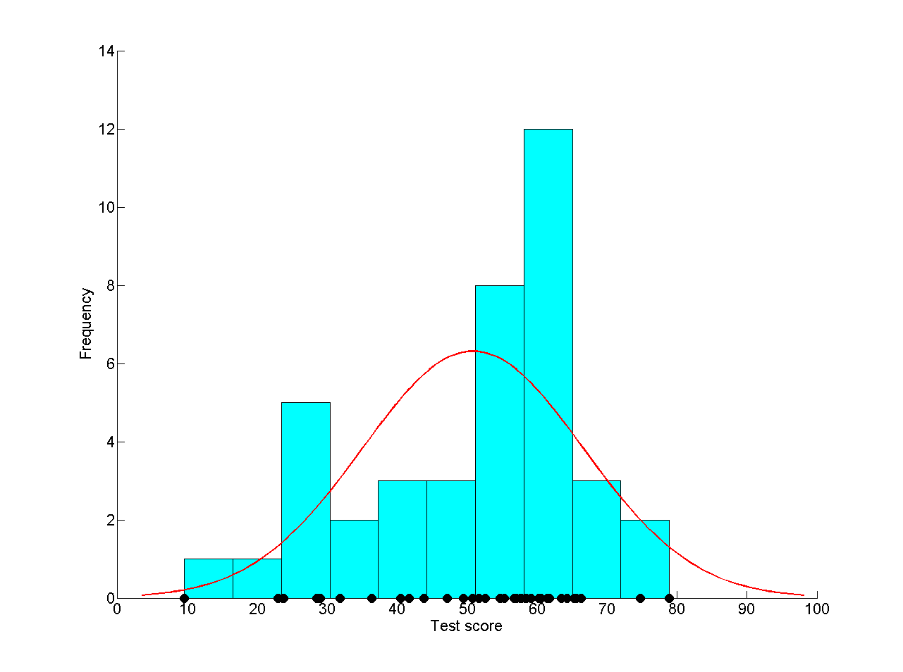
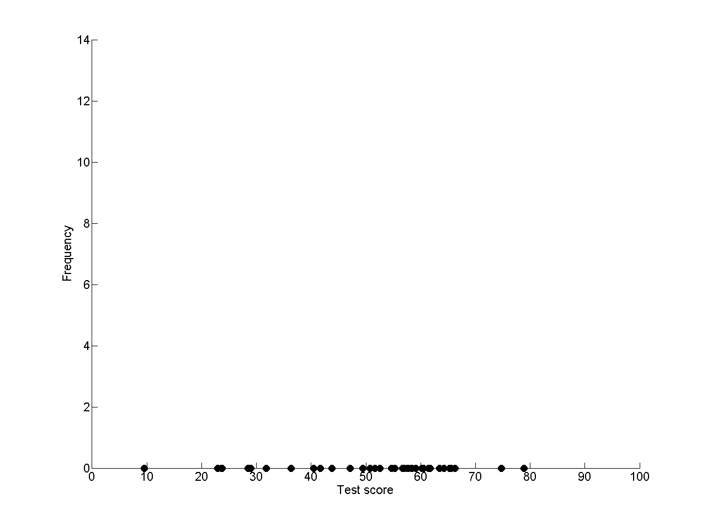
Calculating the likelihood function
Collect our 40 data points
Plot as histogram to visualise
For any value of the parameter μ, we can calculate the likelihood, i.e. how well a normal distribution with mean of μ (and standard deviation of 15) predicts the observed data
As our observations are independent, we can write down the likelihood as a function of the parameter by multiplying the probabilities of each data point y_{i} for a given value of μ:
Performing this calculation for different values of μ gives us points on a curve
Notes:
Showing one possible distribution, can imagine many others with different mean and standard deviations
Now in data space

Slide 21
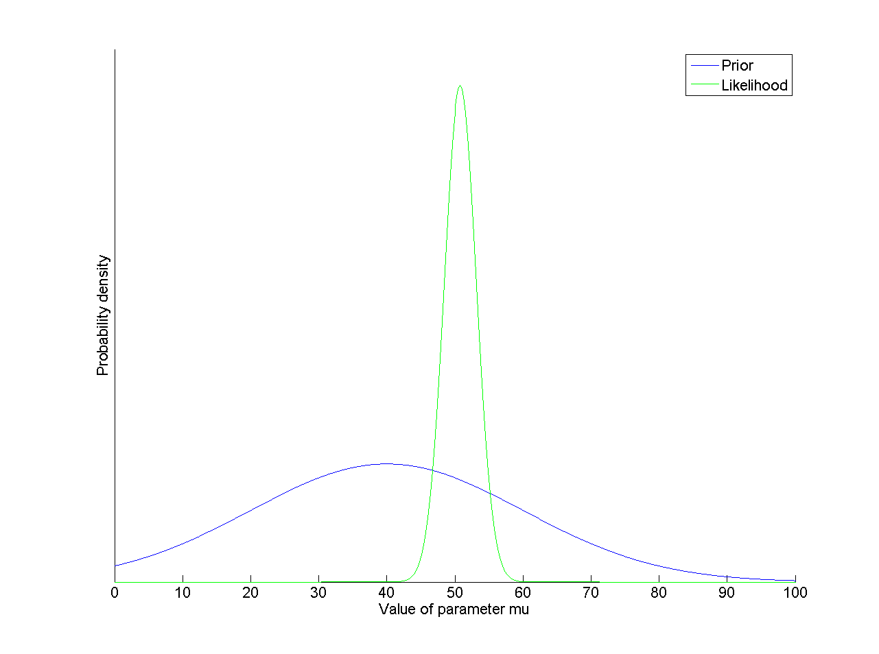
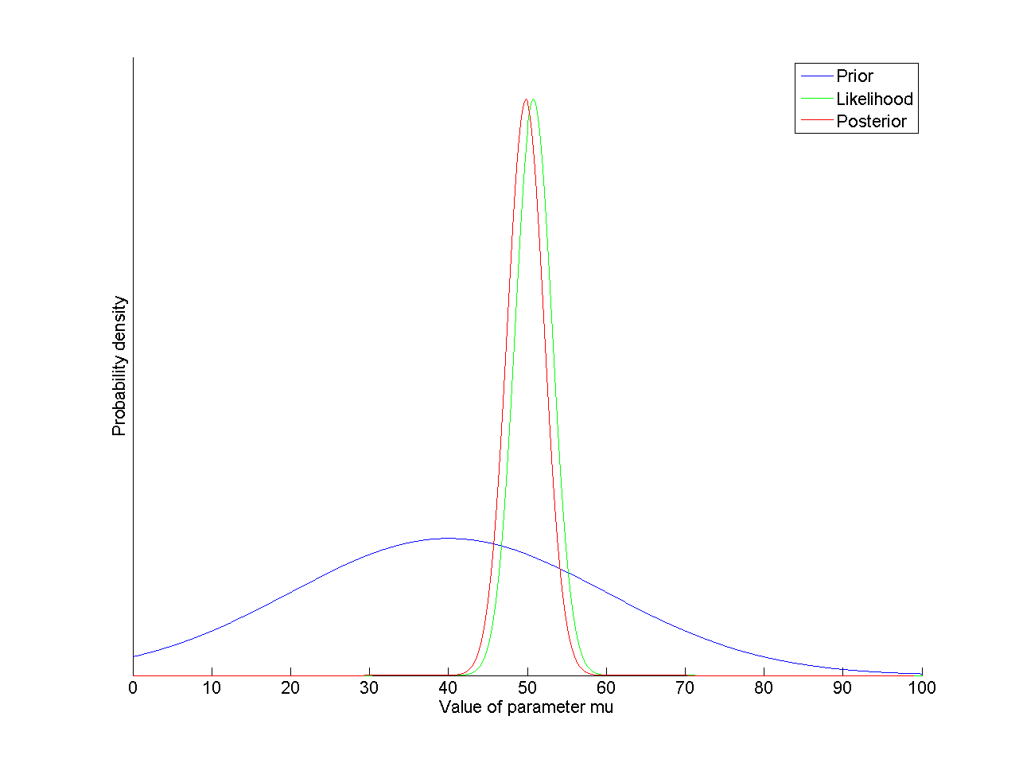
Combining prior and likelihood for posterior
Continuous case
Discrete case
Notes:
Not shown a scale on y-axis here – if we are interested in the relative probability of each of value of the parameter being the true value, we do not need to normalise.
Note – the posterior distribution doesn’t just give a single estimate for the mean of the distribution – we have a feel for how certain we are (the variance of this posterior distribution).

Slide 22
Bayesian model selection
We assumed Cambridge scientists’ Bayesian inference abilities come from a normal distribution with s.d. of 15.
We combined our relatively flat prior on the mean (μ) with a peaky likelihood function derived from the data, to obtain a new posterior distribution on μ.
But taking another look at the data, there seem to be two peaks.
Perhaps there are really two relevant sub-populations – those that attend the Bayesian Theory Interest Group meetings, and those that don’t.
This hypothesis could be represented by a mixture of two Gaussian distributions with different means (and standard deviations).
We can use Bayesian inference to select between the single Gaussian model, and this more complex model.
Notes:
Describe how sum becomes integral

Slide 23
Bayesian model selection
We wish to compare two models for Cambridge scientists’ Bayesian inference abilities, based on our data from 40 test scores:
m₁ – A single Gaussian distribution with unknown mean, and standard deviation of 15 (one parameter)
m₂ – A mixture of two Gaussian distributions with unknown means and standard deviations, and an unknown weighting parameter (five parameters)
For each model, calculate the evidence (marginal likelihood)
This is the normalising constant we’ve already encountered when determining the posterior probability function
It gives a measure for the strength of evidence for a model over all values of the parameters, penalising models with more parameters
p(θ|y,m) = p(y|θ,m) p(θ|m)
Evidence
= p(y|m)
p(y|θ,m) p(θ|m) dθ
Notes:
Describe how sum becomes integral

Slide 24
Bayesian model selection
We can express how much better one model is than another by calculating the ratio of model evidences (Bayes factor, BF)
Superiority of Model 1 (m₁) over M model 2 (m₂) in explaining the data (y) is given by:
Conventions for interpreting BF in terms of superiority of Model 1 over Model 2:
3-20: Positive evidence
20-150: Strong evidence
> 150: Very strong evidence
Difference from classical likelihood-ratio tests: Bayesian model selection does not depend on any single set of parameters.
p (y|m₁)
BF =
p (y|m₂)

Slide 25
Summary
Bayesian inference: Updating our view/understanding of the world by optimally combining existing beliefs with new evidence.
We apply Bayes’ theorem, regardless of whether the inference is about discrete states/hypotheses, or continuous parameters.
This involves multiplying prior probability and likelihood functions of the parameters, and normalising by the model evidence or marginal likelihood to obtain a posterior probability function.
The model evidence is a weighted sum (or integral) of the probability of the new data, over all possible values of the parameters. It can be used to compare and select from alternative models, taking into account how well they predict the data and their complexity.

Slide 26
References and additional resources
Books
Bishop, C.M. (2006) Pattern recognition and machine learning. New York: Springer
Section 1.2 – Probability theory including basics of Bayes
MacKay, D.J.C. (2003) Information theory, inference, and learning algorithms. Cambridge: Cambridge University Press. Available free online at http://www.inference.phy.cam.ac.uk/itprnn/book.pdf
Section 21 – Example of exact enumeration (like sandwich van example)
Section 28 – Model comparison (Bayesian model selection)
Stone, J.V. (2013) Bayes’ Rule: A tutorial introduction to Bayesian analysis. Sebtel Press.
Chapter 1 – Intuitive introduction (available free http://jim-stone.staff.shef.ac.uk/BookBayes2012/BayesRuleBookMain.html)
Chapters 2-5 – Discrete/continuous examples, Gaussian parameter estimation (partly available free on Google Books)
Videos
Christopher Bishop – Introduction to Bayesian Inference http://videolectures.net/mlss09uk_bishop_ibi/
Part 1: 5:37-15:10 – Probability theory including basics of Bayes
David Mackay – Course on Information Theory, Pattern Recognition, and Neural Networks
Lecture 9: http://videolectures.net/mackay_course_09/ 13:50 onward – inferring parameters of a Gaussian, clear explanation of differences between data space and parameter space, nice visual demonstration of likelihood functions.
Lecture 10: http://videolectures.net/mackay_course_10/ Application of Bayes’ Theorem to a physical problem. Watch the intro then skip to 26:39 for Bayes application, but worth watching the whole thing for how Bayes reaches places where other methods don’t.

