Slide 1
VBM
Voxel-Based Morphometry
Francesca Biondo
NB – Slides adapted from of the fMRI for dummies series on the FIL website

Slide 2
Outline
Intro
Pre-processing
  Some additional tweaks to pre-processing
2) Statistics: What does the SPM show in VBM?
  VBM & cVBM
  The GLM in VBM
  Covariates
  Multiple comparison corrections
3) Other developments, an example and some notes

Slide 3
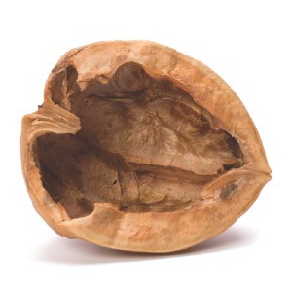
VBM in a
VBM = voxel based morphometry
  morpho = form/ gestalt
  metry = to measure/ measurement
  Studying the variability of the form (shape and size) of “things”
Measures differences in local concentrations of brain tissue [e.g. Grey matter GM, or white matter WM, or CSF]...
these measures are taken at every voxel of the brain and then statistically compared between 2 or more experimental groups...
which establishes statistically significant differences in brain tissue concentration in specific brain regions between these 2 groups...
Whole-brain analysis - does not require a priori assumptions about ROIs
Fully automated
Notes:
One method of investigating neuroanatomical differences in vivo and in an unbiased, objective way is to use voxel-based morphometry (VBM).
The basic idea of VBM is to measure differences in local concentrations of brain tissue, especially grey matter (Ashburner & Friston, 2000); these measures are taken at every voxel of the brain and then statistically compared between two or more experimental groups, thereby establishing statistically significant differences in brain tissue concentration in specific brain regions between the groups under investigation (Ashburner & Friston, 2000; Mechelli, Price, Friston & Ashburner, 2005).
Usually it uses a Whole brain analysis approach, however one could apply VBM to specific ROI...

Slide 4

The 39 steps of VBM
5
Spatial normalisation
2. Tissue segmentation
3. Modulation
4. Smoothing
5. Statistical analysis
output: statistical (parametric) maps
showing regions where certain tissue type differs significantly between groups/ correlate with a specific parameter, eg age, test-score …
Pre-processing (steps 1-4)
The data is pre-processed to sensitise the stat tests to *regional* tissue volumes !
Notes:
VBM analysis is based on (high resolution) MRI brain scans and involves a serious of processing steps, mainly spatial normalisation, segmentation, smoothing and statistical analysis, the end result being statistical maps which show the regions where tissue types differ significantly between groups (Mechelli et al, 2005; see Sejem, Gunter, Shiung, Petersen & Jack Jr [2005] for other possible variations in processing as the one suggested by Ashburner & Friston [2000] or Mechelli et al [2005]).

Slide 5
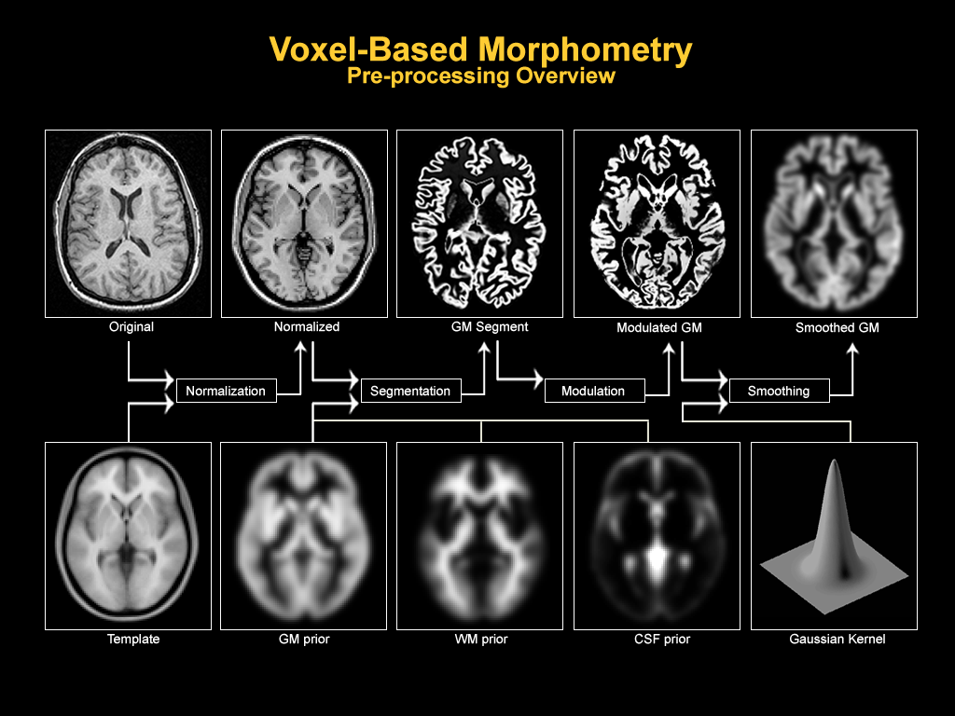
VBM Processing
start
end
1
2
3
4
Notes:
Slide from Hobbs & Novak, MfD (2008)

Slide 6
1 Normalisation
All subjects’ T1 MRI* entered into the same stereotactic space (using the same template) to correct for global brain shape differences
does NOT aim to match all cortical features exactly- if it did, all brains would look identical (defies statistical analysis)
* needs to be high resolution MRI (1 or 1.5mm)
Notes:
During normalisation, participants’ T1 MR images are fitted into the same stereotactic space, usually a template which, ideally, is an amalgamation (average) of many MR images. Participants’ MR scans are warped into the same stereotactic space, thus eradicating global brain shape differences and allowing the comparison of voxels between participants (Ashburner & Friston, 2000; Mechelli et al, 2005).
need for high resolution (1 or 1.5mm) to avoid volume effects (caused by a mix of tissues in one voxel)

Slide 7
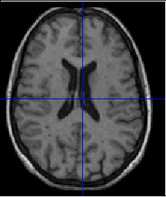
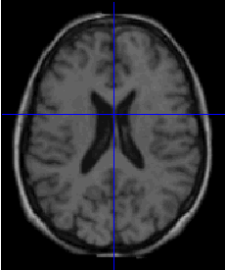
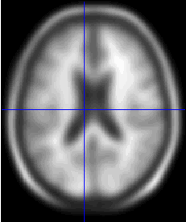

ORIGINAL IMAGE
SPATIAL
NORMALISATION
Either MNI or from large sample of scans!
SPATIALLY NORMALISED IMAGE
TEMPLATE IMAGE
Notes:
Slide from Hobbs Novak (2008)

Slide 8
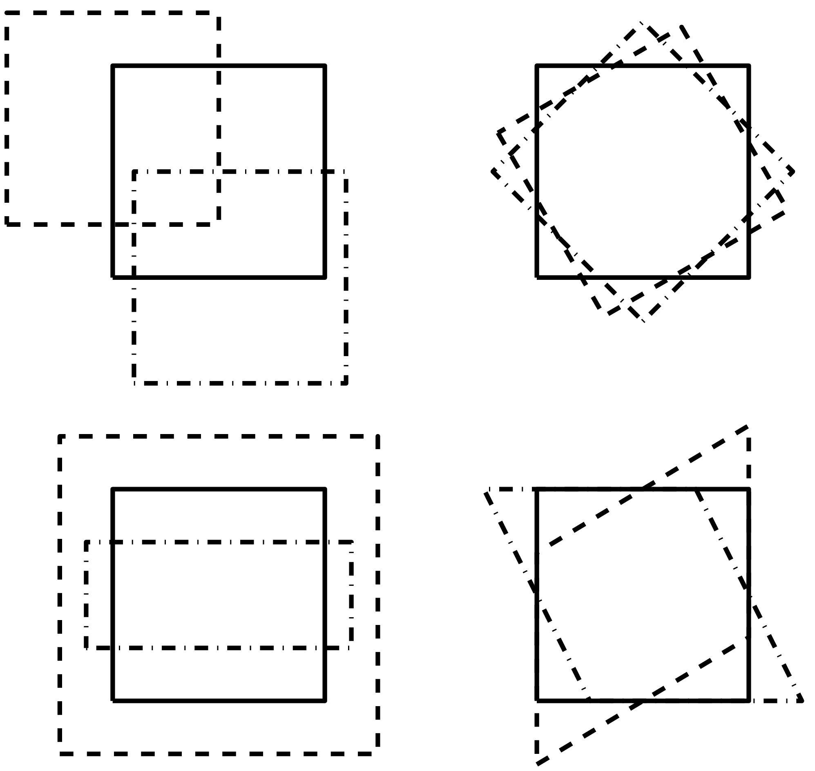
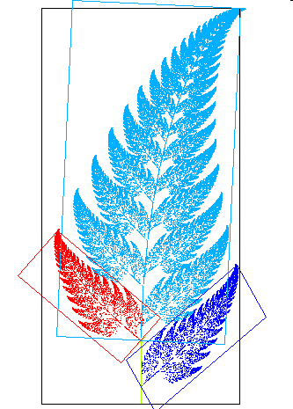
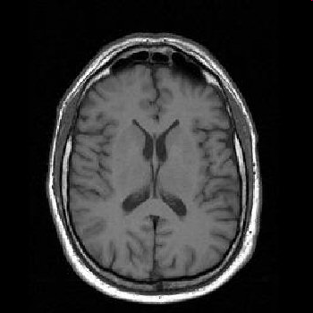
Normalisation- detailed
1) Affine transformation
  Translation, rotation, scaling (zooming), shearing
  Matches overall position and size
FIT
2) Non-linear step
  Process of warping an image to “fit” onto a template
  Aligns sulci and other structures to a common space
The amount of warping (deforming) the MRI has to undergo to fit the template = non-linear registration
Template
Subject MRI
Notes:
Involves 2 steps: (from Mechelli et al (2005) Current Medical Imaging Reviews, 1 (2), 105-113
Spatial normalisation involves registering the individual MRI images to the same template image. An ideal template
consists of the average of a large number of MR images that have been registered in the same stereotactic space. In the
SPM2 software, spatial normalisation is achieved in two steps. The first step involves estimating the optimum 12-
parameter affine transformation that maps the individual MRI images to the template [4]. Here, a Bayesian framework
is used to compute the maximum a posteriori estimate of the spatial transformation based on the a priori knowledge of the
normal brain size variability.
The second step accounts for global nonlinear shape differences, which are modeled by a linear combination of smooth spatial basis functions.
This step involves estimating the coefficients of the basis functions that minimize the residual squared difference between the image and the template, while simultaneously maximizing the smoothness of the deformations. The ensuing spatially-normalised images should have a relatively high-resolution (1mm or 1.5mm isotropic voxels), so that the segmentation of gray and white matter (described in the next section) is not excessively confounded by partial volume effects, that arise when voxels contain a mixture of different tissue types.

Slide 9
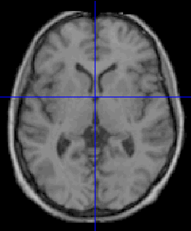
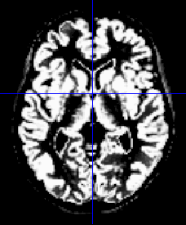
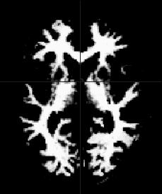
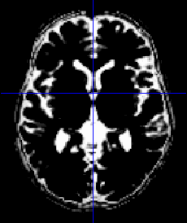
2 Segmentation
normalised images are partioned/classified into
Segmentation is achieved by combining
  mixture model cluster analysis (which identifies voxel intensity distributions of particular tissue types in the original image)
  ☻probability maps/ Bayesion Priors (based on general knowledge about normal tissue distribution)
Lesioned tissue
GM
WM
CSF
Notes:
During the next processing step, segmentation, every voxel is classified as either grey matter (GM), white matter (WM) or cerebrospinal fluid (CSF) in a fully automated segmentation routine. This also involves an image intensity non-uniformity correction (bias-correction) to control for skewed signals in the MR image caused by cranial structures within the MRI coil during data acquisition (Mechelli et al, 2005).
The segmentation in SPM is based on a modified gaussian mixture model (Ashburner & Friston 2000). Bayesian rule is used to assign the probablity for each voxel belonging to each tissue class based on combining the likelihood for belonging to that tissue class and the prior probablity derived from prior probability maps derived from a large number of subjects.
Recent developments have helped to identify lesions in MR scans more accurately and precisely by using a unified segmentation approach (originally described by Ashburner & Friston, 2005) which adds a fourth tissue category “extra” (or “other”) (Seghier, Ramlackhansingh, Crinion, Leff & Price, 2008). This allows voxels with unusual and atypical signals to be recognised and classified as such, rather than being misclassified as WM, GM or CSF.

Slide 10
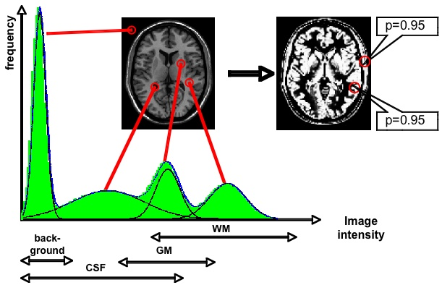
Mixture Model Cluster Analysis
Each voxel has a value between 0 and 1, representing the probability of it being in a particular tissue class
Includes bias correction for image intensity non-uniformity due to the MRI process.
Intensities in T1 fall into roughly 3 classes - SPM can assign a voxel to a tissue class by seeing what its intensity is relative to the others in the image. This is called Intensity Distribution.
Notes:
Slide from Hobbs Novak (2008)
bias correction for image intensity non-uniformity: signal deformation caused by different positions of cranial structures within MRI coil
Signal = signal from subjetc‘s T1 MRI
Intensity Distribution
Segmentation in SPM is obtained from the intensity distribution of the image and prior information for the respective tissue classes. To visualize and analyze image intensity distribution we can plot all values of the image in a histogram. The histogram on the left represents the frequencies of the intensity values of the image. The x-axis shows from left to right increasing image intensities and we can differentiate different curves for each tissue class and background. The right image shows the initial segmentation result without using prior information. If we only use intensity information of the whole image there are several misclassifications outside the cortex. This is because image intensity around the scalp is similiar to that of gray matter as shown in the circles.

Slide 11
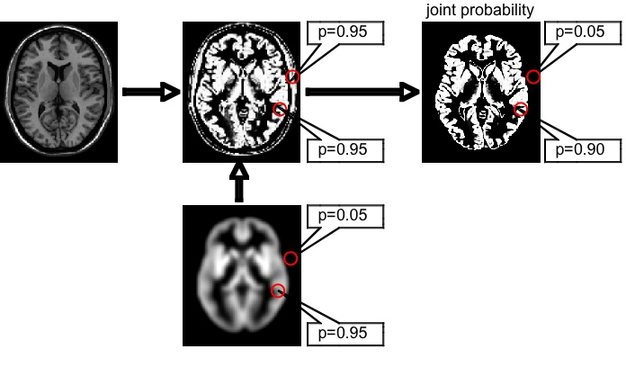
☻Spatial prior probability maps
A GM Prior
Smoothed average of tissue volume, e.g. GM, from MNI. Intensity at each voxel represents probability of being tissue of interest, e.g. GM
BAYES Rule to use priors: SPM combines the initial segmentation result with prior information obtained from a large number of correctly segmented images.
Notes:
if you have a low value, close to 0, this means that this particular voxel has a very low probability of being GM
We can combine the initial segmentation result with prior information obtained from a large number of correctly segmented images. The prior information outside the cortex shows very low probability for belonging to gray matter. If we combine both probabilities using a Bayesian rule we obtain a joint posterior probability with correct results.
PS- There’s an additional clean up segmentation processing which using conditional dilations and erosions can create a clean up mask to remove non-connected parts from the segmented images.

Slide 12
...optimised VBM (older not used anymore)
reduces the misinterpretation of significant differences,
eg misregistering enlarged ventricles as GM
Notes:
from Mechelli et al (2005) Current Medical Imaging Reviews, 1 (2), 105-113
There are cases when structural differences not directly related to GM or WM volumes may be misinterpreted as volumetric differences as a result of normalization. One example is when the size of the ventricles differs significantly between two or more experimental groups. If the ventricles of one experimental group are enlarged during normalization, the surrounding grey and white matter also may be enlarged. This is because the parameters of the normalization only encode highly smooth, low frequency deformations which may not distinguish between the ventricles and the surrounding tissue. As a result, structural differences pertaining to ventricular volume may show up in a VBM study of gray matter volumes. A way of minimizing this potential source of error is to perform the normalization using segmented grey and white matter volumes rather than on the whole brain images.
If all the data entering into the statistical analysis are only derived from gray matter, then any
significant differences must be due to gray matter. Likewise, if all the data entering into the statistical analysis are derived
only from white matter, then any significant differences must be due to white matter changes. The caveat with this
approach, however, would be that the segmentation has to be performed on images in native space (because normalisation hasn’t been skipped). However the Bayesian priors, which encode a priori knowledge about the spatial distribution of different tissues in normal subjects, are in stereotactic space. A way of circumventing this problem is to use an iterative version of segmentation and normalisation operators, (see Fig. 1). First, the original structural MRI images in native space are segmented. The resulting gray and
white matter images are then spatially normalized to gray and white matter templates respectively to derive the
optimized normalisation parameters. These parameters are then applied to the original, whole-brain structural images in
native space prior to a new segmentation. This recursive procedure, also known as “optimized VBM”, has the effect
of reducing the misinterpretation of significant differences relative to “standard VBM”

Slide 13
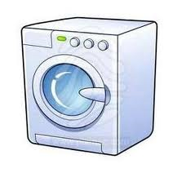
Unified Segmentation
A generative model is used to look for the best fit of an individual brain to a template. It does this by going through recursive cycles of:
Tissue classification
Bias correction
registration
Continues until algorithm can non longer model data more accurately
Results in images that are segmented, bias-corrected and registered
into standard space.
Better results than serial application. Registration and bias correction help the tissue classification and the tissue classification helps the registration and bias correction. (Ashburner and Friston, 2005)
registration
Tissue classification
bias correction
Notes:
The newer alternative normalization in spm5 combines segmentation, bias correction and spatial normalization in the inversion of a single unified model. Estimating the model parameters (to give a maximum a posteriori solution) involves alternating among classification, bias correction and registration steps. This approach affords better results than serial application of each component because conditional dependencies among model parameters are modeled properly i.e. Registration and bias correction help the tissue classification and the tissue classification helps the registration and bias correction (Ashburner and Friston, 2005) quoted from Crinion et al neuroimage 2007.

Slide 14

3 Modulation (optional, but commonly used)
Modulation corrects for changes in brain VOLUME after normalization.
Different types of modulation which makes it...
Confusing.
For example :
  1. Modulation which corrects for both affine and non-linear warping...and
  2. Modulation (most commonly used) which buffers volume change caused only by non-linear spatial normalization.
  And more..
Multiplication of the spatially normalised GM (or other tissue class) by its relative volume before and after warping*, ie:
i₂ = i₁ x [V₁ / V₂]
Notes:
Spatial normalisation expands and contracts some brain regions. Modulation involves scaling by the amount of contraction, so that the total amount of grey matter in the modulated GM remains the same as it would be in the original images.
This step is recommended if you are more interested in volume changes than differences in concentration (or density). Nevertheless, this post-processing step is optional and you can try both, with and without modulation to test your hypothesis. The use of this step depends on your data and what are you interested in. If you decide to use modulation both images will be saved: non-modulated and modulated images (indicated by a leading “m” or “m0″ for non-linear terms only).

Slide 15
An Example
i₂ = i₁ x [V₁ / V₂]
Smaller Brain
Template
i₁ = 1
v₁ = 1
Normalisation
v₂ = 2
Modulation
i₂ = ?
i₂ = 1 x [1 / 2] = 0.5
Larger Brain
Template
i₁ = 1
v₁ = 4
Normalisation
Modulation
i₂ = ?
v₂ = 2
i₂ = 1 x [4 / 2] = 2
V₁ = Volume before normalization (in MRI)
V₂ = volume of the template
i₁ = intensity in signal before normalization (in MRI)
i₂= intensity in signal after normalization
Notes:
Normalisation of temporal lobe:
in a smaller brain, the temporal lobe may only have half the volume compared to the temporal lobe of the template,
Whereas in a bigger brain, the temporal lobe may have twice as much volume as the template
These differences in VOLUME are lost in *unmodulated* data because after normalisation both lobes will show as having the same volume, specifically the volume of the template!
If you want to express the differences in volume, you can adjust the intensity of the signal in the temporal lobe regions
From Mechelli et al (2005)
For example, if one subject's temporal lobe has half the volume of that of the template, then its volume will be doubled. As a result, the subject’s temporal lobe will comprise twice as many voxels after spatial normalisation and the information about the absolute volume of this region will be lost. (e.g. that it was 23cc) In this case, VBM can be thought of as comparing the relative concentration of gray or white matter structures in the spatially normalized images (i.e. the proportion of gray or white matter to all tissue types within a region).
There are cases, however, when the objective of the study is to identify regional differences in the volume of a particular tissue (gray or white matter), which requires the information about absolute volumes to be preserved. Here a further processing step, which is usually referred to as “modulation”, can be incorporated to compensate for the effect of spatial normalisation.
This step involves multiplying the spatially normalised gray matter (or other tissue class) by its relative volume before and after spatial
normalisation. For instance, if spatial normalisation results in a subject's temporal lobe doubling its volume, then the correction will halve the intensity of the signal in this region.
This ensures that the total amount of gray matter in the subject's temporal lobe is the same before and after spatial normalisation.
In short, the multiplication of the spatially normalised gray matter (or other tissue class) by its relative volume before and after warping has critical implications for the interpretation of what VBM is actually testing for. Without this adjustment, VBM can be thought of as comparing the relative concentration of gray or white matter structures in the spatially normalized images. With the adjustment, VBM can be thought of as comparing the absolute volume of gray or white matter structures. The two approaches are known as
“non-modulated” and “modulated” VBM, respectively

Slide 16
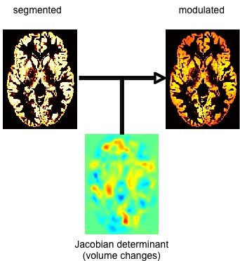
The most frequently type of modulation used is the one that takes into account ONLY non-linear transformations in normalisation .
* Jacobian determinants of the deformation field
Notes:
Effect of modulating segmented images. The Jacobian determinant in the center represents the volume changes due to non-linear spatial normalization. These volume changes are used to modulate the segmentation result on the left and the modulated image is shown on the right side.

Slide 17
Modulated vs Unmodulated
Unmodulated
  Concentration/ density
  proportion of GM (or WM) relative to other tissue types within a region
Modulated
  Volume
  Comparison between absolute volumes of GM or WM structures
Hard to interpret
may be useful for highlighting areas of poor registration (perfectly registered unmodulated data should show no differences between groups)
useful for looking at the effects of degenerative diseases or atrophy
Notes:
Unmodulated data: compares “the proportion of grey or white matter to all tissue types within a region”
Hard to interpret
Not useful for looking at e.g. the effects of degenerative disease
“localised” relative density after correcting for total GM or TIV (multiplicative effects)
Modulated data: compares volumes
Unmodulated data may be useful for highlighting areas of poor registration (perfectly registered unmodulated data should show no differences between groups)
relative volume after correcting for total GM or TIV (multiplicative effects)
Non modulated VBM can be thought of as comparing the relative concentration of GM (the proporation of GM to other tissue types within a region). With the adjustment for volume change, VBM would be comparing the absolute amounts of gray matter in the different regions.

Slide 18
Just a note: What is GM density?
The exact interpretation of GM concentration or density is complicated, and depends on the preprocessing steps used
  It is not interpretable as neuronal packing density or other cytoarchitectonic tissue properties, though changes in these microscopic properties may lead to macro- or mesoscopic VBM-detectable differences
Notes:
18

Slide 19

I’m the Hoff and I make things better
Notes:
Options to improve segmentation/normalization pre-processing phase

Slide 20

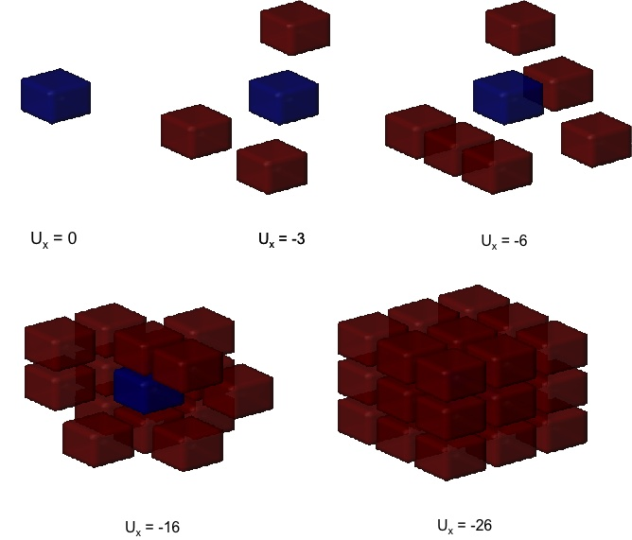
Markov Random Fields
SPM offers this option as an improvement in segmentation.
Using this Hidden Markov Random Field (HMRF) model, we introduce spatial constraints based on neighbouring voxels of a 3x3x3 cube. Neighbouring voxels are expected to have same class labels.
MRF energy Ux is calculated by counting the number of neighbouring voxels of one tissue class in a 3x3x3 cube.
The prior probability of the class and the likelihood probability of the observation is combined to estimate the Maximum a posteriori (MAP).
In the resulting segmentation, the noise level will be minimized.
Notes:
We can optionally use prior information by applying a Hidden Markov Random Field (HMRF) model. Using this model we introduce spatial constraints based on neighbouring voxels of a 3x3x3 cube. The center voxel has 26 neighbours and we can calculate MRF energy by counting the number of neighbours. Neighboring voxels are expected to have the same class labels. The prior probability of the class and the likelihood probability of the observation is combined to estimate the Maximum a posteriori (MAP). Prior probability can be weighted between 0 (no HMRF) and 1 (maximum HMRF for very noisy data) to cover different levels of noise. Parts of this version are based on an implementation of a Gaussian Hidden Markov Random Field (GHMRF) approach by Meritxell Bach Cuadra et al. (2005).
The idea is to remove isolated voxels of one tissue class which are unlikely to be member of this tissue type. It also closes holes in a cluster of connected voxels of one tissue type. In the resulting segmentation the noise level will be minimized.
Depending on your scanner and the used MR sequence your T1-images will contain at least 3% noise level. Hence, I would recommend for most images a medium HMRF weighting of 0.3. If your images are affected by more noise level you can choose a larger HMRF weighting.

Slide 21
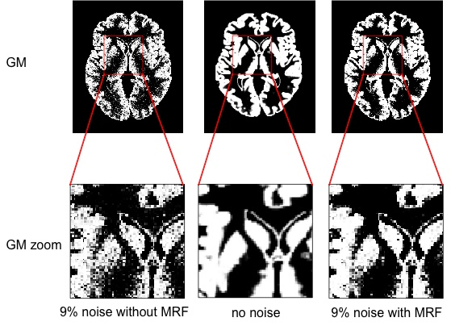
Effect of noise reduction with HMRF
Prior probability can be weighted between 0 (no HMRF) and 1(max HMRF for very noisy data).
Aim is to remove isolated voxels of 1 tissue type which are unlikely to be members of this class. E.g. for T1 image with 3% noise, use medium HMRF of 0.3.

Slide 22
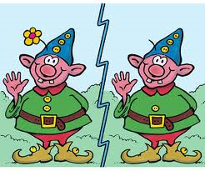
Improving segmentation
There is a great deal of other info that can be incorporated into the classification apart from Markov Random fields...
  e.g. WM has a larger intensity than GM and more intense than CSF (in T1)
  all this info can be used to sensibly bias the estimates
As it stands, VBM not powerful enough to detect subtle abnormalities in individuals.
Voxel-wise MULTIVARIATE approach may provide an improvement on this, by considering other image features apart from GM concentration, for e.g.
  WM concentration
  Local indices of curvature of gyrification such as curvuture of the grey matter segment
Notes:
There is a great deal of other info that can be incorporated into the classification. E.g. Markov Random Fields model, e.g. WM has a larger intensity than GM and more intense than CSF (in T1) – all this info can be used to sensibly bias the estimates.
Ideally, a procedure like VBM should be able to automatically identify any structural abnormalities in a single brain image. However, even with many hundreds of subjects in a database of controls, as it stands, the method may not be powerful enough to detect subtle abnormalities in individuals. A possibly more powerful procedure would be to use some form of voxel-wise multivariate approach. E.g. In addtion to images of GM concentration, other image features would be included – first obvious feature is WM concentration., local indices of curvature of gyrification such as the curvuture of the gray matter segment, image gradients and possibly information from the spatial normalization procedure.

Slide 23

4 Smoothing
Primary reason: increase signal to noise ratio
With isotropic* Gaussian kernel
  usually between 7 & 14 mm
  Choice of kernel changes stats
Effect: data becomes more normally distributed
  Each voxel contains average GM and WM concentration from an area around the voxel (as defined by the kernel)
  Brilliant for statistical tests (central limit theorem)
Compensates for inexact nature of spatial normalisation, “smoothes out” incorrect registration
* isotropic: uniform in all directions
Notes:
Smoothing the segmented images generally increases the signal-to-noise ratio as data points (ie, voxels) are averaged with their neighbours; for MR images this means that each voxel contains the average GM and WM concentration from its surrounding area (as defined by the smoothing kernel) after smoothing. This process also distributes MRI data more normally, thus allowing the use of parametric tests in subsequent statistical comparisons. It also compensates for some of the data loss incurred by spatial normalisation (Mechelli et al, 2005).

Slide 24
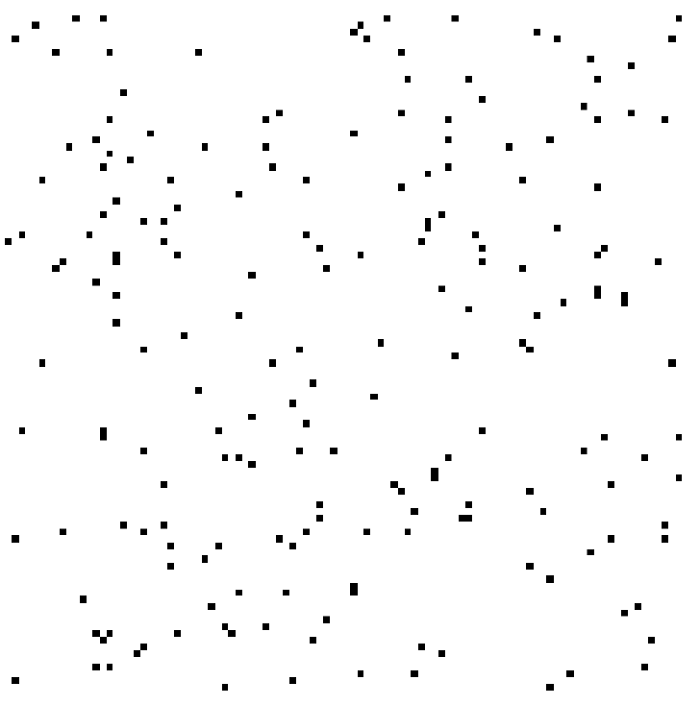

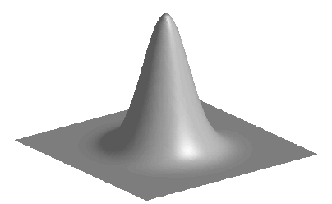
Smoothing
Before convolution
Convolved with a circle
Convolved with a Gaussian
Weighted effect
Notes:
From: John Ashburner
This illustrates the effect of convolving with different kernels. On the left is a panel containing dots which are intended to reflect some distribution of pixels containing some particular tissue
In the centre, these dots have been convolved with a circular function. The result is that each pixel now represents a count of the neighbouring pixels containing that tissue. This is analogous to the effect using measurements from circular regions of interest, centred at each pixel. In practice though, a Gaussian kernel would be used (right). This gives a weighted integral of the tissue volume, where the weights are greater close to the centre of the kernel.

Slide 25
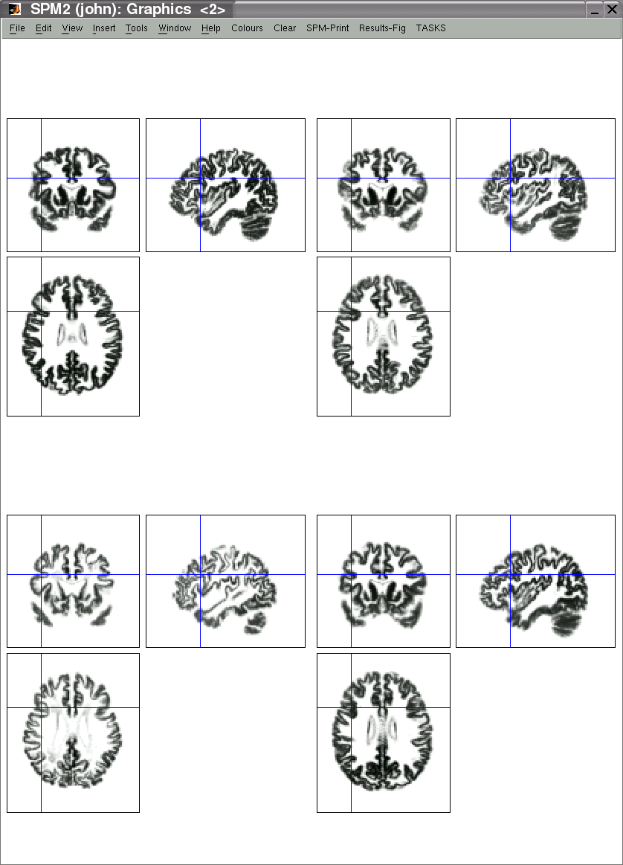
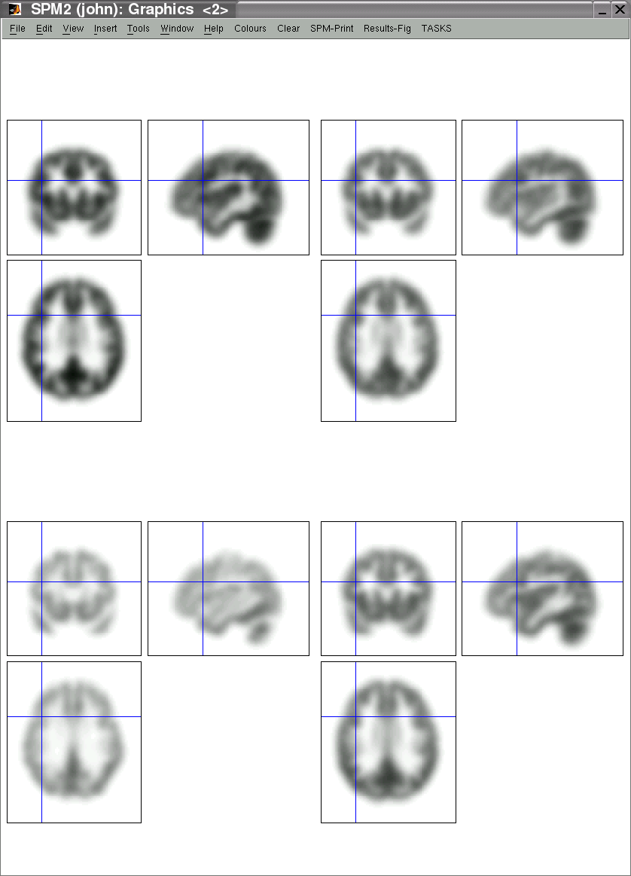
Pre-processed data for four subjects
Warped, Modulated Grey Matter
12mm FWHM Smoothed Version
Notes:
From: John Ashburner

Slide 26

Interim Summary
Spatial normalisation
Tissue segmentation (usually unified segmentation combines 1&2)
3. Modulation (not necessarily but likely)
Smoothing
Next: The STATS!

Slide 27
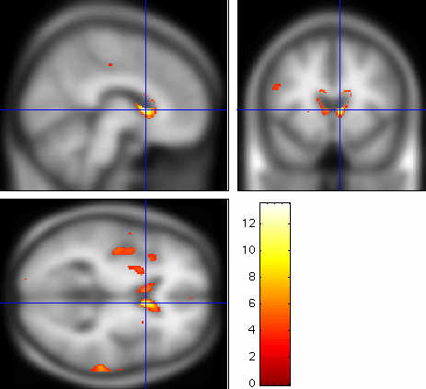
What does the SPM show in VBM?
Voxelwise (mass-univariate: independent statistical tests for every single voxel)
Employs GLM, providing the residuals are normally distributed, GLM: Y = Xβ + ε
Outcome: statistical parametric maps, showing areas of significant difference/ correlations
  Look like blobs
  Uses same software as fMRI
SPM showing regions where Huntington’s patients have lower GM intensity than controls
t-values

Slide 28


One way of looking at data
VBM
  ANOVA/ t-test
  Comparing groups/ populations
  ie, identify if and where there are significant differences in GM/ WM volume/ density between groups
Continuous VBM
  Multiple regression
  Correlations with behaviour
  ie, how do tissue distribution/ density correlate with a score on a test or some other covariate of interest
a known score or value
e.g. Cattell
Both use a continuous variables of GM/ WM
(there are other techniques that use binary measures, eg VLSM – don’t ask !)

Slide 29
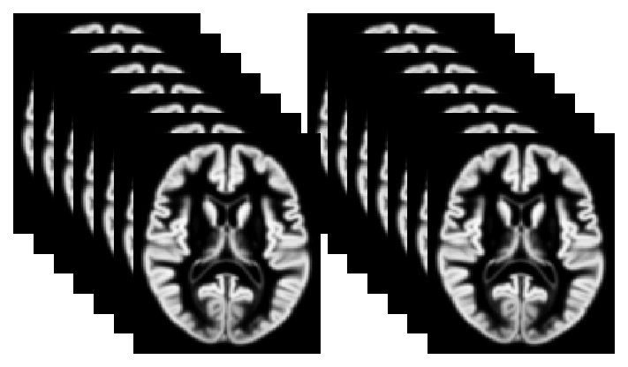
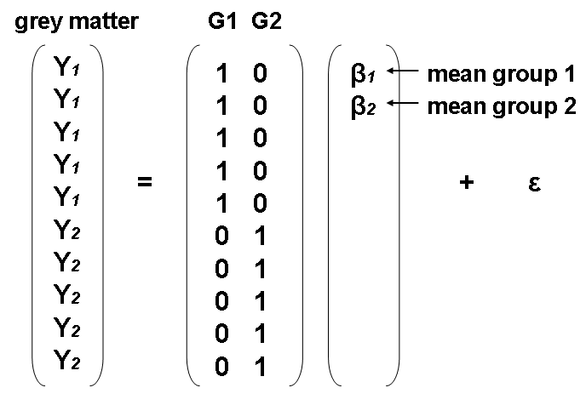
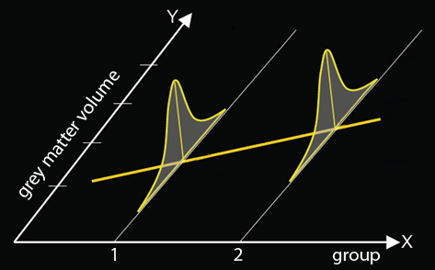
Using the GLM for VBM
e.g, compare the GM/ WM differences between 2 groups
Y = Xβ + ε
H0: there is no difference between
these groups
β: other covariates, not just the mean
Notes:
From: Thomas Doke and Chi-Hua Chen, MfD 2009

Slide 30
VBM: group comparison
GLM: Y = Xβ + ε
Intensity for each voxel (V) is a function that models the different things that account for differences between scans:
V = β₁(AD) + β₂(control) + β₃(covariates) + β₄(global volume) + μ + ε
V = β₁(AD) + β₂(control) + β3(age) + β4(gender) + β5(global volume) + μ + ε
which covariate (β) best explains the values in GM/ WM
In practice, the contrast of interest is usually t-test between β₁ and β_{2, ***}
*** Eg, “is there significantly more GM (higher v) in the controls than in the AD scans and does this explains the value in v much better than any other covariate?”
Notes:
From: Hobbs & Novak, MfD (2008)
Example: Comparison between Alzheimer’s Disease (AD) patients and Controls
Are there significant differences in GM/ WM density or volume between these 2 groups and if so, where are they?
Remember: the GLM works in matrices- so you can lots of values for Y, X, β, μ and ε and calculate “an answer”
Voxel intensity is a function that models all the different things that account for differences between scans (design matrix and other regressors).
Beta value is slope of association of scans or values at that voxel
μ = the population mean/ the constant (mean for AD, mean for controls)
Covariates are explanatory or confounding variables- which covariate (β) best explains the values in GM/ WM besides your design matrix (group)
Covariates could be: age, gender (male brains tend to be systematically bigger than female brains), global volume

Slide 31
continuousVBM: correlation
Correlate images and test scores (eg Alzheimer’s patients with memory score)
SPM shows regions of GM or WM where there are significant associations between intensity (volume) and test score
V = β₁(test score) + β₂(age) + β₃(gender) + β₄(global volume) + μ + ε
Contrast of interest is whether β₁ (slope of association between intensity & test score) is significantly different to zero
Essentially, all VBM statistical analyses use an ANCOVA model so distinguishing CVBM and VBM may be a bit artificial
Notes:
From: Hobbs & Novak, MfD (2008)
Combine group comparison and correlation analyses.

Slide 32
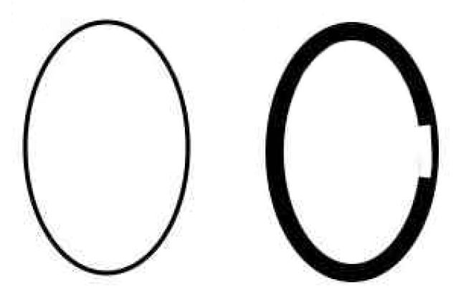
Things to consider: Covariates
Global or local differences
  Uniformly bigger brains may have uniformly more GM/ WM
  considering the effects of overall size (total intracranial volume) may make a difference at a local level
brain A brain B
differences without accounting for TIV
(TIV = global measure)
brain A brain B
differences after TIV has been “covaried out” (differences caused by bigger size are uniformally distributed with hardly any impact at local level)
Brains of similar size with GM differences globally and locally
Mechelli et al 2005
Notes:
Globally, TIV differs but GM is equally distributed in both brains with one exception (right “chink) in brain 2
Chink = local differences
Depending on whether or not you consider global difference in TIV, your VBM analysis will interpret the effect of the chink dramatically different:
TIV not accounted for at a global level in GLM: VBM would identify greater volume in right brain apart from the area of the chink, whereas at the chink both brains would be identified as have equal volumes
If TIV is globally discounted for, then both brains will have equal distribution of volume throughout the brain except for the chink area- the LEFT brain will register with more volume (because all tissue is equally distributed in left brain, whereas there is dramatic drop in volume in the chink in right brain and this drop will be picked up in VBM in terms of volume differences between left and right brain)
I think Mechelli et al (2005) say that both approaches are OK (because you may wel be interested in global effects), you just have to be very clear when you report your results that you have considered TIV (or not).

Slide 33
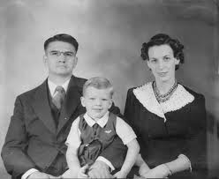

Multiple Comparison Problem/Family Wise Error
Introducing false positives when you deal with more than one statistical comparison
  detecting a difference/ an effect when, in fact, it does not exist
FWE: When a series of significance tests is conducted, the familywise error rate (FWE) is the probability that one or more of the significance tests results in a false positive within the volume of interest (which is the brain)

Slide 34
Multiple Comparisons: an example
One t-test with p < .05
  a 5% chance of (at least) one false positive
3 t-tests, all at p < .05
  All have 5% chance of a false positive
  So actually you have 3*5% chance of a false positive
  = 15% chance of introducing a false positive (FWE)
p value = probability of the null-hypothesis being true

Slide 35

Here’s a happy thought
In VBM, depending on your resolution
  1,000,000 voxels
  1,000,000 statistical tests
do the maths at p < .05!
  50000 false positives
So what to do? What to do?
  1...Bonferroni Correction or
  2...Random Field Theory (used in SPM)

Slide 36
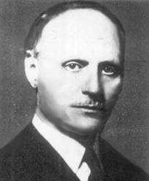
1) either.... Bonferroni
Yo!
Bonferroni-Correction (controls false positives at individual voxel level):
  divide desired p value by number of comparisons
  .05/1000000 = p < 0.00000005 at every single voxel
Not a brilliant solution (false negatives)!
Added problem of spatial correlation
  data from one voxel will tend to be similar to data from nearby voxels – which violates a Bonferroni assumption of independent tests.
Notes:
One solution would be to apply Bonferroni-correction which adjusts the statistical threshold to a much lower p-value (to the scale of p< 0.00000005 or similarly conservative). Whilst this indeed controls the occurrence of false positives, it also leads to very low statistical power, in other words it reduces the ability of a statistical test to actually detect an effect if it exists, due to the very conservative significance levels (Kimberg et al, 2007; Rorden et al, 2007; Rorden et al, 2009)- this is a type II error, a false negative.
From Brett et al (2003) *numbers are changed
If we have a brain volume of 1 million t statistics [..] and we want a FEW rate of 0.05, then the required probability threshold for every single voxel, using Bonferroni correction, would be p < 0.00000005!
Spatial correlation: In general, data from one voxel will tend to be similar to data from nearby voxels; thus, the errors from the statistical model will tend to be correlated for nearby voxels This violates one of the assumptions of Bonferroni correction which requires voxels to be independent of each other.
Functional imaging data usually have some spatial correlation. By this, we mean that data in one voxel are correlated with the data from the neighbouring voxels. This correlation is caused by several factors: * With low resolution imaging (such as PET and lower resolution fMRI) data from an individual voxel will contain some signal from the tissue around that voxel, esp when you have smoothed your data (which you will have done);
The reslicing of the images during preprocessing causes some smoothing across voxels; Most SPM analyses work on smoothed images, and this creates strong spatial correlation (see my smoothing tutorial for further explanation). Smoothing is often used to improve signal to noise.
The reason this spatial correlation is a problem for the Bonferroni correction is that the Bonferroni correction assumes that you have performed some number of independent tests. If the voxels are spatially correlated, then the Z scores at each voxel are not independent. This will make the correction too conservative.

Slide 37

2) Or....Random Field Theory
That one.
SPM uses Gaussian Random Field Theory to deal with FWE
  A body of mathematics defining theoretical results for smooth statistical maps
  Not the same as Bonferroni Correction! (because GRF allows for multiple non-independent tests)
  Finds the right threshold for a smooth statistical map which gives the required FWE; it controls the number of false positive regions rather than voxels
  A few weeks ago Nadja talked to us about RESELS.. Clusters of voxels are considered rather than individual voxels.
Read: Brett, Penny & Kiebel (2003): An Introduction to Random Field Theory Or see http://imaging.mrc-cbu.cam.ac.uk/imaging/PrinciplesRandomFields They’re the same guys ☺
Notes:
From Brett et al (2003)
The question we are asking is now a question about the volume, or family of voxel statistics, and the risk of error that we are prepared to accept is the Family-Wise-Error rate- which is the likelihood that this family of voxel values could have arisen by chance.

Slide 38
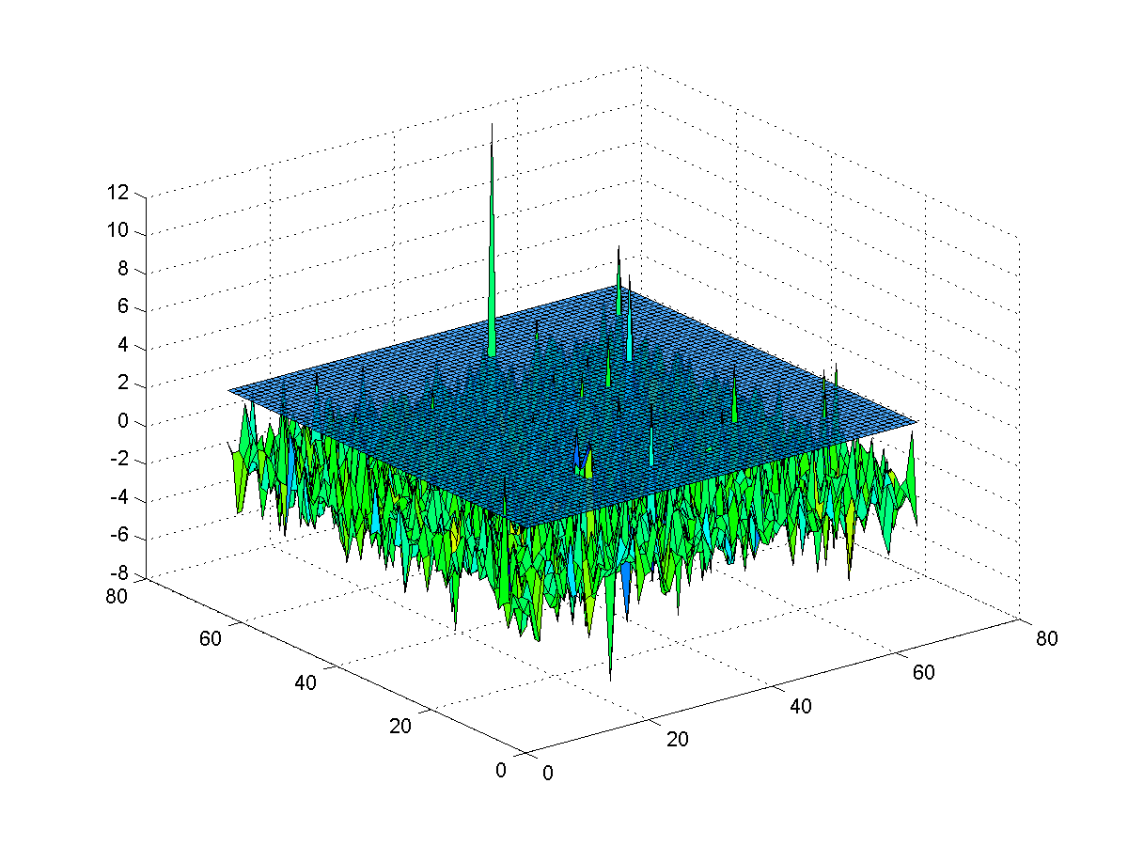
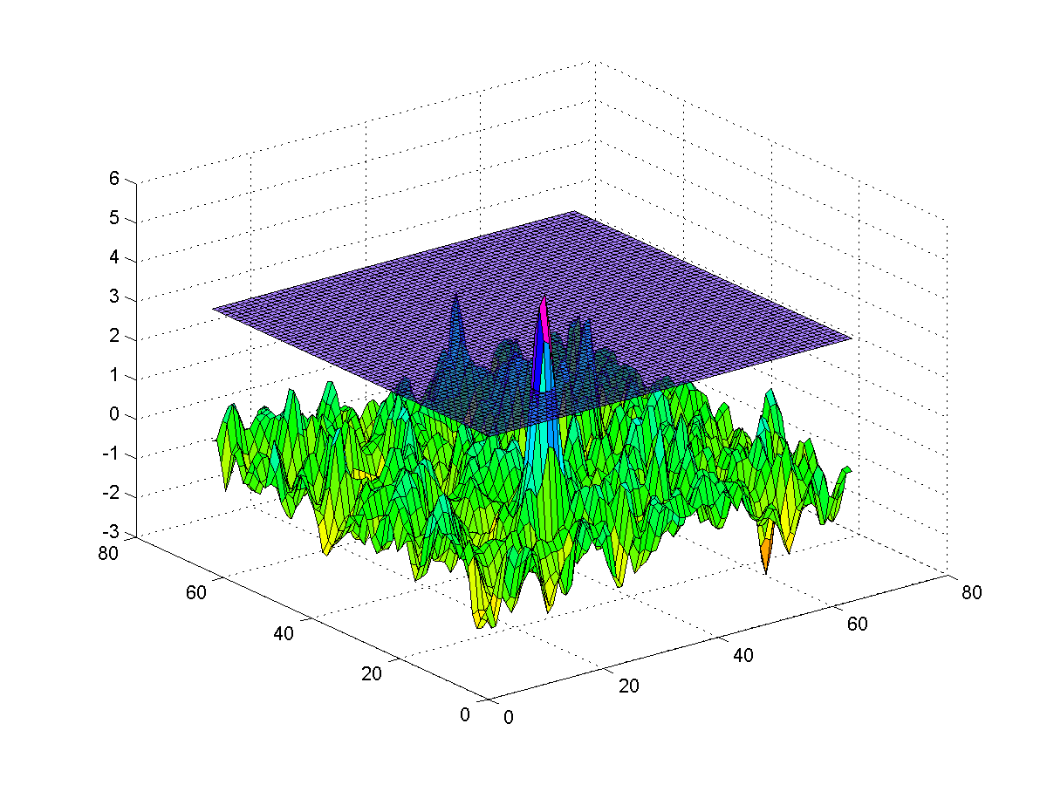
Gaussian Random Field Theory
Finds the right threshold for a smooth statistical map which gives the required FWE;
it controls the number of false positive regions rather than voxels
  Calculates the threshold at which we would expect 5% of equivalent statistical maps arising under the null hypothesis to contain at least one area above threshold
So which regions (of statistically significant regions) do I have left after I have thresholded the data and how likely is it that the same regions would occur under the null hypothesis?
Slide modified from Duke course
Notes:
From: Jody Culham
There is a lot of maths to understand!

Slide 39
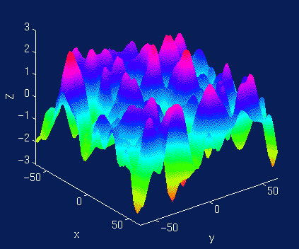
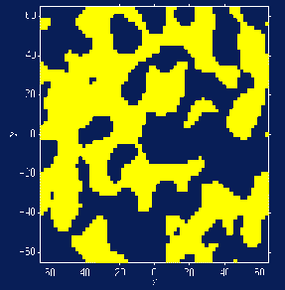
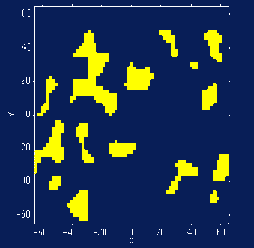
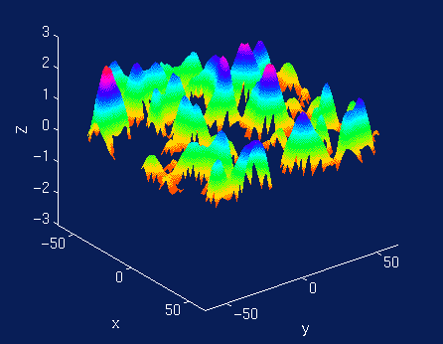
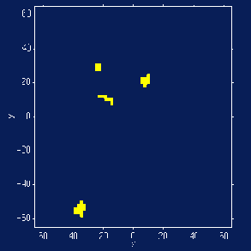
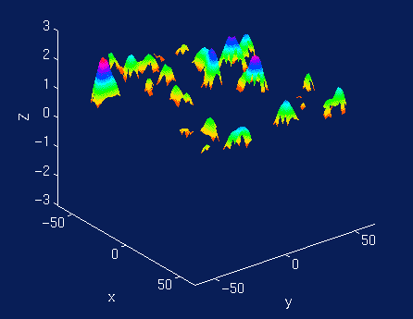
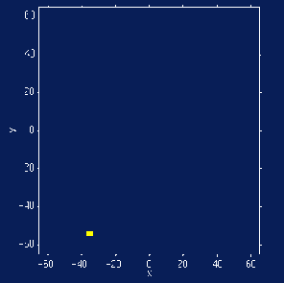
Euler Characteristic (EC)
  threshold an image at different points
  EC = number of remaining blobs after an image has been thresholded
  RFT can calculate the expected EC which corresponds to our required FEW
    Which expected EC if FEW set at .05?
Good: a “safe” way to correct
Bad: but we are probably missing a lot of true positives
Notes:
From Will Penny
So which regions (of statistically significant regions) do I have left after I have thresholded the data and how likely is it that the same regions would occur under the null hypothesis? FWE = likelihood

Slide 40
Main VBM developments
Standard vs unified segmentation VBM
  Tries to improve the somewhat inexact nature of normalisation
DARTEL toolbox / improved image registration
  Diffeomorphic Anatomical Registration Through Exponentiated Lie algebra (SPM5, SPM8)
  more precise inter-subject alignment (multiple iterations)
    more sensitive to identify differences
    more accurate localization
Automated methods for lesion identification
- use outlier detection algorithm (problematic)
(Seghier et al, 2008; Leff et al, Brain, 2009)
Notes:
Dartel employs more realignment parameters (6 million as opposed to 1000 in normal VBM) and these are used to create a group specific template for realignment of all scans.
The template you use for normalisation is based to great degree on the scans you are going to use in your VBM analysis. This procedures is more sensitive to fine grained differences important for realignment which makes it better for later analysis (you will find more statistically significant effects at the local level because you have identified the local level to a greater degree).

Slide 41
An example from recent study (Leff et al, 2009)
Aim of this study was to find out what the neural correlates of auditory STM were and if these areas also supported speech comprehension.
The two main hypothesis were that
  auditory STM and speech comprehension are structurally related but functionally separate, or
  auditory STM and speech comprehension are functionally related, i.e. regions supporting auditory STM are a subset of speech comprehension.
Basic design:
  measure auditory STM (digit span) & speech comprehension + other neuropsychological tests to control for confounds (e.g. EF in digit span).
  Correlate these test scores to GM density in lesioned patients
Notes:
The aim of this study was to find out what the neural correlates of auditory STM were and if these areas also supported language comprehension (given the that previous neuropsychological studies suggested an independece of WM and speech comprehension – warrington & shallice 1969 etc) The authors of this paper suggest that there may have been a methodological flaw in that they used simple as opposed to long sentences to assess lang comprehension.. In favour of this hypothesis is the observations that patients with acquired STM impairment also have speech comprehension deficits. The two main hypothesis were that audtiroy STM and speech comprehension are structurally related but functionally separate, or 2 – aud STM and speech compreh are functionally related, i.e. Regions supporting aud STM are as ubste of speech comprehension.
So here they wanted to compare what between groups or against test scores?
...test scores
The main tasks to adminster are 1) that measures aud STM (digit span) and 2) lang comprehension but they also administered a series of neuropsychological tasks to rule out confounds pertaining to these tasks .. eg. EF (because digit span is not a pure measure of aud stm)

Slide 42
Method
  T1 weighted (1x1x1mm)
  Unified segmentation
  (no mention of modulation) !!
  Smoothing - isotropic kernel of 8mm
  Automated lesion detection - after segmentation each grey matter voxel is compared to the Mean and SE of the voxel in template created from a group of healthy control subjects (N=64 in this study) – acts as a 4th classifier (GM, WM, non-brain and Lesion!). (Seghier 2008)
  Lesion overlap maps - threshold Lesion image into binary, pool all these into one – lesion overlap map – indicates the number of patients who have a lesion at any given voxel.
  Careful: This is not what’s used for stats – because binary not continuous data!
Notes:
No mention of modulation – perhaps it’s included in the unified segmentation procedure (?!)
Ok so first they used an automated method of lesion detection whereby after segmentation each grey matter voxel is compared to the Mean and SE of the voxel in the template created from a group of healthy control subjects (N 64 in this study). This is like a 4th classifier (Gm, Wm, CSF and , 4th lesion tissue).
With this info you can create so called Lesion overlap maps the lesion overlap map indicates the number of patients who have a lesion at any given voxel. But this is not what’s used in the stats...

Slide 43
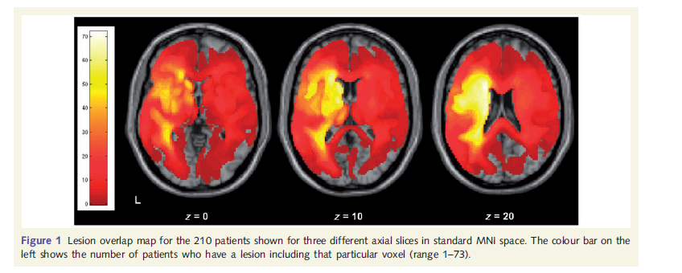
Lesion Overlap Map (Leff et al, 2009)
Many patients with lesions here.
(N=210)

Slide 44
The stats: relationship between digit span and GM density?
Smoothed GM images from 210 patients entered in multiple regression model.
Covariates:
  Age
  Time since stroke
  Volume stroke
AHA!
This was measured by automated lesion-identification algorithm cited earlier!
Notes:
In the stats: they use the smoothed grey matter images from 210 patients (therefore not using lesioned vs non-lesioned - binary – voxels) and are entered in a multiple regression model.
Covariates: age, time since stroke, volume of stroke – which AHA! – was measured by the 4th classifier / automated lesion-identification algorithm cited earlier.
These variables are likely to impact on cognitive performance and we wished to minimize their associated variance so that we could focus our analyses on the relationship between digit-span score and grey matter density
Having identified brain regions where damage covaries with auditory short-term memory capacity, we then investigated whether the structural integrity of these regions also determines spoken discourse comprehension performance. Our hypothesis was that grey matter voxel values in regions supporting auditory
short-term memory capacity would correlate with performance on tests of spoken sentence comprehension.

Slide 45
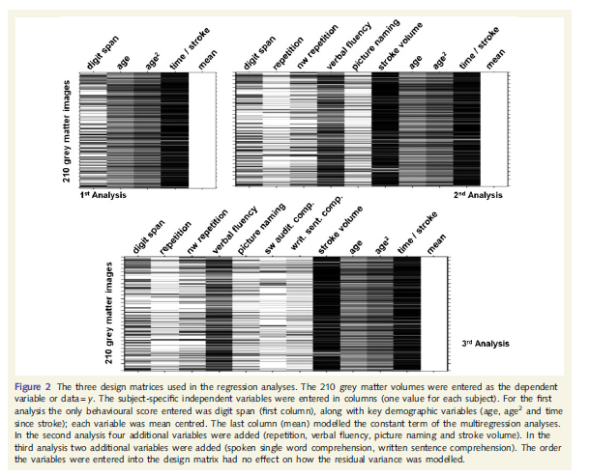
Design matrices
Notes:
VBM and stats
Ok so first they used an automated method of lesion detection whereby after segmentation each grey matter voxel is compared to the Mean and SE of the voxel in the template created from a group of healthy control subjects (N 64 in this study). This is like a 4th classifier (Gm, Wm, CSF and , 4th lesion tissue).
With this info you can create so called Lesion overlap maps the lesion overlap map indicates the number of patients who have a lesion at any given voxel. But this is not what’s used in the stats...

Slide 46
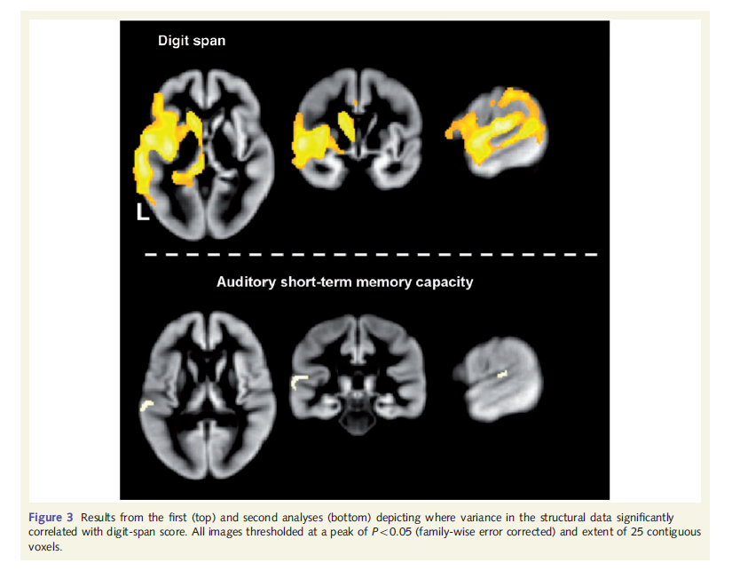
Cortical damage and Digit span
Auditory STM & Cortical damage. So here we need to control for (5) extra regressors to control for processes in digit span which are unrelated to auditory STM e.g. Verbal fluency
Notes:
Superior temporal gyrus and sulcus, lateral and posterior to Heschel’s gyrus. (left hemisphere).
Functional imaging studies can be assumed to highlight regions that may be sufficient to perform
tasks in the scanner—they measure correlations between activation and assumed task demands—but lesion-deficit studies are
able to provide evidence as to which regions may be necessary for the task studied (Price et al., 2006)
In the 3rd analysis they used spoken word comprehension and written
sentence comprehension as added regressors. The cluster
identified by Analysis 2 remained significant
4th analysis added in spoken sentence comprehension as an additional regressor; this resulted
in the loss of a significant effect of digit span. Thus grey
matter density in a region important for auditory short-term
memory capacity correlated more strongly with comprehension
of spoken sentences than with comprehension of either single
words or written sentences.

Slide 47
...main findings
GM density in a region (posterior superior temporal gyrus and sulcus) important for auditory short-term memory capacity correlated more strongly with comprehension of spoken sentences than with comprehension of either single words or written sentences.
The integrity of this area predicts spoken comprehension and auditory STM.
Notes:
In the 3rd analysis they used spoken word comprehension and written
sentence comprehension as added regressors. The cluster
identified by Analysis 2 remained significant
4th analysis added in spoken sentence comprehension as an additional regressor; this resulted
in the loss of a significant effect of digit span. Thus grey
matter density in a region important for auditory short-term
memory capacity correlated more strongly with comprehension
of spoken sentences than with comprehension of either single
words or written sentences.

Slide 48

VBM vs. fMRI
Functional imaging studies can be assumed to highlight regions that may be sufficient to perform tasks in the scanner—they measure correlations between activation
and assumed task demands—but lesion-deficit studies are
able to provide evidence as to which regions may be necessary for the task studied (Price et al., 2006).

Slide 49
Other developments II not directly related to VBM
Multivariate techniques
  VBM = mass-univariate approach identifying structural changes/ differences focally but these may be influenced by inter-regional dependences (which VBM does not pick up on)
  Multivariate techniques can assess these inter-regional dependences to characterise anatomical differences between groups
Longitudinal scan analysis- captures structural changes over time within subjects
  May be indicative of disease progression and highlight how & when the disease progresses (eg, in Alzheimers Disease)
Notes:
Multivariate techniques; See Mechelli et al (2005):
Structural changes can be expressed in a distributed and complicated way over the brain, ie expression in one region may depend on its expression elsewhere

Slide 50
What’s cool about VBM?
Cool
  Fully automated: quick and not susceptible to human error and inconsistencies
  Unbiased and objective
  Not based on regions of interests; more exploratory
  Picks up on differences/ changes at a local scale
  In vivo, not invasive
  As mentioned before: lesion deficit studies are good way of inserting constraints in models.
  Has highlighted structural differences and changes between groups of people as well as over time
    AD, schizophrenia, taxi drivers, quicker learners etc
Not quite so cool
  Statistical challenges:
    Multiple comparisons, false positives and negatives
    extreme values violate normality assumption
  Results may be flawed by preprocessing steps (poor registration, smoothing) by motion artefacts (Huntingtons vs controls)-or severely abnormal brains, or differences not directly caused by brain itself
    Esp obvious in edge effects
Notes:
From London taxi drivers and bus drivers: A structural MRI and neuropsychological analysis, Hippocampus 2006
Maguire, E.A., Woollett, K., Spiers, H.J.
comparing London taxi drivers with London bus drivers, who were matched for driving experience and levels of stress, but differed in that they follow a constrained set of routes. We found that compared with bus drivers, taxi drivers had greater gray matter volume in mid-posterior hippocampi and less volume in anterior hippocampi.
Warnings: VBM may confound the process of misregistration and true anatomical change to the extent that statistical conclusions cannot be trusted.

Slide 51
?
How to interpret GM ‘density’ when using non-modulated VBM.. Any examples?
What is the exact difference between optimized VBM and unified segmentation?
Grey matter density signal is apparently complicated to understand what it reflects in reality... confusing

Slide 52
References
Literature
Ashburner & Friston, 2000
Mechelli, Price, Friston & Ashburner, 2005
Sejem, Gunter, Shiung, Petersen & Jack Jr [2005]
Ashburner & Friston, 2005
Crinion, Ashburner, Leff, Brett, Price & Friston (2007)
On Automated lesion methods:
  Seghier, Ramlackhansingh, Crinion, Leff & Price, 2008,
  Leff et al, Brain paper 2009
Presentations : John Ashburner: www.fil.ion.ucl.ac.uk/~john/misc/AINR.ppt
Spm toolbox + documentation (Random Markov Fields etc) : http://dbm.neuro.uni-jena.de/vbm/

