Slide 1

An introduction to
Multi-Variate Pattern Analysis (MVPA) using
The Decoding Toolbox and
The RSA Toolbox
COGNESTIC, 2022
Daniel Mitchell
Daniel.Mitchell@mrc-cbu.cam.ac.uk

Slide 2
Plan for the day
9:05 – 9:45 | Introduction to MVPA Introduction to the Decoding Toolbox Simple classification demos on toy 2-voxel data
Break
10:00 – 10:45 | The many-voxel case – which features to use? Classification demos using searchlight, “whole-brain” and ROIs
Break
11:00 – 12:00 | Real brain data, and pre-processing Searchlight and ROI demos Statistics Comparing classifiers and other options
LUNCH
1:30 – 2:15 | Introduction to RSA Introduction to the RSA toolbox
Break
2:30 – 3:15 | RSA Toolbox Demos: RDMs, MDS, dendrograms, statistics
Break
3:30 – 4:30 | Time-resolved MVPA, with Olaf Hauk
5pm: Special talk by Duncan Astle - “Development Disorders & Data Science”

Slide 3
Directory structure for demos
In the top level folder, put:
The unzipped TDT folder
The unzipped RSA Toolbox folder
The unzipped folder “imageryexp” with extra example data
The “tutorial” & helper functions:
  tutorial_djm2.m
  fitplots2.m
  fdr_bh.m
  plotSVM_djm.m
AnyName/
  tdt_3.999E2/
    decoding_toolbox
      demos/
        djm/
        TDTdemo8data/
          Sub01_firstlevel
  rsa-master/
      Demos/
  imageryexp/
In the “demos” folder of The Decoding Toolbox, add:
A subfolder with the modified demos (“demos…_djm.m)
A subfolder called “TDTdemo8data” containing the example data downloaded from the TDT website
In the “demos” folder of The RSA Toolbox, add the modified demo files:
“DEMO#...djm.m”
Course materials linked from… https://imaging.mrc-cbu.cam.ac.uk/methods/COGNESTIC2022

Slide 4
Session 2 overview
Introduction to RSA
  What is RSA?
  Why do it?
  How does it work?
The RSA Toolbox
  What is it?
  Why you might want to use it (plus alternatives)
  How does it work?

Slide 5
What is RSA?
“Representational Similarity Analysis (RSA) is
an MVPA method to:
describe and compare geometries of represented conditions
Generalisation of classification:
  More conditions
  More general notion of dissimilarity
  (not “are patterns different?” but “how different are they?” and “how are they different?”)
  No need to predefine stimulus categories/dimensions
(Assumes that the concepts can be embedded in a high-dimensional space, and that the measurements sample this space)

Slide 6
Why do RSA?
Quantifies neural relationships between conditions in an abstract space, derived from, but no longer dependent on, the measurement format…
Allows representational structures to be distinguished,
and compared in common format
Kriegeskorte et al. 2008

Slide 7
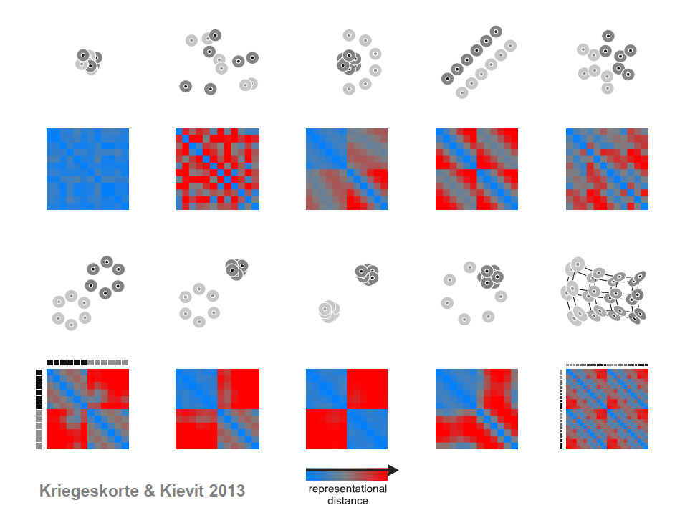
Kreigeskorte & Kievit (2013)

Slide 8
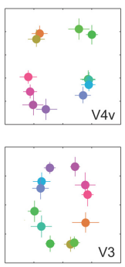
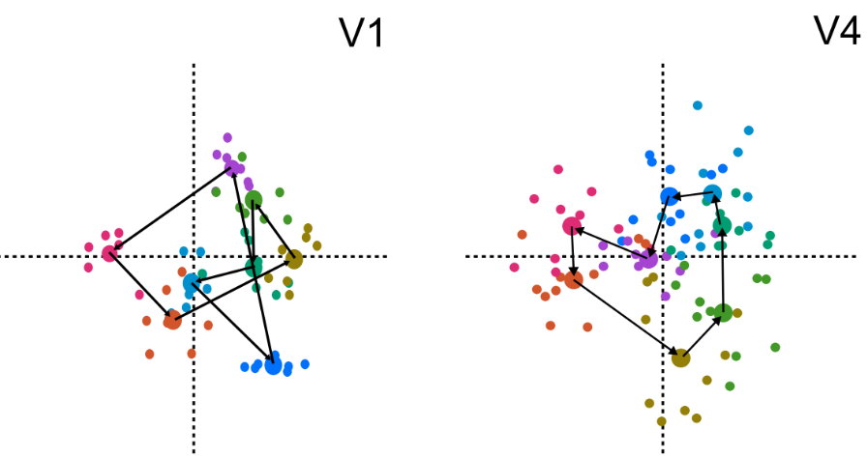
A real example
Classification of colour strongest in V1
But representation in V4 more closely matches perceptual colour space
Stimulus responses also cluster by category in V4
(in colour-naming task)
Brouwer & Heeger 2009, 2013

Slide 9


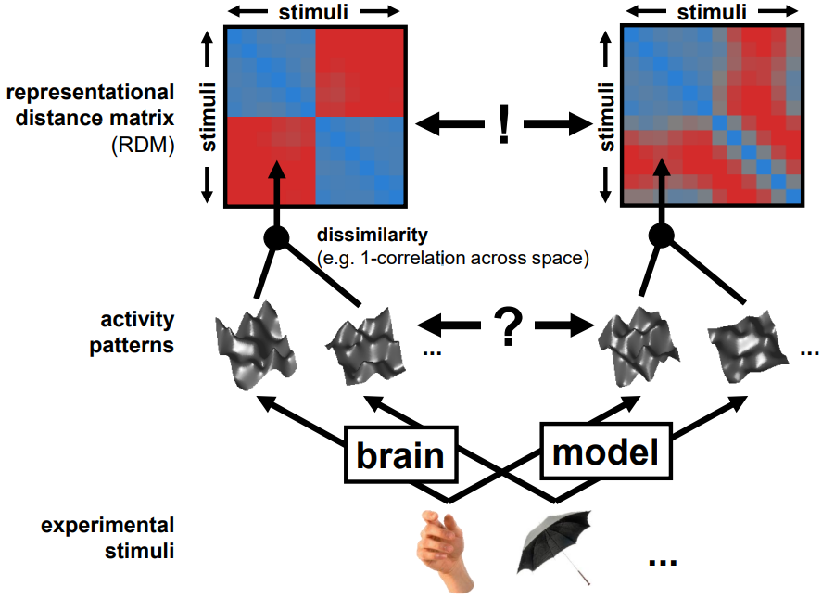
How does it work – the “Representational Similarity Trick”
RSA
dissimilarity
Voxel
Receptive field
Modelling
Image from
Niko Kriegeskorte
RSA workshop 2015

Slide 10
Kriegeskorte et al. 2008

Slide 11
Representational similarity analysis using The RSA Toolbox

Slide 12
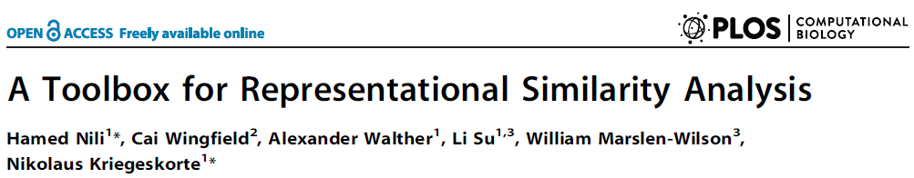
What is The Decoding Toolbox?
Original Matlab implementation can be downloaded here: http://www.mrc-cbu.cam.ac.uk/methods-and-resources/toolboxes/
  Or (as used for these demos) here:
  https://git.fmrib.ox.ac.uk/hnili/rsa
Current development in Python: https://github.com/rsagroup/rsatoolbox
No GUI, but good documentation and multiple demos to familiarise you with the analyses
You can use the demo scripts as a starting point for your own analyses.
Nili et al. (2013)

Slide 13
Why use The RSA Toolbox?
Unless you want to implement the analysis yourself, there aren’t many alternatives!
The Decoding Toolbox had some RSA capabilities,
but less well documented, and I can’t get them to work
Anyone know of serious alternatives?

Slide 14
Some key components:
How does The RSA Toolbox work?
userOptions
  Structure containing main settings
userOptions = defineUserOptions()
  Function to initialise default settings
compareRefRDM2candRDMs(dataRDMs,modelRDMs,userOptions)
  Important function that does the statistics
  Lots of explanation at the top

Slide 15
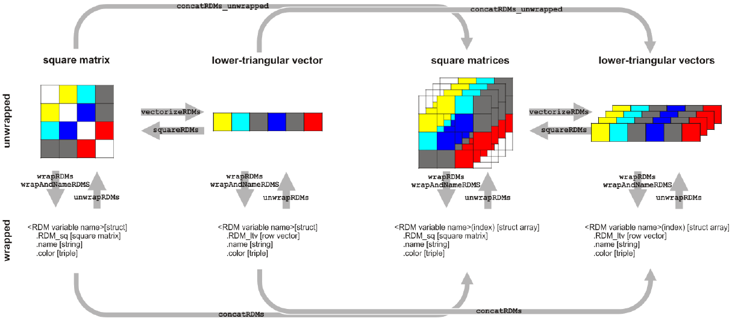
Converting between RDM data formats
Square vs vectorized
Single vs stacked
Bare vs ‘wrapped’
Nili et al. (2013)
Notes:
(stats function wants a cell array, because it can contain multiple stacked RDMs)

Slide 16
DEMO1_RSA_ROI_simulatedAndRealData_djm
Display example “model” and “data/reference” RDMs, from Kriegeskorte et al. 2008 (see next slide)
Visual interpretability of RDM depends on ordering of conditions along rows/columns
Toolbox arranges multiple data RDMs by ROI, then Subject, then Session
(Note two apparent bugs commented in code)

Slide 17
96 object images
Stimuli from Kiani et al. 2007, Kriegeskorte et al. 2008c

Slide 18
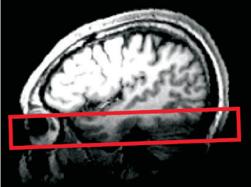
96-object-image fMRI experiment
25 axial slices covering ventral occipital and inferior temporal cortex (no gap)
voxel size: 1.95*1.95*2 mm³
TR: 2 s

Slide 19
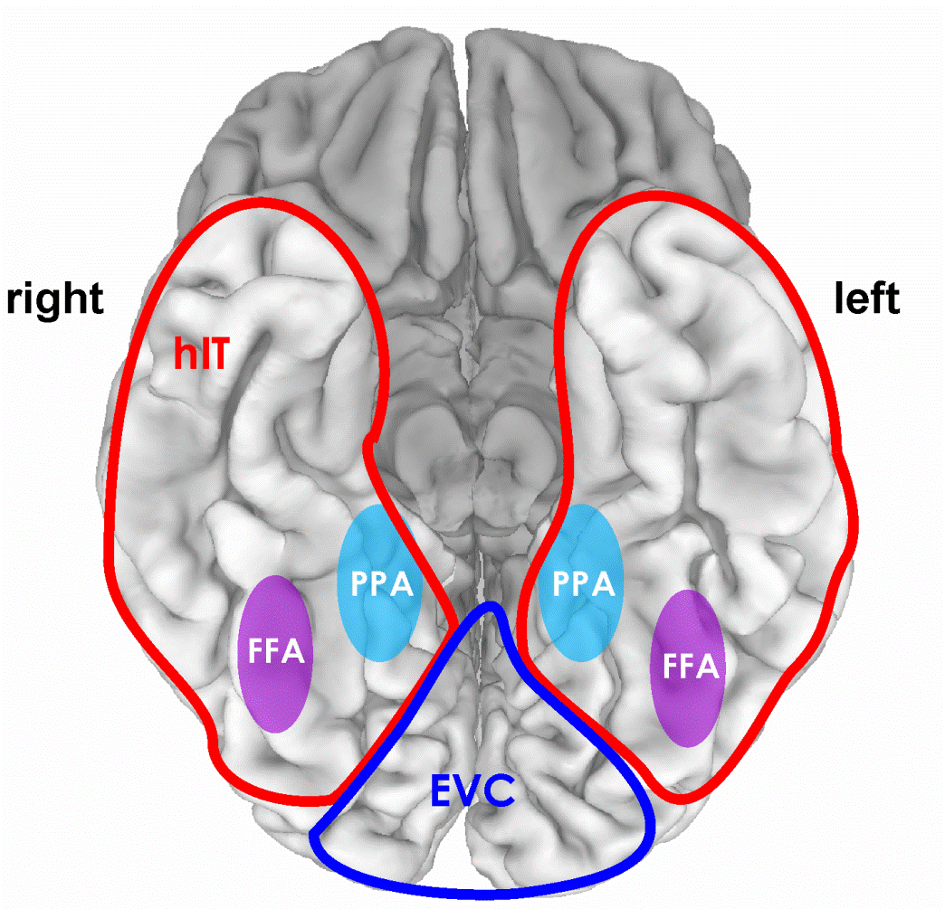
Region of interest: hIT
independent data
bilateral
most visually- responsive voxels within “red” region
results same if FFA and PPA excluded from hIT

Slide 20
Example RDM of IT activity patterns, to be used in demo
96 object images
4 healthy humans
rapid event-related design (4 s SOA)
300 ms stimulus duration
object images spanned a visual angle of 2.9°
fixation-cross
color-judgement task
12 runs/subject, each object image presented once per run
Kriegeskorte et al. 2008

Slide 21
Example RDM of IT activity patterns, to be used in demo
human faces
animate-inanimate
dissimilarity
[percentile]
4 subjects’ average
Kriegeskorte et al. 2008
Notes:
Interpretability depends on the ordering of the stimuli
Consider whether or not to rank the dissimilarities

Slide 22
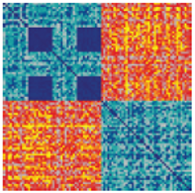
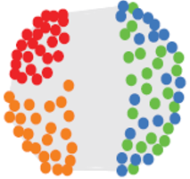
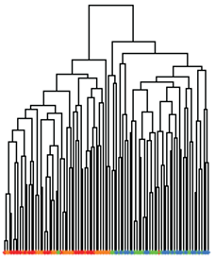
Ways to visualize representational structure
Representational dissimilarity matrix (RDM)
  Contains all multidimensional dissimilarity information
  Interpretability depends on order of stimuli/rows
  (And colour scale, see later)
  Input to statistical inference
Multidimensional scaling (MDS)
  Finds low-dimensional representaion to best preserve
  the high-dimensional (metric or ranked) dissimilarities
  Intuitive
  Discards information/distorts data; can assess with “Shepard plot” or “rubber bands”
  Generally not used for inference,
  but bootstrapped confidence ellipses could be added
  Orientation is arbitrary; Procrustes transform can be used for alignment
Dendrogram
  Defines multiscale clusters
  Assumes hierarchical structure

Slide 23
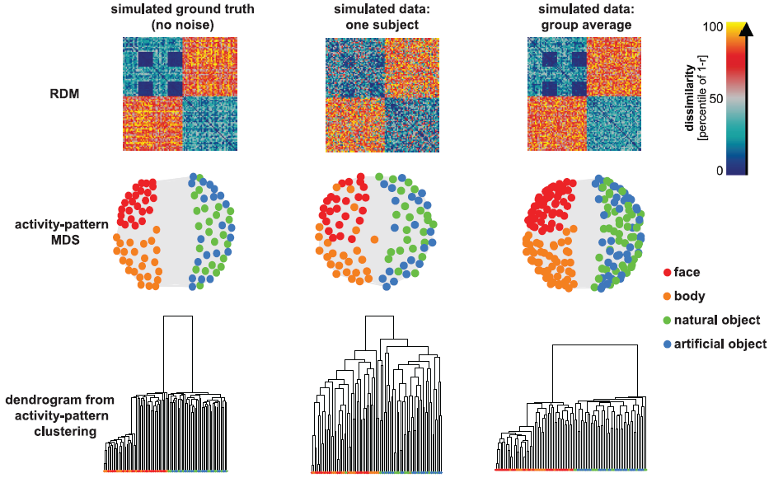
Demo 1: Fig 2 from paper: RDMs, MDS & dendrograms
Nili et al. (2013)

Slide 24
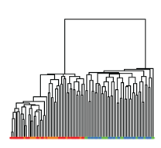
Multidimensional scaling (MDS) of IT dissimilarities
Dendrogram
Dissimilarity
animate
inanimate
body
natural object
face
artificial object
Kriegeskorte et al. 2008
Notes:
MDS - involves distortion and discards information
Dendrogram – a way to define clusters at multiple hierarchical levels

Slide 25
Comparing geometries
– an example “model RDM”
from Marieke Mur 2013
How well do brain representations and subjective experience match?
Notes:
The power of RSA is in comparing geometries…

Slide 26
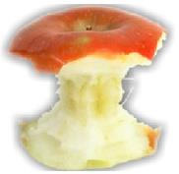

Conventional method:
Pairwise similarity ratings
How similar are these objects?
very similar
very dissimilar
0
5

Slide 27
Many pairwise dissimilarities
96
0
96 x 95 / 2 = 4560 pairs
0
0
0
0
96
0
0
4560 * 4 s = 5 hours per subject
0
0
0
0
0
similarity-judgment RDM

Slide 28
2D arrangement by dissimilarity
RDM
multidimensional
scaling
inverse
multidimensional
scaling
Goldstone, 1994; Risvik et al., 1994

Slide 29
Multi-object arrangement (MA) method
Kriegeskorte & Mur 2012
Subjects arrange objects in 2D by mouse drag-and-drop.
More efficient than pairwise similarity ratings.
Subjects arrange objects in the context of the other objects in the set.
16 healthy human subjects
each subject performed one 1-hour session (outside the scanner)

Slide 30
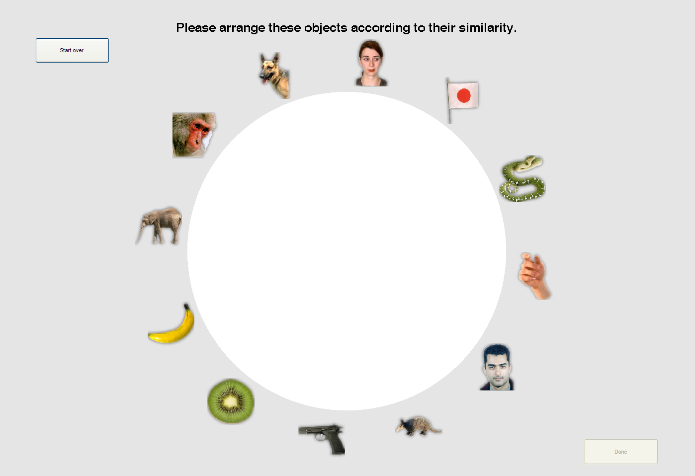
Please arrange these objects according to their similarity

Slide 31
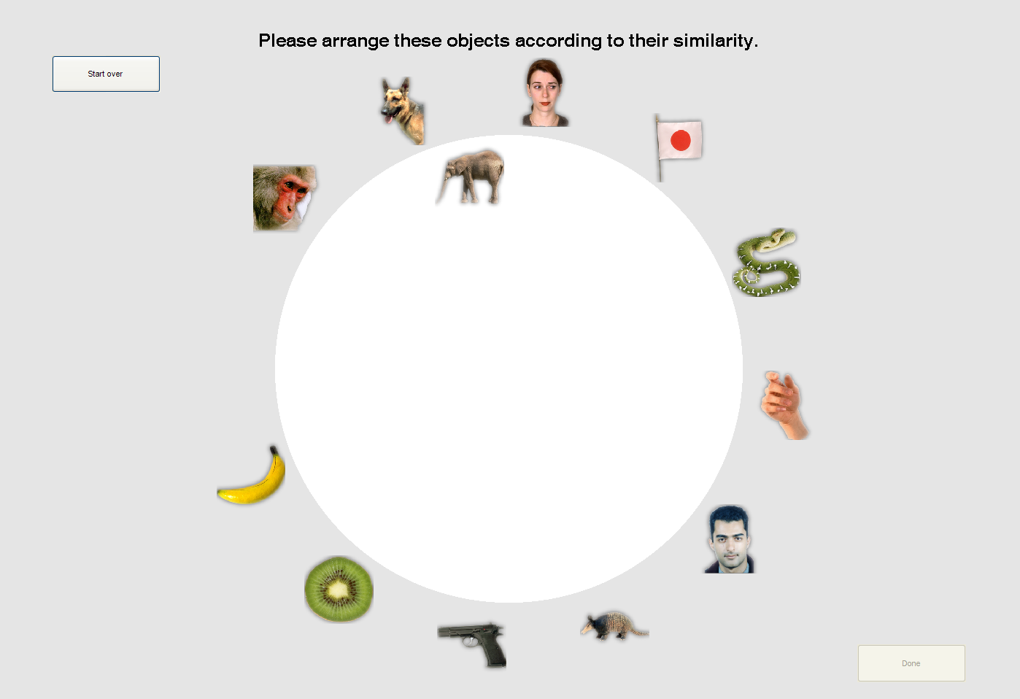
Please arrange these objects according to their similarity

Slide 32
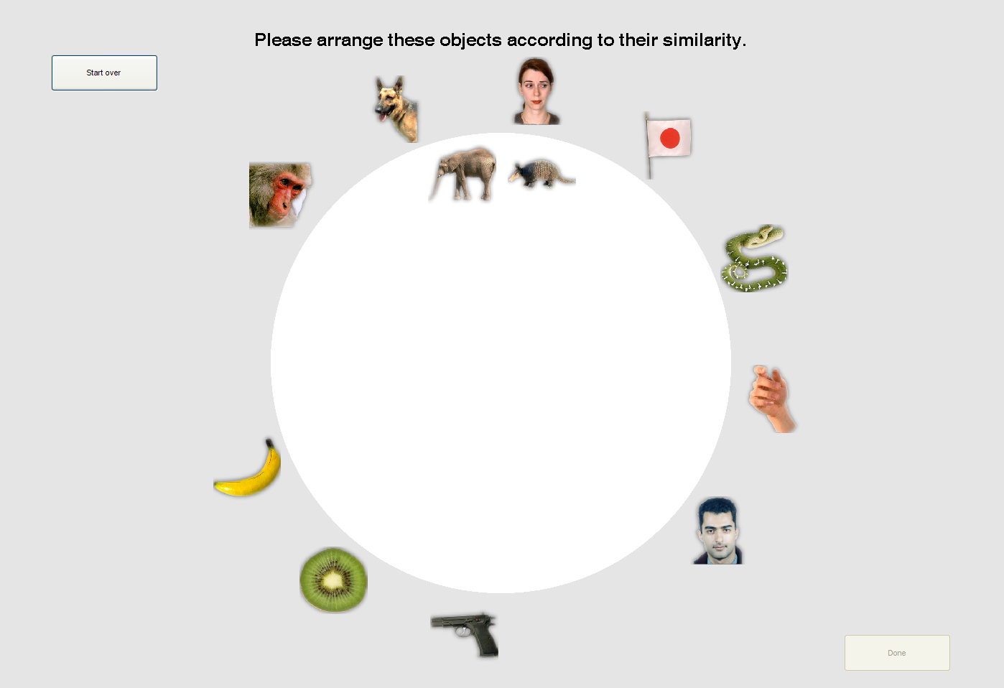
Please arrange these objects according to their similarity

Slide 33
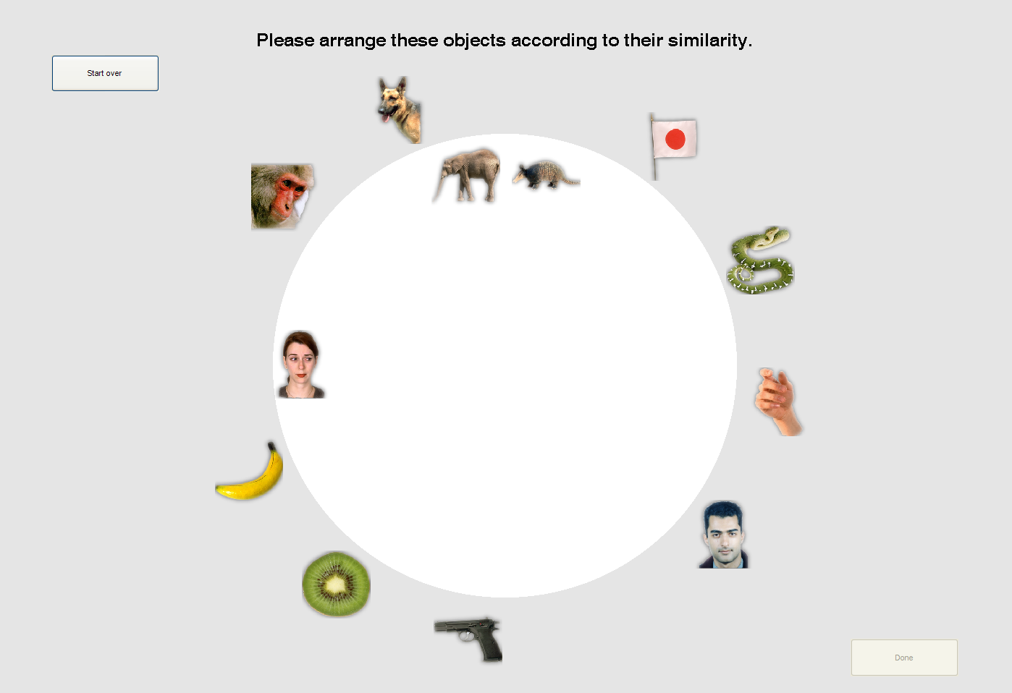
Please arrange these objects according to their similarity

Slide 34
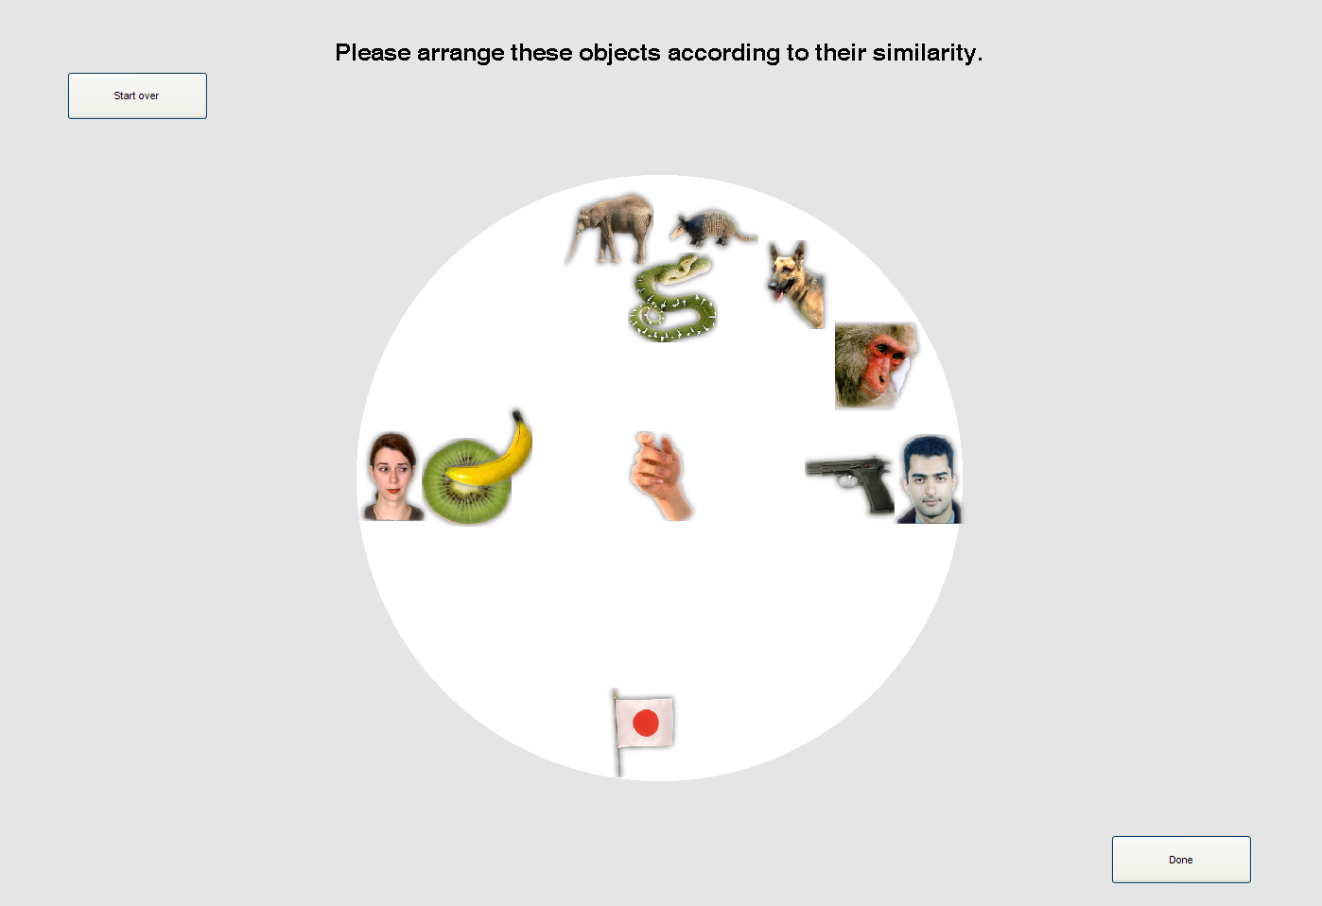
Please arrange these objects according to their similarity

Slide 35
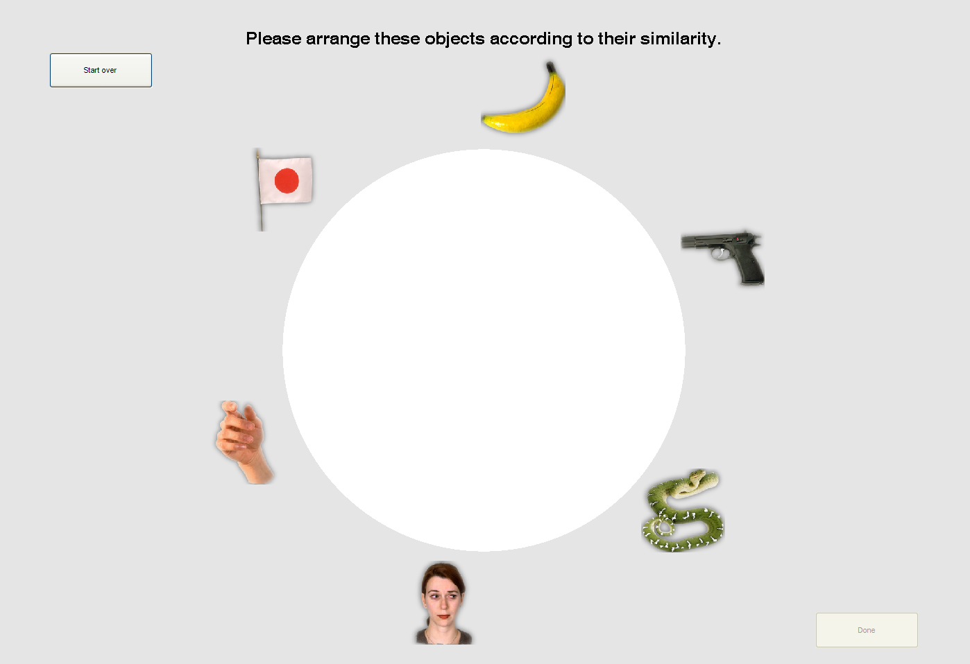
Please arrange these objects according to their similarity

Slide 36
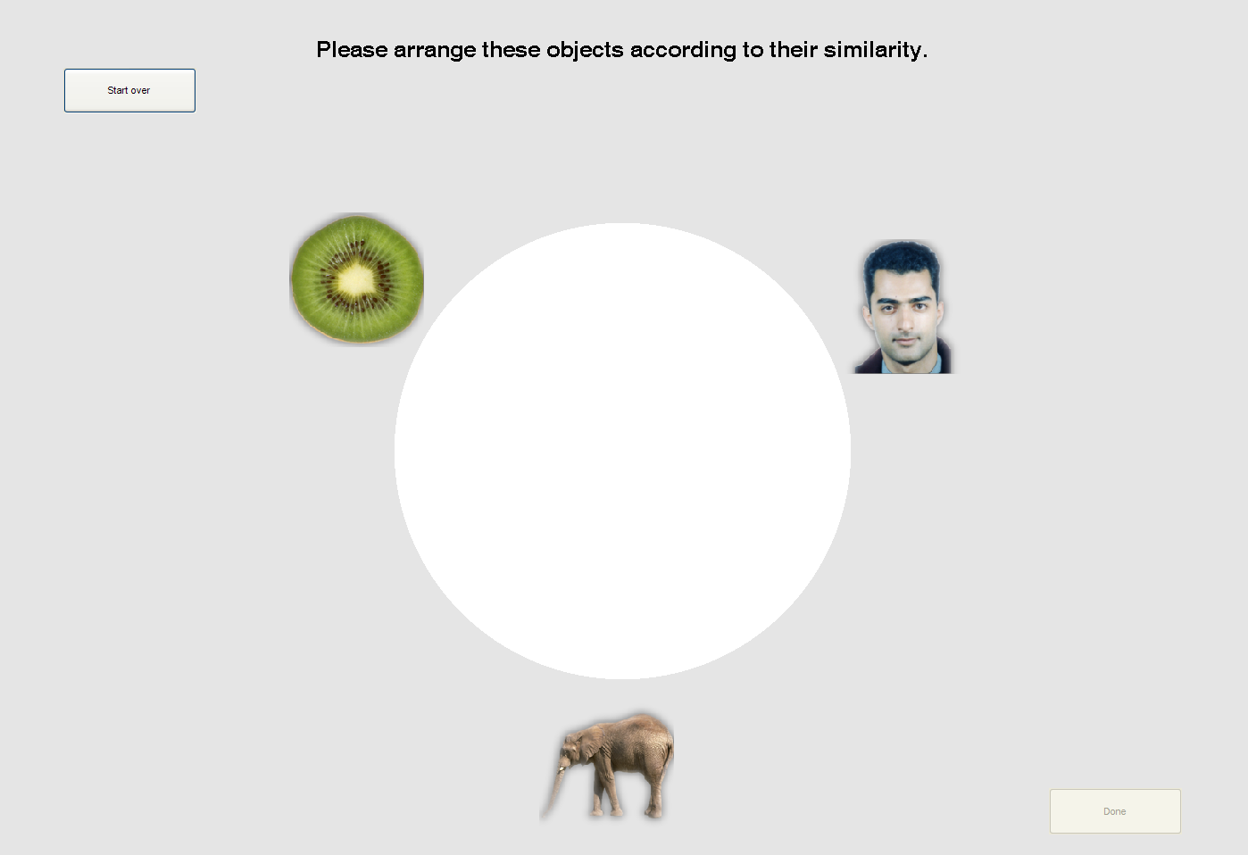
Please arrange these objects according to their similarity

Slide 37
human IT
similarity judgments

Slide 38
2D arrangements by dissimilarity
human IT
similarity judgments
Notes:
Similarity judgements have more and stronger categories
Perhaps because IT is just one brain regions, whereas behaviour is downstream integration of distinctions from many brain regions?

Slide 39
human IT
similarity judgments
animate
inanimate
animate
inanimate
human
nonhuman
face
body
natural
artificial
face
body

Slide 40
Comparing RDMs
96
96
0
0
0
0
0
0
0
0
0
0
96
0
96
0
0
0
0
correlate
dissimilarities
0
0
0
0
0
0
0
0
0
Brain
(“reference RDM”)
Judgments
(“model RDM”)
Non-linear relationship might be expected,
so rank correlation (Spearman/Kendall tau-a) often preferred
Therefore RDMs often rank transformed for display
RDM entries are not independent, so statistical inference must be done across e.g. subjects, or using condition permutation/bootstrap
Could also use multiple regression to predict data RDM from model components
Can compare model geometries with 2nd-order RDM

Slide 41
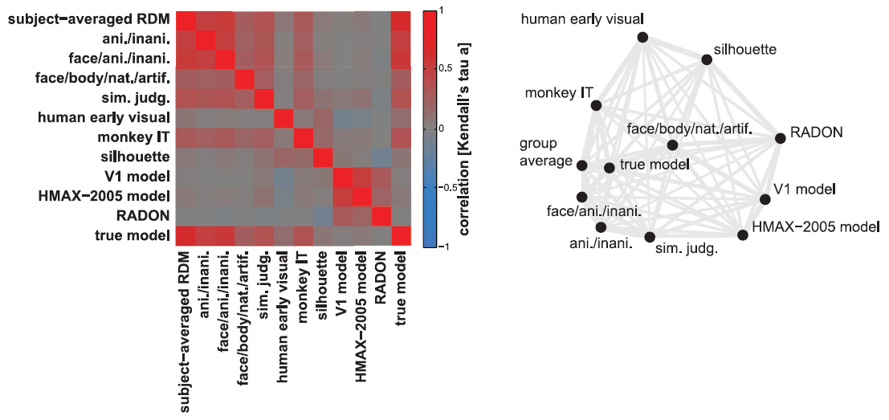
Demo 1: Fig 3 from paper: “RDM RDM” & MDS
Nili et al. (2013)

Slide 42
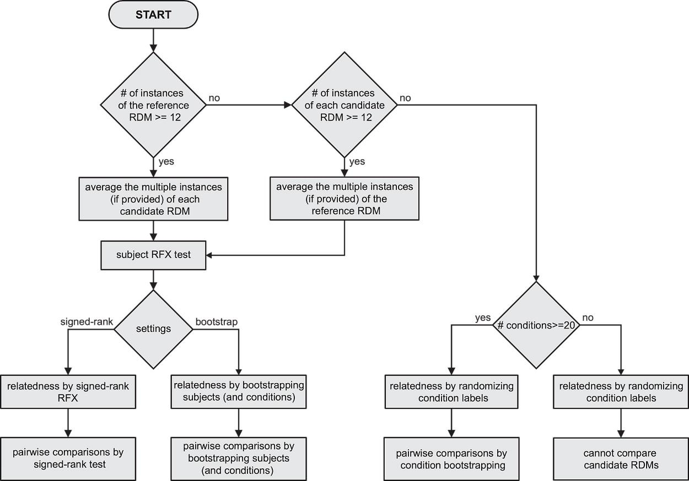
Overview of suggested statistical tests
Nili et al. (2013)

Slide 43
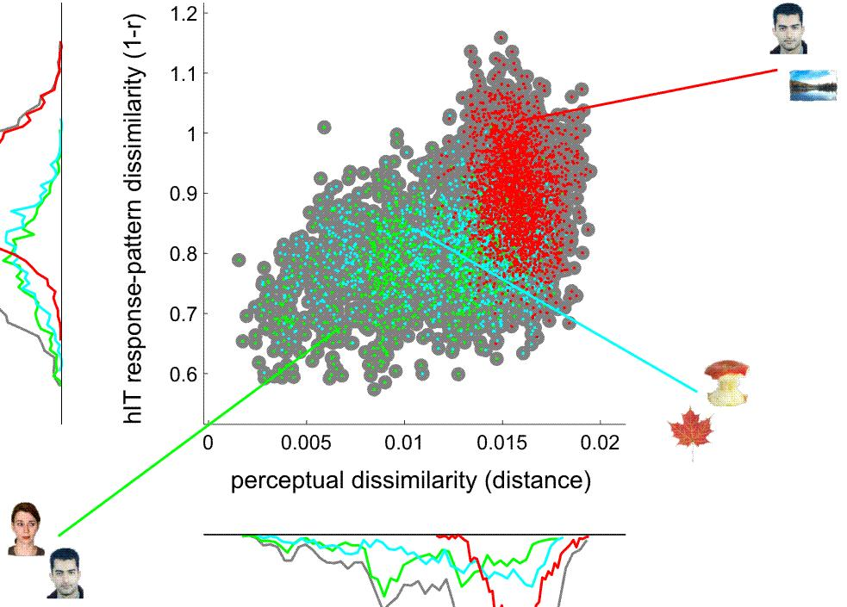
Are hIT and perceptual dissimilarities correlated?

Slide 44
Are hIT and perceptual dissimilarities correlated?

Slide 45
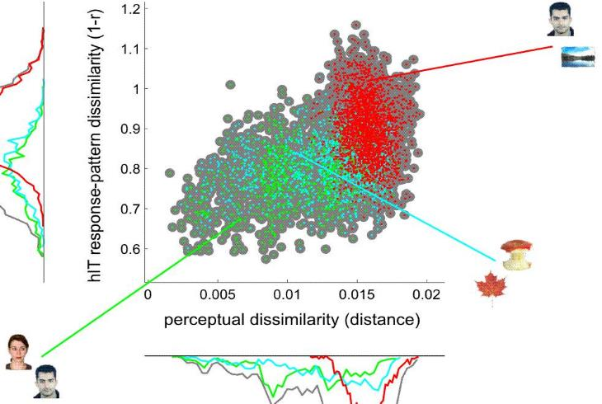
Are hIT and perceptual dissimilarities correlated?
within all images: r=0.39, p<0.0001***
within animates: r=0.34, p<0.0001***
within inanimates: r=0.19, p<0.0001***
animates vs inanimates: r=-0.16, ns
Relationship is nonlinear, and in general we might expect this,
so rank correlation (Spearman/Kendall) usually preferred
Dissimilarities within RDM are not independent:
  Test significance across subjects…
  …or within subjects using row/column permutation

Slide 46
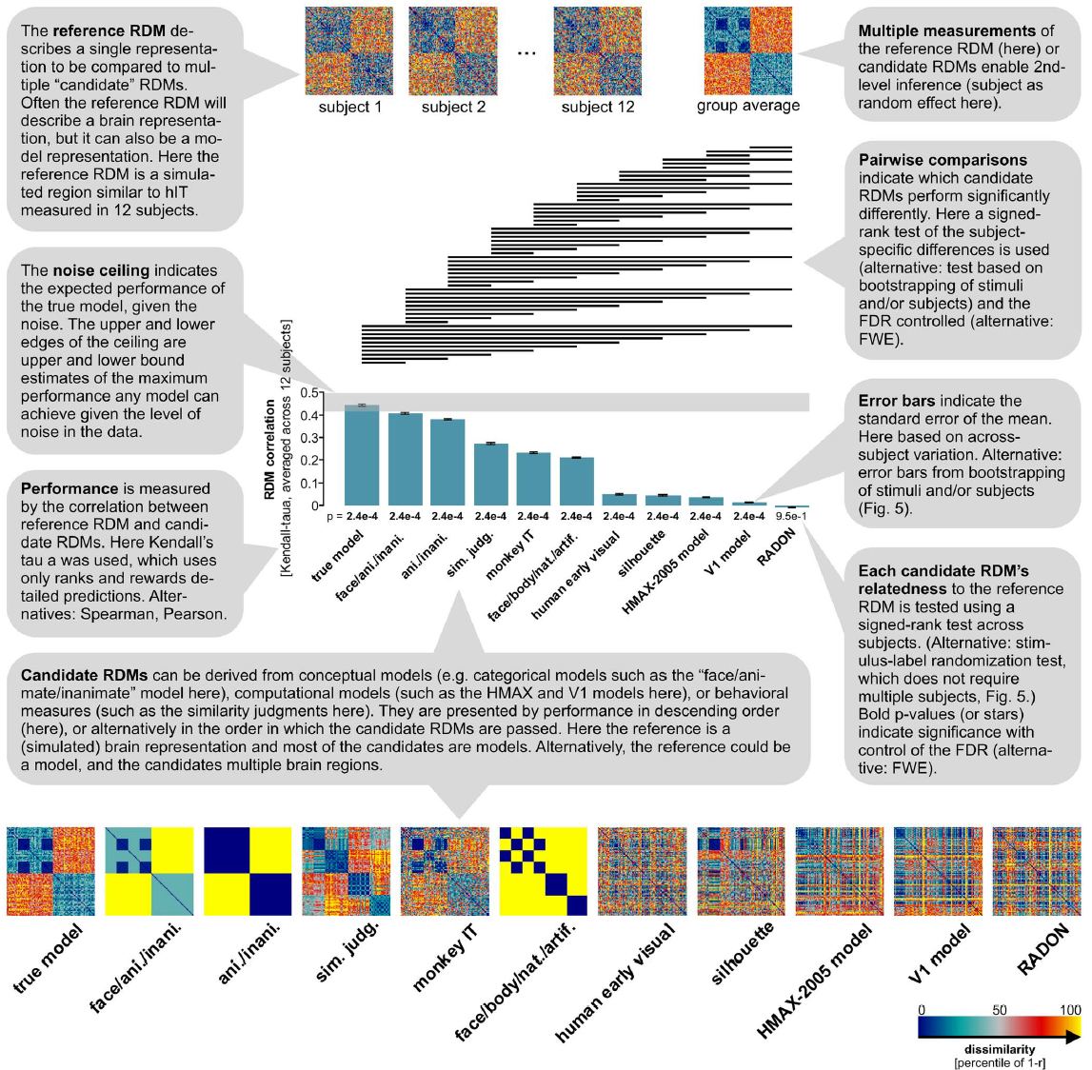
Demo 1: Fig 4 from paper: statistics – simulated data
Note:
the 3rd model RDM is conceptually similar to a binary classification analysis
Nili et al. (2013)

Slide 47
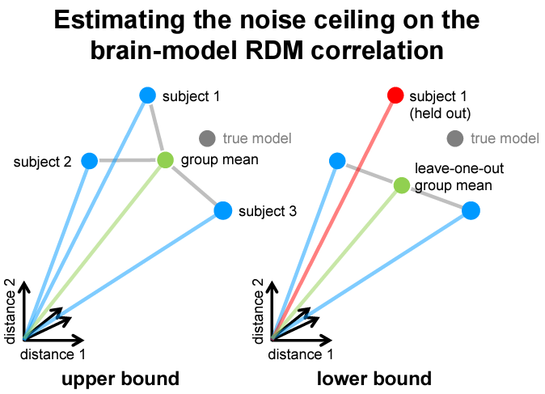
Group mean RDM is best possible model (given the data) for comparing each subject to
Positively biased because comparison subject included in mean
Leave-one-out mean removes this dependence, but is negatively biased because does not use all data
Do we need a better model, or better data?
Nili et al. (2014)

Slide 48
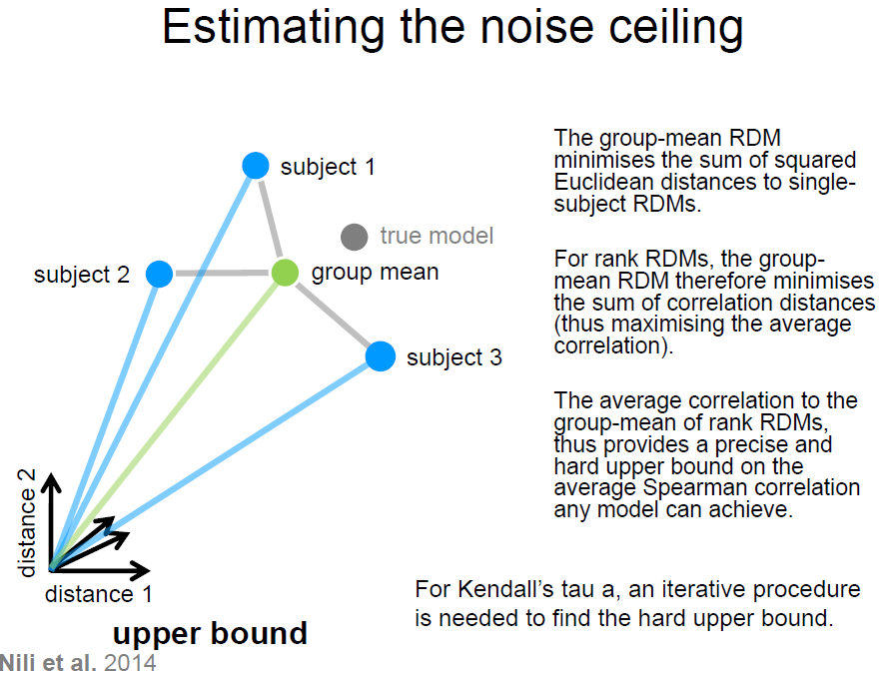
Niko Kriegeskorte
RSA workshop 2015

Slide 49
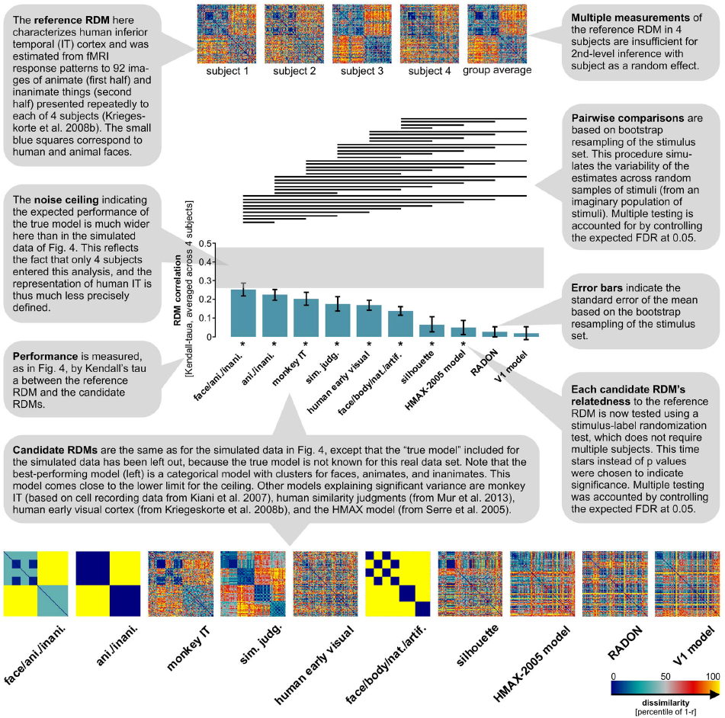
Demo 1: Fig 5 from paper: statistics – real data
Nili et al. (2013)

Slide 50
DEMO2_RSA_ROI_sim_djm
Example "ROI-based" RSA pipeline on simulated data
We’ll look at the userOptions structure in more detail
Data RDMs are calculated by constructRDMs()
  Need to choose a dissimilarity measure…

Slide 51
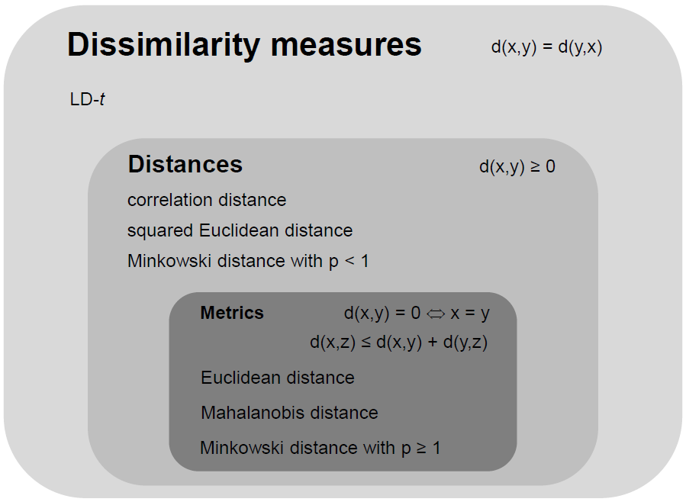
How to measure representational dissimilarity
and other cross-validated “distance estimates”
Image from
Niko Kriegeskorte
RSA workshop 2015

Slide 52
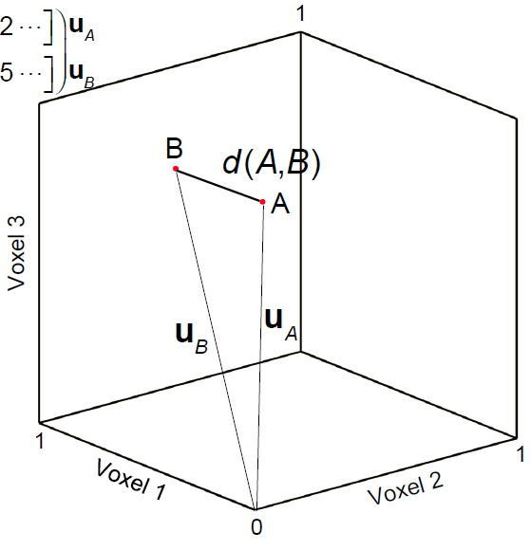
Euclidean distance
Straight-line distance between two patterns in Euclidean space
Image from Alex Walther
RSA workshop 2015

Slide 53
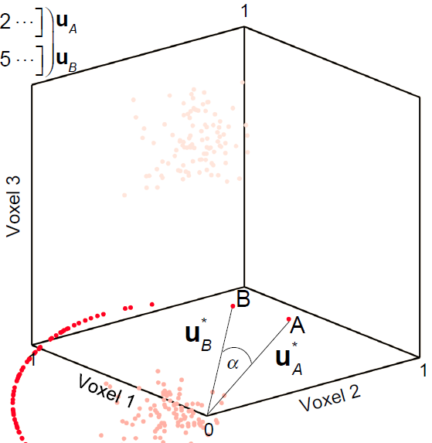

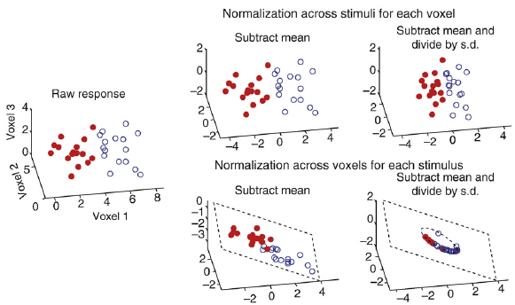
Correlation distance
1 – correlation coefficient
Correlation = cosine of the angle between normalised patterns
Image from Alex Walther
RSA workshop 2015
Misaki et al. 2010

Slide 54
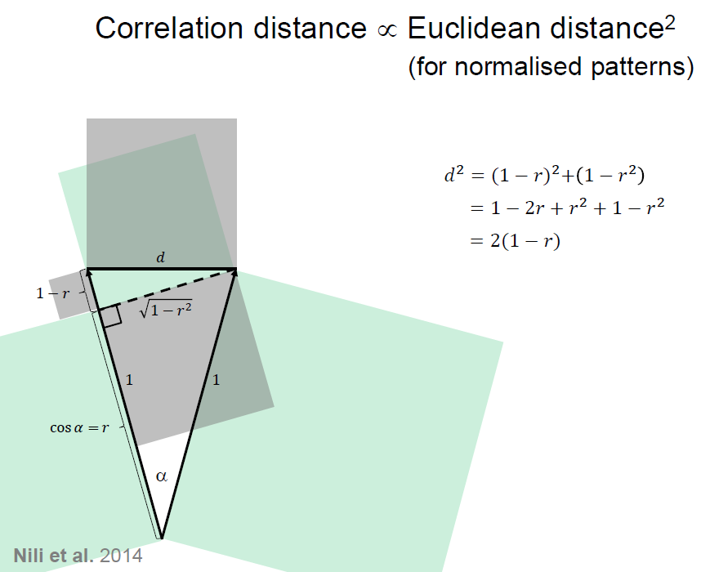
Image from
Niko Kriegeskorte
RSA workshop 2015

Slide 55
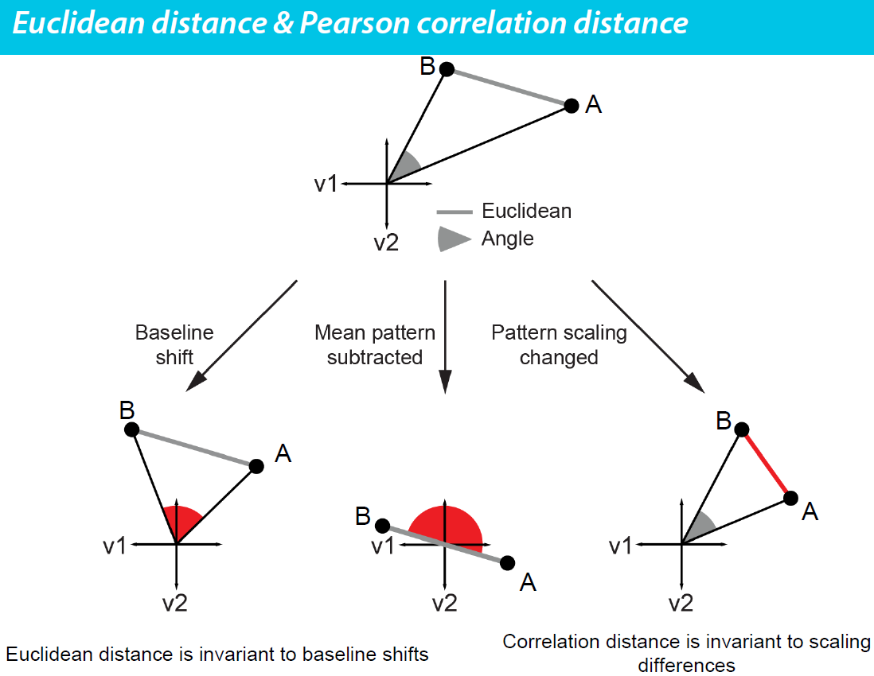
Image from Alex Walther, RSA workshop 2015

Slide 56
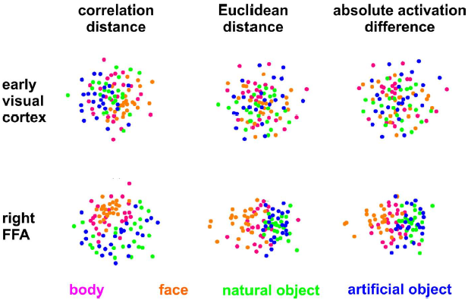
One example of effect in practice:
Kriegeskorte et al. 2008

Slide 57
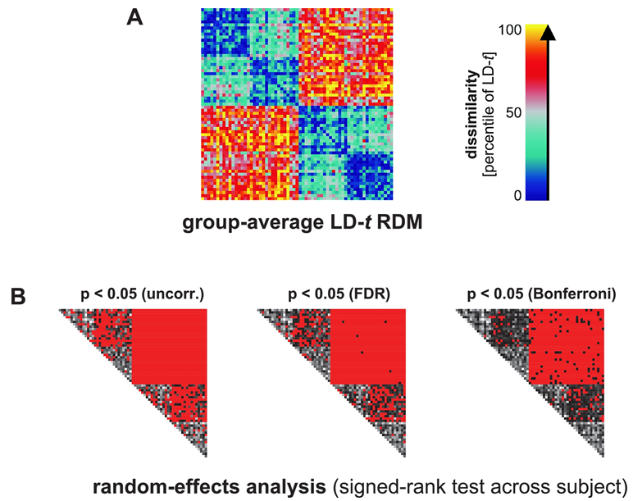
Demo 3: Fig S5 from paper: “LD-t” as a dissimilarity measure
Nili et al. (2013)

Slide 58
Linear Discriminant t value (LDt)
The recommended dissimilarity measure used in the RSA toolbox.
Along with Linear Discriminant Contrast (LDC), aka Crossnobis estimator
Two desired properties:
Multivariately noise normalised
  Like Mahalanobis distance
  Potentially increases sensitivity
Cross-validated
  Generalises
  Not positively biased, with interpretable zero point
  Requires data splitting (may not always be possible, and potentially reduces sensitivity)
(Note the default dissimilarity measure in the RSA toolbox is correlation distance)

Slide 59
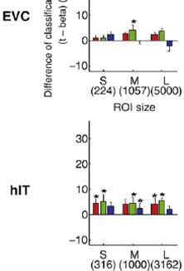
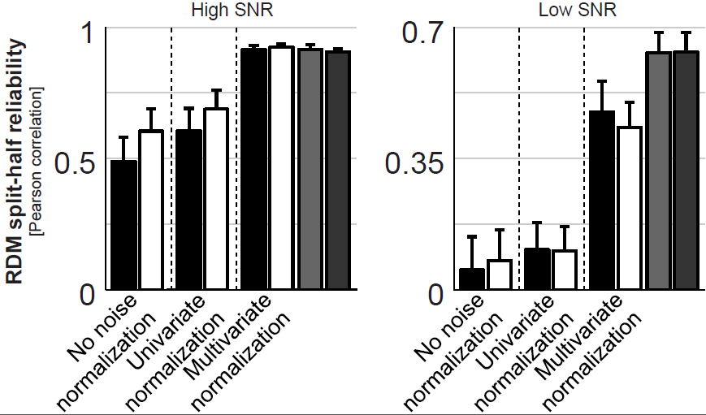
Noise normalisation
Noise normalisation of fMRI response patterns increases reliability of estimated pattern distances.
Univariate:
  Divide each voxel’s beta weight by its standard error → t value
Multivariate:
  Multiply patterns by inverse of (square-rooted) covariance matrix → Mahalanobis distance
Misaki et al. 2010
Image from Alex Walther, RSA workshop 2015

Slide 60
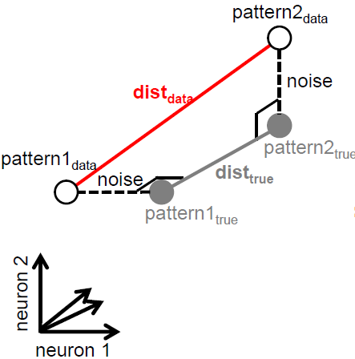
Cross-validated dissimilarity measures
Distances are positive
In high dimensional space, noise is likely orthogonal to pattern separation
Noise means distance measures are positively biased.
Image from
Niko Kriegeskorte
RSA workshop 2015

Slide 61
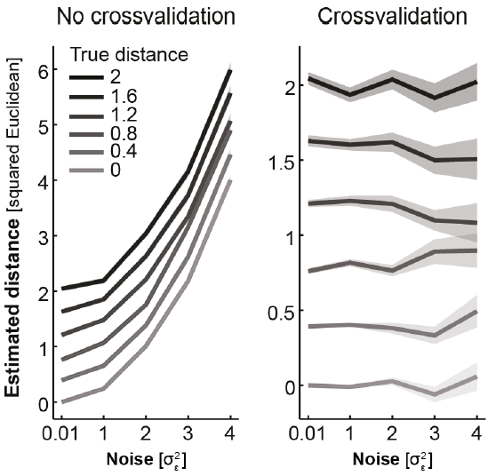
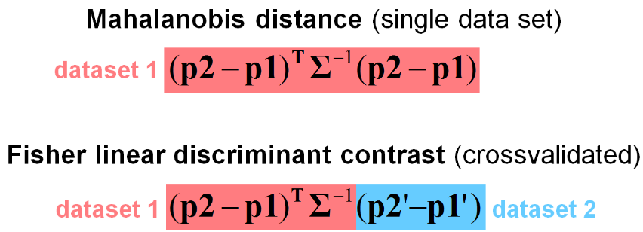
Cross-validated dissimilarity measures
Cross-validated dissimilarity measures
are estimates of distances. So can be negative.
They are unbiased, have an interpretable zero point, and preserve ratio scale.
Noise covariance
(Euclidean distance if identity matrix)
from Alex Walther, RSA workshop 2015
LDC = dot product of difference vectors
~ cosine of angle between them
= zero if orthogonal
Can divide by #voxels to compare ROIs of different sizes
LDt = LDC divided by its standard error
Nili et al. (2013)
Notes:
Dot product = inner product = scalar product
See fig 9c from Nili 2020

Slide 62
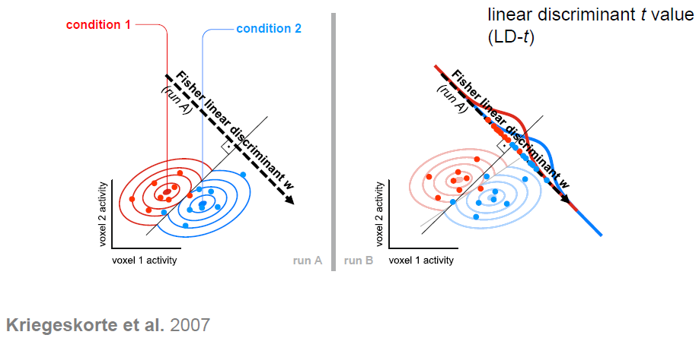
Compare with LDA classifier
Image from
Niko Kriegeskorte
RSA workshop 2015

Slide 63
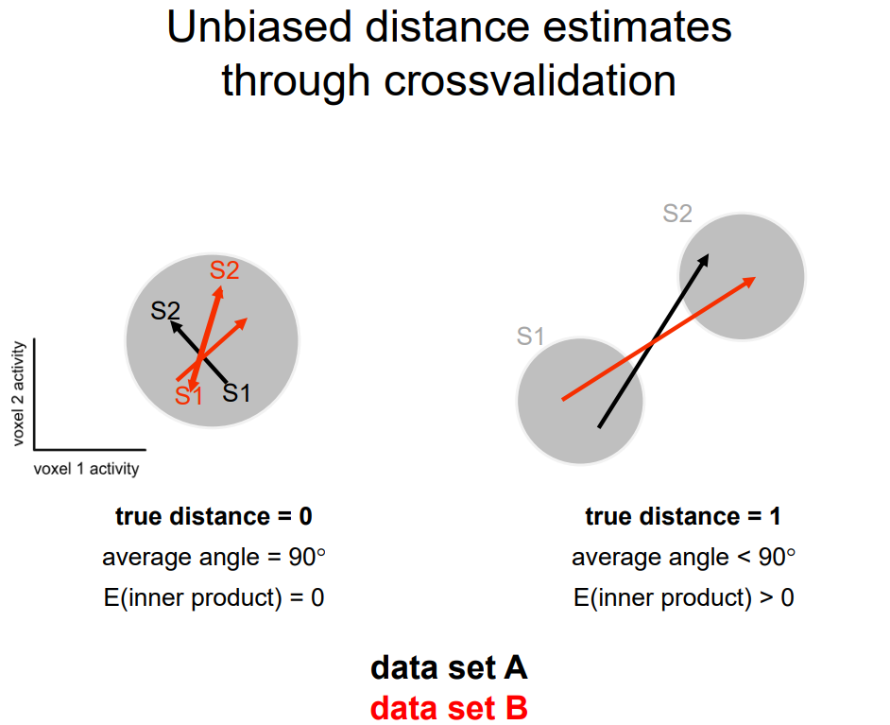
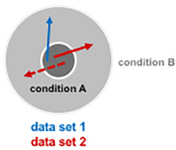
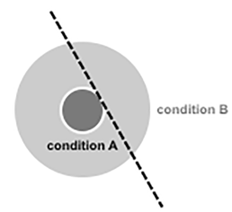
Nili et al. 2020
What if there is no separation of conditions, but one is noisier?
Image from
Niko Kriegeskorte
RSA workshop 2015
What would be the accuracy of a linear classifier?

Slide 64
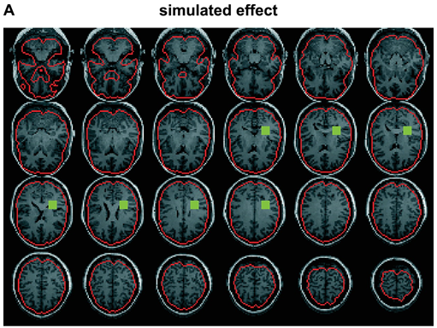
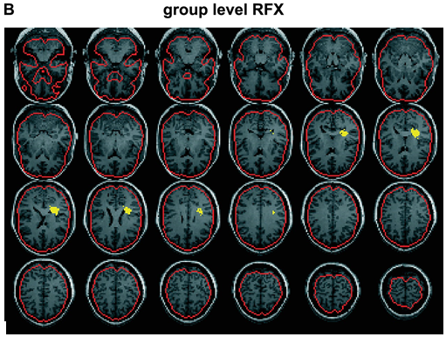
Demo 4: Fig S3 from paper: searchlight mapping
(simulated data)
Nili et al. (2013)

Slide 65
Demo 5: Using real data
– demo data from The Decoding Toolbox
Searchlight example
Visualisation examples for ROIs
Model comparison examples for ROIs

Slide 66
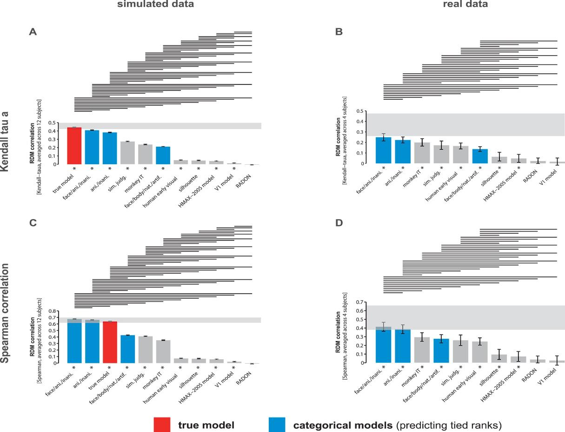
Spearman vs. Kendall tau-a for comparing RDMs
Kendall tau-a was previously recommended for models with ties.
Now a modified Spearman’s rho with random-tie-breaking is recommended
Nili et al. (2014)

Slide 67
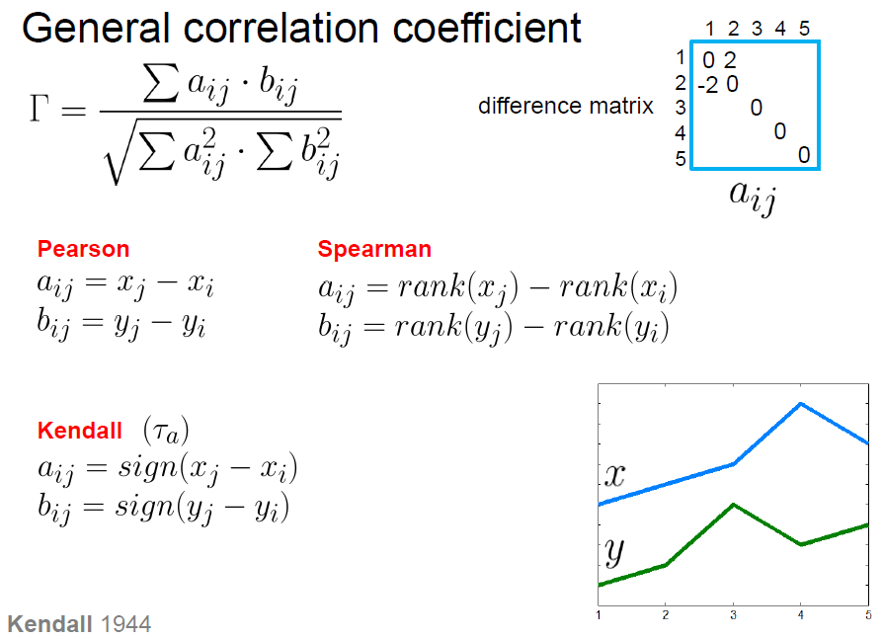
Image from Niko Kriegeskorte, RSA workshop 2015

Slide 68

Image from Niko Kriegeskorte, RSA workshop 2015

Slide 69

Image from Niko Kriegeskorte, RSA workshop 2015

Slide 70
A few example applications…

Slide 71



Slide 72





Slide 73


Brouwer & Heeger 2009, 2013

Slide 74




Slide 75
Integrating fMRI and MEG
- see Olaf’s presentation…

Slide 76
References (a very incomplete list)
RSA methods and review
Kriegeskorte N et al. (2008) Front Syst Neurosci 2(4): 1-28. [original methods paper]
Kriegeskorte N, Kievit R (2013) Trends Cogn Sci 17(8): 401-412. [recent review]
Related methods
Allefield & Haynes (2014) NeuroImage 89: 345-357 [cross-validated MANOVA]
Diedrichsen et al. (2011) NeuroImage 55: 1665–1678 [pattern component modelling]
Diedrichsen et al. (2018) NeuroImage 180: 119-33 [pattern component modelling]
Reviews of representational approaches
Davis & Poldrack (2013) Ann. NY Acad. Sci. 1296:108-134
Haxby et al. (2014) Annu. Rev. Neurosci. 37:435-56
Kriegeskorte & Diedrichsen (2019) Annu. Rev. Neurosci. 42:407-32
RSA toolbox
Nili et al. 2014 PLoS Comput Biol

Slide 77
References (a very incomplete list)
Some example RSA applications in neuroscience
Edelman et al. (1998) Psychobiology 26(4) 309-321 [first application of MDS to fMRI]
Kriegeskorte N et al. (2008) Neuron 60: 1126-1141. [object vision: human - monkey]
Brouwer & Heeger (2009) J.Neurosci. 29(44):13992–14003 [colour coding]
Mur M et al. (2013) Front Psychol 4(128): 1-22. [object vision: brain - behaviour]
Xue G et al. (2010) Science 330: 97-101. [memory: forgotten vs remembered items]
Ward EJ et al. (2013) J Neurosci 33(37): 14749-14757. [memory: implicit vs explicit]
Ritchey M et al. (2013) Cereb Cortex doi:10.1093/cercor/bhs258. [memory retrieval]
Charest et al. (2014) PNAS 111(4): 14565-14570 [individual differences]
Cichy et al. (2014) Nature Neuroscience: 17, 455-62 [Fusing fMRI & MEG]
Mitchell & Cusack (2016) Scientific Reports 6:20232; DOI: 10.1038/srep20232 [mental imagery, and neuro-feedback]
Haxby et al. (2020) eLife: 9:e56601 [hyperalignment]
So many more…!

Slide 78





Extra demo data if time? (tutorial_djm2.m)
Mitchell & Cusack (2016) Scientific Reports 6:20232
200 objects, presented one each per condition
2 conditions (occasional cues to imagine knives or dolphin)
Tutorial data combined over subjects

Slide 79
Thank you

