Slide 1

An introduction to
Multi-Variate Pattern Analysis (MVPA) using
CoSMoMVPA and
The RSA Toolbox
COGNESTIC, 2023
Daniel Mitchell
Daniel.Mitchell@mrc-cbu.cam.ac.uk

Slide 2
Plan for the day
9:05 – 10:00 | Introduction to MVPA Introduction to the CoSMoMVPA Toolbox (and alternatives) First example – fast classification searchlight
Break
10:15 – 11:00 | CoSMoMVPA’s dataset structure Which features to use (ROIs, searchlights)? Which method/classifier?
Break
11:15 – 12:00 | Partitions and cross-validation Output measures and statistics
LUNCH
1:30 – 2:15 | Introduction to RSA Introduction to the RSA toolbox; dataset demos
Break
2:30 – 3:15 | RSA Toolbox Demos: RDMs, visualisations, statistics
Break
3:30 – 4:30 | Time-resolved MVPA, with Olaf Hauk
From 7 pm: Social event at the Tivoli

Slide 3
Overview
Morning
Introduction to MVPA
  What is MVPA?
  Why do it?
  How does it work?
CoSMoMVPA
  What is it?
  Why you might want to use it
  (plus alternatives)
  How does it work?
Afternoon
Introduction to RSA
  What is RSA?
  Why do it?
  How does it work?
The RSA Toolbox
  What is it?
  Why you might want to use it
  (plus alternatives)
  How does it work?
Extension to time & frequency
domains (Olaf Hauk)

Slide 4
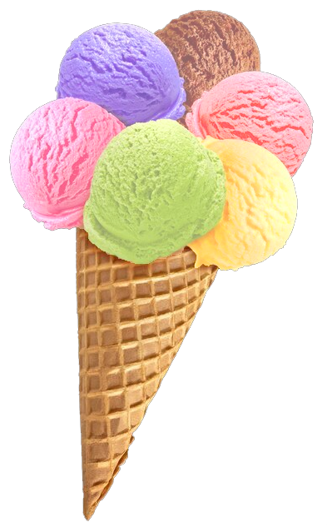
What is MVPA?
“Multi-Variate Pattern Analysis” (MVPA)
relates response patterns
to experimental conditions
Many (overlapping) flavours
Encoding vs decoding
(MVPA can be either or neither)
Activation vs information?
MVB
IEM
cvMANOVA
PCM
RSA
Classification
MVPA
Notes:
For Multivariate Bayes, see e.g. Friston et al., 2008: https://pubmed.ncbi.nlm.nih.gov/17919928/
For Pattern Component Modelling see Diedrichsen et al. 2018: https://www.sciencedirect.com/science/article/pii/S1053811917306985 (this uses priors so is a hierarchical Bayesian model)
For cross-validated MANOVA see Allefeld & Haynes, 2014: https://pubmed.ncbi.nlm.nih.gov/24296330/ (I think this is equivalent to, or a specific case of, PCM)
For Inverted Encoding Models, see e.g. Sprague…Serences 2015: https://www.ncbi.nlm.nih.gov/pmc/articles/PMC4532299/

Slide 5
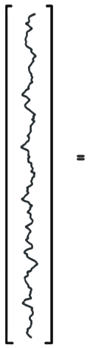
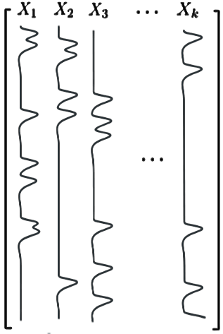
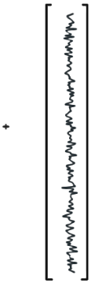






Per voxel (univariate) General Linear Model (GLM)…
…is an encoding model: can we predict the amount of activity in a voxel from the experimental conditions in X?
Activation
coefficients
Error
time
(t)
Data
(measured
BOLD signal)
Design
Matrix
In (multivariate) decoding we try to predict the experimental condition from the pattern of responses

Slide 6
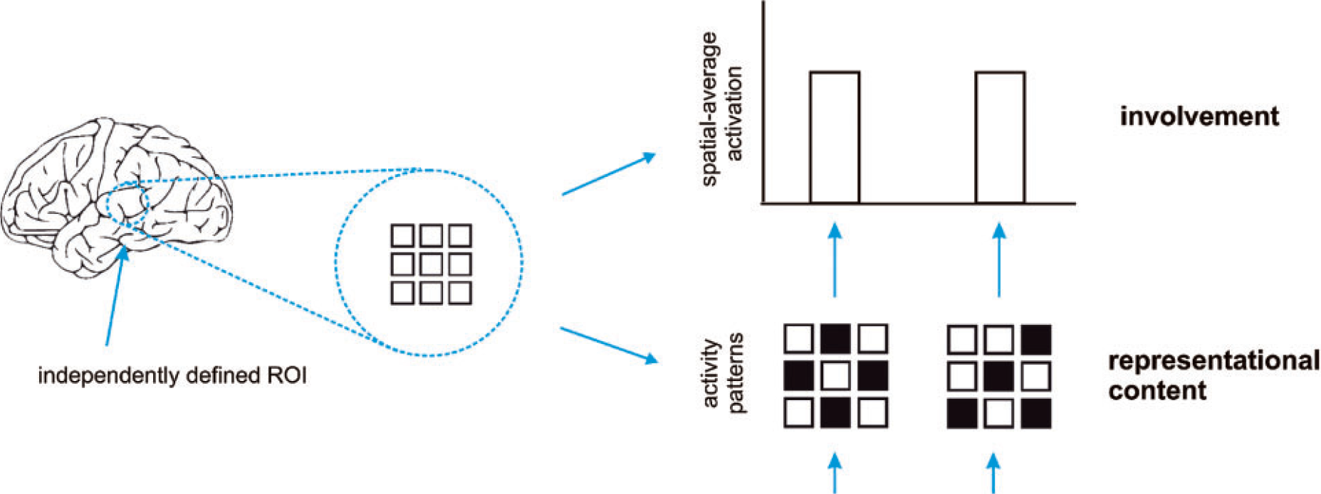
Activation-based (univariate) analysis
Pattern-information analysis
If we can classify experimental conditions based on activity patterns (better than chance)…
Then the activity pattern carries information about the experimental conditions.
Mur et al. (2009)
Notes:
…Real data are noisy, so we need to test whether pattern differences are consistent across repeated presentations…

Slide 7
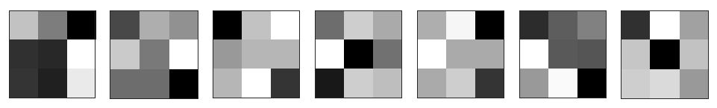
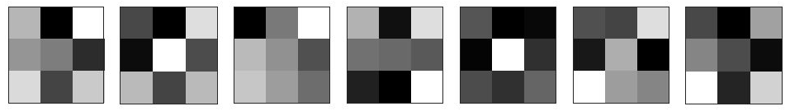
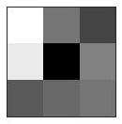
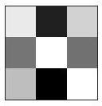
Terminology:
Sample / observation
Label
Class / condition
Patterns
Training set
variable,
feature,
dimension
(e.g. voxel)
Partition /
split /
fold
?
Testing
set

Slide 8
Why do MVPA?
Popularity
Scientific questions
  What information does a brain region represent?
  (e.g. classification: are patterns reliably different?)
  In what format does it represent the information?
  (e.g. RSA: what are distance relations between patterns?)
To make predictions based on brain data
  Disease status? Covert thoughts?
Typically more sensitive than univariate analysis
Notes:
Listed in reverse order of importance: It’s the sensitivity that allows interesting questions to be addressed, and in turn this makes it popular.

Slide 9
How does MVPA work?
classification example
1
2
Weight
vector
Classification boundary
True labels:
?
?
Compare
Voxel 2 activation
?
?
?
Predictions:
Voxel N
Voxel 1 activation
Notes:
Note – we won’t cover multivariate regression, but it’s conceptually similar: instead of predicting a binary label, the model predicts a continuous label. To evaluate performance, the predicted labels across items in the test set can be correlated with their actual labels

Slide 10
Play with SVMs…
LIBSVM:
https://www.csie.ntu.edu.tw/~cjlin/libsvm/

Slide 11
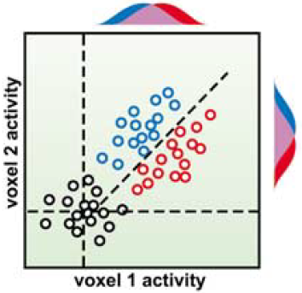
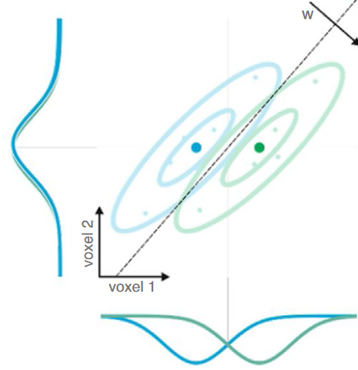
Why can MVPA be more sensitive?
Flexibly combines weak/noisy signal
across features
(including relative activation, non-uniform responses)
Suppresses correlated noise (Hebart & Baker 2018;
interpreting weight vector is tricky: Haufe et al., 2014)
Abstracts from subjects’ idiosyncratic response patterns
(information versus activation)
Cox & Savoy (2003)
Kriegeskorte
& Douglas (2019)
SUBJECT A
SUBJECT B
Voxel 2
Voxel 2
Voxel 1
Voxel 1
Notes:
Note that MVPA is not always more sensitive. Requirement for cross-validation means that 1) model does not use all data at once and 2) there is a risk of overfitting. Univariate analysis on smoothed/averaged data might be more sensitive if its assumptions of homogeneous and consistent activation are correct. (See e.g. Kriegeskorte 2006)

Slide 12
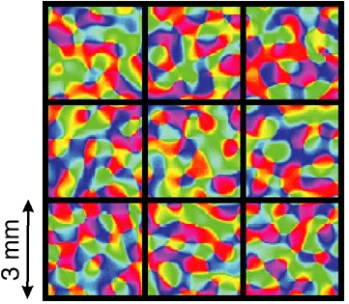
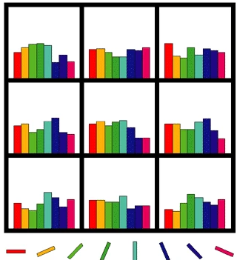
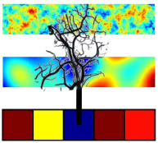
Physiology: fine or coarser scale patterns?
Original view: biased sampling of sub-voxel patterns
Later spatial filtering experiments:
  Removing high spatial frequencies doesn’t always hurt
  (e.g. Op de Beeck, 2010)
  Therefore sampled patterns may be coarse
Much evidence that information is represented at multiple scales
(e.g. FFA/PPA, Haxby 2001; radial orientation bias, etc.)
Veins as multipronged sensors?
(We sample from veins, which sample from neurons)
Often unimportant…
(we want to ask “is there information?”
not “what scale is the information?”),
but could have practical consequences
(consider smoothing and motion)
Kamitani & Tong (2005)
Haynes & Rees (2005)
Boynton (2005)
Kriegeskorte et al. (2009)
Notes:
Orientation column in human is about 0.8mm diameter (Yacoub 2008)

Slide 13
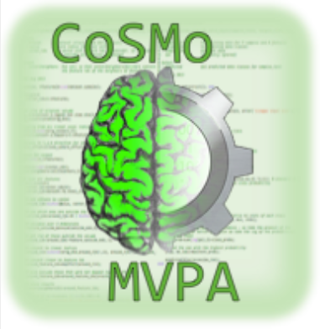
an fMRI/EMEG MVPA toolbox for Octave & Matlab
Oosterhof et al. (2016) http://cosmomvpa.org/
What is CoSMo MVPA?
Notes:
How many people prefer Python over Matlab, and vice versa?
How many people have access to Matlab through their institution?
Would people prefer to only be using Python, or is it helpful to see toolboxes in a variety of languages?

Slide 14



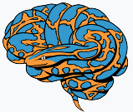

Many alternatives…
Matlab (or Octave) | Python
CoSMoMVPA http://cosmomvpa.org/ | PyMVPA http://www.pymvpa.org/
The Decoding Toolbox sites.google.com/site/tdtdecodingtoolbox/ | MNE-python (for EMEG) https://mne.tools/stable
PRoNTo (for SPM) http://www.mlnl.cs.ucl.ac.uk/pronto/ | NiLearn (general/fMRI) https://nilearn.github.io/stable
Princeton Decoding Toolbox (discontinued) | BrainIAK (+advanced non-MVPA) https://brainiak.org/
MVPA-Light, https://github.com/treder/MVPA-Light
Searchmight (focus on searchlights) http://www.franciscopereira.org/searchmight/
Built-in functions | General ML packages e.g. scikit-learn
RSA Toolbox (focus on RSA) https://git.fmrib.ox.ac.uk/hnili/rsa https://github.com/rsagroup/rsatoolbox
Within larger packages (e.g. BrainVoyager; MNE; 3dSVM in AFNI)
Yet more in Matlab: MANIA, MANAS, MVPANI, Brain Decoder Toolbox 2…
Any I’ve missed?

Slide 15
Why use CoSMoMVPA?
Pros:
  Open source (Octave & Matlab)
  “Simple” but powerful/general (e.g. searchlight concept)
  Modular/extendible
  Flexible data spaces (fMRI & EMEG)
  Compatibility with other software (e.g. PyMVPA)
  Many methods (inc. some less common e.g. DISTATIS; TFCE)
  Documentation, examples and support
  (mailing list: https://groups.google.com/g/cosmomvpa )
Limits:
  Not blazingly fast (but decent)
  No GUI or pretty pictures (but coding is more reproducible)
  No nested cross-validation (but rarely worthwhile)
  Development stalled ~ 3-4 years ago? (but mailing list still active)
Notes:
For TFCE, see Smith & Nichols 2009.
For DISTATIS, see e.g. Abdi et al 2009.

Slide 16
To run the CoSMoMVPA demos
Install Octave from www.octave.org
(unless you have a Matlab installation)
Download CoSMoMVPA from www.cosmomvpa.org
  Follow instructions there to add any extra packages to Octave
  (but cosmo_set_path can be very slow and may not be needed)
  Download & unzip tutorial data
  Run “…/examples/cosmo_wizard_set_config” to specify data location
Download external functions as needed (and add full path):
  AFNI, for AFNI data (http://afni.nimh.nih.gov/afni; just “matlab” subfolder)
  Fieldtrip, if analysing EMEG data (http://fieldtrip.fcdonders.nl; we’ll skip this)
  LIBSVM, to use SVM in Octave (https://github.com/cjlin1/libsvm; can skip)
  surfing toolbox, for surface analyses (https://github.com/nno/surfing; skip)
  NeuroElf, for BrainVoyager data (http://neuroelf.net; skip; not on Octave)
(I’d recommend running “dbstop if error”)
Notes:
I find fieldtrip paths troublesome…
Using ft_defaults causes other things to break, probably by shadowing basic functions. Various ft_ functions call ft_defaults internally (e.g. ft_multiplotTFR)
For EEGLAB data, get EEGLAB from: https://sccn.ucsd.edu/eeglab/
for gifti toolbox, vist: www.artefact.tk/software/matlab/gifti
Nifti and DISTATIS toolboxes seem to be included in default installation.
Lines can be added to start-up script: .octaverc
E.g.:
more off
pkg load io
pkg unload nan
pkg load nan
pkg load statistics
pkg load miscellaneous
pkg load general
Note: I would recommend to structure all scripts as functions. CoSMoMVPA demos and exercises are scripts, so probably wise to run “clear all” before launching them.

Slide 17
Python(+Numpy) vs Octave/Matlab
Python and Octave/Matlab are both high-level programming languages with many similarities
Demos mostly use CoSMo functions, so minimal programming required, but note:
If unsure, just ask! (or Google e.g. “numpy-for-matlab-users”)
Python | Octave/Matlab
Zero-based indexing, with [ ]: e.g. a[0:2] returns first 3 elements of a | One-based indexing, with ( ): e.g. a(1:3) returns first 3 elements of a
Transpose with: a.conj().T | Transpose with: a’
Comment with # | Comment with %
Print values with: print(a) | Print values with: a, or disp(a), or fprintf( ‘%g’ , a)
Loop with e.g.: for i in range(1, 4): | Loop with e.g.: for i = 1:3 end
Can store arbitrary items in a list, e.g.: a = [10, “hello” ]; get last item with: a[-1] | Can store arbitrary items in cell array, e.g.: a = {10, “hello” }; get last item with: a{end}
Get help with: func? | Get help with: help func

Slide 18
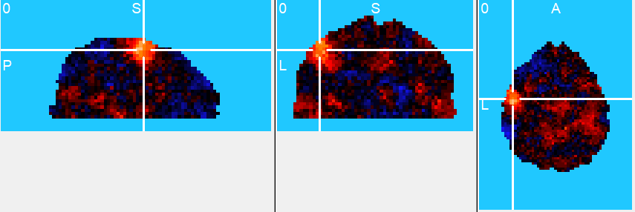
A first example: Tutorial dataset “digit”
single participant
2 conditions: index vs middle finger right-hand button presses for 8 s, followed by 16 s rest
4 fMRI runs with 4 repeats of each condition per run
→ 32 volumes of t-value maps
AFNI format
We might ask – where in the brain is there information about which finger is moving?
From CoSMoMVPA’s “examples” folder, open: “demo_fmri_searchlight_naive_bayes.m”
Add a breakpoint on the last line, then run it.
(Don’t worry about the code for now,
we’ll unpick the details next…)
Notes:
demo_fmri_searchlight_naive_bayes.m
Should take <1 minute (slowest step is defining searchlight neighbourhoods).
Chance is 0.5, so the colours scale here is [0 1]
Exercise: resave in .nii format, and visualise in MRIcroN

Slide 19
A first example: Tutorial dataset “digit”
Where in the brain is there information about digit?
What choices do we need to make to produce this output?
  Which voxels will we include?
  How will we partition/cross-validate?
  Which method/classifier will we use?
  Which output measure will we use?
  (Also, choice of pre-processing etc…)
What question should we ask next?
  Is the information significant?
    for this participant?
    on average across participants?

Slide 20
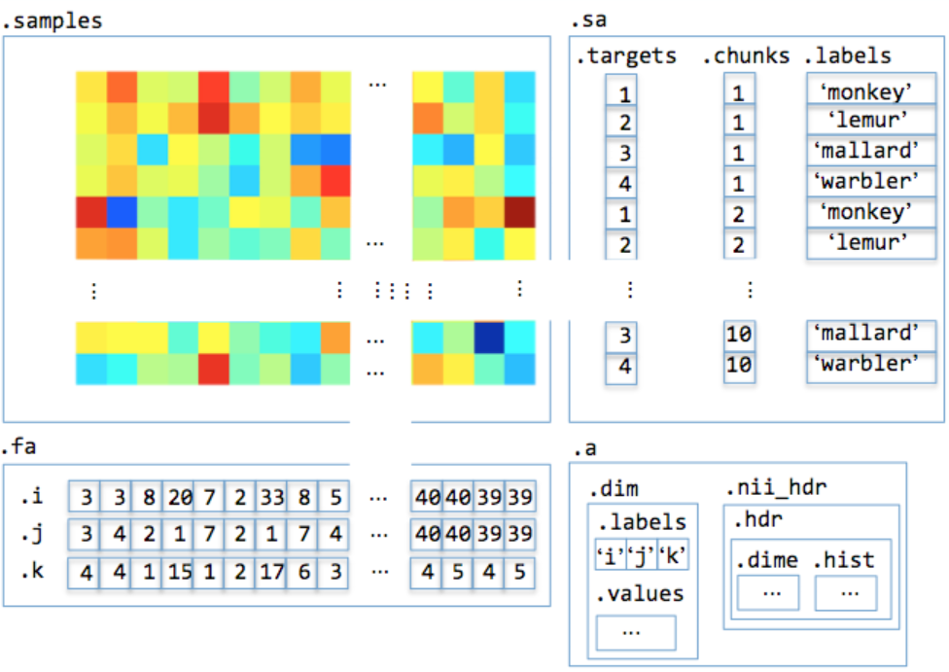
The “dataset” structure
How does CoSMoMVPA work?
“features”
“samples”
“attributes”
Notes:
.targets and .labels typically correspond here.
A dataset can be created without attributes, and arbitrary attributes can be added

Slide 21
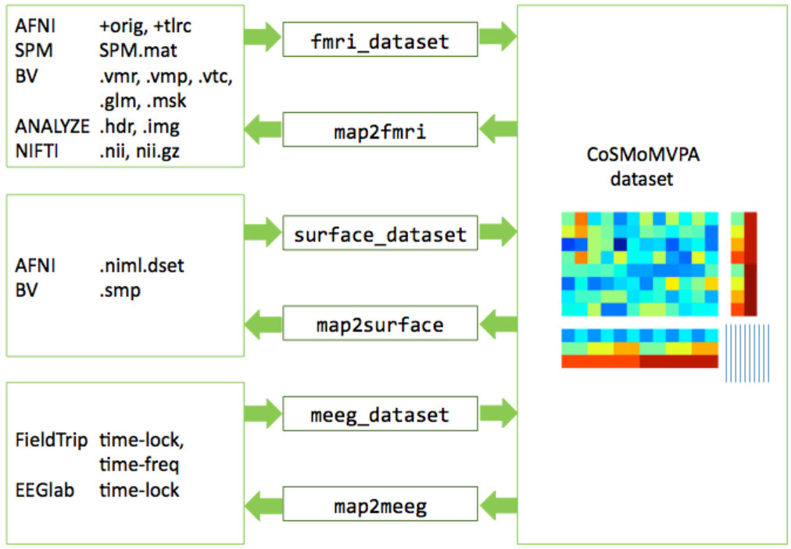
The dataset object is very general, with functions to interface with different software/file types:
How does CoSMoMVPA work?
Notes:
See also:
cosmo_synthetic_dataset()

Slide 22
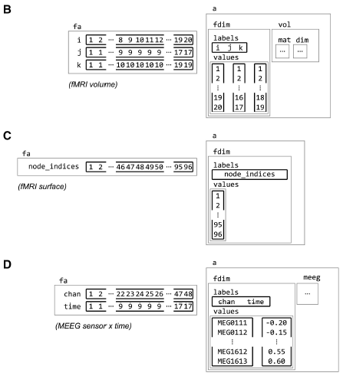
Feature attributes for different dataset types:
fMRI volume
fMRI surface
Can expand to e.g.:
EMEG source xyz
x time
x frequency
EMEG sensor x time
Oosterhof et al. (2016)
Notes:
For fMRI data, use:
cosmo_vol_coordinates(ds, coords)
to convert feature indices to and from spatial (x,y,z) coordinates

Slide 23
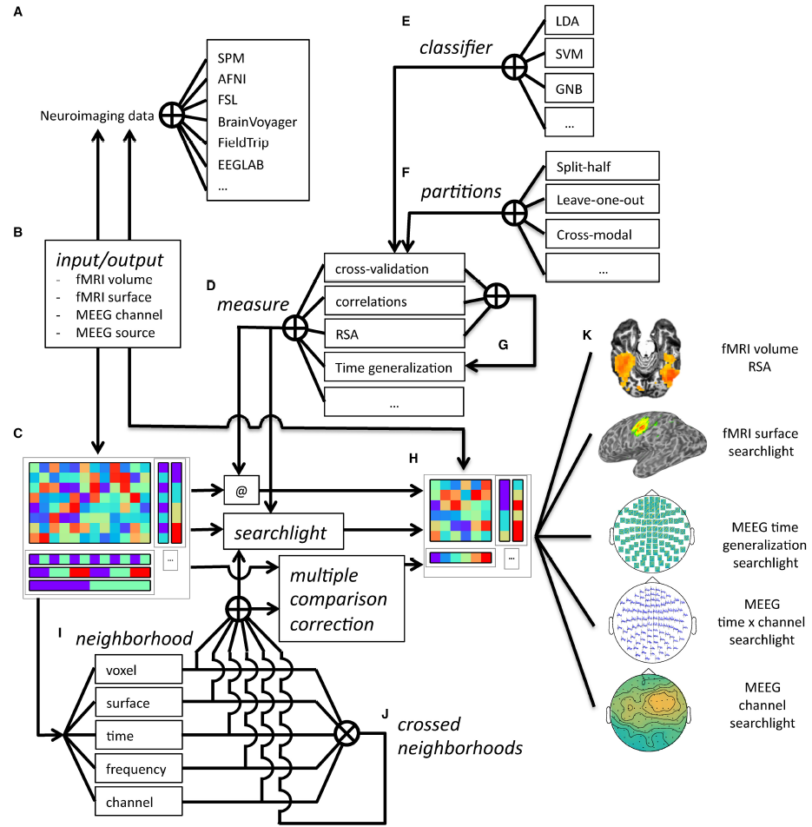
Overview of CoSMoMVPA architecture
Oosterhof et al. (2016)

Slide 24
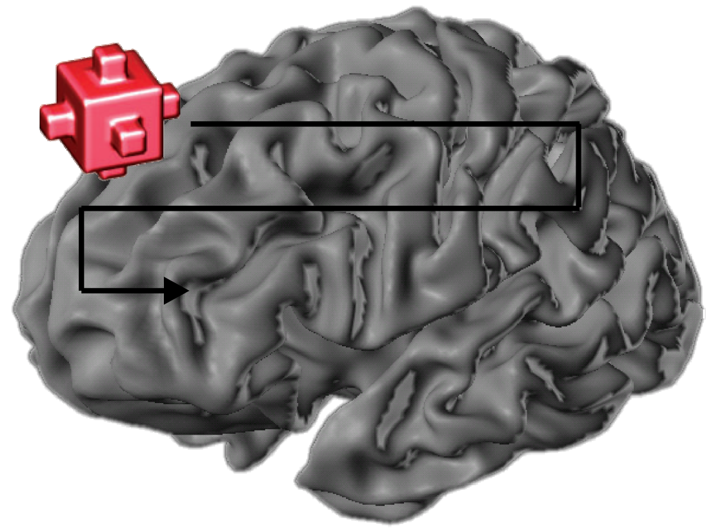
With many features, we need to choose, which of them we want to use
Voxel selection must be based on data independent from test data set
(not specific to MVPA!)
Choice of which features to use determines:
  inference that can be made;
  SNR/risk of overfitting
Most common ways of voxel selection:
  structural ROI (anatomy; e.g. traced per subject, or from an atlas)
  functional ROI (activity; e.g. from per-subject localizer, or coordinates from literature)
    univariate (activation differences)
    multivariate (pattern differences)
  “Searchlight” (roving ROI; often local/contiguous, but needn’t be)
  “whole brain” (global ROI; more for prediction applications)
Could do this at same time as training the model, but would need nested-cross-validation (complicated, slow, and loss of training data may outweigh any benefits)
Kriegeskorte et al.
2006

Slide 25
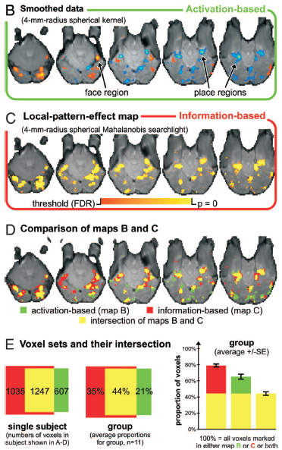
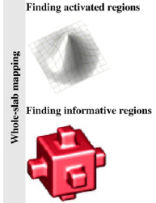
The first searchlight paper
Example comparison of activation-based and information-based mapping
Kriegeskorte et al. 2006, 2007

Slide 26
Selecting voxels, continued
How many voxels?
  Depends on the expected spatial extent of effects,
  and the scientific question.
  few → risk of missing signal
  many → risk of overfitting (too noisy) & weaker localization
Might information be distributed across
non-contiguous regions?
Sometimes people select the same number of voxels in each subject, and for each region of interest.
But beware direct comparisons between regions!
(Equating voxel number doesn’t make them equal;
e.g. MT neurons might encode motion more strongly than V1/V2, but decoding is weaker because neurons are more finely intermixed.
Often important to consider interaction with condition)

Slide 27
To create a dataset, specify:
- “samples” (the activation patterns themselves)
- “target” (class labels)
- “chunks” (to be treated as independent)
- optional feature mask
E.g. : ds = cosmo_fmri_dataset(‘input.nii’); ds.sa.targets = (1:6)’; ds.sa.chunks = 1;
Or: ds = cosmo_fmri_dataset( ‘input.nii',...
'targets', (1:6)', ...
'chunks', 1, ...
'mask', 'brain_mask.nii’ );
Creating a dataset structure
Notes:
Note – same cosmo_fmri_dataset function can load an ROI mask, just omitting target and chunk inputs.
Can merge chunks using cosmo_chunkize(ds, nchunks)
See also:
cosmo_check_dataset
cosmo_dim_insert
cosmo_dim_remove
cosmo_dim_prune
cosmo_dim_rename
cosmo_dim_transpose

Slide 28
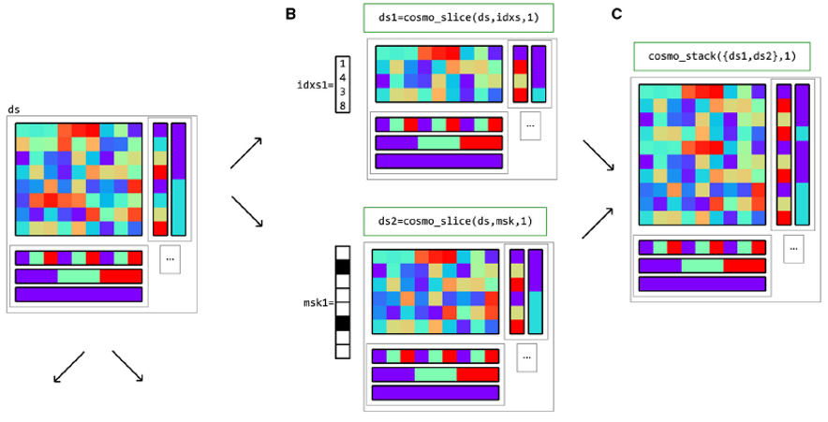
Slicing & Stacking datasets
cosmo_slice() selects a subset of samples (dimension 1) or features (dimension 2)
Specified as index vector or logical mask:
Oosterhof et al. (2016)
Notes:
Slice by giving it indices or logical mask, and dimension to slice along (1=samples; 2=features)
See also:
cosmo_split

Slide 29
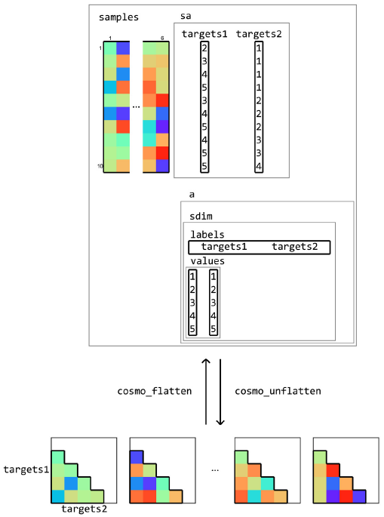
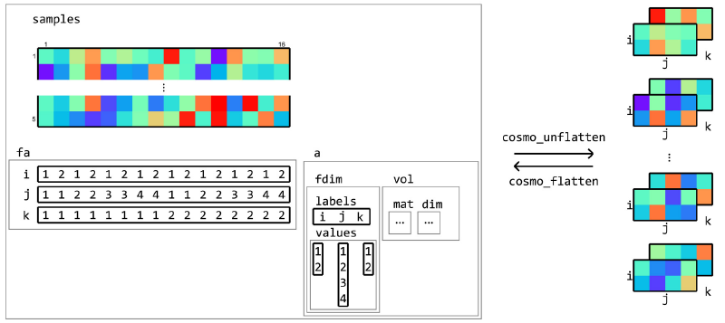
Flattening/unflattening datasets
“Unflatten” extracts the 2D samples matrix from the dataset structure into full n-dimensional array
“Flatten” does the reverse
Oosterhof et al. (2016)

Slide 30
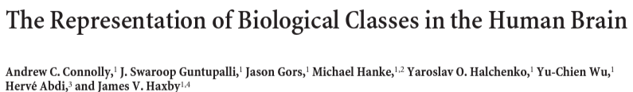
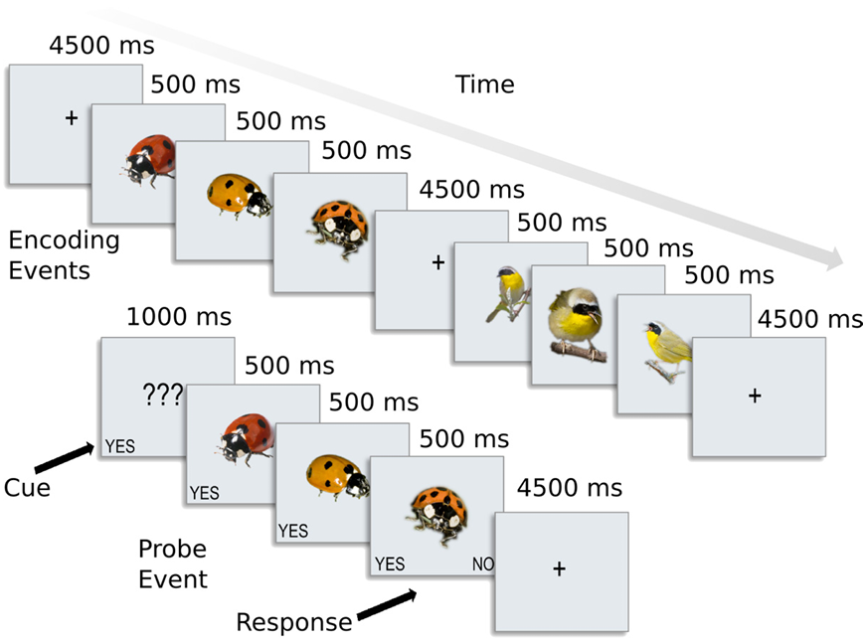
Tutorial dataset “AK6” (Animal Kingdom, 6 species)
8 subjects
10 fMRI runs each
6 conditions per run
→ 60 volumes
Native space
Nifti format

Slide 31
Try it yourself
This example shows you how to:
  create & label a dataset,
  “slice” it to select an ROI
On the CoSMoMVPA website, go to
→ “Exercises” then
→ “Runnable examples – skeleton files” (https://www.cosmomvpa.org/matindex_skl_run.html)
Select “run_dataset_basics_skl”
Copy the whole script, and paste into an empty file in the Octave editor.
Have a go at replacing the lines:
%%%% >>> Your code here <<< %%%%
You can find the answers in the “examples” folder of the toolbox: run_dataset_basics.m (~ 5 s)
Notes:
Advanced exercise: Try “run_operations_on_datasets_skl”

Slide 32
To run MVPA across all features in dataset, specify :
- “measure” (function handle for analysis type) and its “args” (options)
E.g.:
The “measure” concept in CoSMoMVPA
measure = @cosmo_crossvalidation_measure;
measure_args.classifier = @cosmo_classify_lda;
measure_args.partitions = cosmo_nfold_partitioner(ds);
measure = @cosmo_correlation_measure;
measure = @cosmo_dissimilarity_matrix_measure;
measure = @cosmo_target_dsm_corr_measure;
measure_args.target_dsm = RDM;
measure = @cosmo_dim_generalization_measure;
measure_args.measure = @cosmo_crossvalidation_measure;
measure_args.dimension = ‘time’;
measure_args.radius = 1;
Then:
ds_result = measure(ds [, measure_args] );
Notes:
Note: the output result shares the “dat.aset” structure
cosmo_crossvalidation_measure also supports:
args.output
args.check_partitions
args.normalization (zscore, demean, or scale_unit, per feature; plus PCA by # or by percent variance)
args.average_train_count (for making pseudotrials)

Slide 33
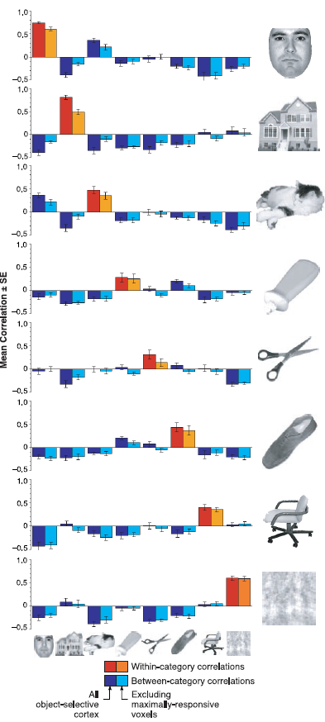
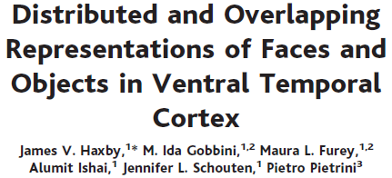
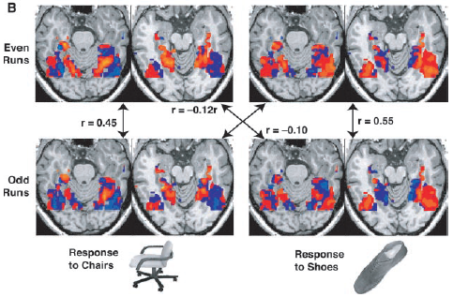
Notes:
Many of the examples in the CoSMoMVPA toolbox use this approach.
It’s fast and sensitive, but outperformed by other classifiers e.g. SVM. (See e.g. Haxby et al 2011; Haxby 2012), so we won’t use it here.
It can be thought of as 1-nearest neighbour classification, using correlation as a distance measure and one particular partition.

Slide 34
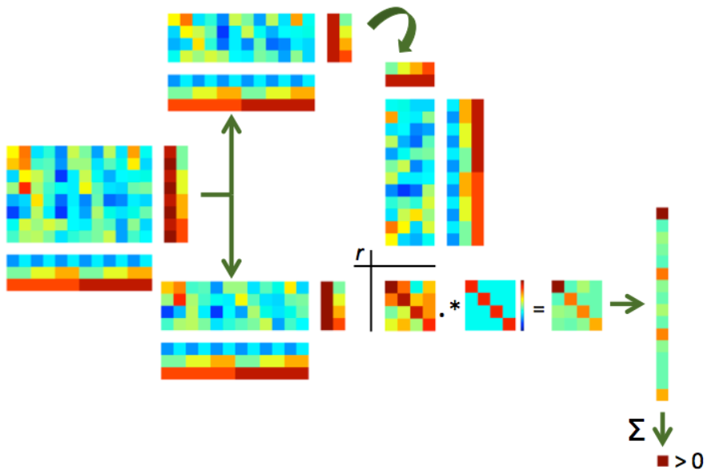
Schematic of “Haxby-style” split-half correlation approach using CosMOMVPA:

Slide 35
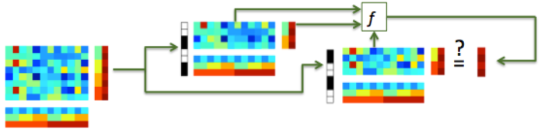
Typical classification uses multiple samples per class – by characterising the covariance of responses it is potentially more sensitive than split-half correlation analysis
Typical classifiers use Euclidean rather than correlation distance, which is invariant to shifts and rotations, and has a well-defined noise distribution.

Slide 36
Partitions, classifiers & outputs
Partition schemes:
  partitions = cosmo_nfold_partitioner (ds);
  partitions = cosmo_oddeven_partitioner (ds);
  partitions = cosmo_nchoosek_partitioner (ds);
  partitions = cosmo_balance_partitions (partitions);
Classifiers:
  @cosmo_classify_lda
  @cosmo_classify_svm (_libsvm, _matlabsvm, _matlabcsvm)
  @cosmo_classify_naive_bayes
  @cosmo_classify_knn
Output values:
  ‘accuracy’, ‘balanced_accuracy’, ‘fold_predictions’…
Notes:
the nfold_partitioner & oddeven_partitioner are just special cases of the nchoosek_partitioner
See also:
cosmo_chunkize
cosmo_check_partitions
cosmo_balance_partitions
cosmo_independent_samples_partitioner
cosmo_average_samples

Slide 37
Try it yourself
This example shows you how to:
  define a measure (“crossvalidation” in this case)
  define its options (classifier, partitions, and output)
On the CoSMoMVPA website, go to
→ “Exercises” then
→ “Runnable examples – skeleton files” (https://www.cosmomvpa.org/matindex_skl_run.html)
Select “run_crossvalidation_measure_skl”
Copy the whole script, and paste into an empty file in the Octave editor.
Have a go at replacing the lines:
%%%% >>> Your code here <<< %%%%
You can find the answers in the “examples” folder of the toolbox: run_crossvalidation_measure.m (~5 s)
Notes:
Should take just a few seconds to run

Slide 38
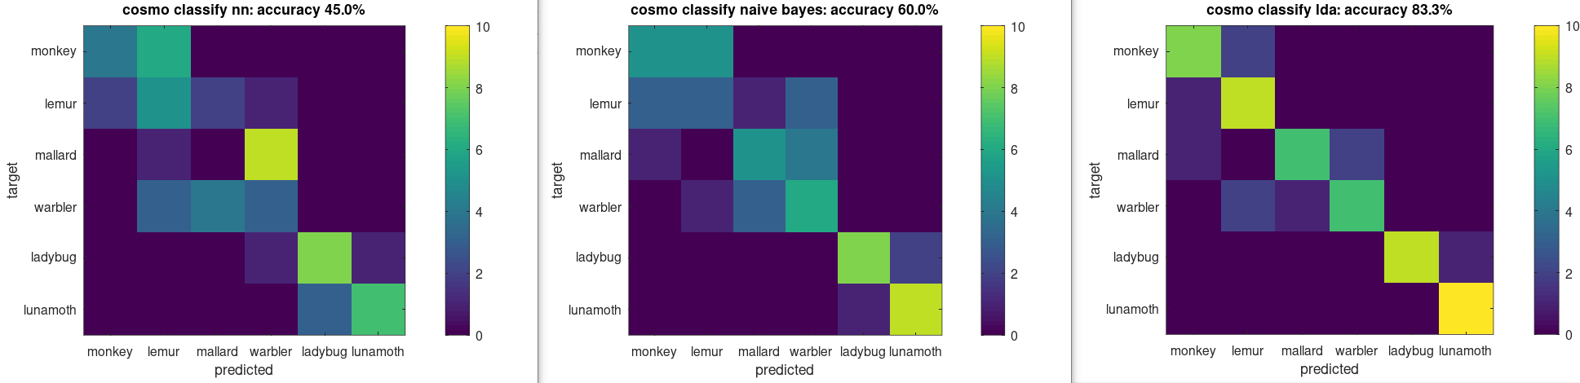
Are the performance differences between the three classifiers as you might expect?
Why, or why not?

Slide 39
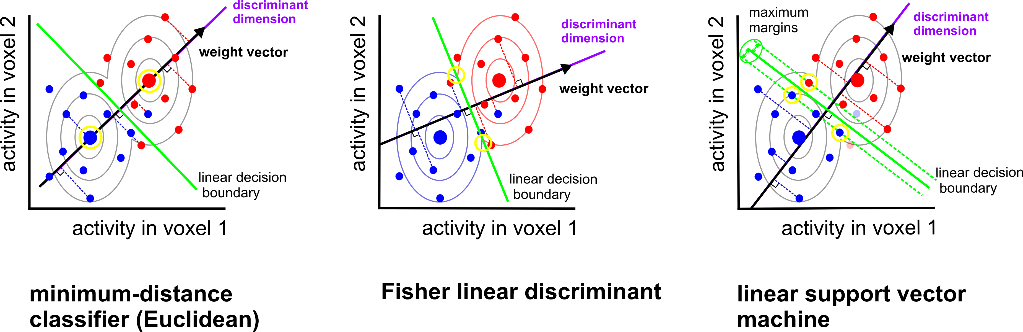
Boundary placement: some linear classifiers
(AKA LDA)
assumes identical and multivariate normal distributions (need to estimate covariance)
(AKA centroid-nearest neighbor)
assumes identical and isotropic distributions
no assumptions about distributions
(need to choose C, or nu)
Mur et al. (2009)
Notes:
LDA is equivalent to Linearly Constrained Minimum Variance Beamformer?
Also, Logistic regression
GNB, LDA and QDA are generative/parametric models
Logistic regression & linear SVM are discriminative models
Nearest neighbour classifiers are simpler in that no parameters are learned, but require a choice of distance metric and of neighbourhood definition

Slide 40
Which classifier is best?
Will depend on:
how well each classifier’s assumptions are met
how much data are available
desired inference/interpretation
Linear SVM and Fisher linear discriminant (with shrinkage covariance estimator) often perform well for fMRI data.
Misaki et al. 2010; Pereira 2011
Notes:
LDA can do simultaneous multiclass classification, but SVM needs to combine pairwise classifications.
Covariance matrix estimation can be slow, especially for many voxels.
So with few voxels and many classes, perhaps prefer LDA? With few classes and many voxels, perhaps prefer SVM?
They will also differ somewhat in their sensitivity to outliers.
LDA gives a more direct measure of class membership probability

Slide 41
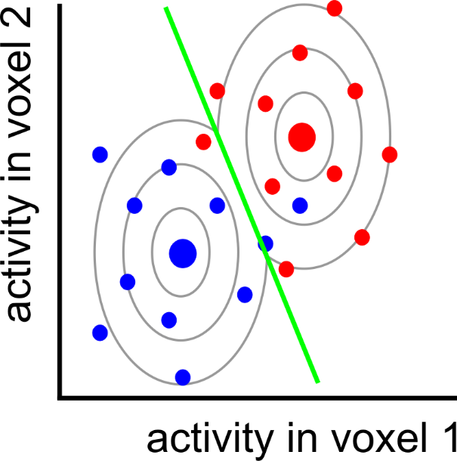
Can we do better?
Notes:
Here is the LDA classifier from before. It is making three mistakes on the training set.

Slide 42
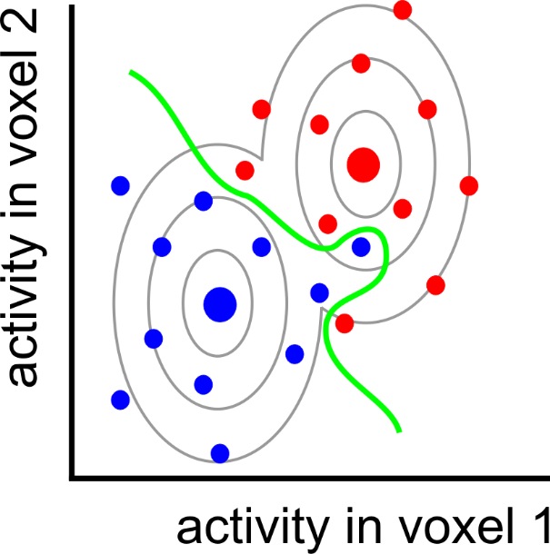
nonlinear
classifier

Slide 43
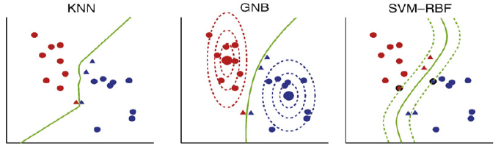
Some non-linear classifiers
K-nearest neighbour
(Quadratic)
Gaussian Naïve Bayes
SVM with radial/polynomial/sigmoid basis function
Nonparametric
(need to select k,
and distance metric)
Assumes multivariate, but non-identical, normal distributions
(ignores voxel correlation)
No assumptions about distributions
(need parameter selection)
Misaki et al. 2010

Slide 44
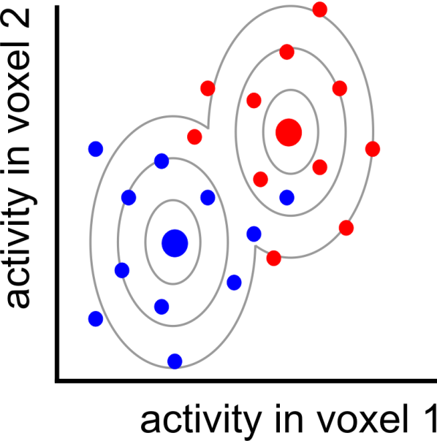
Pattern = signal + noise

Slide 45
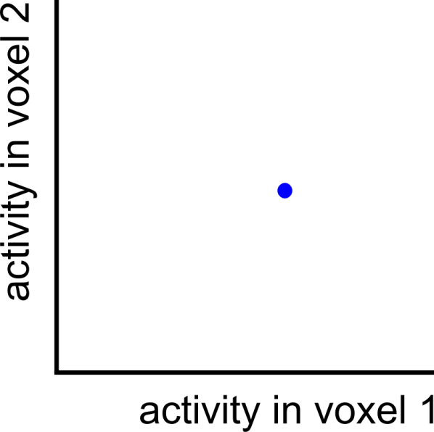
Pattern = signal + noise
measured pattern
(signal + noise)

Slide 46
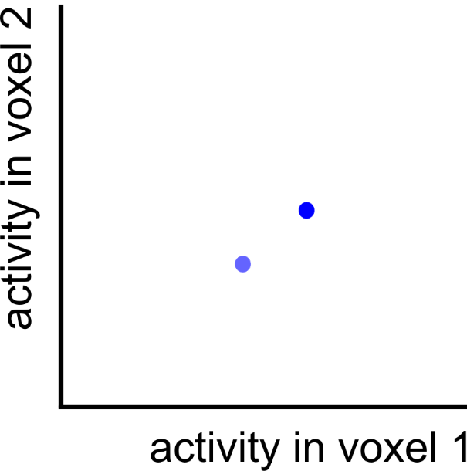
Pattern = signal + noise
measured pattern
(signal + noise)
true pattern
(signal)

Slide 47
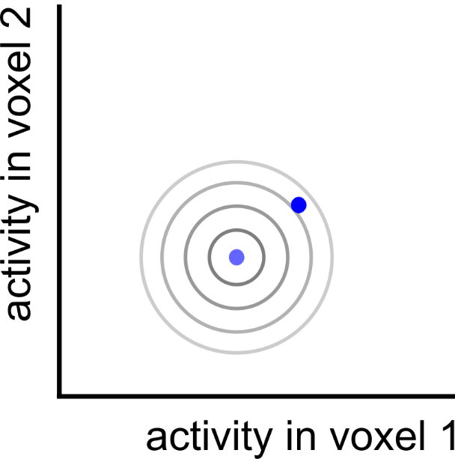
Pattern = signal + noise
measured pattern
(signal + noise)
true pattern
(signal)

Slide 48

Pattern = signal + noise
measured pattern
(signal + noise)
true pattern
(signal)
noise displacement

Slide 49
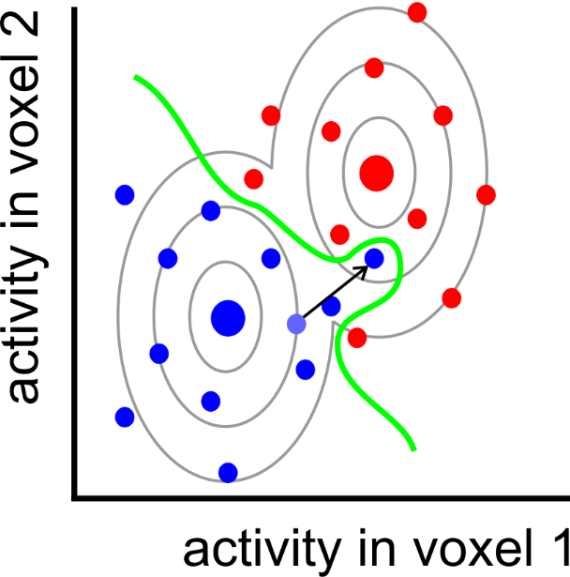
Overfitting

Slide 50
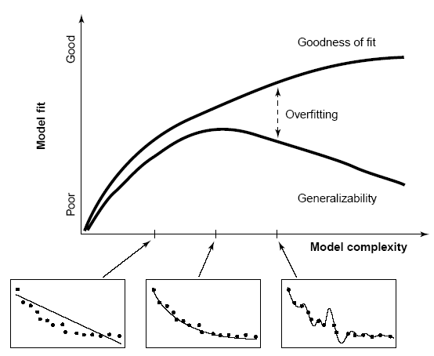

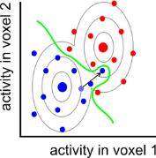
Overfitting
After determining the decision boundary, we need to test how well the boundary generalises to new data (e.g. cross validation).
(training data)
performance
(hold-out data)
boundary complexity
Notes:
Regularisation: use prior assumptions to constrain the ways in which the boundary is shaped and shifted so as to discriminate the categories in the training data.

Slide 51
Overfitting
After determining the decision boundary, we need to test how well the boundary generalises to new data (e.g. cross validation).
Linear classifiers usually perform better on fMRI data than nonlinear classifiers.
Overfitting can be further reduced by:
regularisation
dimensionality reduction of the activity patterns
(e.g. voxel selection or PCA)
Notes:
Regularisation: use prior assumptions to constrain the ways in which the boundary is shaped and shifted so as to discriminate the categories in the training data.

Slide 52
To run a searchlight analysis, also specify “neighbourhood”:
Searchlights
neighbourhood = cosmo_spherical_neighborhood (ds, ...
'count', 100);
neighbourhood = cosmo_surficial_neighborhood (ds, ...
{'pial.asc', 'white.asc'}, 'count', 100);
neighbourhood = cosmo_meeg_chan_neighborhood (ds, ...
'count', 10, 'chantype', chan_type);
neighbourhood = cosmo_interval_neighborhood (ds, ...
'time', 'radius', time_radius);
neighbourhood = cosmo_cross_neighborhood (ds, ...
{neighbourhood1 , neighbourhood2});
Then:
ds_result = cosmo_searchlight( ds, neighbourhood,
measure [, measure_args] );
Notes:
Frequency neighborhoods are also possible.

Slide 53
Try it yourself
This example shows you how to:
  define a searchlight neighbourhood
  run a classification searchlight
On the CoSMoMVPA website, go to
→ “Exercises” then
→ “Runnable examples – skeleton files” (https://www.cosmomvpa.org/matindex_skl_run.html)
Select “run_crossvalidation_searchlight_skl”
Copy the whole script, and paste into an empty file in the Octave editor.
Have a go at replacing the lines:
%%%% >>> Your code here <<< %%%%
You can find the answers in the “examples” folder of the toolbox: run_crossvalidation_searchlight.m (~4 mins)
Notes:
This might take ~4 mins to run

Slide 54
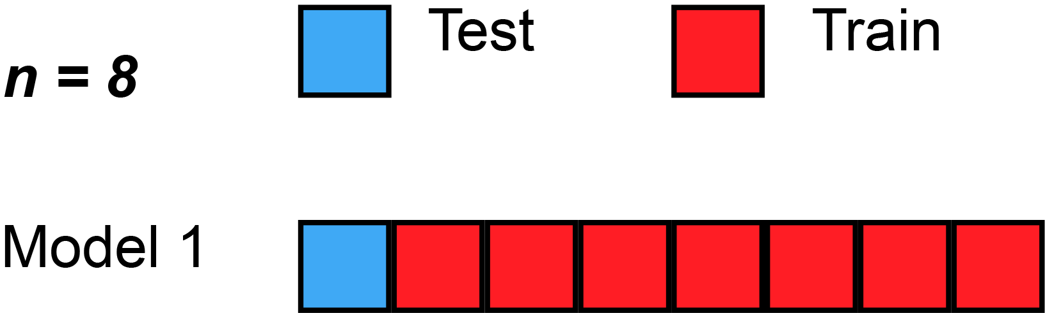
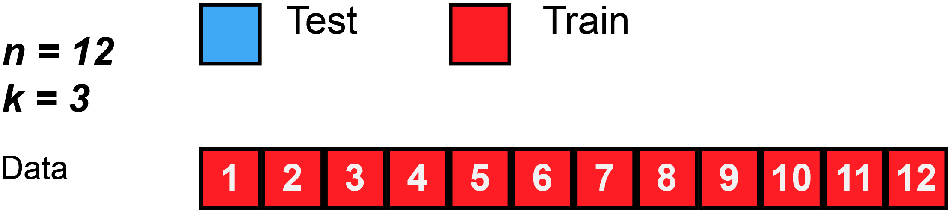
Data splitting/partitioning
Holdout/validation set from single context
  Safe but often not efficient/stable
Separate datasets from different contexts (“cross-classification”, “cross-generalization”)
  used to test generalization & demonstrate common format
  (e.g. train on perception, test on imagery;
  train at time-point 1, test at time-point 2)
Cross-validation within full single dataset
  Reuse data for both training and testing in different splits/folds
  Average performance across folds
  “split half”…
  …“k-fold”…
  … “leave-one-out”
  Training and testing data should be independent within a fold (“decoding step”), but will be dependent across folds
  Ideally want conditions balanced within each partition (“chunk”)
More ways to split… more precise performance estimate?
More training data per split… more sensitive?
Gifs from Wikipedia

Slide 55
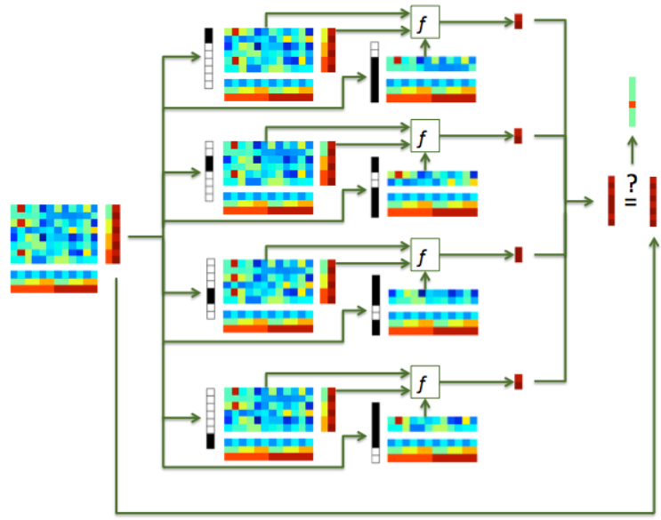
Data splitting/partitioning

Slide 56
Cross-validation granularity: generalise to….?
  new trial/stimulus pair
  (leave-stimulus-pair-out)
  new run (leave-run-out)
  new subject (leave-subject-out)
  (“hyperalignment”, Haxby, 2011; 2020)
Why do we need out-of-sample prediction at all?
  Classical univariate analysis uses within-sample statistical estimation
  (activation can be estimated in a direct and unbiased way)
  In MVPA we want to estimate “information”, and out-of-sample prediction provides an unbiased estimate of this (with minimal assumptions).
Fewer samples
More different distributions
Cleaner samples
More independence

Slide 57
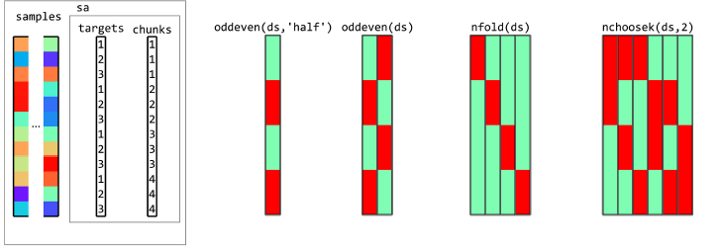

Partitioning samples in CoSMoMVPA
Examples with 3 conditions (targets) in each of 4 runs (chunks):
Oosterhof et al. (2016)

Slide 58

Partitioning samples in CoSMoMVPA
Example with 2 conditions (targets) in each of 3 runs (chunks), cross-generalized across “modality”:
(Could similarly cross-generalize across participants)
Oosterhof et al. (2016)

Slide 59
Specific considerations for fMRI data
Temporal autocorrelation:
  Dependencies between patterns within a run
  Safest for test/train patterns to come from different runs
Pre-processing:
  Similar to standard univariate analysis
    Probably:
      motion-correction
      Slice-scan-time correction
    Possibly:
      normalisation to template space (if random-effects searchlight analysis across subjects; could do this afterwards)
      Slight spatial smoothing (could increase or decrease SNR, depending on spatial scale of signal vs noise)

Slide 60

Performance measures
Possible pros/cons
Simple | Continuous | Accounts for imbalance | Insensitive to variance | Available per sample | Available for all classifiers
☺ | ☹ | ☹ | ☹ | ☹ | ☺
☺ | ☹ | ☺ | ☹ | ☹ | ☺
☹ | ☹ | ☺ | ☹ | ☹ | ☺
☹ | ☹ | ☺ | ☹ | ☹ | ☺
☹ | ☺ | ☹ | ☺ | ☺ | ☺
☺ | ☺ | ☹ | ☹ | ☺ | ☹
Several options, e.g.:
Accuracy (proportion correct classifications)
Accuracy per class (balanced accuracy)
D-prime (and other sensitivity measures)
Area under ROC curve
Decision variable
  e.g. signed distance from margin
  Probability of correct classification

Slide 61

d’ (sensitivity)
Chance = 0
ROC curve
AUC
(area under curve)
chance = 0.5
Criterion

Slide 62
Statistical inference
Dominant in the literature:
Random-effects analysis across subjects, using standard one-sample
right-sided t test.
H₀: μ = 50% (for balanced 2-class); H_{a}: μ > 50%
Is this valid?
observations (i.e. subjects) are independent
reasonable to assume probability distribution of classification accuracy is identical across subjects
number of subjects is large enough for the central limit theorem to apply
(can assume sampling distribution approaches a normal distribution)
But, take care over chance level (especially for unbalanced classes)
If any doubt, can use permutation test instead; wise to include negative control
If true value of dependent measure can not be negative, t-test only provides FFX inference (Allefeld et al. 2016)

Slide 63

Statistical inference
Error variability
across folds
(Non-independent:
probably invalid)
Error variability
across subjects
(Independent:
probably valid)

Slide 64



Statistical inference
subject-average
classification accuracy
If the computed t value falls within the top 5% (blue) of the t distribution → reject H₀.

Slide 65
Statistical inference
However:
are we sure that the accuracy is 50% under H₀?
What about stats within a subject?
→ use a permutation test:
  create null distribution by randomly shuffling condition labels many times (1000-10,000) before training
  remove relationship between labels and patterns
  assumes data are exchangeable (H₀: all classes come from same distribution)
  But:
    slow;
    permutations limited by number of samples/classes (insensitive)
    complicated: permutations must preserve balance/autocorrelation

Slide 66


Statistical inference
Null distribution of
subject-n
classification accuracy

Slide 67

Statistical inference
If the actual classification accuracy falls within the top 5% (blue) of the null distribution → reject H₀.
Notes:
Safe (likely to be valid), but time-consuming, and fixed-effects inference.

Slide 68
Statistics in CoSMoMVPA
No specific function for within-subject significance testing, but null distribution can be constructed by iterating cosmo_randomize_targets().
See e.g.: run_permutation_test()
For 2nd-level t-tests and simple ANOVAs, can use: cosmo_stat(), or whatever way you would normally run these tests
Multiple comparisons correction is as for mass-univariate analyses
For cluster correction (e.g. Threshold-Free Cluster Enhancement, TFCE), can use: cosmo_montecarlo_cluster_stat()
(See e.g.: run_multiple_comparisons_correction()
…but for me this is very slow!)
Notes:
TFCE Monte Carlo multiple comparison correction returns 2-tailed z-scores:
values beyond 1.65 (for one-tailed) or 1.96 (for two-tailed) tests are significant.
Use 1-normcdf(z) to convert to p-values
For cluster correction of permutation test, pass the null distribution to
cosmo_montecarlo_cluster_stat in opt.null.
run_multiple_comparisons_correction() is very slow!

Slide 69
Example group t-test
Example permutation test
See “run_permutation_test.m”
Run “example_djm_partitions.m” (~ 1 minute)
(from COGNESTIC23 materials webpage)
This also shows three different CV schemes:
  with only eight subjects, and much cross-subject variance, there is little difference between them, but, as expected:
  highest mean accuracy with most training data per fold (leave-one out)
  more folds take longer to run, but reduce variance
Notes:
The classification is quick – most of this time is loading the data per subject.

Slide 70
Unbalanced samples
A classifier that doesn’t look at the test data should be at chance (on average)
In this case, what is the expected proportion of correct classifications (accuracy) for N balanced classes?
But what will happen if there are more samples from class A than class B (in both test and train sets)?
What could we do about this?
  Design the experiment to collect balanced data
  Resample the data at each fold to restore balance
  Use an output measure that is unbiased for unbalanced data
Run “example_djm_unbalanced.m” (~3.5 minutes)
(from COGNESTIC23 materials webpage)
Notes:
~50 s per “case”; the classification is quick – most of this time is loading the data per subject.

Slide 71

Unbalanced samples

Slide 72
A small selection of influential papers and example applications…

Slide 74






Slide 75




Slide 76





Slide 77






Slide 78



Slide 79



Slide 80





Slide 81



Slide 82



Slide 83
References (a selective list)
Linear classification tutorials
Mur M et al. (2009) Soc Cogn Affect Neurosci 4: 101-109. [conceptual introduction]
Pereira F et al. (2009) Neuroimage 45(1 Suppl): S199-S209. [introduction]
Schreiber K, Krekelberg B (2013) PLoS ONE 8(7): e69328. [cautionary comments on statistical inference]
Kriegeskorte N et al. (2006) PNAS 103(10): 3863-3868. [multivariate searchlight]
Linear classification reviews
Norman KA et al. (2006) Trends Cogn Sci 10(9): 424-430.
Haynes JD, Rees G (2006) Nat Rev Neurosci 7: 523-534.
Linear classification: a few example applications in neuroscience
Kamitani Y, Tong F (2005) Nat Neurosci 8(5): 679-685. [vision: classify orientations]
Formisano E et al. (2008) Science 322: 970-973. [voices: classify speakers & vowels]
Haynes JD et al. (2007) Curr Biol 17(4): 323-328. [cognitive control: task preparation]
Emrich et al. (2013) J.Neurosci. 33(15):6516–6523 [visual working memory]

Slide 84
References (a selective list)
Recursive feature elimination (RFE)
De Martino F et al. (2008) Neuroimage 43: 44-58.
Thoughts on choice of classifier & preprocessing options
Mourao-Miranda J et al. (2005) Neuroimage 28: 980-995. [SVM vs FLDA]
Kriegeskorte et al. (2009) Nat Neurosci 12(5): 535-540. [how to prevent selection bias]
Misaki M et al. (2010) Neuroimage 53: 103-118. [compares 6 different classifiers]
Garrido L et al. (2013) Front Neurosci 7(174): 1-4. [subtract the mean pattern?]
Relationships between classification (decoding), encoding, and RSA
Naselaris T et al. (2011) Neuroimage 56: 400-410.
Kriegeskorte N (2011) Neuroimage 56: 411-421.
Kriegeskorte & Douglas (2019) Curr Opin Neurobiol 55:167-79
Comparison with classical univariate approach
Hebart MN & Baker CI (2018) Neuroimage 180: 4-18.
Source of data for extra ‘hands on’ example
Mitchell & Cusack (2016) Scientific Reports 6:20232; DOI: 10.1038/srep20232

Slide 85





Extra demo data if time?
Mitchell & Cusack (2016) Scientific Reports 6:20232
200 objects, presented one each per condition
2 conditions (occasional cues to imagine knives or dolphin)
Tutorial data combined over subjects

Slide 86

A puzzle: what might be wrong?
Run 1
Run 2
Run 3
Run 4
100%
50% (chance)
0%
4 runs
2 activation patterns per run, in response to coloured shapes
Shape and colour are fully counterbalanced across runs
Leave-one-run-out cross validation
Significantly below-chance decoding of shape (circle vs square)
Tip: consider the cross-validation fold that tests on run 1

Slide 87
Lunch time!

