Slide 1
EEG/MEG 3:
Time-Frequency Analysis
Olaf Hauk
olaf.hauk@mrc-cbu.cam.ac.uk
COGNESTIC 2023
Notes:
Almost all images are methods-related – although none neuroimaging.
Title a bit of a trap – it’s not about HCN, but about methods!
Remind to put e-mails on sign-up sheet.

Slide 2
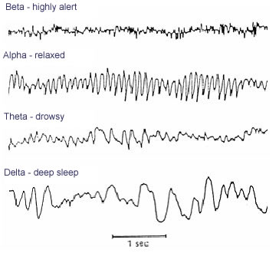
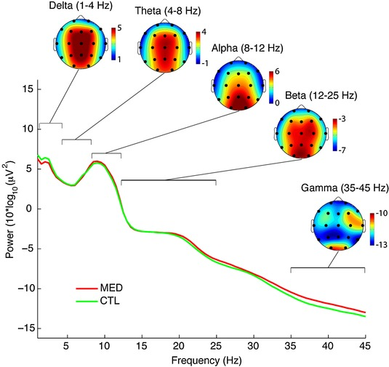
“Brain Rhythms” and “Oscillations”
Time course and topography may differ among different frequency bands
(and may depend on task, environment, subject group etc.)
=> Different frequency “bands” may reflect different processes/computations, systems/networks, etc.
Cahn et al., Cogn Proc 2010, http://link.springer.com/article/10.1007%2Fs10339-009-0352-1/

Slide 3
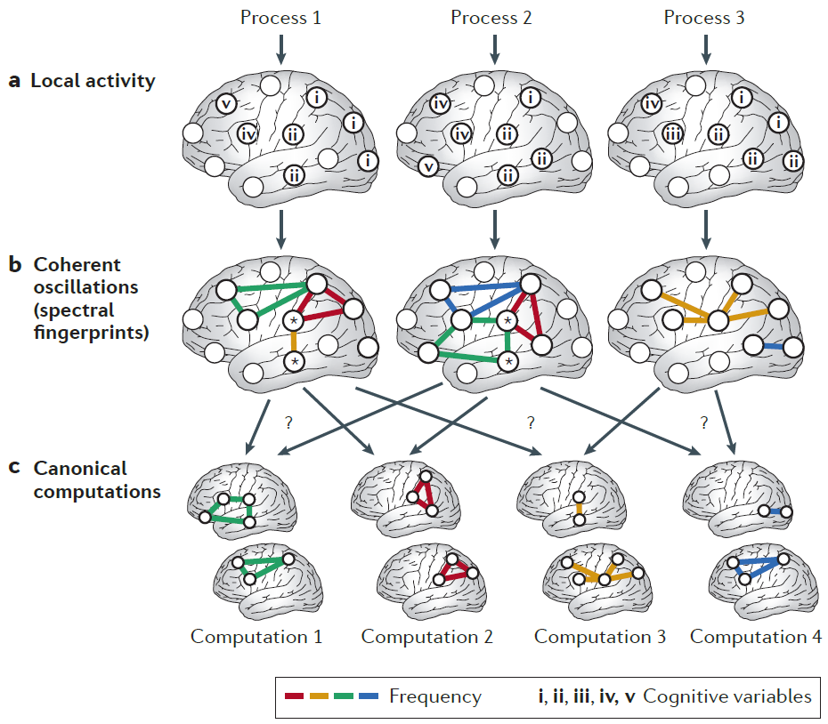
“Brain Rhythms” and “Oscillations”
Siegel et al., Nat Nsc 2012

Slide 4
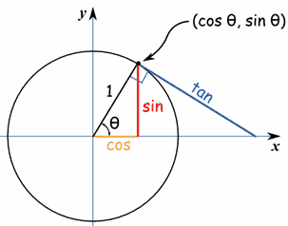
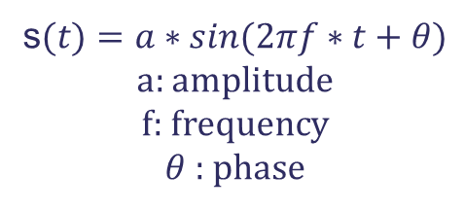
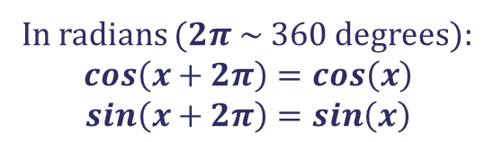
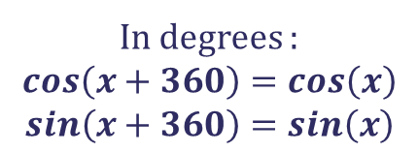

Periodic Signals
A periodic signal repeats itself with a period T.
This is the case, for example, for sine and cosine functions:
s$(t)=a∗sin⁡(2πf∗t+θ)$
a: amplitude
f: frequency
$θ$: phase
In radians ($2π$~ 360 degrees):
$$cos\left(x+2π\right)=cos\left(x\right)$$
$$sin\left(x+2π\right)=sin\left(x\right)$$
360⁰ ~ 2$π$
In degrees :
$$cos\left(x+360\right)=cos\left(x\right)$$
$$sin\left(x+360\right)=sin\left(x\right)$$
On a unit circle, a 360⁰ angle corresponds to a circumference of 2*pi
https://www.youtube.com/watch?v=z82I6u4DFTo

Slide 5
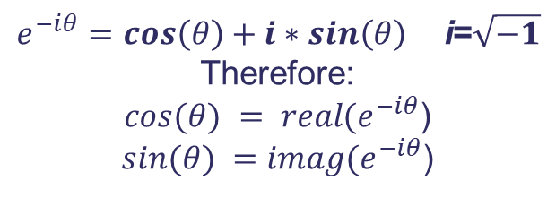
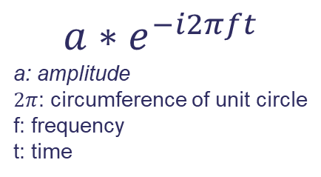
Polar Representation Of Periodic Signals
Euler’s Formula
“Complex” numbers can capture the two axes of the coordinate system for the circle around which the vector rotates periodically – this is rather abstract but helps the notation enormously.
$e^{−iθ}=cos\left(θ\right)+i∗sin\left(θ\right)$ i=$\sqrt{−1}$
Therefore:
$cos⁡(θ) = real(e^{−iθ}$)
$sin⁡(θ) =imag(e^{−iθ}$)
An oscillation at a particular frequency can be described in a
“polar representation”:
$${a∗e}^{−i2πft}$$
a: amplitude
$2π$: circumference of unit circle
f: frequency
t: time
imaginary part
real part

Slide 6
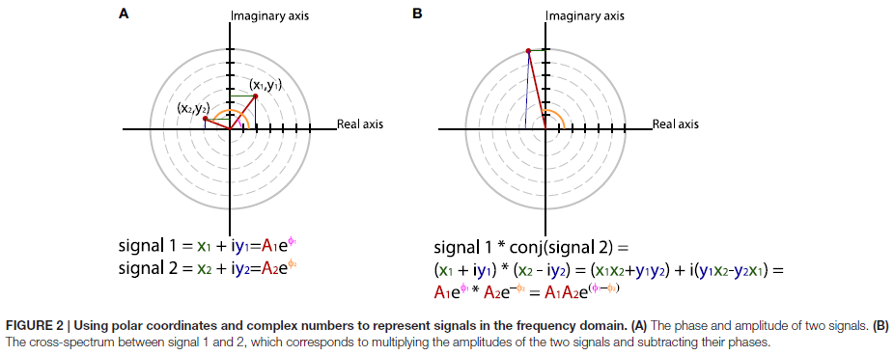
The Polar Representation Of Periodic Signals
Convenient To Compare Periodic Signals
Bastos & Schoeffelen, Front Syst Nsc 2016
https://www.frontiersin.org/articles/10.3389/fnsys.2015.00175/full

Slide 7
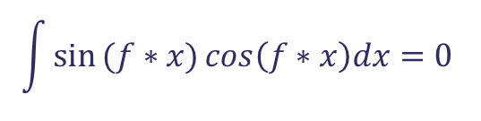
Sine and Cosine Are Orthogonal to Each Other
(at a given frequency)
sine
cosine
$$\int{sin}(f∗x){cos\left(f∗x\right)dx=0 }$$

Slide 8
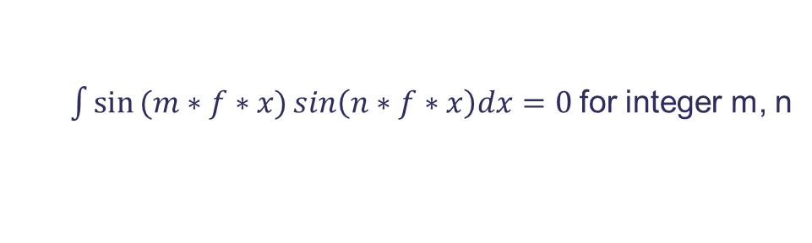
Sine/Cosine At Integer Frequency Intervals
Are Orthogonal
Sin(x)
Sin(2*x)
$\int{sin}(m∗f∗x){sin\left(n∗f∗x\right)dx=0 }$for integer m, n

Slide 9
Entering the Frequency Domain:
Fourier Transform in Words
What you want:
You’ve got a signal consisting of N sample points (equidistant).
You want to know which frequencies contribute to the signal, and how much.
In other words:
You want to describe your signal as a linear combination of sines and cosines,
ideally of orthogonal basis functions made up of sines and cosines.
What you’ve got:
With N samples, you can estimate at most N independent parameters.
You cannot estimate frequencies above half of the sampling frequency SF (Nyquist).
For a given frequency, sine and cosine are orthogonal,
i.e. 2 basis functions per frequency.

Slide 10
Entering the Frequency Domain:
Fourier Transform in Words
Divide the frequency range 0 to SF/2 evenly into N/2 frequencies.
For every frequency, create a sine and a cosine.
Use these (orthogonal) sines and cosines as your basis functions.
Project these basis functions onto your data, get the amplitudes for individual basis functions – that is your frequency spectrum.
Fast Fourier Transform (FFT): A fast algorithm to do this.
(I’m cheating a bit, assuming an appropriate N and ignoring the mean. But the principle is ok.)

Slide 11
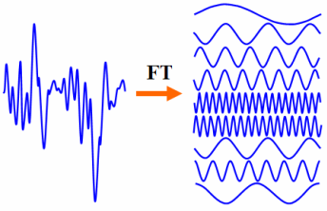
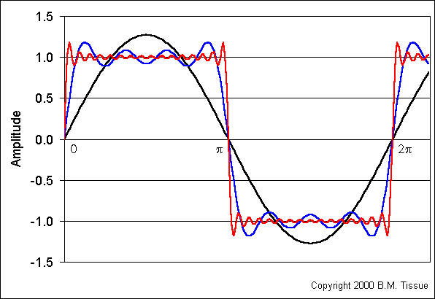
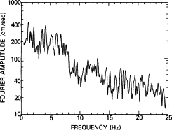
The Fourier (De-)Composition
Decomposing signals
into sine/cosine terms
Approximating a step function
with Fourier terms
Frequency Spectrum
1 term
4 terms
16 terms

Slide 12
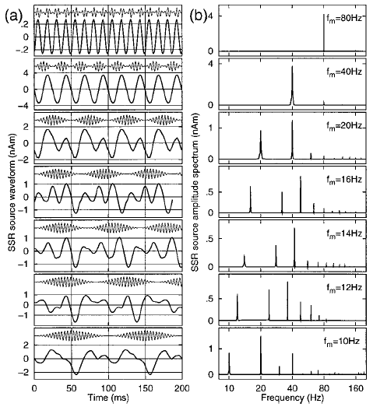
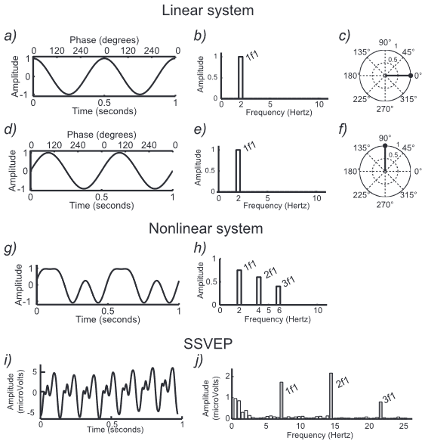
Steady State Responses
Auditory Steady State Response
(ASSR)
Visual Steady State Response
(VSSR)
Ross et al., JASA 2000, https://pubmed.ncbi.nlm.nih.gov/10955634/
Norcia et al., J Vision 2015, https://www.ncbi.nlm.nih.gov/pmc/articles/PMC4581566/

Slide 13
Fast Periodic Visual Stimulation (FPVS)

Slide 14
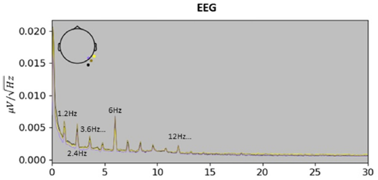
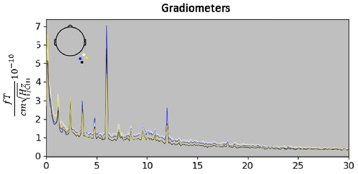
Fast Periodic Visual Stimulation (FPVS)

Slide 15
Fast Periodic Visual Stimulation (FPVS)
Hauk et al., NI 2021, https://www.sciencedirect.com/science/article/pii/S1053811921007345

Slide 16
Motivation for Time-Frequency Analysis
Fourier Transform assumes sines and cosines with constant amplitudes across the whole time series (“stationarity”).
But what does an FFT mean for a signal like this?
Signal
FFT Spectrum
Amplitude
Power
Time
Frequency

Slide 17
Motivation for Time-Frequency Analysis
You could run separate FFTs for different (sliding) time windows:
Time
But different window sizes are more or less optimal for different frequencies.
Run different FFTs with different window sizes for different frequency ranges? Ouff.

Slide 18
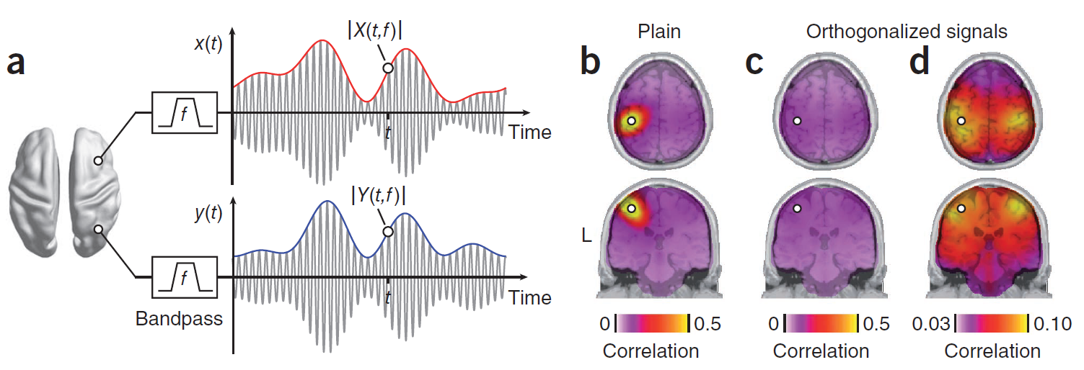
Functional Connectivity of Resting State Activity
(“Hilbert”) Envelope for a frequency band
Hipp et al., Nat Nsc 2012, https://www.nature.com/articles/nn.3101

Slide 19
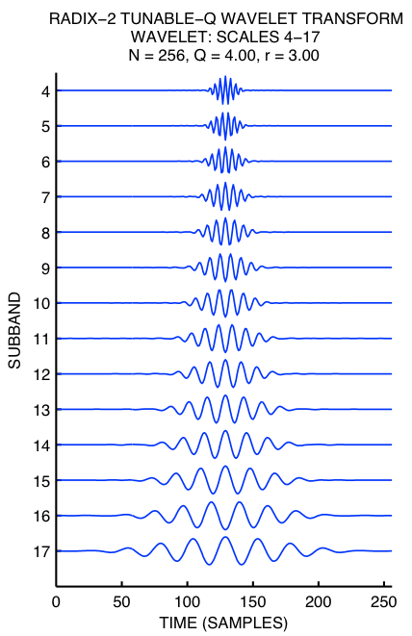
Time-Frequency Analysis: Wavelets (“little waves”)
Wavelets provide an optimal trade-off between frequency and time resolution.
Wavelets are getting “broader” with decreasing frequency
=>
Time resolution decreases as frequency decreases
Frequency ->
Wavelets are convolved with the data to give instantaneous amplitude and phase estimates for different frequency ranges.

Slide 20
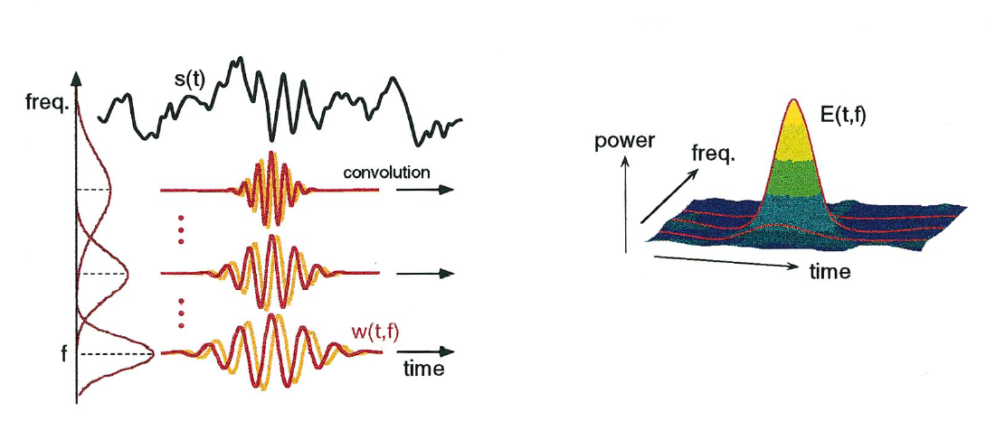
Time-Frequency Analysis: Wavelets
Wavelet Transform
Trade-off between time and frequency resolution
Time-Frequency Power
Tallon-Baudry & Bertrand, TICS 1999
https://pubmed.ncbi.nlm.nih.gov/10322469/

Slide 21
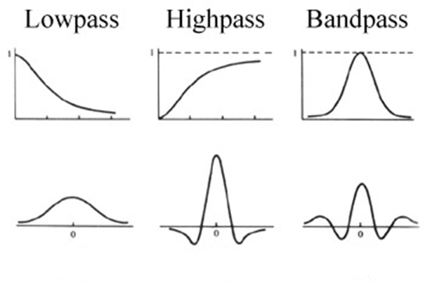
Where have we seen this before?
Basic Principals of Frequency Filtering
Time-domain and frequency-domain filtering are two sides of the same coin:
One type of frequency-domain filtering corresponds to one type of time-domain filtering.
Frequency domain
Frequency
Time domain
Time
https://uk.mathworks.com/matlabcentral/fileexchange/51155-time-domain-filtering-vs-frequency-domain-filtering-in-images

Slide 22
A Very Rough Rule of Thumb
One needs at least 2 cycles of a frequency to get a meaningful estimate
(of amplitude, phase, etc.)
Duration (in ms) of 2 cycles at frequency f (in Hz): 2*1000/f
1 Hz: 2000 ms = 2 s
10 Hz: 200 ms = 1/5 s
40 Hz: 50 ms = 1/20 s
100 Hz: 20 ms = 1/50 s
The lower the frequency, the longer the time window required to estimate the signal.

Slide 23
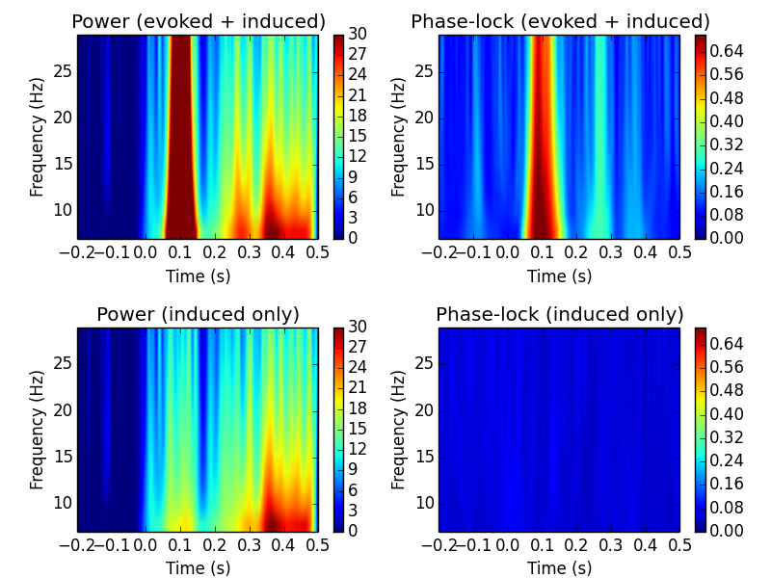
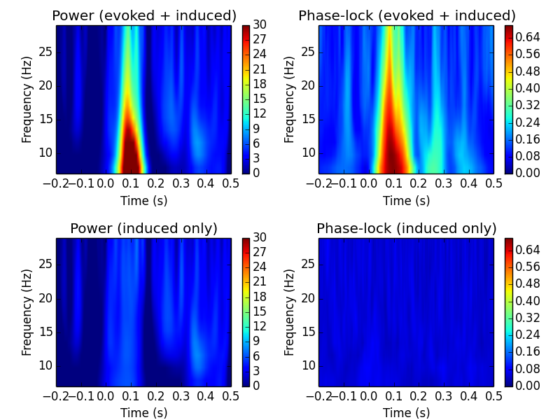
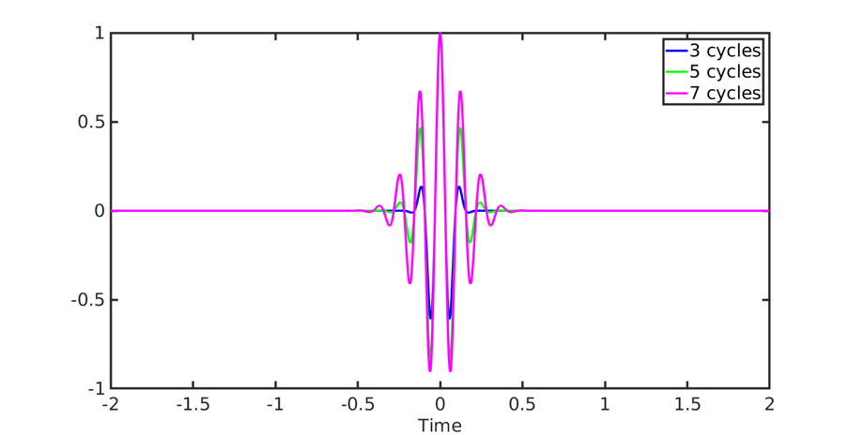
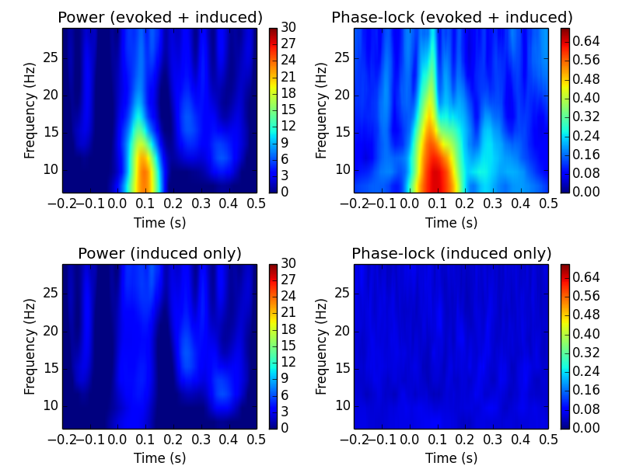
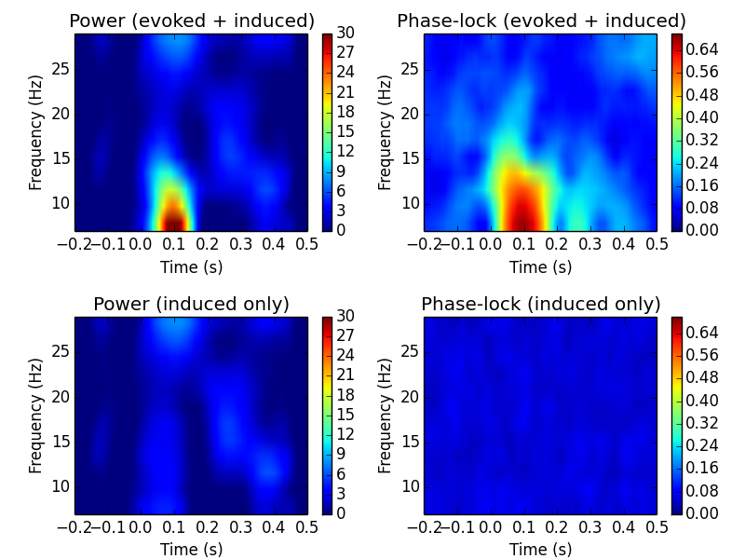
Effect of Number of Cycles
1 cycle
2 cycles
3 cycles
Freq/3 cycles
Rule of thumb: For low frequencies (<~10Hz), n=2 or 3; for higher frequencies n=f/3.

Slide 24
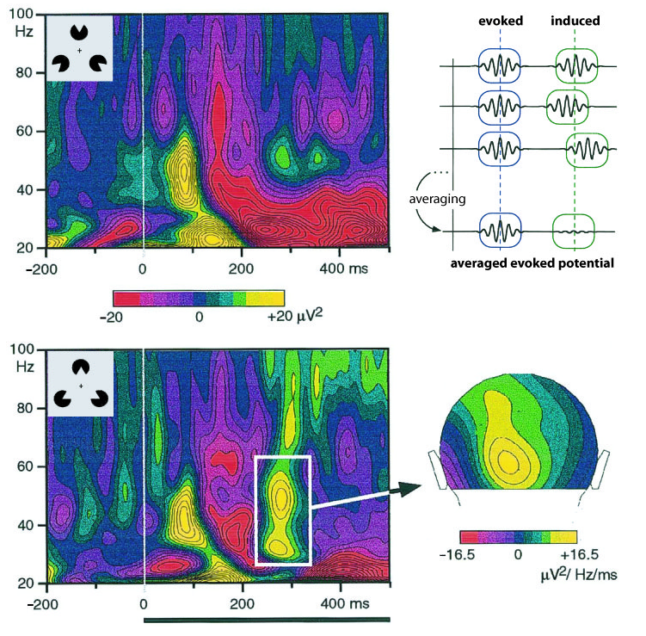
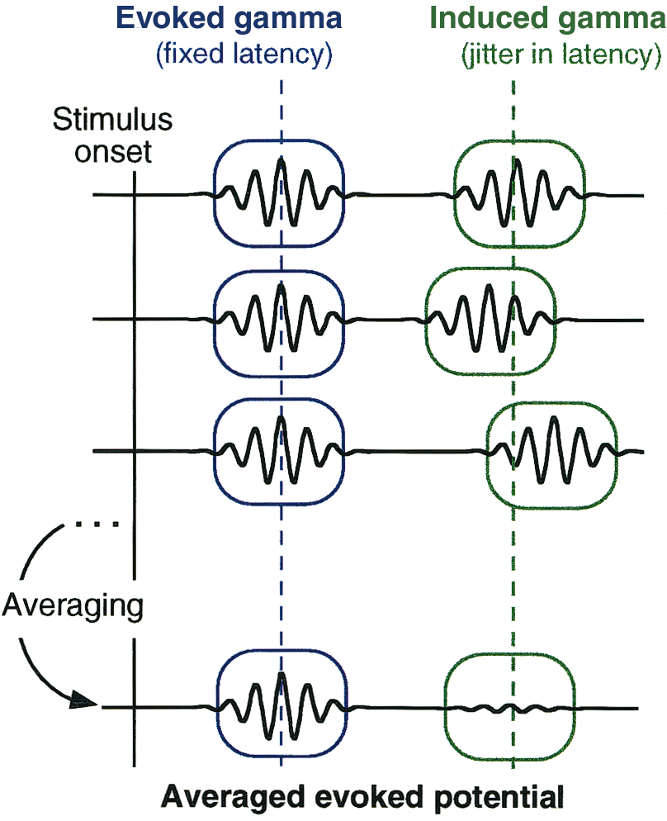
Evoked and Induced Rhythmic Activity
Time ->
evoked
induced
Frequency ->
Tallon-Baudry & Bertrand, TICS 1999
https://pubmed.ncbi.nlm.nih.gov/10322469/

Slide 25
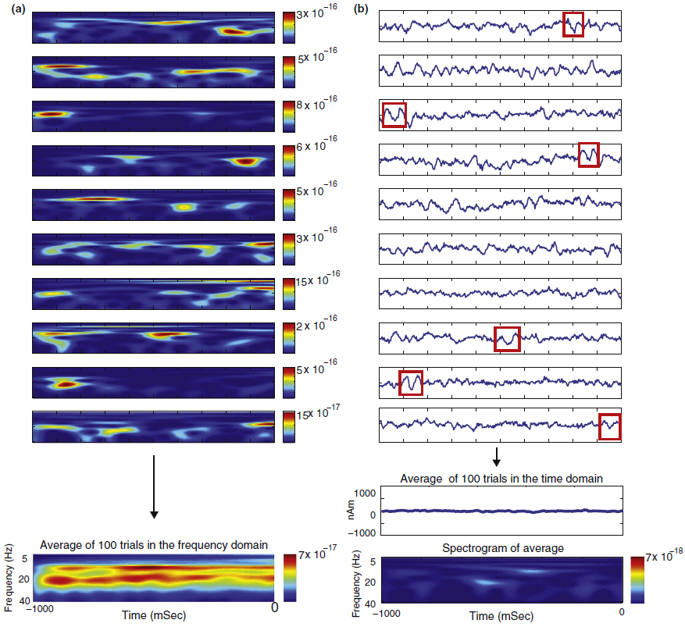
When brain rhythms aren’t “rhythmic” – the example of beta “oscillations”
“beta bursts”
rather than “oscillations”
Jones et al., Curr Op Neurobiol 2016
https://pubmed.ncbi.nlm.nih.gov/27400290/

Slide 27
“Single-Trial Analysis” and Source Estimation
Computing the power of a signal is a non-linear transformation.
Linear transformations are associative:
T(a+b) = T(a)+T(b)
Therefore, the result is the same whether you apply a linear transformation before or after averaging your epochs.
Spectral power is non-linear!
If you want the average power, you have to compute power for individual epochs first, then average.
The noise level and a priori knowledge about sources will be different for single trials compared to the average.
For example, a single/multiple dipole model may be justified for the average (e.g. auditory P1 etc.), but not for single trials.

Slide 28
Power Estimation Changes the Time Course
+
sine(x)
sine²(x)
-
For example, the frequency spectrum for sine(x) and sine²(x) are very different.

Slide 30

Thank you
MRC Cognition and Brain Sciences Unit
@MRCCBU
mrc-cbu.cam.ac.uk

