Slide 1
Matlab Lecture - 4th December 2012
Structuring & debugging
Matlab code
Danny Mitchell
(adapted from Rhodri Cusack)

Slide 2
Outline
Writing clear code
Writing code that works (debugging)
Writing faster code
Writing code faster
A red outline to code indicates it is an example of BAD PRACTICE
X

Slide 3
Why write clear code?
Easier in many ways…
  to follow while you are writing and debugging it
  (i.e., reduces the chances of bugs)
  to understand when you come back to it later
  to modify
  for others to understand and modify

Slide 4
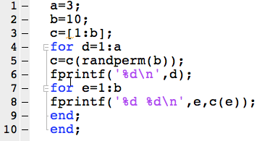
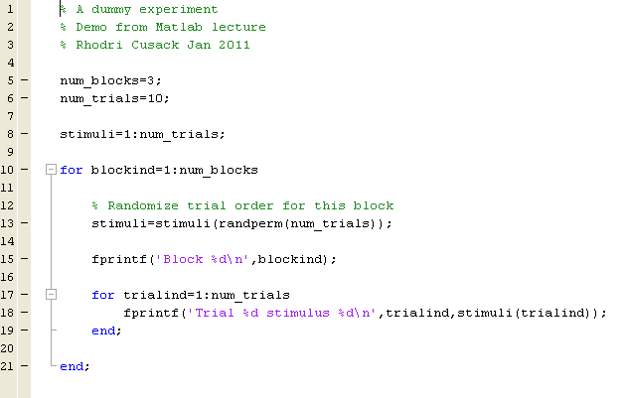
Making code more readable (example 1)
X
Structure your code
  Leave spaces
  Indent (Ctrl-I)
Use meaningful variable names
Add comments
Be consistent
    myVariable
    MyVariable
    myvariable
    my_variable
    MYVARIABLE
Modularise (use sub functions)
Cells to demarcate regions

Slide 5
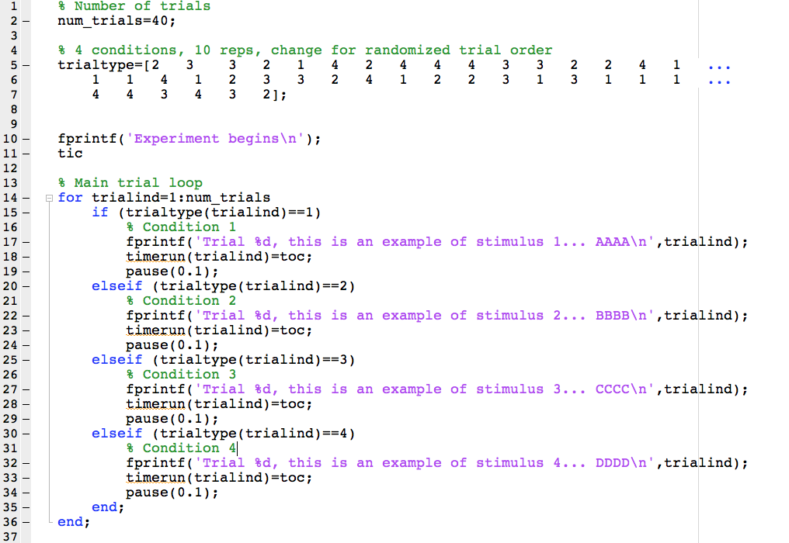
Making code more readable (example 2):
Write this more clearly…
X
Repeated (especially non-independent) information
makes it hard to change, and allows odd inconsistencies
Long manually entered lists are hard to
check, easy to get wrong, and hard to
change
Repeats of similar code are tedious to write, read and maintain.
Easy way to introduce bugs!

Slide 6
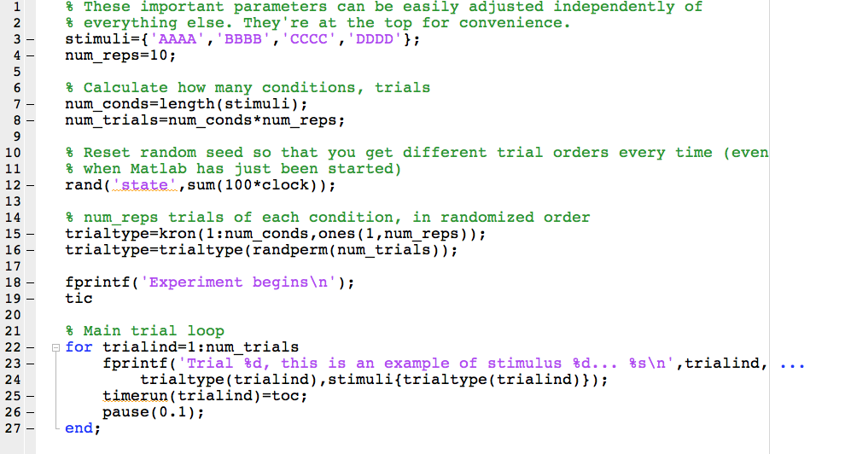
Making code more readable (example 2): Maybe you did better?
Occasionally syntax changes between versions:
RandStream.create('mt19937ar','seed',sum(100*clock));
There are often many ways to skin a cat:
trialtype=repmat(1:num_conds,[1 num_reps]);

Slide 7
Structuring your code into functions
As scripts become larger, they can become cumbersome
  Hard to find one section
  Hard to run just one part (although there is a mechanism for this, cell execution, in later Matlab versions)
  Hard to reuse one part – need to find it, remember what variables it needs and so on
Functions are usually better:
  See Jason’s slides
  encapsulate job, with a well defined input and output interface
  No need to worry about what might or might not be in the workspace
  Easier for Mlint to spot more potential problems
This is another good chance to make things readable:
  Choose clear function names
  Document each function, in particular, saying what the input and output parameters are
  Structure them into directories
Code-folding can also make a large file more readable

Slide 8
Keeping the workspace tidy, and optimizing memory
Use the appropriate data type
Use sparse variables?
Initialise variables prior to use (largest first)
Group related variables into structures?
Clear unwanted variables (but be careful!)
Pack (command-line only)
Other options (last resorts?):
Launch without Java Virtual Machine?
Save to file (slow)

Slide 9


Debugging
It is rare for anyone to write a piece of code that works first time
When you identify a problem:
  Don’t Panic!*… (it’s normal)
  Read the error message!
  Stare at the code for a little while to try to work out what is wrong
  If this doesn’t work, test the code in different ways to narrow down the problem.
    value of variables in workspace
    data type of variables
    shape and size of matrices
    functions on path
    Plot data (See Matt and Ed’s talk)
  Built-in help, online documentation, manuals, CBU wiki
  A programmer’s secret…
  Phone a friend
How long does debugging take?
  10s – 24 hours per bug
* Arthur C. Clarke said Douglas Adams' use of "Don't panic” was perhaps the best advice that could be given to humanity.

Slide 10
Integrated development environments (IDEs)
Integrated design/debugging environments
Typically consist of:
  Source code editor
  Compiler/interpreter
  Debugger
Makes coding much easier
  The cycle of “tweak code - rerun – examine output” is a major factor in how long a program takes to write.
  “Debuggers” let you run code line-by-line and examine what is happening
  M-Lint will…
    spot errors,
    potential errors,
    opportunities for optimization,
    and suggests improvements!
    Calculate McCabe complexity metric (mlint filename.m –cyc) …aim for < 10
    Shut up if you tell it to: %#ok
  useful for simple problems, and invaluable when tackling more complex code.
  useful to fix own code, or to work out what another program (e.g. SPM) does.
A little time becoming familiar with the debugger is time very well spent!

Slide 11
K>> Using the debugger
Breakpoints
  Adding breakpoints manually
  Triggering debug mode on an error (dbstop if error)
  Triggering debug mode immediately from a script (dbstop(mfilename))
  conditional breakpoints (dbstop in MFILE at LINENO if EXPRESSION)
Moving in the stack
  dbup, dbdown
Progressing through the code…
  dbcont (F5)
  dbstep (F10)
  dbstep in (F11)
  dbstep out (shift+F11)
…or not
  dbquit
Catching an error without the debugger
  try……catch……end
Be careful! Record the exception

Slide 12
K>> Practice using the debugger!
Errors we will encounter in the function debugging_practice.m:
  ??? Unbalanced or unexpected parenthesis or bracket.
  ??? The expression to the left of the equals sign is not a valid target for an assignment.
  ??? Input argument "MySize" is undefined.
  ??? Maximum variable size allowed by the program is exceeded.
  ??? Error using ==> interp2 at 147: XI and YI must be the same size
  ??? Subscript indices must either be real positive integers or logicals.
  ??? Conversion to cell from double is not possible.
  ??? Reference to a cleared variable
  ??? Undefined function or method 'showmatrix' for input arguments of type 'double'.
  ??? Error using ==> set: Width and height must be > 0
  ??? Error using ==> axes: Value must be a 4 element vector
  ??? Undefined function or variable x2

Slide 13

Writing faster code: Vectorization
Matlab has been designed for maths
For some things (e.g., matrix maths) it is very fast:
  Highly optimized libraries much faster than if you wrote your own C code
Interpreted language, and loops can take forever:
BUT…
  Sometimes loops are necessary.
  Sometimes loops are more intuitive.
  If you are going to use a slow loop,
  indicate progress! E.g…
    fprintf
    drawnow
1700 times slower!
(but most of this can be recovered by preallocation)

Slide 14
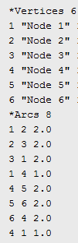
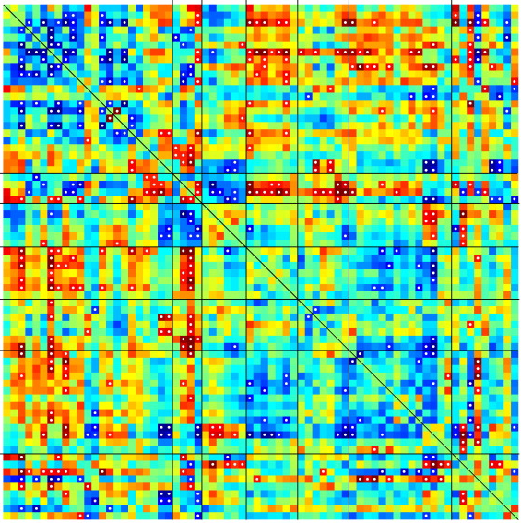
Vectorization: a real life example
Write out a connectivity matrix to Pajek format:
~11,000 nodes
~140,000,000 connections

Slide 15
Writing code faster
Parallelization
matlabpool
parfor
Is it worth it?
GPU
Optimization can become addictive
You might want to use the Matlab Profiler, which will tell you which parts of your code take the most time
A rare case… run-once jobs
  A. Spend 1 hour writing the code, and 10 hours running it
  B. Spend 10 hours writing the code, and 1 hour running it

Slide 16
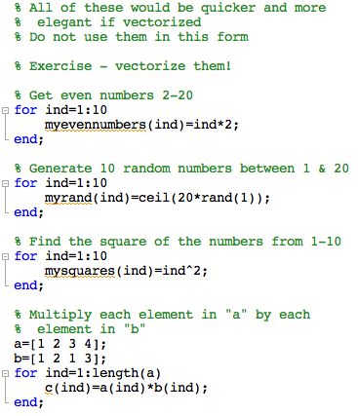
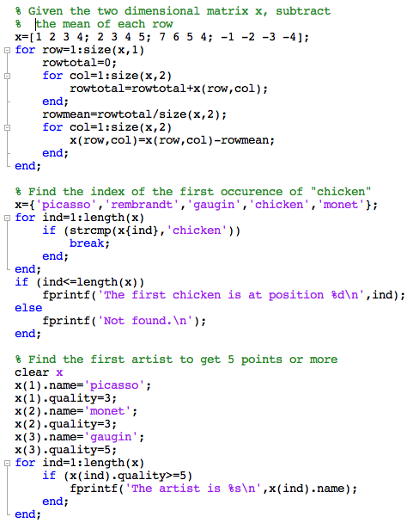
Vectorization excercises

Slide 17
Documentation
Some of the tips in this presentation should help you make code that is more “self documenting”
However, explicit documentation is important
  Document each script or function at the top, saying what it does and what inputs and outputs it has, and give an example of useage.
  Say what changes you make subsequently
  Add documentation to wikis, websites and so on
  The chances are, it will be you that needs it most!

Slide 18
Using objects to structure code in Matlab
Object-oriented programming is a way of programming first invented by the Xerox PARC & popularised by C++ & Java
  Combine the specification for storing data about something (“properties”) and the functions that can manipulate this data (“methods”)
  A description of a type of object is called a “class”
  A single object is called an “instance”
  Classes are hierarchical, so one class may derived from another, inheriting all of the properties & methods, and then adding new ones
Matlab has a way of implementing this – look out for directories called @something
  These are class descriptions
  (e.g., @nifti & @meeg in SPM; see Rik’s lecture)
Essentially, another way of organizing things

Slide 19
Version control (not specific to Matlab)
Version control (or source control) programs such as subversion (SVN) or Git can be invaluable
A “repository” of the code keeps track of all changes
  Any previous version may be accessed
You can synchronise your local copy with someone else’s
  You can both change different parts of the code simultaneously and then the source control program will integrate the changes
  If you both change the same piece, there is a “conflict resolution” mechanism
Particularly useful for larger projects with many files or ones you are working with more than one person

Slide 20
Practice makes better.
Ever tried. Ever failed. No matter.
Try again. Fail again. Fail better.
Samuel Beckett, 1983
Good luck!

