Slide 1
Introduction to signal analysis in Matlab: GLM I
Ed Sohoglu
MRC Cognition and Brain Sciences Unit
13th November 2018

Slide 2
General Linear Model (GLM)
Important statistical tool used in psychology and neuroscience for analysing behavioural data, EEG, MEG, fMRI etc.
It is “general” because it can accommodate many different types of statistical tests all in the same framework (e.g. t-tests, regression, correlation, ANOVA etc.)

Slide 3
General Linear Model
Y = β1X1 + β2X2 + …
Y is the observed data (e.g. reaction time, BOLD activity)
X is our ‘design matrix’ containing all our explanatory variables/regressors (e.g. condition, group or continuous covariates like age)
β1 captures how much X1 explains the data in Y (and so on for β2 etc.)
Usually we know Y and X so we try to solve for β

Slide 4
Solving for β: Numerical example
Simple scenario: Y = β1X1
If Y = 10 and X = 2, what is β?
Use what we know from linear algebra
  Y / X1 = β1X1 / X1
  Or β1 = Y / X1
  Or β1 = YX1⁻¹
Try in Matlab:
Y = 10; X = 2;
B = Y * inv(X);

Slide 5
Solving for β: Extension to matrices
Usually our data do not consist of a single number (Y = 10) but rather several numbers (Y = 10 5 6 2 1), one number for each trial or subject (N)
Our design matrix X will also contain several numbers, arranged as a rectangular array (i.e. matrix) of N subjects (rows) by M variables/regressors (columns)
This means we need the matrix formulation of the GLM:
Y₁
Y_{n}
Y_{N}
X₁₁ … X_{1m} … X_{1M}
X_{n1} … X_{nm}… X_{nm}
X_{N1} … X_{Nm}… X_{NM}
β₁
β_{m}
β_{M}
=
Or more concisely: Y = XB

Slide 6
Solving for β: Matrix example
As before, we are trying to solve for B in the equation Y = Xβ
If Y = [-5 10] and X = [2 -1; 0 1], what is β?
Solution same as before
  β = X⁻¹Y
Try in Matlab:
Note that matrix inversion is not the same as element-wise division!
Compare in Matlab:
So how do we know that the solution for B is correct? Because XB should equal Y.
Check in Matlab:
Y = [-5 10]'; X = [2 -1; 0 1];
B = inv(X) * Y;
inv(X)
1./X
X*B

Slide 7
Pseudoinverse
The matrix inverse is only defined for square matrices. This is a problem if we have the typical situation of fewer explanatory variables than subjects/trials (i.e. the number of columns in X is less than the the number of rows)
The matrix inverse is also only defined when none of our explanatory variables are linear combinations of other explanatory variables
In these situations, the pseudoinverse can be used instead
In Matlab: pinv()

Slide 8
Graphical example
Our data are mean reaction times (RTs) from 10 subjects.
Use GLM to model RT as a function of subjects’ age
RT (ms)
RT = age*β1 + c + e
Using the inverse of X to solve for β minimises the error and therefore gives us the least squares solution (i.e. the best fit of the GLM to our data)
β1 = 3
c = 490
Age

Slide 9
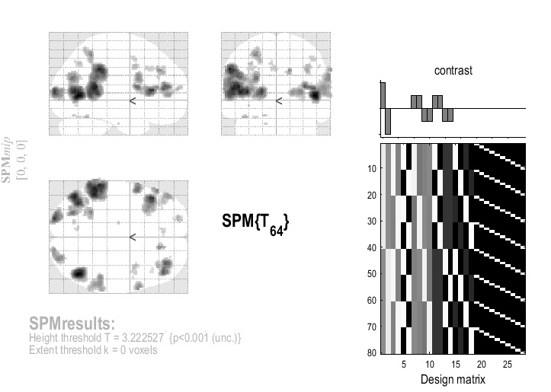
Visualising the design matrix
Commonly seen in neuroimaging software like SPM
What does our design matrix for the age/reaction time experiment look like?
Subjects
Β1 (age)
c

Slide 10
Useful references
Handbook of Functional MRI Data Analysis (Poldrack, Mumford and Nichols 2011). Appendix A: “Review of the GLM”
Cyril Pernet’s website http://www.sbirc.ed.ac.uk/cyril/glm/GLM_lectures.html
Poline and Brett (2012) NeuroImage “The general linear model and fMRI: Does love last forever?”

