Slide 1
Analysis of Longitudinal Data
Peter Watson
MRC CBU

Slide 2
Changes over time

Slide 3
Multilevel models
Nesting of levels
Pupils<Classes<schools
postcode areas<cities<regions
Time<participants
Time level 1, participant level 2

Slide 4
GLMs and GLMMs
GLMs: fixed effects, only random effect is error variance
Y = XB + error
GLMMs: fixed and random effects
Y= XB + ZU + error
Z is a subset of variables, B, which can additionally vary randomly with variance U

Slide 5
Variance components derivation: 5 time points BDI
Expected Mean Squares
Variance Component
Source Var(Participant) Var(Error) Quadratic Term
Intercept 5.000 1.000 Intercept
Participant 5.000 1.000
Error .000 1.000
Dependent Variable: BDI

Slide 6
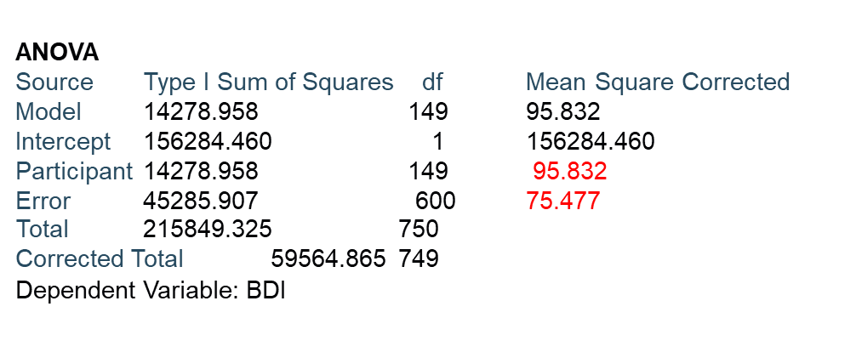


Derivation of variance components (5 time points on BDI scores)
ERROR(SUBJECTS)
$$σ_{e}^{2}$$
ERROR(TIME W SUBS)
(95.832-75.418)/5=4.08,
VC(SUBJECTS)
$$σ_{u_{0}}^{2}$$

Slide 7
Multilevel models see Field (2013) 823, 824
Random intercepts (with the intercept term included)
    Y_{ij} = β₀ + μ₀ + β t_{ij} + ε_{ij}
Random slopes (time i on j-th person)
    Y_{ij} = β₀ +(β_{t} t_{ij} + μ_{t}) + ε_{ij}
Random intercepts and random slopes
    Y_{ij} = (β₀ + μ₀ )+(β_{i} t_{ij} + μ_{t} ) + ε_{ij}
Handles incomplete cases
Useful for handling more than one random factor e.g. in studies featuring items tested on subjects

Slide 8
Multilevel models in R (Code adapted from Adam Wagner in Simblett et al. 2017) and data based on intervention over time in Blackwell et al. (2015)
library(lme4)
Lme continuous outcome
Lmer continuous; uses slightly different syntax to lme
Do the same thing but you can do some things with one but no the other
Glmer handles counts and binary outcome

Slide 9
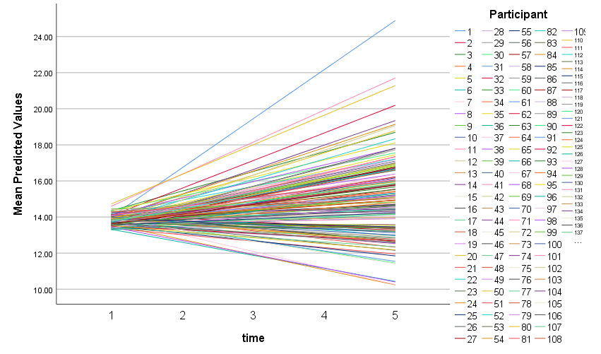
Random slopes and intercepts
With the Random Slopes model we allow the slope to be estimated for each level
of the higher level variable (participant)
Random intercepts, random slopes and their correlation, r(μ_{1j}, μ_{0j}) usually negative since lower scores have more scope to rise over time

Slide 10
Features
Likelihood ratio tests as with GLMs
Uses anova(model1, model2) to compare fits
Effect sizes: need to use lme to obtain these
library(effects)
Residual plot checks: uses lme output
Normal probability plots (qqplots)

Slide 11
95% Confidence intervals for Beck score means

Slide 12
95% Cis use lme
bdiModelB <- lme (BDI~grp*time+Gender+BDIcategory , random=~1|id,data=BDIData)
intervals(bdiModelB)
summary(bdiModelB)

Slide 13
Parameters
> bdiModelA
Formula: BDI ~ grp * time + Gender + BDIcategory + (1 | id)
Data: BDIDataFixed Effects:
(Intercept) grpTreatment
29.5707 -1.1278
time3m timeBaseline
1.5957 2.6809
timeFollow-Up timePost
-1.1064 -2.4468
GenderMale BDIcategorySevere
0.4985 0.7279
grpTreatment:time3m grpTreatment:timeBaseline
0.9857 -0.9832
grpTreatment:timeFollow-Up grpTreatment:timePost
3.9901 5.3538

Slide 14
> summary(ef)
grp*time effect
time
grp 1m 3m Baseline Follow-Up Post
Control 30.09441 31.69015 32.77526 28.98802 27.64760
Treatment 28.96658 31.54797 30.66425 31.85030 31.87356
Lower 95 Percent Confidence Limits
time
grp 1m 3m Baseline Follow-Up Post
Control 27.28338 28.87912 29.96423 26.17700 24.83657
Treatment 26.02756 28.60895 27.72523 28.91128 28.93453
Upper 95 Percent Confidence Limits
time
grp 1m 3m Baseline Follow-Up Post
Control 32.90544 34.50118 35.58629 31.79905 30.45863
Treatment 31.90560 34.48700 33.60327 34.78932 34.81258

Slide 15
Interpretation
the difference of form:
(time k – 1m) in treatment - ( time k – 1m) in controls
= (31.87-28.97) - (27.65-30.09) = 2.90 + 2.44 = 5.34 is
represented by the grpTreatment:timePost regression coefficient in bdiModelA in lmer

Slide 16
Time by group interaction LRT
> anova(bdiModelA,bdiModelB)
refitting model(s) with ML (instead of REML)
Data: BDIData
Models:
bdiModelB: BDI ~ grp + time + Gender + BDIcategory + (1 | id)
bdiModelA: BDI ~ grp * time + Gender + BDIcategory + (1 | id)
npar AIC BIC logLik deviance Chisq Df Pr(>Chisq)
bdiModelB 10 3345.4 3386.5 -1662.7 3325.4
bdiModelA 14 3346.4 3403.9 -1659.2 3318.4 7.0687 4 0.1323
>

Slide 17
Conversion of t values to Cohen’s d (Pustejovsky (2014))
Cohen's d = t [Sqrt(1/n1 + 1/n2)] (two independent groups)
                Value Std.Error DF t-value p-value
grpTreatment:timePost 5.353785 2.8851709 352 1.855622 0.0643
summary(as.factor(BDIData$grp))
Control Treatment
235 215
library(psych)
t2d(t=1.86,n1=235,n2=2151.86* sqrt(1/235 + 1/210)
d.ci(0.17,n1=235,n2=215) lower effect upper
[1,] -0.0153978 0.17 0.3552099

Slide 18
Effect sizes
ef <- effect("grp:time", bdiModelA)
> summary(ef)
grp*time effect
time
grp 1m 3m Baseline Follow-Up Post
Control 30.09441 31.69015 32.77526 28.98802 27.64760
Treatment 28.96658 31.54797 30.66425 31.85030 31.87356
Lower 95 Percent Confidence Limits
time
grp 1m 3m Baseline Follow-Up Post
Control 27.28338 28.87912 29.96423 26.17700 24.83657
Treatment 26.02756 28.60895 27.72523 28.91128 28.93453
Upper 95 Percent Confidence Limits
time
grp 1m 3m Baseline Follow-Up Post
Control 32.90544 34.50118 35.58629 31.79905 30.45863
Treatment 31.90560 34.48700 33.60327 34.78932 34.81258

Slide 19
Orthogonal polynomials: Wilson et al. (2000)
orth_poly <- poly(yy2$V14, degree=2)
p301 <- lm(yy2$V12 ~ orth_poly)
p301 <- lm(yy2$V12 ~ yy2$V14 + I(yy2$V14^2))

Slide 20
Orthogonal polynomials of learning

Slide 21
BDI data: quadratic polynomial fits (N=90); different intercepts, same slope
bdiModelA <- lmer(BDI~time2+I(time2^2) + (1|id),
data=BDIData)
pred <- fitted(bdiModelA)
plot(time2,pred)
(time2 = time expressed as a numeric)
Is there a time^2 by group interaction?

Slide 22
Single changepoint

Slide 23
Single changepoint as a regression
Y = A + B1 (time-K1)[I(time<=k1)] + B2 (time-K1) [I(time>=k1)]
where I() is the indicator function. npts in the code below are the number of time points (equal to 10 in this example).
K1=3; two linear predictors both zero at the third timepoint
> gp1
[1] -2 -1 0 0 0 0 0 0 0 0
> gp2
[1] 0 0 0 1 2 3 4 5 6 7

Slide 24
Where is the changepoint
Permuting through all possible changepoints the best fit is a changepoint at time 5 (lowest RSS)
print(rss1)
[1] 37.587879 26.072222 15.911538 11.560790 8.494118 15.123529 27.277812
[8] 33.815385 36.472222 37.587879

Slide 25
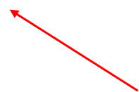
Any number of changepoints (Kashlak, 2019)
cpt.meanvar(x,penalty="Manual",pen.value="4*log(n)",method="BinSeg",Q=5,class=F)
[1] 50 100 150 152 200
User specified penalty function
Number of changepoints
Where mean and/or variance changes
}
Extra variation, same slope of change

Slide 26
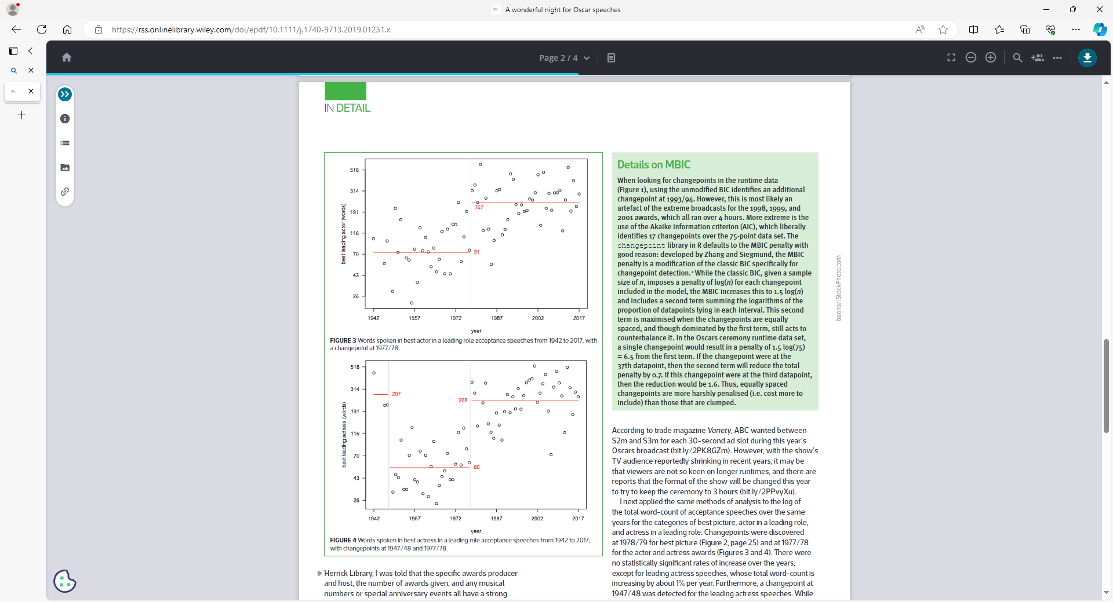
Kashlak, 2019 Oscar speech data: MBIC penalty

Slide 27
How mean.var locates changepoints
Cpt.Meanvar is in the changepoint library in R
Compares Residual SS for pairs of intervals of data to find changepoint
Penalty function (scaler*log(n)) increasing for each succeeding time point, n, reduces the danger of finding too many changepoints
AIC = n ln(RSS/n) + 2 number of terms in changepoint model
BIC = n ln(RSS/n) + number of terms in changepoint model*log(n)

Slide 28
Generalised Additive Models (Gams)
Y = Gam(t) = intercept + s(t,k) + covariates
where s() is a smoothing parameter with upto k knots, joins polynomials together, the knots form the joining points
Y can be a continuous score, binomial or counts (like a GLM)
Can extend GAM to GAMM to additionally have random effects e.g. a random intercept

Slide 29
Gams looking at IQ group differences: posterior Fossa (cancer treatment vs controls)
Carroll et al. (2016) and Wagner et al. (2020) continuous outcome

Slide 30
Gam modelling of intrusions (Holmes et al., 2016)
Small numbers of intrusions so use a Poisson distribution
Fit a Gam to the numbers of intrusions, I, on day t, t=1,8
Work out the predicted value and convert to a probability using
P(i) = E^{-mu} mu^{i} / i! where mu is the prediction from the Gam
Predicted value for day t = intercept + (t-1)*s(t,4), t=1,8

Slide 31
Number of Intrusions days 0-7
cond d0 d1 d2 d3 d4 d5 d6 d7
1 2 1 1 0 1 1 0 0
1 2 1 1 0 1 0 0 0
1 5 1 4 1 0 0 0 0
1 0 1 0 0 0 0 0 1
1 5 0 0 0 0 0 2 1
1 4 1 0 0 0 1 2 0
1 0 0 0 0 0 0 0 0
1 4 2 1 0 0 0 0 1
1 3 0 0 0 0 0 2 0
1 5 3 3 3 1 1 0 0
1 5 4 2 2 2 2 2 2

Slide 32
Gam syntax in R for intrusion example
library(gam)
ejt=read.table("ej_exp2_newdata_May14.txt",header=T)
y=seq(0,10)
poiser=function(x,i)
(exp(-x)*x^i)/factorial(i) computes probability of i intrusions on day t with the mean number of intrusions on day t in x(t)
r1=gam(as.vector(t(ejt[1:26,3:10]))~(s(rep(1:8,26),4)),family="poisson") fit gam
barplot(poiser(r1$coef[1],y),names.arg=c("0","1","2","3","4","5","6","7","8","9","10"),xlab="Number of Intrusive Memories",ylab="Probability", main="Day 0",,ylim=c(0,1),col=rgb(0,0,0,max=255)) barplot of predicted daily numbers of intrusions

Slide 33
Predicted number of intrusions (mu) on each day for 26 controls (N=26) (same for each person, fixed effect)
> r1$fitted.values
1 2 3 4 5 6 7 8
3.1405682 1.3468241 0.9970647 0.9001482 0.7534677 0.7053244 0.6011870 0.4015696
9 10 11 12 13 14 15 16
3.1405682 1.3468241 0.9970647 0.9001482 0.7534677 0.7053244 0.6011870 0.4015696
17 18 19 20 21 22 23 24
3.1405682 1.3468241 0.9970647 0.9001482 0.7534677 0.7053244 0.6011870 0.4015696
25 26 27 28 29 30 31 32
3.1405682 1.3468241 0.9970647 0.9001482 0.7534677 0.7053244 0.6011870 0.4015696
33 34 35 36 37 38 39 40
3.1405682 1.3468241 0.9970647 0.9001482 0.7534677 0.7053244 0.6011870 0.40156
…..

Slide 34
Predicting numbers of intrusions over 10 days (Mike Bonsall) in Holmes et al. (2016)

Slide 35
Time series plot of intrusions using Gam
Look at number of intrusions in the control group over 8 days 0-7
Number of intrusions day i-1 = intercept + (i-1)*s(t,7) i=1,8
Only plot days where at least one intrusion occurs
Blob plot with area of blob proportional to number of intrusions

Slide 36
Time series syntax for Gam
pdf("U:\\My Documents\\ej_Control_Group_April14.pdf")
symbols(x=dfxa$ev1, y=dfxa$ev2, circles=sqrt(dfxa$ev3/pi), inches=0.25, bg=rgb(0,0,0,max=255), fg=NULL,xlab="Time (Days)",ylab="Number of Intrusive Memories",main="No-Task Control",bty="l")
r1=gam(as.vector(t(ejt[1:26,2:9]))~(s(rep(1:8,26),4)),family="poisson") fit gam
o=order(rep(0:7,26))
lines(rep(0:7,26)[o],r1$fitted[o],lwd=3) plot predicted numbers of intrusions
dev.off()

Slide 37
Time series in gam (Mike Bonsall) in Holmes et al. (2016)

Slide 38
Gam with random subject BDI scores (intercepts)
                Random subject intercepts
x <- rnorm(450)
r2=gam(BDI~x+s(idd, bs="re"),data=BDIData,family="gaussian")
Idd is a factor (subject identifier, N=90), BDI is Beck score and x is a covariate; gam with random intercepts doesn’t seem to like additionally smoothing of factors like time into a random effects model
Covariate varies across both time points and subject

Slide 39
Specific case
A specific case of a Gamm is a random (intercept) effects model fitted by lme and lmer
r2=gam(BDI~time2+s(idd,bs="re"),data=BDIData,family="gaussian")

Slide 40
Gam with random subject intercept and varying covariate fitted to Beck data

Slide 41
Path Diagram:Features (1)
Ellipses
  (unobserved) factors
Rectangles
  (observed) variable scores
Intercepts
(used to compare means)
or

Slide 42
Path Diagram: Features (2)
Straight arrows
  loading coefficients (factors to observed)
  residuals (to observed)
Curves with arrows on each end
  correlations between factors
  correlations between residuals

Slide 43
Comparative Fit Index (CFI)
Recommended by Peter Bentler (2007), “Mr EQS”
0<= CFI <=1
CFIs above 0.9 indicate a good fit
(some controversy over using cut-offs - Barrett (2007), Heene et al (2011))
Compares fits of observed and the “null” model
  “null” model assumes no relationship between any pair of variables
Favours parsimonious models

Slide 44
Assessing model fit
Can compare some model fits
N > 100 Chi-square gives false +ves
Fit indices proposed as alternatives
some commonly fit indices used
  CFI - Comparative Fit index
  NFI (also called TLI) - normed fit index
  NNFI - Non-normed Fit index
Other indices are also recommended (Bentler, 2007) based on residuals

Slide 45
Other fit indices (including information criteria) are available
Fit indices for non-Normal data which re-scale the chi-square
Fit indices which make sure each factor loading in the model is “pulling its weight” (Akaike’s information criterion=AIC, Schwarz bayesian criterion=BIC)
AIC = Model chi-square – 2 x model df
(takes into account number of loadings as well as model fit)
BIC = Model chi-square – Log(Sample Size) x model df;
BIC differences >10 suggest better fit (Raftery, 1995)
Preacher et al (2012) suggest 95% bootstrap CIs for BIC

Slide 46
TEACh data (Manly et al)
293 children (aged 6-16) from Melbourne, Australia had their attention levels tested
Three hypothesised attention types
  Selective (2 measures)
  Switch Control (2 measures)
  Sustained (5 measures)

Slide 47
Model fit
MODEL CHI-SQUARE P CFI
(df)
One factor 95.05 (27) <.001 .78
Three factor 32.09 (24) .125 .97
Good Fits: p>.05; CFIs > 0.9

Slide 48
3 Factor model
0.73
0.36
0.56
Switch
Sustained
Select
0.42
S
0.54
0.51
0.74
0.54
0.79
0.37
walk1
Skycon
Map1n
Creswt1
Optet
Scrdatt
0.46
Dualtask
code10
0.45
0.37
0.74
0.56
0.71
0.70
0.82
score1t
0.87
0.79
0.69

Slide 49
CFA in R (One time point)
Sem
Cfa (also unlike sem produces a completely standardised solution which is quoted in papers)
Can input matrix of (Polychoric or Pearson) correlations produced by e.g. hetcor or covariances or raw data

Slide 50
Polychoric input (R sem)
res <- hetcor(p1, p2, p3, p4, p5, p6, p7, p8, p9, p10, ML=FALSE, std.err=FALSE)
opt <- options(fit.indices = c("GFI", "AGFI", "RMSEA", "NFI", "NNFI", "CFI", "RNI", "IFI", "SRMR", "AIC", "AICc", "BIC", "CAIC"))
library(sem)
model.f1<-matrix(c( 'F1->p1', 'lam1',NA, 'F1->p6', 'lam2',NA, 'F2->p3', 'lam3',NA,'F2->p4', 'lam4',NA,…'F3->p9', 'lam10',NA,
'p1<->p1', 'th1' ,NA, 'p2<->p2', 'th2' ,NA, … 'p10<->p10', 'th10',NA,
'F1<->F1', NA, 1, 'F2<->F2', NA, 1, 'F3<->F3', NA,
'F1<->F2', 'gam1', NA,'F1<->F3', 'gam2', NA, 'F2<->F3', 'gam3', NA),
ncol=3, byrow=T)
sem.poly.f1<-sem(model.f1, res$correlation, 293)
summary(sem.poly.f1)

Slide 51
Cfa ( R lavaan)
p1 <- x$skycon_s
p2 <- x$score1ts
p3 <- x$creacc1s
p4 <- x$creswt1s
…
x <- data.frame(p1,p2,p3,p4,p5,p6,p7,p8,p9,p10)
opt <- options(fit.indices = c("GFI", "AGFI", "RMSEA", "NFI", "NNFI", "CFI", "RNI", "IFI", "SRMR", "AIC", "AICc", "BIC", "CAIC"))
config.invar<-'#factor loadings
eta1 =~ p1+p6
eta2 =~ p4+p10
eta3 =~ p2+p5+ p7+p8+p9
#latent variable variances
eta1~~eta1
eta2~~eta2
eta3~~eta3
#latent variable covariances
eta1~~eta2
eta1~~eta3
eta2~~eta3
#unique variances
p1~~p1
…
p10~~p10'
cfa.fit1<-cfa(config.invar,
data = x)
summary(cfa.fit1, standardized=T, fit.measures=TRUE)

Slide 52
Growth models using latent variables (Hojjat Farahani)
Latent factors representing each time point score
Intercepts to all times (loadings equal to 1)
Slope looking at change between time points
Linear slope usually fitted with values of 0,1,2,.. between times
Maths achievement scores in 606 students assessed at three time points; single score of motivation (covariate)

Slide 53
Maths (A1-A3) and Motivation (R1-R3) scores
> head(B)
A1 B1 C1 ABC1 D1 E1 F1 DEF1 G1 H1 I1 GHI1 R1 O1 A2 B2 C2 ABC2 D2 E2 F2 DEF2
1 18 12 25 55 17 23 29 69 10 20 16 46 15 15 25 9 15 49 32 29 37 98
2 30 15 11 56 18 25 24 67 11 16 14 41 13 11 28 15 15 58 36 32 30 98
3 26 7 9 42 18 30 28 76 9 19 14 42 10 16 30 12 18 60 37 34 40 111
4 25 11 18 54 18 34 36 88 10 22 13 45 12 10 30 15 20 65 32 36 36 104
5 22 7 17 46 18 33 26 77 8 20 15 43 11 14 25 12 16 53 42 32 29 103
6 12 7 15 34 18 38 35 91 9 21 17 47 14 13 30 15 15 60 40 38 36 114
G2 H2 I2 GHI2 R2 O2 A3 B3 C3 ABC3 D3 E3 F3 DEF3 G3 H3 I3 GHI3 R3 O3 R A
1 10 22 18 50 14 15 30 12 20 62 37 38 42 117 12 24 20 56 18 17 47 73
2 12 20 18 50 14 13 30 15 22 67 40 38 37 115 12 22 19 53 17 14 44 88
3 10 20 17 47 13 15 30 15 25 70 42 39 42 123 12 23 17 52 15 16 38 86
4 10 24 17 51 15 15 30 15 25 70 39 42 40 121 11 24 19 54 5 15 32 85
5 10 22 20 52 12 15 30 15 20 65 40 40 38 118 11 24 20 55 13 18 36 77
6 10 22 19 51 14 13 30 15 18 63 38 42 40 120 12 24 20 56 16 16 44 72

Slide 54
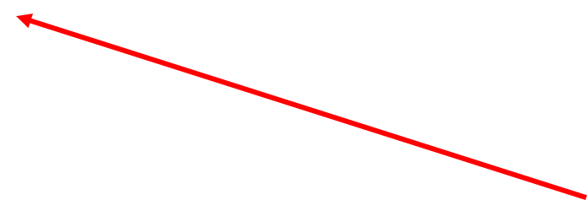


Linear Growth Curve
Ma2
Ma3
Ma1
1
2
0
1
2
1
1
1
Intercept
Slope
Motivation

Slide 55
Fitting in Lavaan
>model <- 'i=~ 1*R1 + 1*R2 + 1*R3 #intercept
+ s =~ 0*R1 + 1*R2 + 2*R3 #linear slope
i ~~ s # covariance of intercept and slope
+ i~A #average motivation score with intercept
+ s~A #average motivation score with slope
+ '
> fit <- growth(model, data=B ) # like sem but uses means
> fit

Slide 56
Results : parameter estimates
Intercept 14.78 (Maths score at T1)
Slope 1.34 (motivation goes up by 1.34 between each time point)
Regression (loadings)
Average Motivation score association with Math score at T1 -0.016 NS
Average Motivation score association with linear change in maths 0.003 NS

Slide 57
Average motivation effect compared with average from motivation at three time points with intercept (i) and slope (s) of maths score
Regressions:
Estimate Std.Err z-value P(>|z|)
i ~
A1 -0.033 0.030 -1.105 0.269
A2 -0.014 0.055 -0.264 0.792
A3 0.005 0.080 0.060 0.952
s ~
A1 0.010 0.010 1.002 0.316
A2 0.003 0.013 0.018 0.734 0.463
A3 -0.022 0.026 -0.837 0.402
Regressions:
Estimate Std.Err z-value P(>|z|) Std.lv Std.all
i ~
A -0.016 0.018 -0.922 0.356 -0.005 -0.038
s ~
A 0.003 0.006 0.547 0.584 0.003 0.025
{
-0.014
{

Slide 58
Results: Fit indices
summary(fit,fit.measures=TRUE, rsquare=TRUE, standardized=TRUE)
Fit indices > 0.98
RMSEA 0.077, 90% CI (0.03,0.13)
SRMR 0.013
Chi-square 9.23 (2df) p=0.01

Slide 59
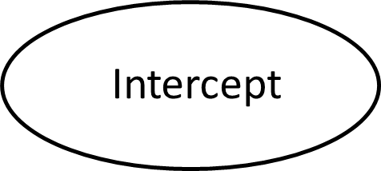


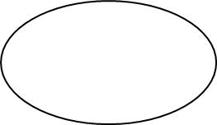

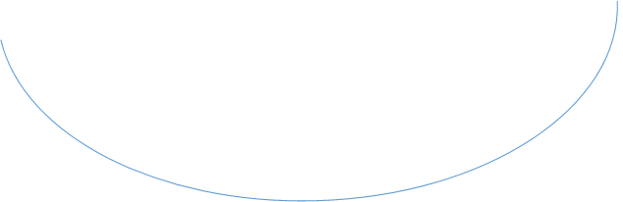
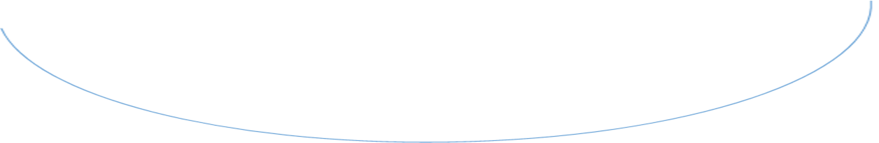
Repeated measures
Additional constraint needed loadings SG1=SG2=SG3
0
σ² =1
Time 1
Time 2
Time 3
=
=
=
SG5
MG5
SG8
MG8
SG3
RG3
MG3
RG5
RG8

Slide 60
Ability scores over time
Science
Reading
Mathematics
2108 schoolchildren taken each at 3, 5 and 8 years

Slide 61
Estimated means (intercepts) different factor means, ability means
 | S | R | M
Grade 3 raw | 50.99 | 127.65 | 99.71
Grade 3 model | 51.03 | 127.26 | 99.74
Grade 5 raw | 65.25 | 151.09 | 124.34
Grade 5 model | 51.03 | 126.65 | 102.90
Grade 8 raw | 84.89 | 172.04 | 142.46
Grade 8 model | 51.03 | 116.43 | 98.54

Slide 62
Fit indices
User Model versus Baseline Model:
Comparative Fit Index (CFI) 0.998
Tucker-Lewis Index (TLI) 0.996
Robust Comparative Fit Index (CFI) 0.998
Robust Tucker-Lewis Index (TLI) 0.995
Loglikelihood and Information Criteria:
Loglikelihood user model (H0) -41918.095
Loglikelihood unrestricted model (H1) -41900.334
Akaike (AIC) 83914.190
Bayesian (BIC) 84120.830
Sample-size adjusted Bayesian (SABIC) 83996.938
Model Test User Model:
Test statistic 35.522
Degrees of freedom 15
P-value (Chi-square) 0.002
Rule of thumb for chi-square: 35.5/15<3

