Slide 1
MRC Cognition and Brain Sciences Unit
Graduate Statistics Course 2024 http://imaging.mrc-cbu.cam.ac.uk/statswiki/StatsCourse2024

Slide 2
4: Categorical Data Analysis
Categorical Data, Contingency Tables and the Pearson Chi-Squared Statistic
Peter Watson
(with thanks to Ian Nimmo-Smith)
31 October 2024

Slide 3
The Naming of Parts
Categorical Data
Frequency Tables
The Chi-Squared Goodness-of-Fit Test
The Chi-squared Distribution
The Binomial Test
The Chi-squared test for association
Simpson, Cohen and McNemar

Slide 4
SPSS procedures that help
FREQUENCIES
  for information about one classification at a time
CROSSTABS
  for combined information about more than one classification
CHI-SQUARE
  for comparing observed frequencies with hypothetical ones
BINOMIAL
  for testing whether performance differs from ‘chance’ (whatever that is)

Slide 5
Types of Data: Quantitative
Numerical measurements or counts
  Continuous measurements
    Reaction time, BOLD signal, EEG signal, …
  Discrete measurements
    Whole numbers, like numbers of errors, marks in an exam ….

Slide 6
Types of Data: Qualitative
Nominal
Ordinal data

Slide 7
Nominal
The categories are descriptive labels
  Outcome: {Error, Correct}
  Sex: {Female, Male}
  ...

Slide 8
From ICD-10: Chapter V: Mental and behavioural disorders
(International Statistical Classification of Diseases and Related Health Problems)
F00-F99 - Mental and behavioural disorders
  (F00-F09) Organic, including symptomatic, mental disorders
  (F00.) Dementia in Alzheimer's disease
  (F01.) Vascular dementia
    (F01.1) Multi-infarct dementia
  (F02.) Dementia in other diseases classified elsewhere
    (F02.0) Dementia in Pick's disease
    (F02.1) Dementia in Creutzfeldt-Jakob disease
    (F02.2) Dementia in Huntington's disease
    (F02.3) Dementia in Parkinson's disease
    (F02.4) Dementia in human immunodeficiency virus (HIV) disease
  (F03.) Unspecified dementia
  (F04.) Organic amnesic syndrome, not induced by alcohol and other psychoactive substances
  (F05.) Delirium, not induced by alcohol and other psychoactive substances
  (F06.) Other mental disorders due to brain damage and dysfunction and to physical disease
  (F07.) Personality and behavioural disorders due to brain disease, damage and dysfunction
  (F09.) Unspecified organic or symptomatic mental disorder

Slide 9
Ordinal
The categories are ranged in an order
  Rating scale:
    Endorsement of a statement: {Strongly agree, Agree, Neutral, Disagree, Strongly disagree}
  Age:
    Age Group: {20+ to 30, 30+ to 40, 40+}
  Position
    Birth order: {1st, 2nd, 3rd, 4th, ...}
    Target position: {Left, Central, Right}
    Trial block: {1st, 2nd, 3rd, …}

Slide 10
Frequency Tables
Observations are classified according to some scheme
The numbers of observations falling into each category of the classification are called the frequencies

Slide 11
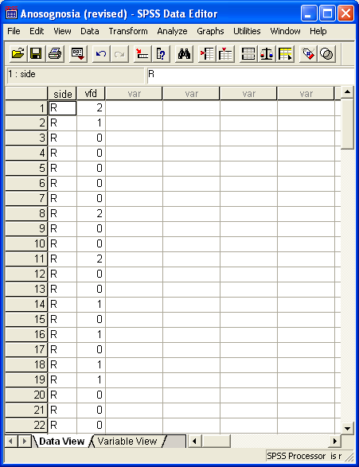
Visual Field Deficit Problems in Hemiplegic Patients

Slide 12
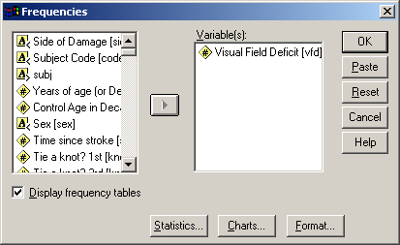
FREQUENCIES
Analyze ⇒ Descriptive Statistics ⇒ Frequencies
Put the variable that holds the category information into the Variables(s) box
Press OK ...

Slide 13
Frequency Table

Slide 14
Bar charts
Selecting ‘Bar Chart’ from the ‘Charts’ options gives you a graphic which you can cut and paste ...

Slide 15
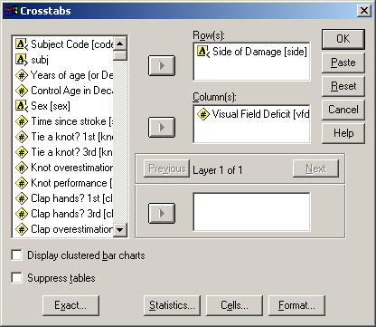
Contingency Table
Items are classified by two or more classifications simultaneously
  E.g. Side of Damage and Severity of Visual Field Deficit
Analyze ⇒ Descriptive Statistics ⇒ Crosstabs
Select ‘Side of Damage’ and ‘Visual Field Deficit’ to define the row/column categories

Slide 16
CROSSTABS
It looks as if there may be more VFD in RBD than in LBD

Slide 17
Word Recognition Crosstabs
Word recognition looks quite good (80%)
But Non-word rejection is low (50%)

Slide 18
Goodness-of-Fit Chi-squared Test
Suppose we have a Theory
  i.e. a ‘model’ that predicts the expected frequencies (E) in each category
We actually observe the frequencies (O)
We measure how good a fit the data are to the theory by the formula:
  X² = Σ(O-E)²/E where the sum is over all the categories
This is called Pearson’s Chi-Squared Statistic

Slide 19
Significance
Large values of X² suggest the model doesn’t fit the data well
  This leads to Goodness-of-fit tests
We look at the value of X² and see whether it is unusually large by reference to a χ²-distribution with k-1 degrees-of-freedom where k is the number of categories in the classification

Slide 20
‘Degrees of Freedom’
An elusive concept that occurs throughout statistics. In essence it means the number of independent pieces of information in a sample relevant to the estimation of some parameters or calculation of a statistic.
  For example in a two-by-two contingency table with a given set of marginal totals only 1 of the cells at a time is ‘free’ -- once it is specified all the others are determined -- and the table thus has a single degree of freedom.
The important point here is we can only interpret X² if we also know its degrees of freedom, as we see later when we look at the chi-squared distribution.

Slide 21
Degrees of Freedom = 1
x | 10-x | Row 1 Total = 10
13-x | x-3 | Row 2 Total = 10
Column 1 Total = 13 | Column 3 Total = 7 | Table Total = 20

Slide 22
Degrees of Freedom = 4 (#rows-1) times (#cols -1)
x | y | 10-x-y | Row 1 Total = 10
u | v | 10-u-v | Row 2 Total = 10
12-x-u | 7-y-v | x+y+u+v-9 | Row 3 Total = 10
Column 1 Total = 12 | Column 2 Total = 7 | Column 3 Total = 11 | Table Total = 30

Slide 23
Tolman, Ritchie and Kalish (1946)
Place learning in rats
Blocked
Food
D
A
New
A
New
Food
B
C
D: New alley to original food source
Phase 1
Phase 2

Slide 24
The Chi-Squared Goodness of Fit Test by hand
    Tolman, Ritchie and Kalish (1946)
    X²=(4-8)²/8+(5-8)²/8+(8-8)²/8+(15-8)²/8 = 9.25
    The 95% percentile of the χ²(3) distribution is 7.82 (from tables)
      P < 0.05
      Exact P = 0.0261
        Via MATLAB: 1-chi2cdf(9.25,3)
    We reject the Null Hypothesis that Alleys are chosen equiprobably.

Slide 25
The Chi-Square(d) Goodness of Fit Test by SPSS
Enter the data
  ‘alley’
    nominal
      1,2,3,4
  ‘choices’
    frequencies
      4,5,8,15
> alley <- rep(1:4, c(4, 5, 8, 15))
> chisq.test(table(alley))
Chi-squared test for given probabilities
data: table(alley)
X-squared = 9.25, df = 3, p-value = 0.02615

Slide 26
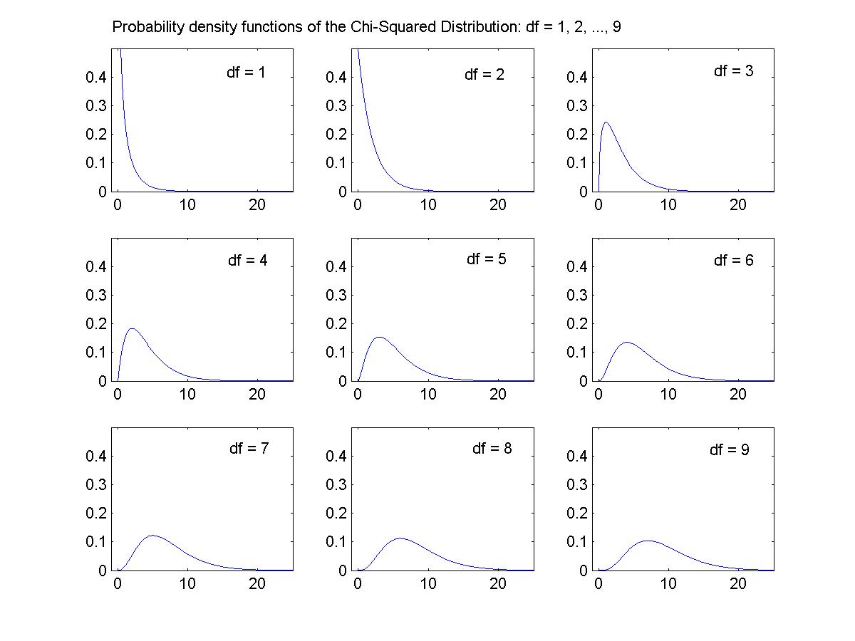
The Chi-Squared (χ²) Distribution
Shape determined by ‘degrees of freedom’ (df)
J-shaped for df = 1 or 2
Unimodal for df > 2
  Mode = df - 2
Mean = df

Slide 27
Chance performance and the Binomial Test
In a multiple choice test
  2-alternative forced choice (2AFC)
    p(correct) = p(error) = 0.5
  4AFC …
    p(correct) = 0.25, p(error) = 0.75
Was the subject just guessing when she got 14/20 in a 2AFC test?

Slide 28
The Binomial Test
Analyze ⇒ Non-Parametric ⇒ Binomial Test
> binom.test(14,20)
Exact binomial test
data: 14 and 20
number of successes = 14, number of trials = 20, p-value = 0.1153
alternative hypothesis: true probability of success is not equal to 0.5
95 percent confidence interval:
0.4572108 0.8810684
sample estimates:
probability of success
0.7

Slide 29
Confidence Intervals for Binomial Proportions
X=14, N=20
95% CI (WALD) (0.499, 0.901)
95% CI (WILSON) (0.481, 0.855)
Consistent with the P values, the Confidence Interval only just includes 0.5
(Calculated using a spreadsheet available on the CBU statistics website at http://imaging.mrc-cbu.cam.ac.uk/statswiki/FAQ/BinomialConfidence. which also features a similar solution to the difference in two (in)dependent proportions)

Slide 30

Noah’s Ark, or The World of Two by Two
Pearson’s Chi-squared
  Yates’ Continuity Correction
Fisher’s Exact Test
Odds and Odds Ratios
  log odds and log odds ratios
Sensitivity and Specificity
  Gerd Gigerenzer (2002). Reckoning with Risk, Penguin.
  Signal Detection Theory

Slide 31
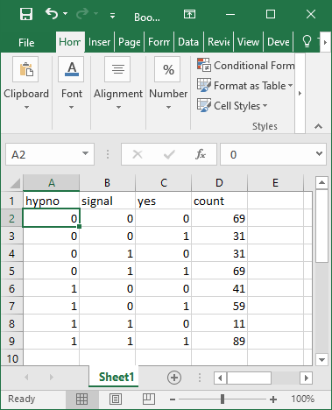
Signal Detection Theory
Example 2a from Macmillan & Creelman, 1991, p.31

Slide 32
Sensitivity and Specificity
Testing for the presence of a Disease in a person from a population
Sensitivity: Probability that a Positive result means when the Disease is present - P(+|D)
Specificity: Probability that a person who tests Positive has the Disease – P(D|+)
  Influenced by the Prevalence of the Disease in the population: P(D).
See Martin Bland: An Introduction to Medical Statistics
http://imaging.mrc-cbu.cam.ac.uk/statswiki/FAQ/Bayes

Slide 33
Simpson’s Paradox: example (I)
Hospital I
The New treatment is positively associated with recovery (Recovery rate 10.6% vs 4.8%).

Slide 34
Simpson’s Paradox: example (II)
Hospital II
Again, the New treatment is positively associated with recovery (Recovery rate 98.8% vs 67.2%).

Slide 35
Simpson’s Paradox: example (III)
Combined data
When combined, the New treatment is negatively associated with recovery (Recovery rate 35.8% vs 57.9%).

Slide 36
Simpson’s Paradox explained
The end points of the in-between line are differently weighted averages of the end points of the upper and lower lines

Slide 37
Measuring agreement
Kappa
  Two judges rate items on the same categorical scale
  How well do they agree?
  Use Crosstabs with two classifying variable having the same categories
  Select Kappa under the Statistics options
  http://imaging.mrc-cbu.cam.ac.uk/statswiki/FAQ/kappa
  Alternative kappa (Brennan and Prediger, 1981)

Slide 38
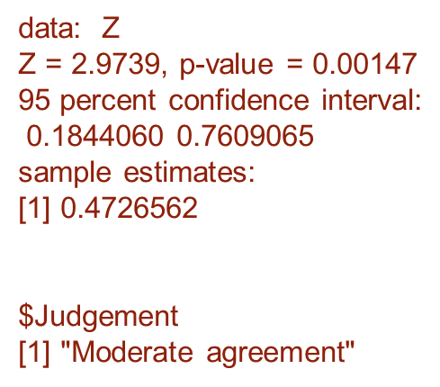
Agreement
> Z <- cbind(c(15,2,3),c(1,3,2),c(0,1,3))
> Z
[,1] [,2] [,3]
[1,] 15 1 0
[2,] 2 3 1
[3,] 3 2 3
Kappa.test(Z)
% Agreement is 21/30 = 70% but could be high due to chance

Slide 39
Measuring change
A patient with acquired dyslexia does a 40 item picture naming task twice at a 6 month interval
Accuracy falls from 19/40 to 11/40
Is this a real deterioration, noting that 28/40 items show no change across the two tests

Slide 40
McNemar’s Test
This is specifically designed for this type of hypothesis
Equivalent to a Binomial Test (with p=0.5) of Freq(Correct⇒Error) vs. Freq(Error⇒Correct)
In this case 10 vs. 2
> X <- cbind(c(19,2), c(10,9))
> X
[,1] [,2]
[1,] 19 10
[2,] 2 9

Slide 41
McNemar’s Test
In this case we can assert that there is evidence of deterioration
> mcnemar.test(X, correct=TRUE)
McNemar's Chi-squared test with continuity correction
data: X
McNemar's chi-squared = 4.0833, df = 1, p-value = 0.04331
Can obtain confidence intervals for the difference in proportions: http://imaging.mrc-cbu.cam.ac.uk/statswiki/FAQ/BinomialConfidence/2gpp
Also McNemar-Bowker tests for changes in times in a k x k table

Slide 42
Association or Independence
Chi-squared test of association
Comparing two or more classified samples
Testing whether the frequencies for one classification depend on the category of another classification
Only to be used when the numbers in the cells are frequencies, never with proportions, percentages or measurements

Slide 43
Association or Independence
Is Side of Lesion associated with Sex of Patient?
Select Frequencies and then ‘Chi-square’ and ‘Phi’ under Statistics, and ‘Exact’ under Exact…
sex <- rep(1:2, c(30,34))
side <- c(rep(1,8),rep(2,22),rep(1,14),rep(2,20))

Slide 44
The Output ...
fisher.test(table(sex,side))
Fisher's Exact Test for Count Data
data: table(sex, side)
p-value = 0.294
> result <- chisq.test(table(sex,side))
> result
Pearson's Chi-squared test with Yates' continuity correction
data: table(sex, side)
X-squared = 0.91374, df = 1, p-value = 0.3391
No evidence of any above-chance association between Sex and Side of Lesion
Phi = chi-square/sqrt(N)
(2x2 tables only)
> library(lsr)
Warning message:
package ‘lsr’ was built under R version 4.0.5
> cramersV(table(sex,side))
[1] 0.1194873
Can derive confidence intervals for difference in proportions
http://imaging.mrc-cbu.cam.ac.uk/statswiki/FAQ/BinomialConfidence/2gp

Slide 45
Residuals for location of any differences
z <- (result$observed-result$expected)/sqrt(result$expected)
> pout <- 2*pnorm(-abs(z),0,1)
> z
side
sex 1 2
1 -0.7201115 0.5211785
2 0.6764270 -0.4895619
> pout
side
sex 1 2
1 0.4714563 0.6022425
2 0.4987696 0.6244439
> chisq.test(table(sex,side))$stdres
side
sex 1 2
1 -1.219595 1.219595
2 1.219595 -1.219595
>
> result$expected
side
sex 1 2
1 10.3125 19.6875
2 11.6875 22.3125
> result$observed
side
sex 1 2
1 8 22
2 14 20

Slide 46
Larger tables
Two way tables can be analysed the same way
Three- (or more) way classifications need a more analytical approach such as Log Linear Modelling, available with the Loglinear procedure

Slide 47
A 3 x 3 Example
> Z1
[,1] [,2] [,3]
[1,] 195 218 21
[2,] 98 338 61
[3,] 2 12 26
> result
Pearson's Chi-squared test
data: Z1
X-squared = 196.02, df = 4, p-value < 2.2e-16
> cramersV(Z1)
[1] 0.3177086
Contingency Coefficient also used for tables larger than 2x2

Slide 48
Cautions (I)
Pooling of data can mislead, or even violate the assumptions of the tests (cf Simpson)
Each individual observation is supposed to be independent of the others
So pooling multiple observations across a group of subjects will typically violate this rule
This needs to be handled using either summary measures (e.g. Log Odds), Generalised Linear Mixed Models or Matched Pairs: http://imaging.mrc-cbu.cam.ac.uk/statswiki/FAQ/MatchedPairs

Slide 49
Cautions (II)
It is conventional to be cautious if there are low Expected values in any cell (e.g. E<5).
Recent research suggest this is overcautious, though use of Fisher’s Exact Test is recommended in the general case. Campbell (2007) however suggests (N-1/N) x chi-square for 2x2 tables with Expected Values > 1.
Alternatively one can amalgamate across two or more categories.

Slide 50
Next week at 11am
  ANOVA of balanced multi-factorial designs: between subject designs, and single subject studies

