Slide 1
MRC Cognition and Brain Sciences Unit
Graduate Statistics Course

Slide 2
6: Repeated Measures ANOVA
Repeated Measures & Mixed Model ANOVA
Within- & Between- Subject Designs
Peter Watson
(with thanks to Ian Nimmo-Smith)

Slide 3
What we will cover in this talk
  Two sample t-Test vs. Paired t-Test
  Repeated Measures as an extension of paired measures
  Single factor Within-Subject design
  Sphericity
  Two (or more) factors Within-Subject design
  Mixed designs combining Within- and Between-Subject factors
  Mixed Models, e.g. both Subjects & Items as Random Effects factors
  Testing for Normality
  Single degree of freedom approach

Slide 4
Repeated Measures
Subjects tested in more than one condition
  Increased sensitivity
  but added complications!
Not looking at the Temporal/Time Series aspects of Repeated Measures.

Slide 5
Repeated Measures
Independent samples t-test vs. Paired t-test
  Two groups tested under each of two conditions
  One group tested under both conditions

Slide 6
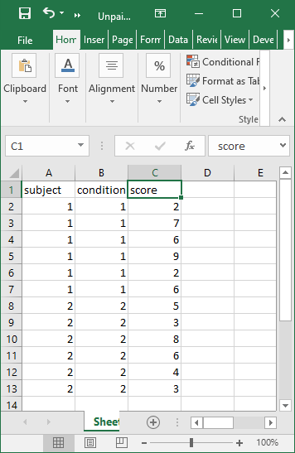
Independent samples t-test
2 groups of 6 subjects
Each group tested under different conditions

Slide 7
Independent samples t-test
Comparison of the two conditions will have to take account of the full between-subject variability

Slide 8
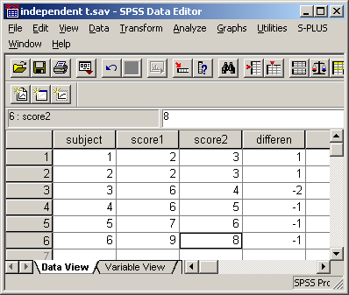
Paired samples t-test
Score2-Score1

Slide 9
Unpaired t-test
Code
Output
> t.test(score ~ condition,data = y, var.equal = TRUE)
Two Sample t-test
data: score by condition
t = 0.35908, df = 10, p-value = 0.727
alternative hypothesis: true difference in means is not equal to 0
95 percent confidence interval:
-2.602549 3.602549
sample estimates:
mean in group 1 mean in group 2
5.333333 4.833333

Slide 10
Paired samples t-test

Slide 11
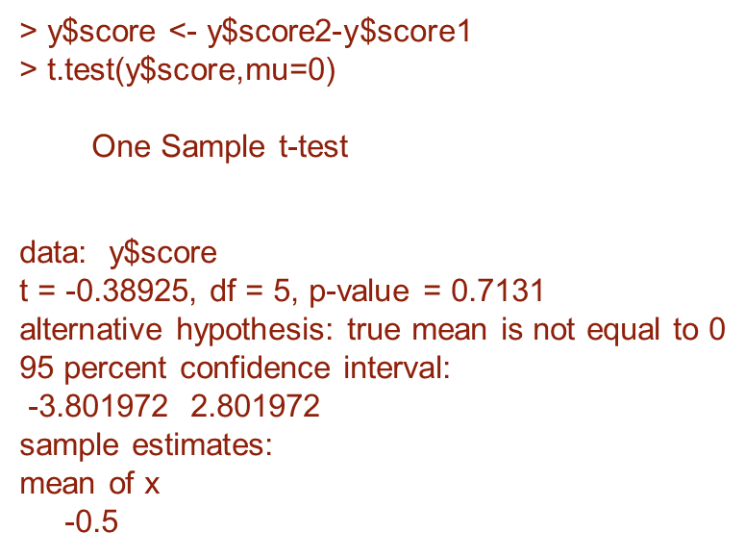
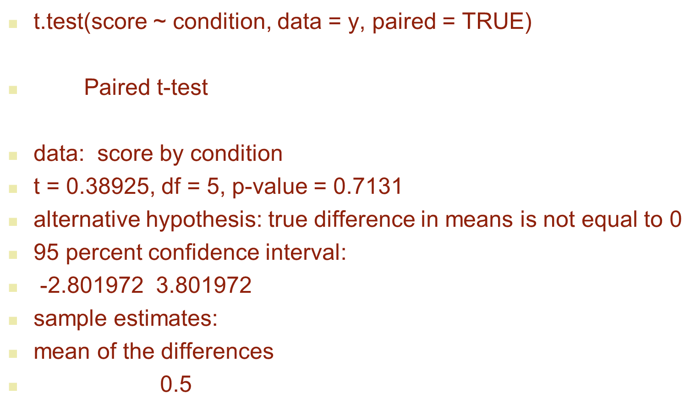

Two ways of comparing Score 1 and Score 2
One sample t of difference
Paired sample t

Slide 12
Paired samples t-test
The correlation between Score 1 and Score 2 is due to repeated testing on the same subject.

Slide 13
Repeated Measures
Analysing differences between conditions measured ‘within subjects’ can avoid the variability due to ‘between subjects’ differences and lead to more powerful tests.
Repeated Measures ANOVA generalises the Paired Sample t-test approach.

Slide 14
Random Factors and Generalisability
Another way of looking at ANOVA models for these designs is by explicitly representing Subjects as Levels of a Factor.

Slide 15
Random Factors and Generalisability
Do we want to generalise to a population of which the subjects are a sample?
  If so we describe Subjects as a Random Factor.
  For designs for which there is more than one additional Experimental Factor this has important implications for how the data must be analysed.

Slide 16
Random Factors and Error Terms
There is a separate Error Term for each combination of Within Subject Factors.
Correlations between Repeated Measures help to make the design more powerful
  but inhomogeneities can complicate the situation

Slide 17
Between Subject Design
40 subjects are allocated to 4 treatment groups.
Control
Semantic
Lexical
Phobic
Each subject is given ten trial of a lexical decision task

Slide 18
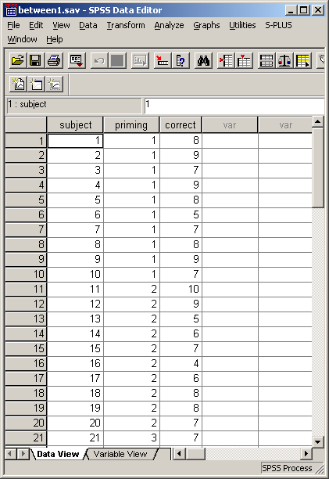
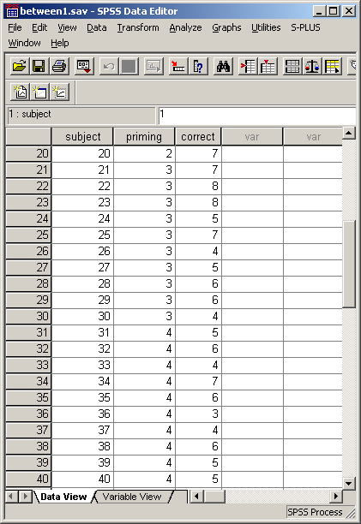

Slide 19
Between-Subjects Design

Slide 20
Between-Subjects Design
Total Sum of Squares (SS)
115.9 on 39 d.f.
Priming
(Between groups)
38.9 on 3 d.f.
Error SS
(Between subjects within groups)
77.0 on 36 d.f.
Within
Group 1
9 d.f
Within
Group 2
9 d.f
Within
Group 3
9 d.f
Within
Group 4
9 d.f

Slide 21
Within Subject Design
Each of 10 Subjects are tested under all 4 conditions
Repeated Measures design

Slide 22
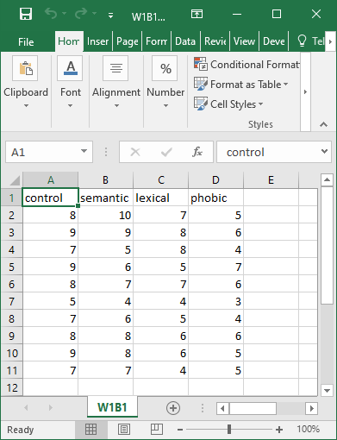
Within Subject Design
Each subjects data is linked by being on the same line; the conditions become separate variables.

Slide 23
Between vs. Within Subjects Design
Between group profile
Within Individual and mean Group profiles

Slide 24
Within Subject Design
Each comparison (e.g. Semantic vs. Phobic)
could be done by doing a Paired Sample t-Test
T(9) = 3.767, P=0.004 (two-tailed)

Slide 25
ANOVA of Paired t-Test
Total
60.95 on 19 d.f.
Between Ss
31.45 on 9 d.f.
Within Ss
29.5 on 10 d.f.
Between
Conditions
18.05 on 1 d.f.
Error (Conditions)
[Ss x Conditions]
11.45 on 9 d.f.

Slide 26
Why use Repeated Measures designs?
Repeated Measures ANOVA combines the evidence from all these Paired Samples T-Tests to get more powerful tests because they have (typically)
  Higher degrees of freedom
  Smaller Mean Square Error

Slide 27
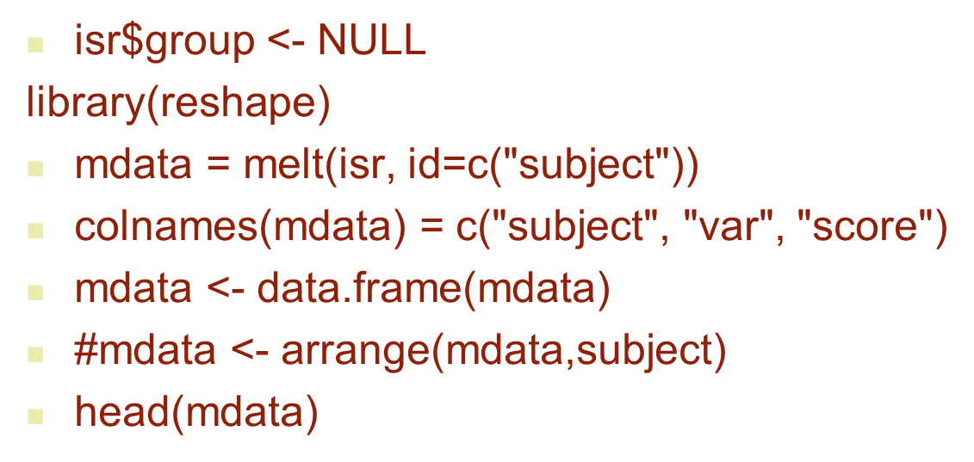
Formatting for RM ANOVA
Put into long format
Long format data
> head(mdata)
subject var score
1 1 control 8
2 2 control 9
3 3 control 7
4 4 control 9
5 5 control 8
6 6 control 5

Slide 28
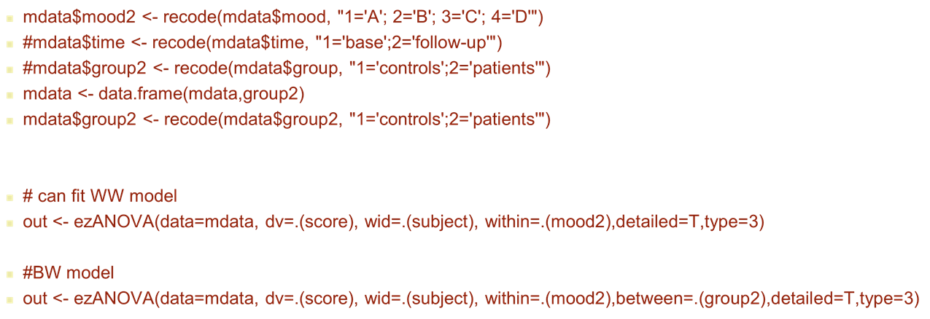
Run EZANOVA

Slide 29
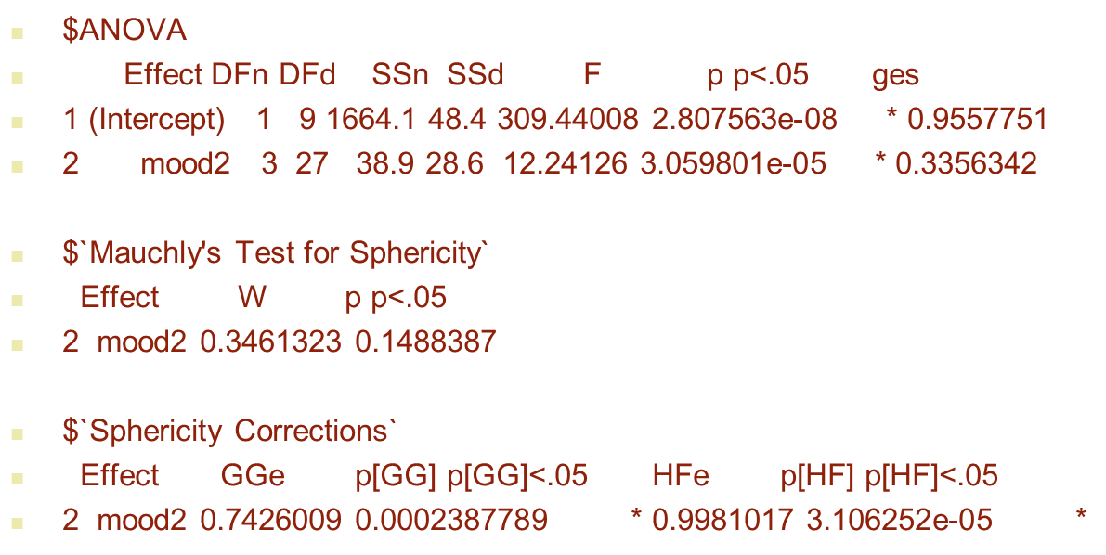

Rm anova
Report
EZANOVA out
Unadjusted: F(3, 27) = 12.241
G-G: F(2.2, 20.1)= 12.241
H-F: F(3.0,26.9)= 12.241
I.e. the observed F-ratio is assessed against
a distribution with adjusted degrees of freedom.

Slide 30
Within-Subjects ANOVA
Total
115.9 on 39 d.f.
Between Ss
48.4 on 9 d.f.
Within Ss
67.5 on 30 d.f.
Between
Conditions
38.9 on 3 d.f.
Error (Conditions)
[Ss x Conditions]
28.6 on 27 d.f.

Slide 31
Numerical illustration of computing SS (1)
C1 C2 mean(sub)
Sub 1 1 1 1
Sub 2 2 2 2
Sub 3 3 3 3
Sub 4 2 5 3.5
Mean cond 2 2.75 2.375

Slide 32
Numerical illustration of computing SS (2)
Total SS = (1 – 2.375)² + … + (5 – 2.375)² = 11.875
Condition SS = 4(2 – 2.375)² + 4(2.75-2.375)² = 1.125
Subject SS = 2(1-2.375)² + … + 2(3.5-2.375)² = 7.375
Subject x Condition SS = Total SS – Condition SS – Sub SS
For more details (including algebra for balanced designs):
http://imaging.mrc-cbu.cam.ac.uk/statswiki/FAQ/ss

Slide 33
Strategies for handling violation of sphericity
Single Degree of Freedom contrasts (modelled on Paired Sample T-Test) using corresponding error terms.
Epsilon: Correction factor for degrees of freedom in
F Ratios
Greenhouse-Geisser
Huynh-Feldt
Lower bound
Multivariate approach.

Slide 34
Choice of Correction Factors
Strategy:
If Mauchly is OK, quote unadjusted.
If not, use Greenhouse-Geisser
G-G is known to be conservative.
H-F attempts to correct for this but can overcorrect!
Field (2012) however notes the Mauchly test has low
power for small N

Slide 35
More than one Repeated Measures Factor?
2 x 2 Within Subject design
Valence: Positive vs. Negative
Orientation: Up vs. Down
All subjects tested in all 4 combinations.

Slide 36
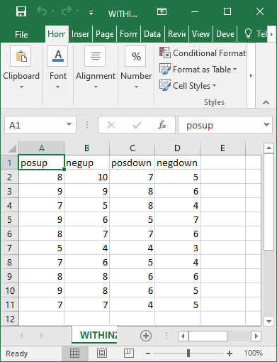
More than one Repeated Measures Factor?

Slide 37
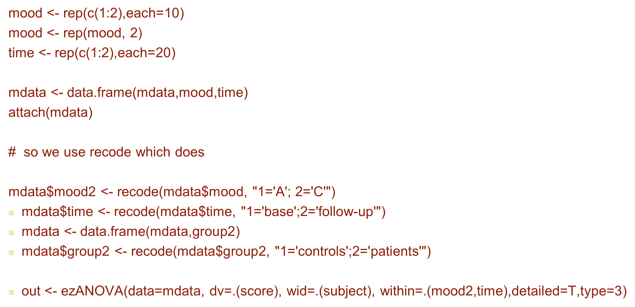
Valence and position ANOVA

Slide 38
> out
$ANOVA
Effect DFn DFd SSn SSd F p p<.05 ges
1 (Intercept) 1 9 1664.1 48.4 309.44008264 2.807563e-08 * 0.955775085
2 time 1 9 32.4 8.1 36.00000000 2.024993e-04 * 0.296160878
mood2 1 9 6.4 8.1 7.11111111 2.576279e-02 * 0.076738609
4 mood2:time 1 9 0.1 12.4 0.07258065 7.936906e-01 0.001297017
Three
Strata

Slide 39
Total
115.9 on 39 d.f.
Between Ss
48.4 on 9 d.f.
Within Ss
67.5 on 30 d.f.
Error (Conditions)
[Ss x Conditions]
28.6 on 27 d.f.
Between
Conditions
38.9 on 3 d.f.
T
32.4 on 1
Error T
8.1 on 9
M
6.4 on 1
Error M
8.1 on 9
TxM
0.1 on 1
Error TxM
12.4 on 9

Slide 40
Numerical SS computation generalises easily
Obtain Total SS, Between subject SS, Valence SS and Time SS as in earlier example
We also need the interaction term: Valence x Time SS =
Between Condition SS – Valence SS – Time SS
where Between Condition SS =
10 (7.7 – 6.45)² + … + 10 (5.1-6.45)² = 38.9
(where 7.7, 7, 6 and 5.1 are the 4 condition means each based on 10 subjects and 6.45 is the overall mean from 40 subjects)
Obtain the subjects by condition SS by subtraction as before

Slide 41
Mixed Design
with both Within- and Between- Subject factors
One Between Subjects factor:
Sex (2 levels, M vs F)
One Within Subject factor:
Condition (4 levels, Con, Sem, Lex, Pho)

Slide 42
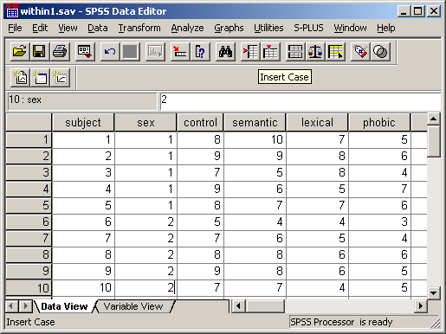

Slide 43
Hierarchical Decomposition in 1W2B RM ANOVA
Total
115.9 on 39 d.f.
Within Ss
67.5 on 30 d.f.
Between Ss
48.4 on 9 d.f.
Ss x Conditions
28.6 on 27 d.f.
Sex
14.4/1
Error
(Between)
34/8
Sex x Priming
2.2/3
Error (Priming)
26.4/24
Priming
38.9 /3

Slide 44
out
$ANOVA
Effect DFn DFd SSn SSd F p p<.05 ges
1 (Intercept) 1 8 1664.1 34.0 391.5529412 4.430257e-08 * 0.96497536
2 group2 1 8 14.4 34.0 3.3882353 1.029323e-01 0.19251337
3 mood2 3 24 38.9 26.4 11.7878788 6.081327e-05 * 0.39174220
4 group2:mood2 3 24 2.2 26.4 0.6666667 5.807294e-01 0.03514377
$`Mauchly's Test for Sphericity`
Effect W p p<.05
3 mood2 0.3690834 0.2483242
4 group2:mood2 0.3690834 0.2483242
$`Sphericity Corrections`
Effect GGe p[GG] p[GG]<.05 HFe p[HF] p[HF]<.05
3 mood2 0.751164 0.000380626 * 1.060437 6.081327e-05 *
4 group2:mood2 0.751164 0.542749220 1.060437 5.807294e-01

Slide 45
Numerical computation of SS
Follows from earlier couple of examples since…
… the ‘top’ part of the F test namely SS of terms, e.g. condition, sex which do not have ‘subjects’ in their name are the same whether the term is a between or a within subject factor

Slide 46
Pros and Cons of Repeated Measures Designs
Pro:
More sensitive/powerful
More efficient
Con:
Fatigue
Transfer effects
Learning
Issues:
Blocked vs Mixed

Slide 47
Within Subject Designs
Advantages: reduces background 'noise', eliminates individual differences, need fewer subjects, repeated measures statistical tests more sensitive.
Disadvantages: Order effects: learning/practice ; fatigue; practical problems (e.g. long-acting effects of the independent variable, e.g. teaching methods.)
Solutions: Counterbalance order (can be difficult); Train until asymptote on learning curve is reached (time-consuming). Test on different days.

Slide 48
Between Subject Design
Advantages: no order effects
Disadvantages: more individual differences, less sensitivity
  Could use pre-test baseline / difference score
Question: Are Subjects a confound? I.e. could your results simply be due to individual differences between subjects?
Very important: Random sampling and random allocation to conditions.

Slide 49
Mixed ANOVA Designs
Some Between Subject Factors
Some Within Subject (Repeated Measures) Factors

Slide 50
Items taken by participants
Items not a Random Factor
  Can you regard the set of items as a fixed test?
  Counterbalancing could help with some designs (Raaijmakers)
Items are a Random Factor
  Complex Mixed Model ANOVA is now computationally available.

Slide 51
Mixed Model ANOVA
This describes the situation where we have one or more Fixed Effects Factor and one or more Random Effects Factor
A full analysis is (now) possible but complicated.
  MIXED MODELS & REML (e.g. using lme in R; MIXED in SPSS)
Random item and subject variances
    Y_{ij} = β₀ + βX_{item,sub} + μ_{item} + μ_{subject} + ε_{item,sub}

Slide 52
Testing for Normality
ANOVA models are based on assumptions of Normality
  Tests of normality should be applied to the residuals rather than to the raw data
  When assessing normality in a within subject design it is the distribution of the differences between pairs of conditions that matters
  This means you have to do the ANOVA before you can decide on (non-)normality issues

Slide 53
Single degree of freedom approach for within-subject designs
Propagates from the feature that repeated measures ANOVA of paired measures are equivalent to simple ANOVA of the differences between the pair of measures
  Choose a contrast of interest, e.g.
    difference;
    slope;
    interaction
  Perform a simple ANOVA on this derived measure which represents 1 of the available within-subject degrees of freedom

Slide 54
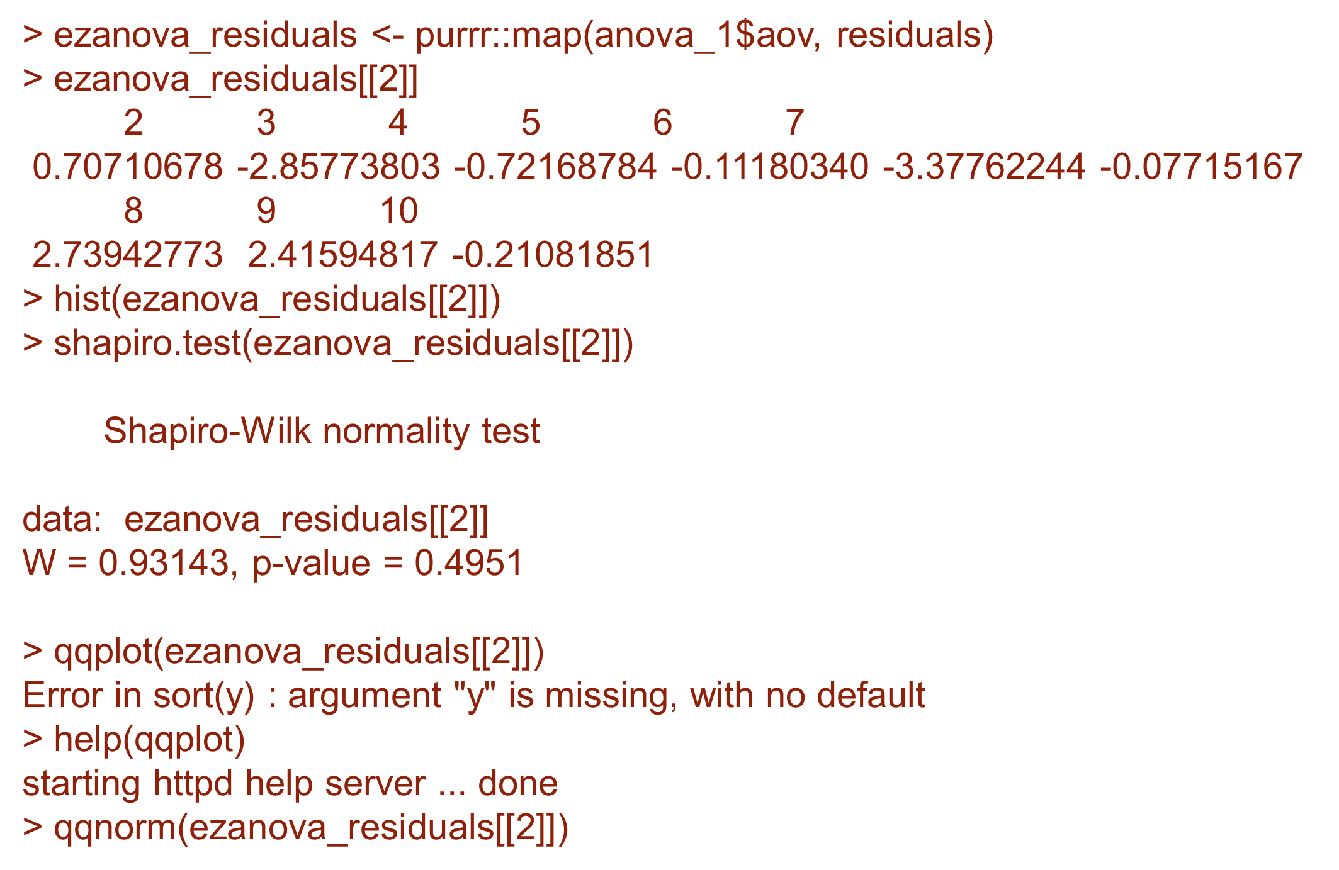
Normality

Slide 55
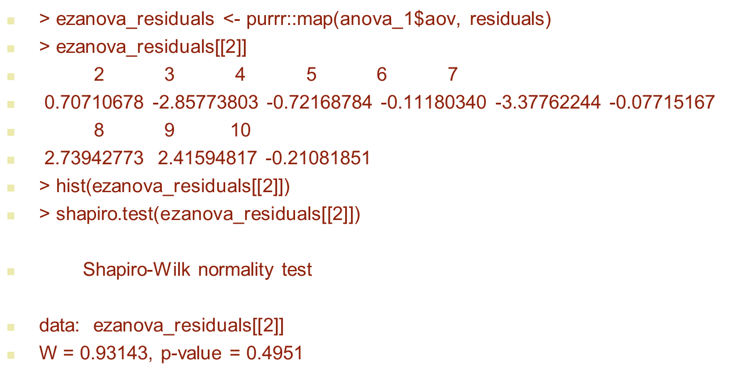
Assumptions
Residuals checks BW design with priming, sex
Qnorm plot

Slide 56
Next week
Thursday at 11:00
  Post-hoc tests, multiple comparisons, contrasts and handling interactions

