Slide 1


Variation in measures and markers of the timeliness of diagnosis in cancer patients
Yoryos (Georgios) Lyratzopoulos
Reader in Cancer Epidemiology &
Senior Cancer Research UK Clinician Scientist Fellow
University College London

Slide 2
Acknowledgements – for joint working and discussions over the years
Statisticians
Gary Abel, Katie Saunders, Silvia Mendonca, Josephine Barbiere, Marc Elliott
Public Health England / Cancer Registration colleagues
David Greenberg, Brian Rous, Clem Brown, Sean McPhail, Carolynn Gildea
Academic general practitioners or internists
Martin Roland, Greg Rubin, Richard Neal, Fiona Walter, Willie Hamilton
Nancy Keating, Hardeep Singh, Peter Vedsted (and colleagues)
Psychologists and social scientists
(late) Professor Jane Wardle and many HBRC@UCL colleagues

Slide 3
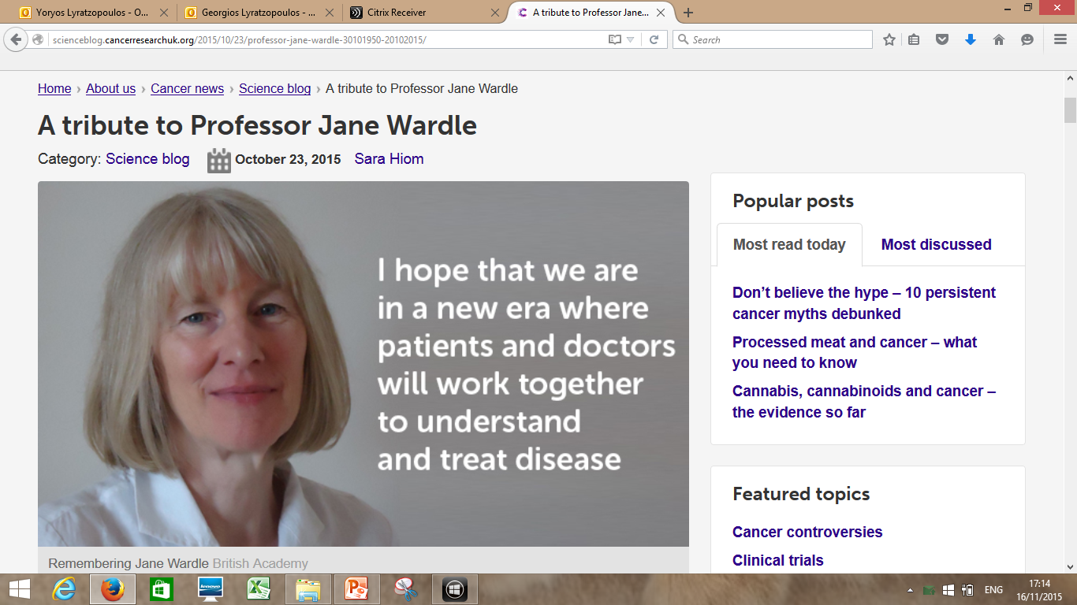

Slide 4


Slide 5
Table of contents
Cancer and population health; cancer prevention and control strategies
Early/late of diagnosis of cancer definitions
Does early diagnosis matter, and why?
Learning from person-level variation in measures of diagnostic timeliness
Where do we go from here

Slide 6
Table of contents
Cancer and population health; cancer prevention and control strategies

Slide 7
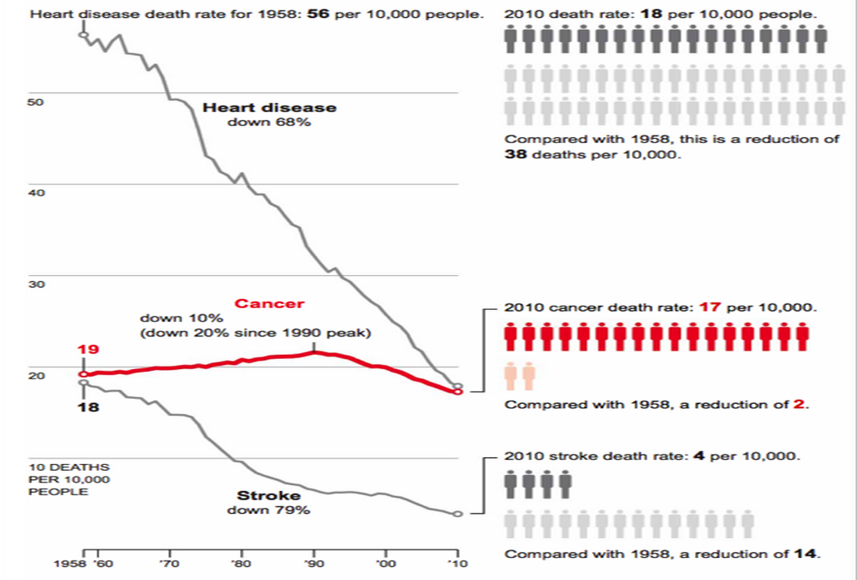
Cancer matters for population health -US

Slide 8
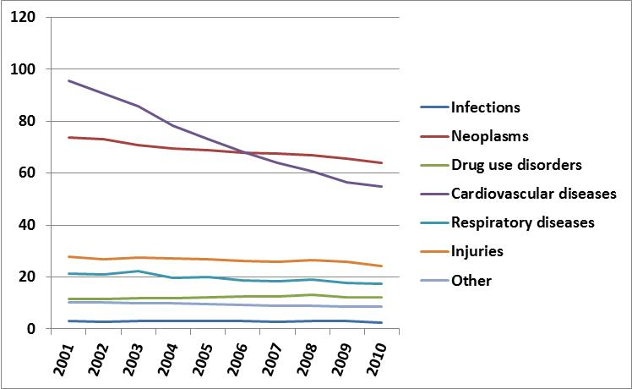
Avoidable mortality by cause
(/100,000 population) UK

Slide 9
Potential Solutions: Approach with humility – it is a complex problem
Primary prevention
Reducing mortality by reducing incidence
Screening (asymptomatic)
Reducing mortality by improving the survival of patients with cancer
Early diagnosis (symptomatic)
Improving treatments

Slide 10
Primary prevention of cancer
Pros
Could prevent up to 40% - 45% of cases
Synergy with CVD control
Cons
Will not prevent most cases
Substantial lags (not a solution ‘tomorrow’) – think mesothelioma
Parkin DM et al., 2011; Vineis and Wild, 2013

Slide 11
Potential Solutions:
Approach with humility – a complex problem
Primary prevention
There are limitations in all 4 approaches
Progress across all 4 dimensions most likely needed
Screening (asymptomatic)
Early diagnosis (symptomatic)
Improving treatments

Slide 12
Table of contents
Early/late of diagnosis of cancer definitions

Slide 13
Measuring timeliness of diagnosis
What do we mean?
Emergency diagnosis
Patient interval (delay)
Stage at diagnosis
  Number of pre-referral consultations with GP
Psycho-social factors (Awareness-beliefs-attitudes, fear, fatalism)
Primary care interval (delay)
Secondary care interval
(referral-to-Dx / Dx-to-Tx targets)
Short-term survival

Slide 14
Two ‘families’ of measures
Interval measures
Patient interval
Primary care interval
Secondary care interval
Outcome measures
Stage at diagnosis
Emergency diagnosis
Short-term survival
Lyratzopoulos G. Cancer Epidemiol 2014

Slide 15
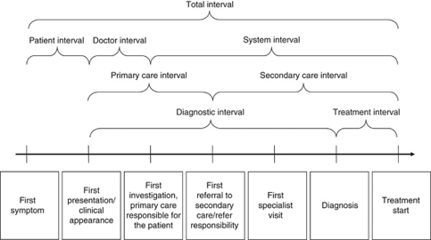
Time-based (interval, ‘pure’) measures
Weller et al, Br J Cancer, 2012

Slide 17
Interval measures
Patient interval
Primary care interval
Surrogate markers
Awareness-beliefs-attitudes
Number of pre-diagnostic consultations
Lyratzopoulos G, Cancer Epidemiol 2014
Lyratzopoulos G. Cancer Epidemiol 2014

Slide 18
Table of contents
Does early diagnosis matter, and why?

Slide 19
Why timely diagnosis matters
Improving patient experience
Improving clinical outcomes
(in at least some patients)
Increasing efficiency / cost-effectiveness
Decreasing medico-legal & other complaints

Slide 20
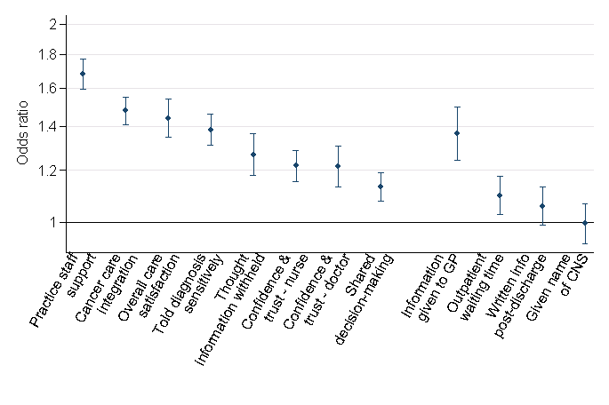
Odds ratios for negative experience of subsequent cancer care for cancer patients with 3+ pre-diagnostic consultations with a general practitioner
Evaluative questions
Report questions
Mendonca, Abel, Saunders, Wardle, Lyratzopoulos, Eur J Cancer Care, 2015

Slide 21
Stronger associations for aspects of subsequent care relating to / involving primary care…
….but still detectable associations on hospital care processes
Mendonca, Abel, Saunders, Wardle, Lyratzopoulos, Eur J Cancer Care, 2015

Slide 22
Table of contents
Learning from person-level variation in measures / markers of diagnostic timeliness

Slide 23
The epidemiology of the
primary care interval and
‘number of pre-referral consultations’

Slide 24
Cancer (all cancers) patients referred to hospital for specialist investigation after…
1 consultation 58% (7,499)
2 consultations 25% (3,202)
3 consultations 9% (1,195)
4 consultations 4% (511)
5+ consultations 5% (628)
82%
18%
Rubin, McPhail, Elliott, RCGP, 2011
Lyratzopoulos, Abel, McPhail, Neal, Rubin, Br J Cancer, 2013
Lyratzopoulos et al, Br J Cancer 2013

Slide 25
The sensitivity of up to 2 GP consultations for diagnosing (suspecting) cancer is 82%
1 consultation 58% (7,499)
2 consultations 25% (3,202)
3 consultations 9% (1,195)
4 consultations 4% (511)
5+ consultations 5% (628)
82%
18%

Slide 26
The problem is:
Less common than generally thought
Far more frequent that it would have been expected if the root problem was ‘rogue’ professional performance
18%

Slide 27
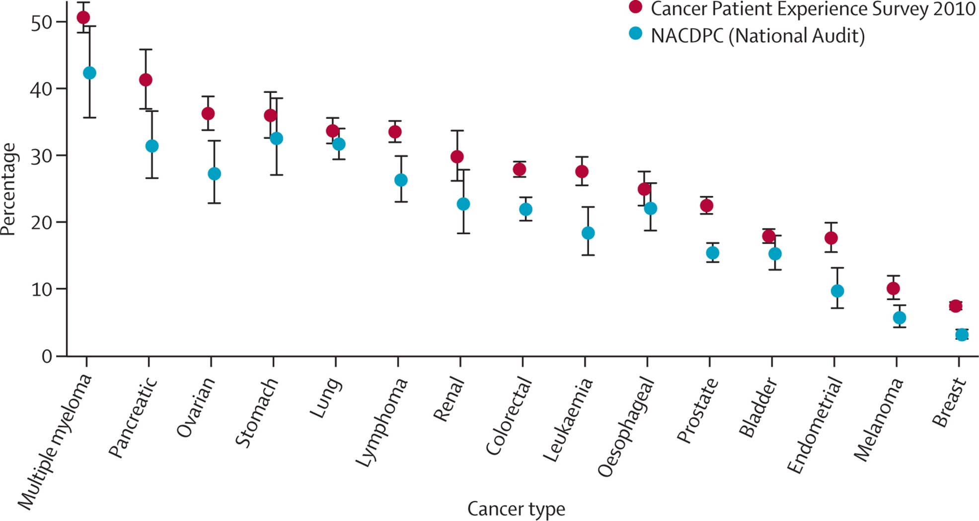
Very wide variation by cancer in the % patients who saw GP three or more times
Lyratzopoulos et al, Lancet Oncol 2012
Lyratzopoulos, Neal, Barbiere, Rubin, Abel, Lancet Oncology, 2012

Slide 28
‘Symptom signature’ of different cancers seems to drive variation in post-presentation delays
Symptom specificity
(of the average case)
Low
High
Notes:
28

Slide 29
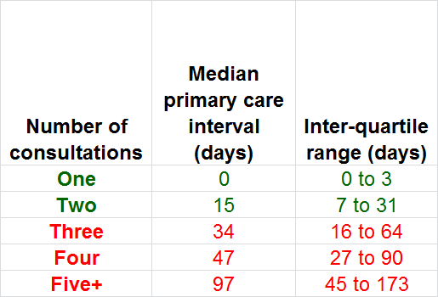
More pre-referral consultations do (on average) translate to longer primary care intervals
Lyratzopoulos, Abel, McPhail, Neal, Rubin, Br J Cancer, 2013

Slide 30
I will revisit these themes further in the talk
Variation in primary care intervals chiefly reflect scientific limitations in diagnosing common symptoms with poor specificity for cancer
Appreciating variation in diagnostic difficultly of different cancers (symptoms), can inform different strategies for improvement
Notes:
30

Slide 31
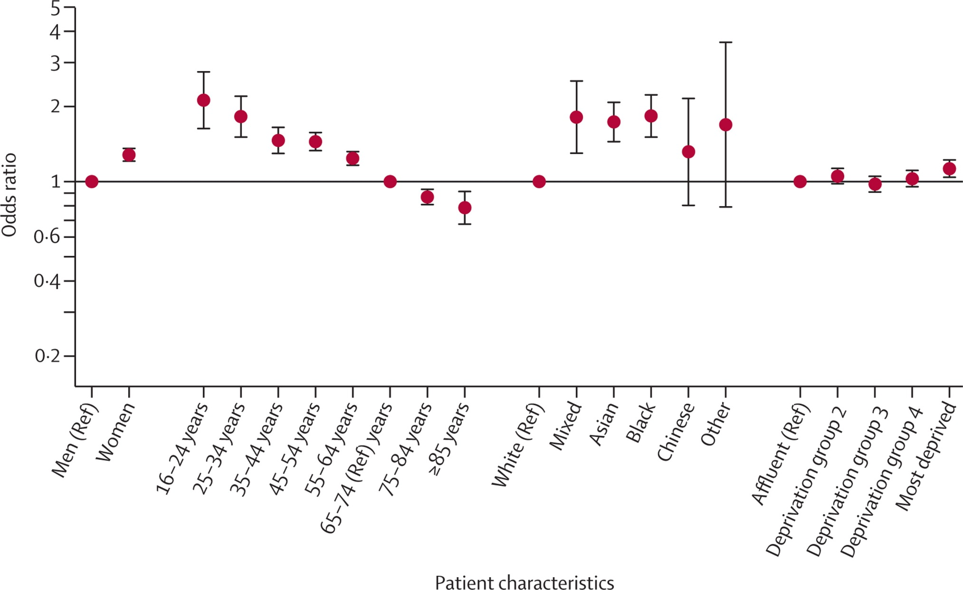
Adjusted ORs for 3+ consultations by patient characteristic
Lyratzopoulos, Neal, Barbiere, Rubin, Abel, Lancet Oncology, 2012
Notes:
This slide presents variation in the OR of 3+ consultation by patient group. I will guide you through the results taking each patient characteristic in turn.

Slide 32
Lack of familiarity?
“Epidemiological optimism”? (symptom PPV low in young / women)
Notes:
How can we explain these patterns?
We have no direct evidence but we can make some hopefully useful hypotheses
For sex and age differences, a potentially useful hypothesis is to consider that doctor referral behaviour and psychology if you wish is influenced by either knowledge of cancer incidence (which is lower in younger patients and in women) – we can call this ‘epidemiological optimisms’.
Another hypothesis is that age and sex variation is driven by by the lack of familiarity of cancer presentations in these groups.
These are both useful hypothesis to explore by further research as they can lead to different improvement interventions.

Slide 33
Notes:
For ethnic variation, in order to gain insights about the potential mechanism generating these differences, we explore the potential for interaction between age and ethnicity.

Slide 34
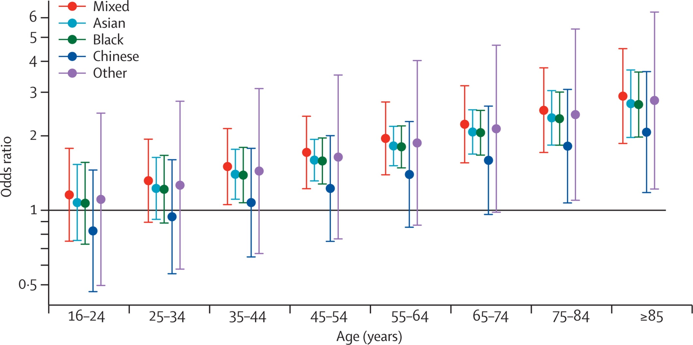
Ethnic differences concentrated in middle and older age ethnic minority patients
Communication barriers?
Notes:
And here are the results of this analysis
It can be seen that most of the ethnic differences in the probability of 3+ consultations relate to patients of middle or older age.
Whereas in contrast, younger patients have identical or nearly identical experience of this outcome.
This pattern points to the likely importance of barriers in communication between doctors and older ethnic minority patients.
These barriers can reflect low fluency in English, or different social norms of medical consultation and etiquette in different cultures.

Slide 35
Notes:
Here we see that women had a somewhat higher odds ratio (1.27) compared with men – or otherwise, all other things being equal, and for cancer occurring in either sex, it is more difficult to suspect the diagnosis of cancer in women than in men.

Slide 36
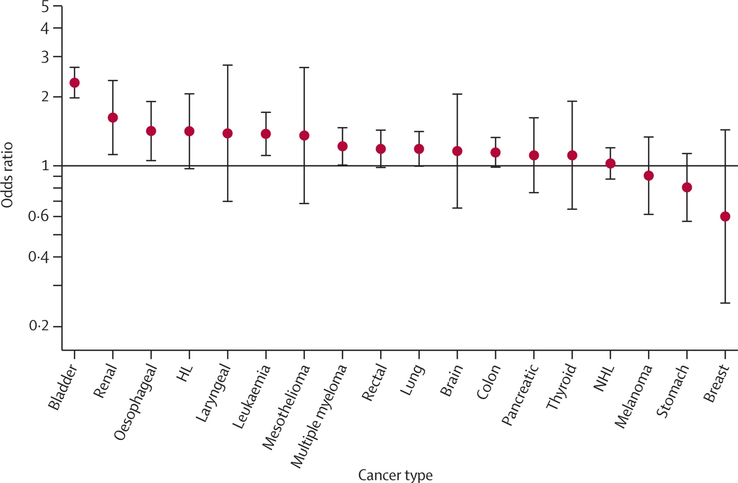
Adjusted ORs (women vs. men) of 3+ pre-referral consultations
Women particularly more likely to have 3+ pre-referral consultations for urinary tract cancers

Slide 37
The epidemiology of the
patient interval and
‘awareness’ measures

Slide 38
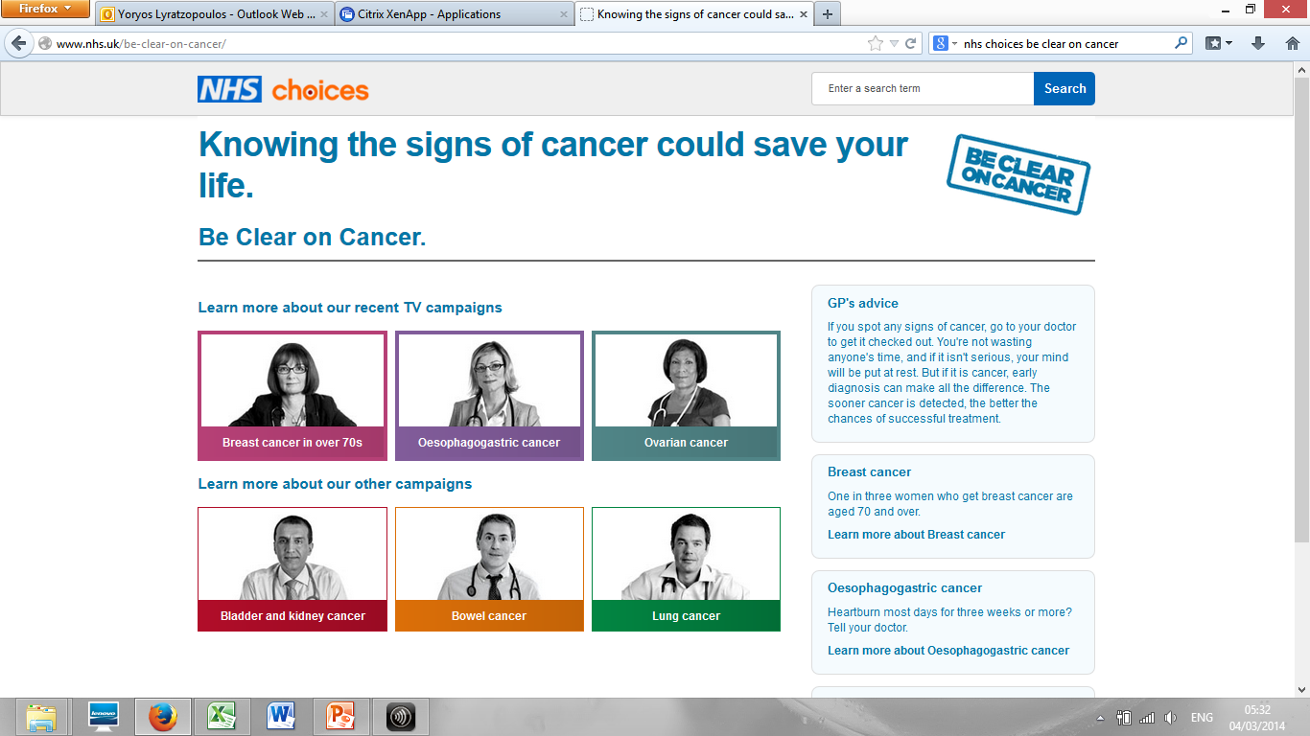

Slide 39
Problems with measuring the patient interval (symptom onset to presentation)
 | Strengths | Limitations
Patient interview / questionnaire studies | Potentially highly accurate and detailed | Possibly unrepresentative particularly for patients who die early
Studies of medical consultation records | High representativeness (generalisability) | Limitations of completeness and accuracy

Slide 40
Problems with measuring the patient interval (symptom onset to presentation)
 | Strengths | Limitations
Patient interview / questionnaire studies | Potentially highly accurate and detailed | Possibly unrepresentative particularly for patients who die early
Studies of medical consultation records | High representativeness (generalisability) | Limitations of completeness and accuracy

Slide 41
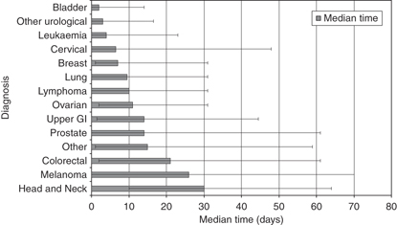
Median time (days) from trigger symptom onset to presentation, by cancer – Scottish data
Baughan P et al, Br J Cancer 2009

Slide 42
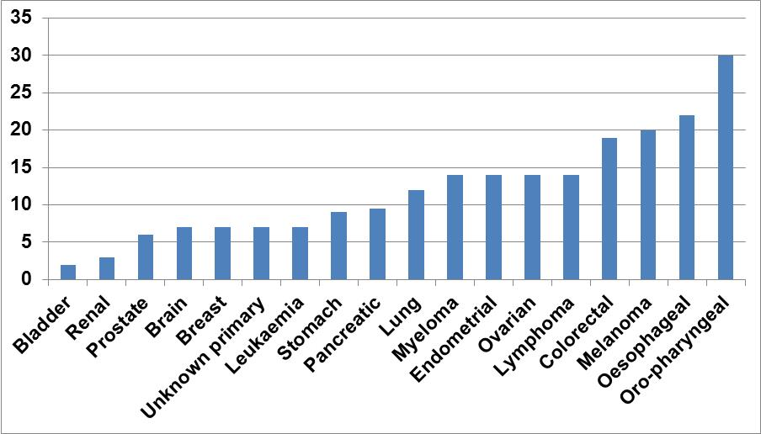
Median time (days) from trigger symptom onset to presentation, by cancer – English audit data
English data confirm earlier reported patterns of variation in patient interval in Scottish patients
Keeble et al, Int J Cancer, 2014

Slide 43
Median time (days) from trigger symptom onset to presentation, by cancer – English audit data

Slide 44
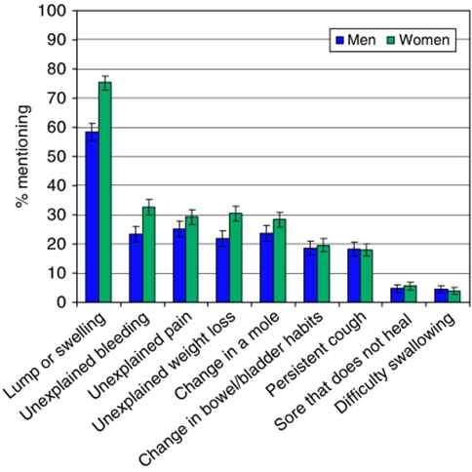
Wide variation in ‘recall’ of different cancer symptoms among members of the public
Robb et al., Br J Cancer, 2009

Slide 45
Inequalities in stage at diagnosis
and their combined interpretation with evidence about the length of intervals
Notes:
45

Slide 46
Inequalities in stage at diagnosis by deprivation
Adjusted for sex, deprivation, tumour type & screening
Lyratzopoulos, Abel, Brown, Rouse, Vernon, Roland, Greenberg, Ann Oncol, 2013

Slide 47
Inequalities in stage at diagnosis by deprivation
Adjusted for sex, deprivation, tumour type & screening

Slide 48
Inequalities in stage at diagnosis in older age (> 65)
Adjusted for sex, deprivation, tumour type and screening
Lyratzopoulos et al, Ann Oncol, 2013

Slide 49
Inequalities in stage at diagnosis in older age (> 65)
Adjusted for sex, deprivation, tumour type and screening
Lyratzopoulos et al, Ann Oncol, 2013

Slide 50
Lyratzopoulos et al, Lancet Oncol 2012
Lyratzopoulos, Neal, Barbiere, Rubin, Abel, Lancet Oncology, 2012

Slide 51
Trivial primary care ‘delay’ for patients with cancers associated with inequalities in stage

Slide 52
Inequalities in stage at diagnosis concentrated on cancers with the shortest primary care intervals
Therefore, inequalities in the patient interval likely responsible for inequalities in stage at diagnosis
Normalising behaviours in respect of ‘indolent’ symptoms may hold the key
Continuing investment in public health educational interventions is indeed needed
  particularly targeted on ‘easy-to-spot’ cancers and inequality groups

Slide 53
Table of contents
Where do we go from here

Slide 54
Two key questions in early diagnosis research
How to help patients to appropriately appraise symptoms and present soon after their onset
How to support doctors to appropriately suspect cancer once the patient has sought help

Slide 55
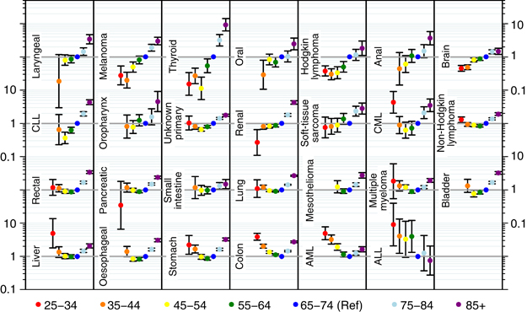
0.75 million patients, 27 cancers, ~2000 strata
(cancer-age-sex-deprivation) regarding risk of emergency presentation
Very large degree of complexity and variability – lots of variation to explain and learn from
Abel, Shelton, Johnson, Elliss-Brookes …., Br J Cancer 2015, NAEDI Supp.

Slide 56
The vision for stratified early diagnosis policy and research
Better understanding of variation in risk
Targeting and tailoring of early diagnosis efforts
Interventions: Increased effectiveness & efficiency
Research: Higher ‘Return on Investment’ (ROI)

Slide 57
A taxonomy of interventions to improve diagnostic safety – after presentation
New test / diagnostic pathway development
Clinical decision-support (curing consultation)
Clinical audit - root cause analysis
System factors engineering
Singh H et al, JCO 2015
Graber M, Diagnosis, 2014

Slide 58
Hard-to-spot cancers: Diagnostic test/service development (new and old tests) particularly useful
Most patients have symptoms of low specificity
Diagnostic tests (new/old) possibly only answer
*There is now a POC test for myeloma (Prof. Mark Drayson, Univ. Birmingham)
Notes:
58

Slide 59
‘Middle range’ diagnostic difficulty: Decision support; EHR-embedded ‘triggers’; (in UK / Denmark etc.: ‘open access’ interventions)
Notes:
59

Slide 60
Easy-to-spot cancers: Professionally-led learning (case reviews, ‘root cause analysis’, significant event audit)
Most patients have
clear-cut symptoms
How low is low enough?
Some patients will present atypically even with those cancers (e.g. if first presentation is because of symptoms of metastasis)
Notes:
60

Slide 61

The beginning of a stratified approach for breast cancer / older age inequalities in diagnosis
Should we expect initiatives for melanoma focusing specifically on older men?

Slide 62
BCOC campaigns so far:
-Do not focus on oro-pharyngeal / oral ulcer and oesophageal / dysphagia
-Do include bladder and kidney / haematuria

Slide 63
Summary - Different sources of variation in timeliness of diagnosis
From: Variable specificity of symptoms of different cancers
  Key driver of variation in the primary care interval
To: Variable patient behaviour, mediated through psycho-social factors [‘awareness’, fear / fatalism…]
  Key driver of variation in stage at diagnosis for easy-to-spot cancers
NB: Sources of variation do differ for different cancers

Slide 64
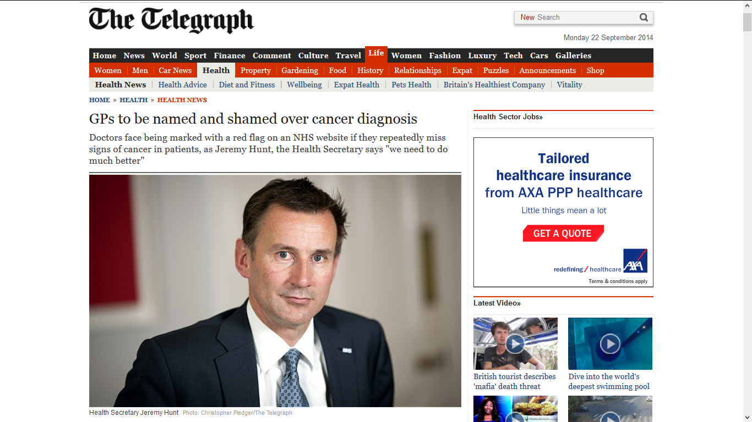

Slide 65
The known unknowns / future research
Over-diagnosis / indirect diagnostic benefits from early diagnosis interventions
Evaluation and cost-effectiveness of complex interventions (health education campaigns)
Impact of interventions on inequalities
Organisational variation in diagnostic quality – NAEDI grant (8,000 English practices profiled for variation in diagnostic activity)

Slide 66
Integrated approach from prevention to treatment
Prevention
Screening
Early diagnosis
Treatment
Surv’ship
‘Early diagnosis’ but one of the ways to achieve progress in cancer prevention and control

Slide 67
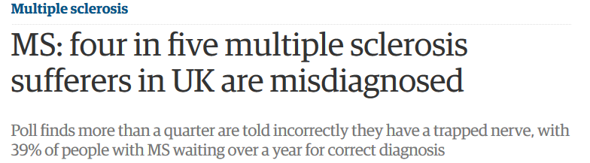

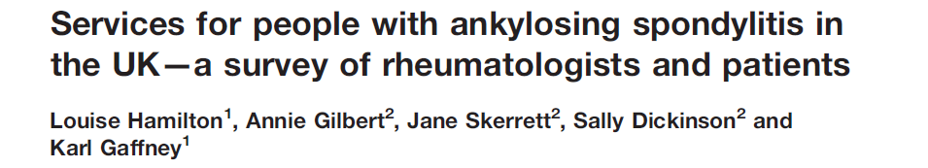
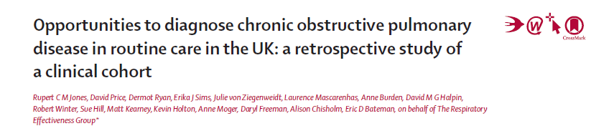
Challenge of diagnostic timeliness not unique to cancer
AS: Median diagnostic interval =
6 years
COPD: 5/6 patients had missed diagnostic opportunities in last 5 years
Jones et al, Lancet Resp Med, 2014

Slide 68
Challenge of diagnostic timeliness not unique to cancer
A broad coalition of funders, researchers and policy makers is needed to speed up progress in earlier diagnosis of all consequential illness
Median diagnostic interval = 6 years
5/6 patients had missed diagnostic opportunities in last 5 years
Jones et al, Lancet Resp Med, 2014

Slide 69


Slide 70
Phase of Dx process
Clinical encounter
Follow-up
Patient factors
Awareness / psychosocial factors
Practical barriers / fear of result or procedure
Provider factors
Inadequate Hx taking / cognitive factors
Cognitive barriers / biases
System factors
Rigid consultation norms / 10’ consultation
Over-reliance on patients to ‘call back’
Cognitive over-load / unappreciated abnormal findings
Lack of fail-safe systems for no-shows or alerting abnormal results
Practical barriers / attitudinal issues
Test performance

Slide 71



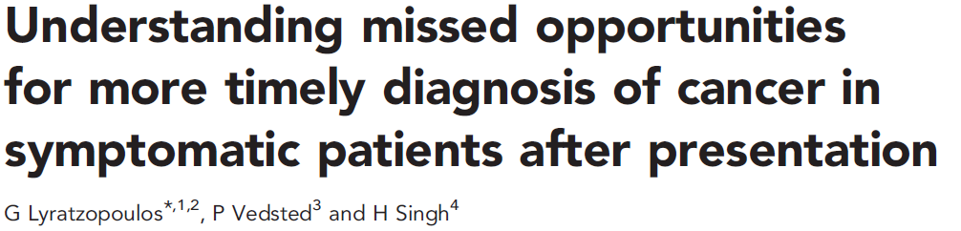

Slide 72
Thank you for listening twitter @glyratzopoulos

