Slide 1
Mapping Health
Why, How, Considering what ...
Sylvia Richardson

Slide 2
Why should we be interested in mapping health ?
Geographical variations of chronic and infectious diseases have been historically used as important sources of knowledge when trying to understand disease determinants
    Highlighting sources of heterogeneity and spatial patterns (if any)
    Suggesting public health determinants or aetiological clues
The geographical scale of the analysis and the type of representation chosen has been very diverse, ranging from world wide variations to small area studies.

Slide 3
Different aims
Disease mapping is carried out to summarise spatial and spatial temporal variation in risk
    descriptive purpose
    to provide context for further studies
Ecological studies exploit geographical variation in “environmental exposure”. They can be done globally or around a point source
Cluster detection tries to identify “unusual aggregation” (in space or space x time) of incident cases of disease
  we wont discuss clusters today

Slide 4
Limitations -- Difficulties
Dealing with observational studies
  confounders?
Dealing with aggregated data (loss of information)
  ecological bias
Dealing with sparse data
  large intrinsic variability → need to “borrow information”
Dealing with structured/ correlated data
  spatial models
Dealing with heterogeneity of exposure
  source of bias

Slide 5
I - Disease mapping studies
Aims
Descriptive purposes to summarise spatial and spatio-temporal variations in disease risk
To generate aetiological hypotheses
For surveillance, to highlight areas at apparently high risk
To aid policy information and resource allocation
In this talk, I will focus on chronic diseases and
spatial epidemiology studies involving aggregated counts, rather than point reference data.

Slide 6
I - A brief historical look
Long history
Examples
Spot maps
Choropleth maps
Standardised disease maps and atlases
Recent developments: Small area disease mapping
  Cholera and the Broad Street Pump (Snow, 1854)
  Heart disease, cancer and TB in England & Wales (Haviland, 1878)
  Cancer rates
    by county in England & Wales (Stocks, 1936-39)
    by UK LEA (Gardner, 1968-78)
    by US counties
    International atlases

Slide 7
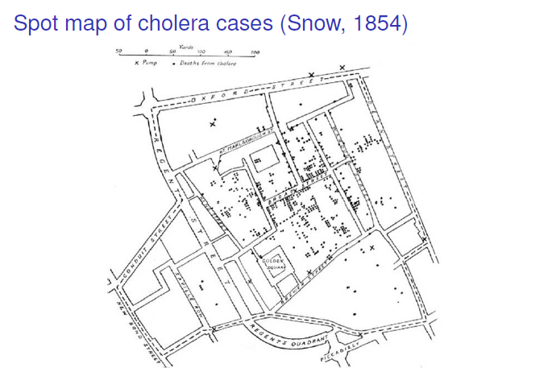
Spot map of cholera cases
John Snow, 1854

Slide 8
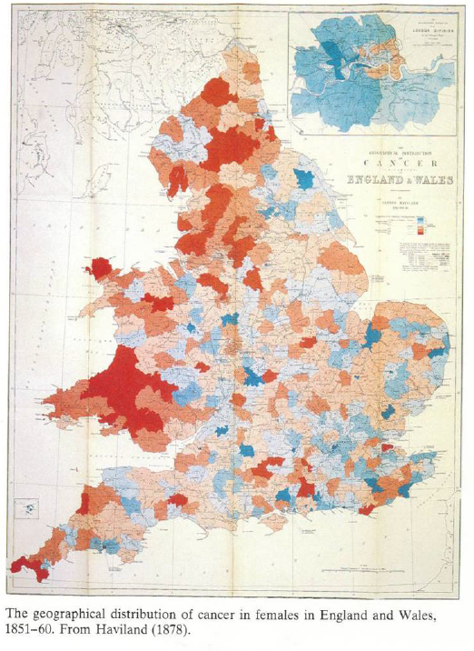
Geographical distribution of
mortality for cancer in females
Haviland (1878)
Crude death rate
using data
from vital registration
1851-60
Low risk in red
High risk in blue

Slide 9
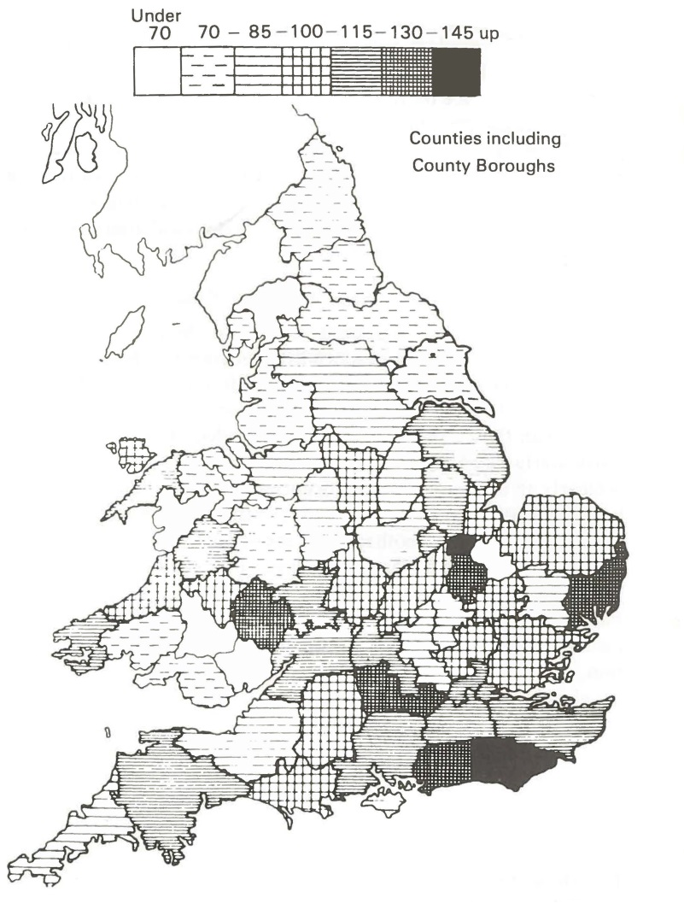
Regional distribution by county of cancer prevalence
Stock (1939)
Cancer of the ovary in women > 25
(1921-1930)
SMR = Standardised
Mortality Ratio
= O/E
O = observed nb of cases
E = “expected” nb of cases
adjusted for age and urban/rural
distribution in county
SMR

Slide 10
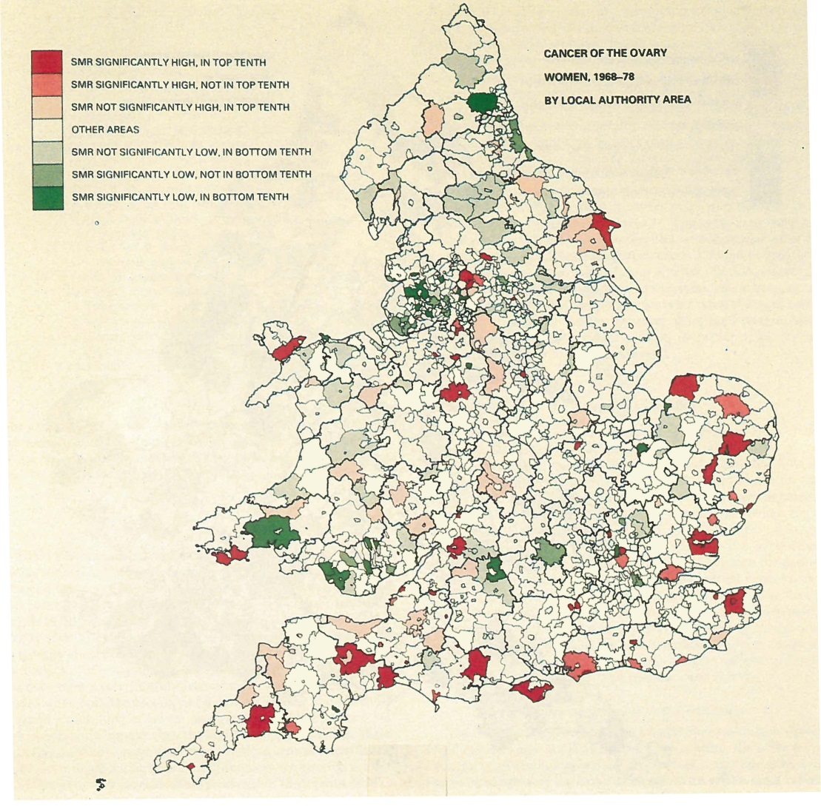
Cancer mapping by local authority areas (LEA)
Gardner (1984)
Cancer of the ovary (1968-1978)
Similar geographical
pattern as in the maps
produced by Stock
Here the colour scale
is broken down by
significance and rank
in the top and bottom
tenth.

Slide 11
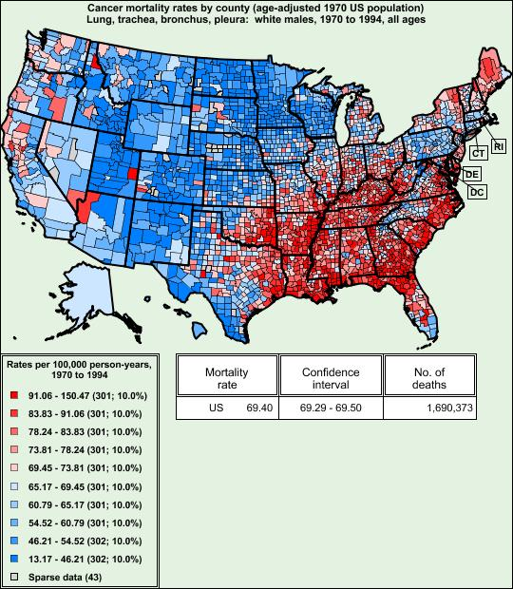
US Cancer atlas 1970-1994
Cancer of lung, trachea,
Bronchus and pleura

Slide 12
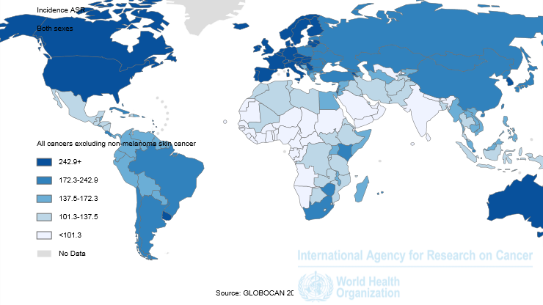
WHO cancer atlas: GLOBOCAN 2012
Incidence (ASR) All cancers

Slide 13
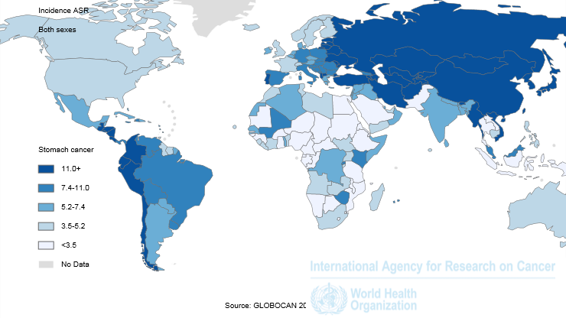
WHO cancer atlas: GLOBOCAN 2012
Incidence (ASR) Stomach

Slide 14
II - Statistical framework for disease mapping studies
Uses count data aggregated over space x time units
  Typically routinely collected data from e.g. registers
  aggregation level often determined by administrative criteria
  breakdown of cases in age, sex, (socio-economic) strata
  need demographic data to get a denominator, i.e. population at risk per strata
  size of population at risk varies
O_{i}: observed nb of cases
E_{i}: expected nb of cases
(adjusted for age, sex,…)
Basic model:
O_{i} ~ Poisson (θ_{i} E_{i})
θ_{i} = Relative Risk (RR) for area i (parameter of interest)
= SMR_{i} = O_{i} / E_{i}
SE(SMR_{i}) ∝ 1 / E_{i}

Slide 15
Small area studies
In the last two decades, interest has focused in conducting spatial analyses of health outcomes at the small area scale
Small scale
  “exposure of population” is more homogeneous → more interpretability?
  better able to detect highly localised effects
BUT sparse data need more sophisticated statistical analysis techniques

Slide 16
Statistical considerations for disease mapping studies
Mapping SMRs for small areas can be misleading:
as SE(SMR_{i}) ∝ 1 / E_{i}
→ SMR can be highly imprecise for areas with small population and/or rare diseases
Small-area maps of SMRs tend to be visually dominated by the most imprecise estimates in rural areas with the smallest populations
Small-area maps of statistical significance (i.e. showing areas with SMR significantly different from 1) tend to be dominated by the most precise estimates in urban areas with large populations
  Problems of multiple significance testing

Slide 17
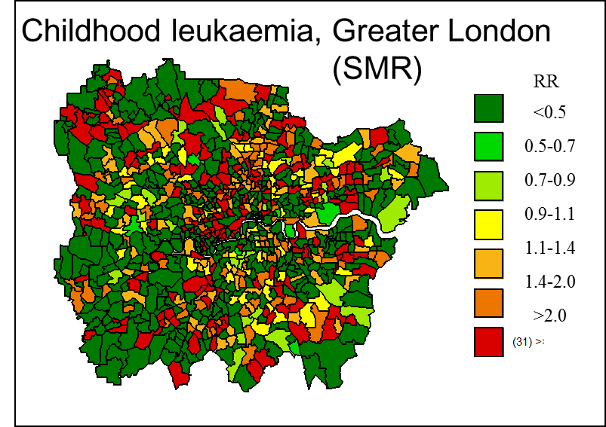
Statistical considerations for disease mapping studies
SMR_{i} makes no use of data on disease rates in other areas, even though these are likely to be similar to rate in area i
Ignores possible spatial correlation between disease risk in nearby areas due to possible dependence on shared spatially varying risk factors
Is the variability real
or simply reflecting estimates
with different precision?
Best et al, JRSSA, 2001

Slide 18
Stabilising estimates via a
Bayesian hierarchical model
Overall disease risk
2nd level
Borrowing
information
log (θ_{i} ) ~ Normal (μ, σ²)
‘True’ (latent) relative risk θ_{i}
1st level
  O_{i} ~ Poisson(θ_{i} E_{i}),
Observed disease risks SMR
Poisson
noise

Slide 19
Bias-variance trade off
Relative risks are ‘shrunk’ and stabilised (smoothed)
Childhood leukaemia, London
(SMR)
RR
<0.5
0.5-0.7
0.7-0.9
0.9-1.1
1.1-1.4
1.4-2.0
>2.0
SASHU Key et al
Estimate of θ_{i} the ‘true’ relative risk in area i is a weighted average of:
  observed area-level risk ratio (SMR_{i})
  parameters μ, σ² reflecting the overall distribution of the RR
  weights depending on E_{i} and the population at risk in area

Slide 20
Modelling choices
Choice of distribution at 2nd level is influential:
  Balance between over-smoothing and allowing necessary heterogeneity
  Input prior information on dependence and multivariate structure
Conditional Independence
Exchangeable
Conditional Autoregressive Model
Markov Random Fields

Slide 21
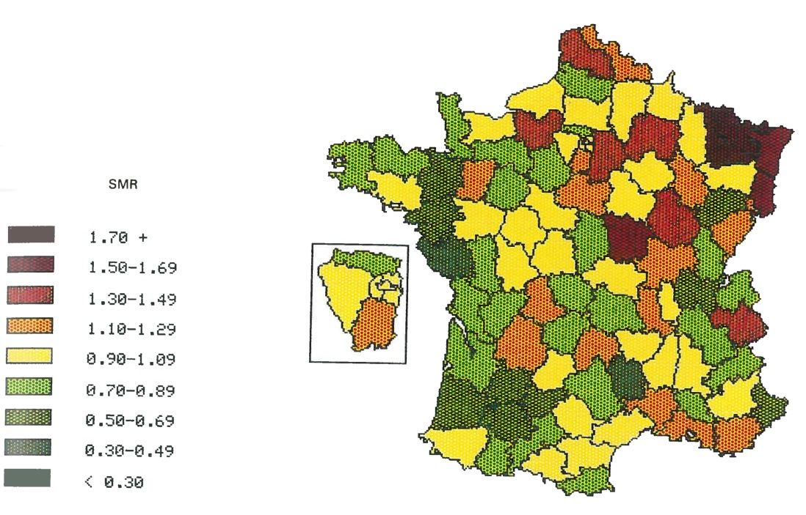
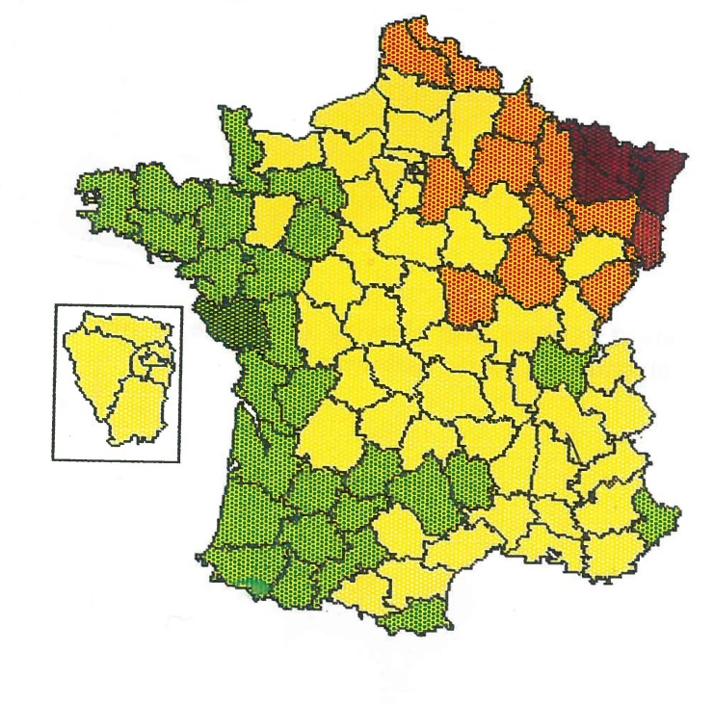
Gall-bladder cancer in France male 1971-78 (Mollié 1990)
Spatial smoothing
(posterior mean of θ_{i})
SMR

Slide 22
Including spatial dependence
Non-spatial smoothing
Childhood leukaemia, London
(SMR)
RR
<0.5
0.5-0.7
0.7-0.9
0.9-1.1
1.1-1.4
1.4-2.0
>2.0
SASHU Best et al, 2001
Spatial smoothing

Slide 23
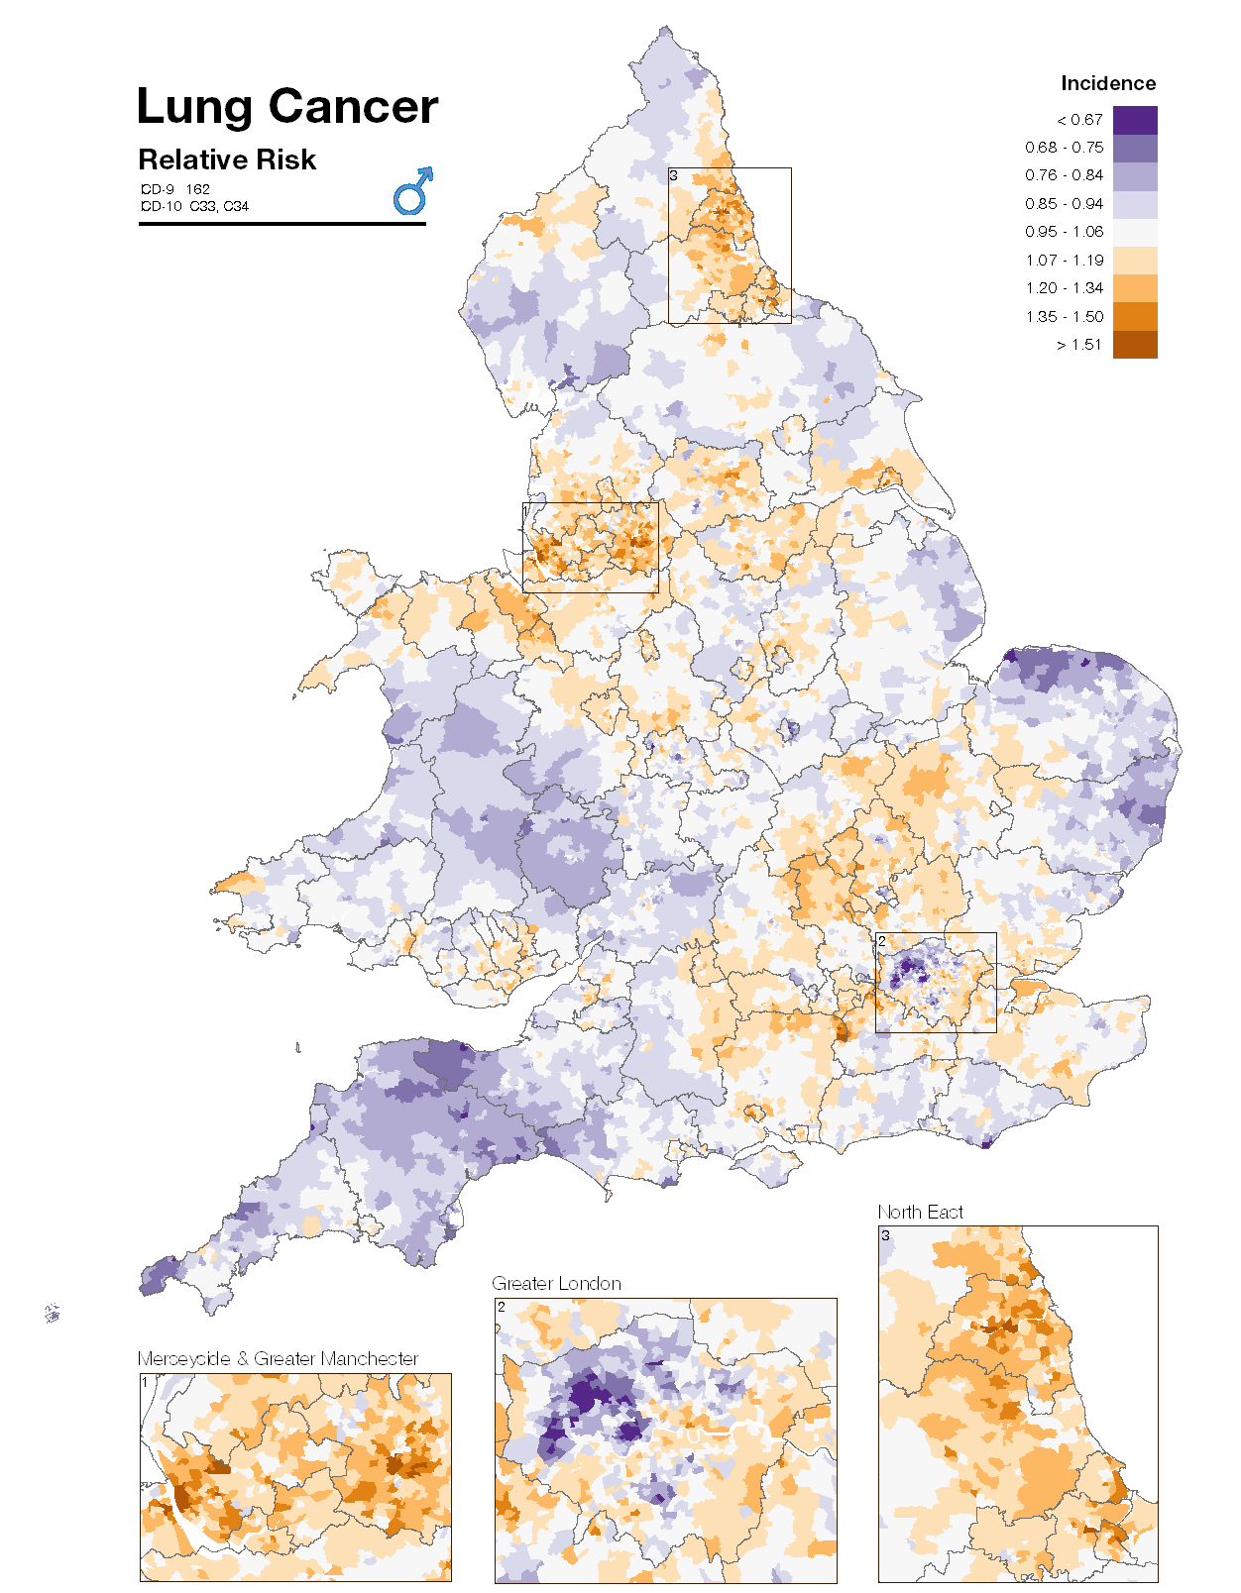

Environment and Health Atlas 2014
Smoothed Relative Risk of male lung
cancer incidence adjusted for age and deprivation
Ward-level maps 1985-2009
Male/female separately
Chloropleth maps
Smoothing included systematically : local using spatial neighbours and global
A bi-polar scheme is used as risks are below or above average.
Each health outcome use same nine point scale. Each increment represents 12% increase in the log RR
Slide by courtesy of
Anna Hansell, SASHU

Slide 24
III- Geographical correlation studies
Examine geographical associations between health outcomes and “environmental” exposure using variables defined on “groups”
Also known as ecological regression studies
Exploits natural contrasts in exposure
  Air pollution, noise, EMF
  Socioeconomic and demographic factors
for investigating aetiological or public health questions
Can be performed around a “point source”
  Am I at risk if I live near X?

Slide 25
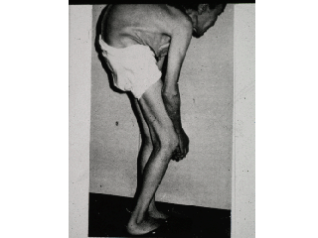
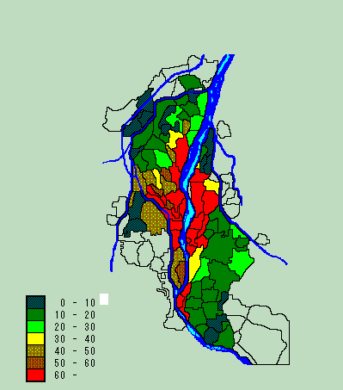
Striking geographical correlation pattern
Sea of Japan
Prevalence of itai-itai
disease patients in the
Jinzu River basin from
1967 to 1993
(per1000 person)
Jinzu River
Kumano River

Slide 26
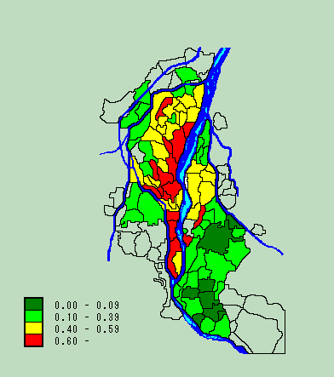
Distribution of rice cadmium
concentration in the Jinzu
River basin from 1971 to
1974 (Toyama Prefecture)
Sea of Japan
Jinzu River
Ida River
Kumano River
ppm

Slide 27
Ecological study of Childhood
Leukaemia and Benzene exposure related to traffic
Benzene is a recognized carcinogen at moderate to high doses (IARC, 1981)
Study addressed concerns that low dose exposure to environmental benzene may increase risk of leukaemia in vulnerable groups, e.g. children
Geographical study by Best et al (2001):
  872 wards in London
  734 leukaemia cases in children 0-15 yrs, 85-96
Benzene emissions from outdoor sources on 1km grid
Model: A regression of log θ_{i} on the average benzene emission Xi in each ward i is included within the smoothing model (global ψi+spatial random effects φi)
log (θ_{i} ) = β0 + βx Xi + ψi + φi

Slide 28
Cube root benzene
emissions (tonnes/year)
Childhood leukaemia (SMR)
RR
<0.5
0.5-0.7
0.7-0.9
0.9-1.1
1.1-1.4
1.4-2.0
>2.0
A unit of exposure corresponds to variation between the 10% and 90% quantile of exposure
Positive association between benzene emission and the risk of childhood leukaemia was found at several geographical scales, allowing for measurement error and within area variability in the exposure
RR associated with a unit increase of exposure varied
between 1.44 and 2.56 and 95%CI excluded 1

Slide 29
Limitations of ecological regression studies
Studies performed using aggregated data are difficult to interpret as there is loss of direct link between exposure and outcome at the individual level. They are particular subject to:
  Spatial confounding (many covariates may have similar patterns)
  Ecological bias, i.e. difference between risk measured at group level and individual level risk
  Exposure model: attributes an “average exposure” to all individuals in the group
  → Measurement error

Slide 30
IV - Spatial Confounding
Spatial Confounding is pervasive in area level studies as population distribution is far from “spatial randomness”
Environmental risk factors and socio-demographic factors often have similar gradients
  “environmental injustice”
  problems of interpretation (over/under adjustment)

Slide 31
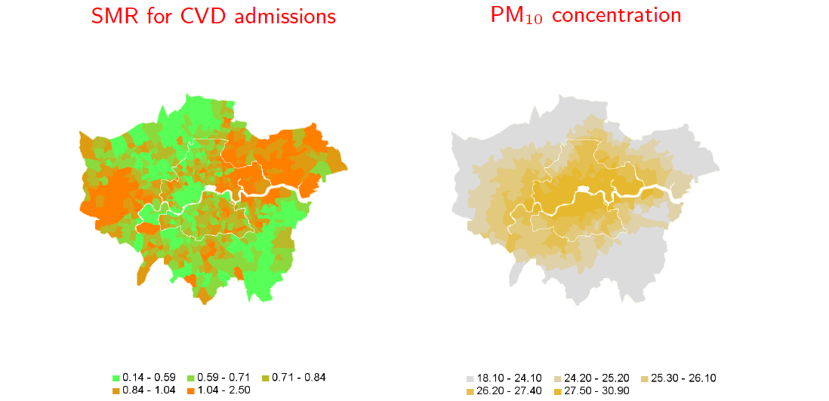
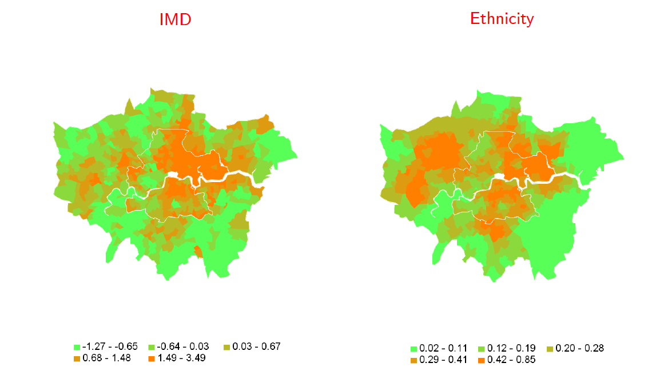
Spatial confounding:
Air pollution and CVD hospital admissions in London (electoral wards)
Ecological analysis of CVD on PM₁₀, adjusting for deprivation and ethnicity finds a protective effect of PM₁₀ !

Slide 32
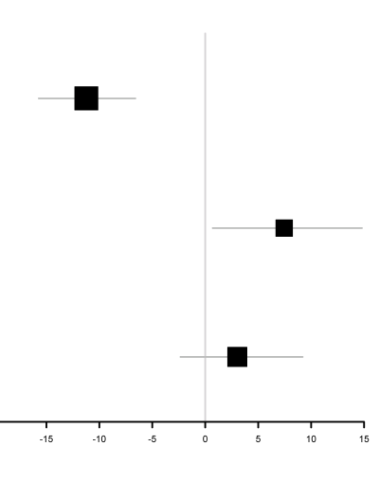
Reducing spatial confounding
Air pollution and CVD hospital admissions in London (electoral wards)
Log relative risk of hospital admission
dichotomised exposure: PM₁₀>25μg/m₃
Ecological analysis of Y=CVD on X=PM₁₀, adjusting for deprivation and ethnicity finds a protective effect of PM₁₀ !
pure ecological regression
using additional
survey data
(73% wards)
using additional
survey data
with imputation
to all wards

Slide 33
Reducing spatial confounding
Air pollution and CVD hospital admissions in London (electoral wards)
Log relative risk of hospital admission
dichotomised exposure: PM₁₀>25μg/m₃
Ecological analysis of Y=CVD on X=PM₁₀, adjusting for deprivation and ethnicity finds a protective effect of PM₁₀ !
pure ecological regression
using additional
survey data
(73% wards)
Residual confounding
using additional
survey data
with imputation
to all wards

Slide 34
Reducing spatial confounding
Air pollution and CVD hospital admissions in London (electoral wards)
Log relative risk of hospital admission
dichotomised exposure: PM₁₀>25μg/m₃
Ecological analysis of Y=CVD on X=PM₁₀, adjusting for deprivation and ethnicity finds a protective effect of PM₁₀ !
pure ecological regression
using additional
survey data
(73% wards)
Residual confounding
using additional
survey data
with imputation
to all wards
Supplement area level data with survey data where additional confounders (smoking, drinking, obesity, diabetes, ...) are recorded

Slide 35
Integrating survey information in area level studies
When using survey data to provide estimates of area level confounders, several issues typically arise
Need to upscale the survey confounders to area level mean parameters through a sub-model of the survey data
In many cases, the survey is incomplete geographically, imputation in the other areas using their link with recorded area characteristics?
Imputing one by one many confounders in the remainder areas can be computationally demanding and quite unstable ...
Dimension reduction?

Slide 36
Ecological propensity score approach
Focus of interest is the association of the relative risk with average level of X in an area, adjusted for the other spatial confounders (measured at area level or captured by surveys)
  Regress exposure X on the up-scaled area level confounder means to build an ecological propensity score in the survey areas
  Impute the propensity score (a scalar) in other areas with the help of spatial structure and other observed area level characteristics
  Include both X and the propensity score in the regression model of the relative risk log(θi) in all areas

Slide 37
Reducing spatial confounding
Air pollution and CVD hospital admissions in London (electoral wards)
Log relative risk of hospital admission
dichotomised exposure: PM₁₀>25μg/m₃
Ecological analysis of CVD on PM₁₀, adjusting for deprivation and ethnicity finds a protective effect of PM₁₀ !
pure ecological regression
using additional
survey data
(73% wards)
Residual confounding
using additional
survey data
with imputation
to all wards
Supplement area level data with survey data where additional confounders (smoking, drinking, obesity, diabetes, ...) are recorded
Wang, Richardson, Hansell, Blangiardo 2016

Slide 38
V - Ecological /Aggregation bias
Consider a very simple ecological model:
Y_{i} ~ Binomial(q_{i}, N_{i}); logit(q_{i}) = a + b X_{i} + c Z_{i}
Y_{i} is the number of disease cases in area i
N_{i} is the population in area i
Z_{i} is an area level covariate (e.g. deprivation index)
X_{i} is the proportion of exposed individuals in area i
q_{i} is the area-specific disease rate
exp(b) = odds ratio associated with average exposure X_{i}
This is the group level association. Not necessarily equal to individual-level association:
y_{ij} ~ Bernoulli(p_{ij}), person j, area i; logit p_{ij} = α_{i} + β x_{ij} + γ Z_{i}
i.e. b ≠ β → ecological bias
i.e. b ≠ β → ecological bias

Slide 39
Ecological bias
Ecological bias arises for different reasons:
Confounding (already discussed)
  try to account for confounders in model
Specification bias: Non-linear exposure-response relationship, combined with within-area variability of exposure
  No bias if exposure is constant in area (contextual effect)
  Bias increases as within-area variability increases
  …unless models are refined to account for this hidden variability

Slide 40
Improving interpretability of ecological inference
Alleviate bias associated with within-area exposure variability.
Obtain information on within-area distribution f_{i}(x) of exposures, e.g. from individual-level exposure data.
Use this to form well-specified model for ecological data by integrating the underlying individual-level model.
Y_{i} ~ Binomial(q_{i} , N_{i}); q_{i} = ∫ p_{ik}(x) f_{i}(x) dx
q_{i} is average group-level risk
p_{ik}(x) is individual-level risk given covariates x
f_{i}(x) is distribution of exposure x within area i (or joint distribution of multiple exposures)

Slide 41
Example of integrated group-level model
Suppose we have single binary covariate x
Individual-level disease model (person j, area i)
log p_{ij} = a + b x_{ij} (log link assumed for simplicity)
→ p_{ij} = eª if person j is unexposed (x_{ij}=0)
p_{ij} = e^{a+b} if person j is exposed (x_{ij}=1)
Integrated group-level model
X_{i} = proportion exposed in area i (mean of x_{ij})
q_{i} = average prevalence of disease in area i
= ∑_{j} p_{ij} /N_{i}
= eª (1-X_{i}) + e^{a+b} X_{i}
= eª + eª(e^{b}-1) X_{i}

Slide 42
Designs
There are four main designs
Individual: Interest is in estimating the individual effects linking x_{ij} and y_{ij}
Ecological: Inference is focussed on the area level relationship between Y_{i} and Z_{i} (e.g. benzene and leukaemia)
Semi-ecological: Contains individual outcome and covariate data, but exposure of interest (environmental or social) is measured at group level using geo-coded information
Mixed: Group level outcomes are supplemented by some individual outcome data. Covariates / exposures are also available at different levels

Slide 43
Benefits of mixed designs
Individual level survey data often lack power to inform about contextual and/or individual-level effects
Even when correct (integrated) model used, ecological data may not contain enough information about some or all effects of interest
In mixed designs
  Gain power by combining both types of model / data?
  Reduce/ control ecological bias by “anchoring” parameters of interest using the survey data ?

Slide 44
Statistical framework for mixed designs
Link different data sets through common parameters
  Hierarchically Related Regression (HRR) models
  Allows borrowing of information
Bayesian hierarchical models are particularly appropriate as they give additional flexibility to
  Build sub-models to account for additional complexity, e.g. missing (covariate /outcome) data, or measurement error
  Include structured random effects, e.g. spatial, (when necessary)

Slide 45
Multilevel model for individual data
β
γ
σ²
α_{i}
x_{ij}
y_{ij}
Z_{i}
person j
area i

Slide 46
Multilevel model for individual data
y_{ij} ~ Bernoulli(p_{ij}), person j, area i
β
γ
σ²
logit p_{ij} = α_{i} + β x_{ij} + γ Z_{i}
α_{i}
x_{ij}
y_{ij}
Z_{i}
person j
area i

Slide 47
Multilevel model for individual data
y_{ij} ~ Bernoulli(p_{ij}), person j, area i
β
γ
σ²
logit p_{ij} = α_{i} + β x_{ij} + γ Z_{i}
α_{i}
α_{i} ~ Normal(0, σ²)
x_{ij}
y_{ij}
Z_{i}
person j
area i

Slide 48
Multilevel model for individual data
y_{ij} ~ Bernoulli(p_{ij}), person j, area i
β
γ
σ²
logit p_{ij} = α_{i} + β x_{ij} + γ Z_{i}
α_{i}
α_{i} ~ Normal(0, σ²)
x_{ij}
y_{ij}
Z_{i}
Weak priors on σ², β, γ
β = individual-level effects
γ = contextual effects
person j
area i

Slide 49
Building a HRR model
Ecological model
σ²
β
γ
α_{i}
Z_{i}
Y_{i}
X_{i}
N_{i}
area i

Slide 50
Building the HRR model
Ecological model
Y_{i} ~ Binomial(q_{i}, N_{i}), area i
σ²
β
γ
q_{i} = ∫ p_{ij}(x_{ij},Z_{i},α_{i}, β,γ)f_{i}(x)dx
α_{i}
Z_{i}
Y_{i}
X_{i}
N_{i}
area i

Slide 51
Building the HRR model
Ecological model
Y_{i} ~ Binomial(q_{i}, N_{i}), area i
σ²
β
γ
q_{i} = ∫ p_{ij}(x_{ij},Z_{i},α_{i}, β,γ)f_{i}(x)dx
α_{i}
α_{i} ~ Normal(0, σ²)
Z_{i}
Y_{i}
X_{i}
Priors on σ², β, γ
N_{i}
area i

Slide 52
Combining individual and aggregate data
Multilevel model for individual data
Ecological model
β
γ
σ²
σ²
β
γ
α_{i}
α_{i}
x_{ij}
y_{ij}
Z_{i}
Z_{i}
Y_{i}
X_{i}
person j
N_{i}
area i
area i

Slide 53
Combining individual and aggregate data
β
γ
σ²
Hierarchical Related Regression
(HRR) model
Joint likelihood for y_{ij} and Y_{i} depending on shared parameters β, γ, σ²
α_{i}
x_{ij}
y_{ij}
Z_{i}
Y_{i}
X_{i}
person j
N_{i}
area i

Slide 54
Case-study : Socioeconomic predictors of heart diseases
Question
Characterising the part played by individual level socio-demographic predictors on heart disease
Is there evidence of contextual effects ?
Design
HRR using
Individual-level survey data: Health Survey for England.
Area-level administrative data: Census small-area statistics and Hospital Episode Statistics
Methodological issues
Sparse individual data per area (0-9 subjects per area) so difficult to estimate contextual effects.

Slide 55
Results from analysis of individual
survey data: Heart Disease
(n=5226, all adults)
Univariate regression
Area deprivation
Multiple regression
Area deprivation
No car
Social class IV/V
Non white

Slide 56
Comments
CI wide and not significant for most effects
Adjusting for individual risk factors (compositional effects) appears to explain contextual effect of deprivation for heart disease
  But survey data lack power to provide reliable answers about contextual effects
Can using HRR and combining survey with aggregate data help?
  Compare individual level analysis with well specified aggregate model and HRR model

Slide 57
Estimated coefficients (with 95% CI)
of the risk of hospitalisation for
heart disease:

Slide 58
Comments
Large gains in precision achieved by including aggregate data
  Non significant contextual effect of deprivation for heart disease
Little difference between estimates based on aggregate data alone and combined individual + aggregate data
  Individual sample size very small (~0.1% of population represented by aggregate data)
In other applications with larger individual sample sizes and/or less informative aggregate data, combined HRR model may yield greater improvements

Slide 59
Summary
Mapping health outcomes is an essential component of environmental epidemiology & public health investigations
Interpretation issues
  Be aware of spatial confounding
  Use of mixed designs is a fruitful area for the future
    to help controlling ecological bias
    to exploit rich cohort data and GIS technology
Statistical issues
  Need to borrow information across space (& time)
  Sensitivity to choice of smoothing model
  Best methods to perform confounder adjustment is an active area of research

Slide 60
Thanks
To my long standing collaborators
Nicky Best, Marta Blangiardo
Paul Elliott, Anna Hansell
PhD students
Yingo Wang, Philip Li
And to the staff of SASHU and the Centre for Environment and Health at Imperial College

